Slide 1

USING
HIGH TEMPERATURE CAMERAS IN
FLOAT GLASS
Tod Canty Jr.
JM Canty Inc
Buffalo NY
JM Canty, Inc. · Buffalo, New York · Phone: (716) 625-4227 | JM Canty, Ltd. · Dublin, Ireland · Phone: +353 (1) 882-9621

Slide 2
IMAGE PROCESSING APPLICATIONS
Sand Melt
Glass Level
Onion Skin
Gripper Monitor
Ribbon & Stone Detection
Width & Knurl
JM Canty, Inc. · Buffalo, New York · Phone: (716) 625-4227 | JM Canty, Ltd. · Dublin, Ireland · Phone: +353 (1) 882-9621

Slide 3
Sand Melt
Using the CANTY High Temperature Camera and CANTYVISION Client glass companies can now automate their Sand Melt Control System. Using camera analysis the operators receive an alarm if the sand melt line has been crossed by any un-melted product. A visual verification is also provided by the Ethernet gigabit camera. Alarm conditions can be output via 4-20mA or OPC to a PLC or DCS for complete control.
JM Canty, Inc. · Buffalo, New York · Phone: (716) 625-4227 | JM Canty, Ltd. · Dublin, Ireland · Phone: +353 (1) 882-9621

Slide 4
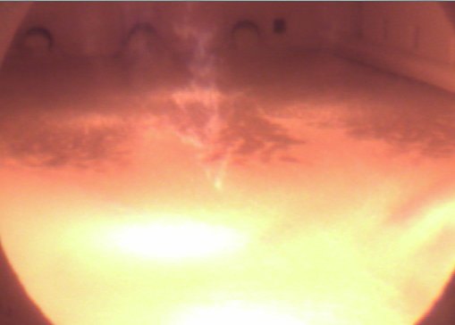
Sand Melt

Slide 5
Level
The Canty system consists of a high temperature Ethernet process camera and incorporates special software to reduce glare along with a unique orifice plate that eliminates any debris from adhering to the lens, offering a clear view of the molten level at all times. This new low cost, no-maintenance system replaces expensive traditional platinum dipper probe systems which tend to coat over in a matter of weeks as well as nuclear gauges, which tend to drift and eliminates the need for stilling wells. Level measurements are made in real-time on a continuous basis, with a resolution of 001". CANTYVISION™ Software utilizes image based technology to continually track the edge. A crosshair is used to continually indicate the position of the edge and a numerical output is given. What’s more, your results are visually verifiable on your local area network or localized computer! 4-20mA current loop available.
JM Canty, Inc. · Buffalo, New York · Phone: (716) 625-4227 | JM Canty, Ltd. · Dublin, Ireland · Phone: +353 (1) 882-9621

Slide 6
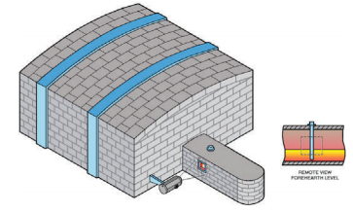
Level
JM Canty, Inc. · Buffalo, New York · Phone: (716) 625-4227 | JM Canty, Ltd. · Dublin, Ireland · Phone: +353 (1) 882-9621

Slide 7

Level
JM Canty, Inc. · Buffalo, New York · Phone: (716) 625-4227 | JM Canty, Ltd. · Dublin, Ireland · Phone: +353 (1) 882-9621

Slide 8
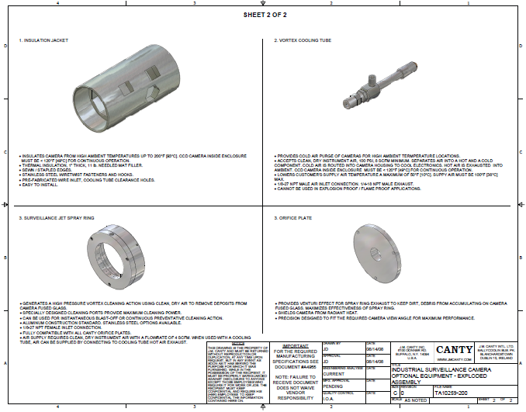
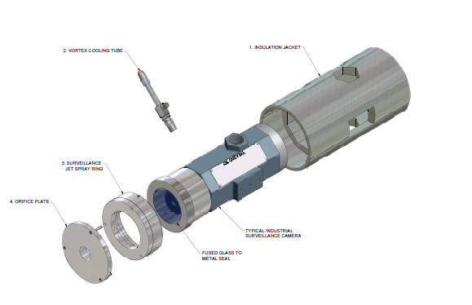
Level camera
JM Canty, Inc. · Buffalo, New York · Phone: (716) 625-4227 | JM Canty, Ltd. · Dublin, Ireland · Phone: +353 (1) 882-9621

Slide 9
Onion Skin
By controlling the position and shape at the initial draw in the front of the tin bath (also known as Onion Skin) results in more uniform pull. This results in less waste and higher efficiency for the glass. The camera system is able to effectively monitor and measure real time location of the onion and provide a 4-20mA output or OPC to a PLC or DCS for complete automated control.
JM Canty, Inc. · Buffalo, New York · Phone: (716) 625-4227 | JM Canty, Ltd. · Dublin, Ireland · Phone: +353 (1) 882-9621

Slide 10
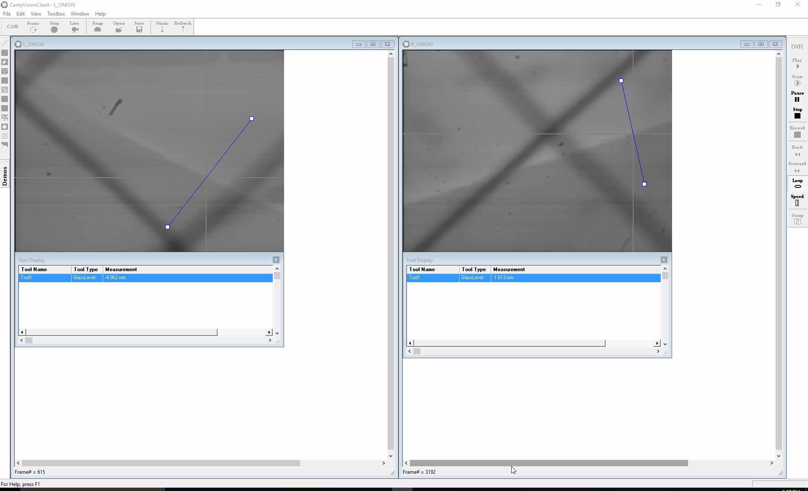
Onion Skin Video
JM Canty, Inc. · Buffalo, New York · Phone: (716) 625-4227 | JM Canty, Ltd. · Dublin, Ireland · Phone: +353 (1) 882-9621

Slide 11
Gripper Monitor
To help eliminate unnecessary waste operators could improve the gripper control. Typically the grippers are run very conservatively so it does not get off track and cause major problems but by doing this they decrease production and increase waste. The gripper is what causes a knurl in the glass. The knurl to the edge is cut off and discarded as waste. What CANTY allows is a way the gripper can be controlled closer to the edge which decreases the gap between the knurl and edge. This is an easy way to increase production!
JM Canty, Inc. · Buffalo, New York · Phone: (716) 625-4227 | JM Canty, Ltd. · Dublin, Ireland · Phone: +353 (1) 882-9621

Slide 12
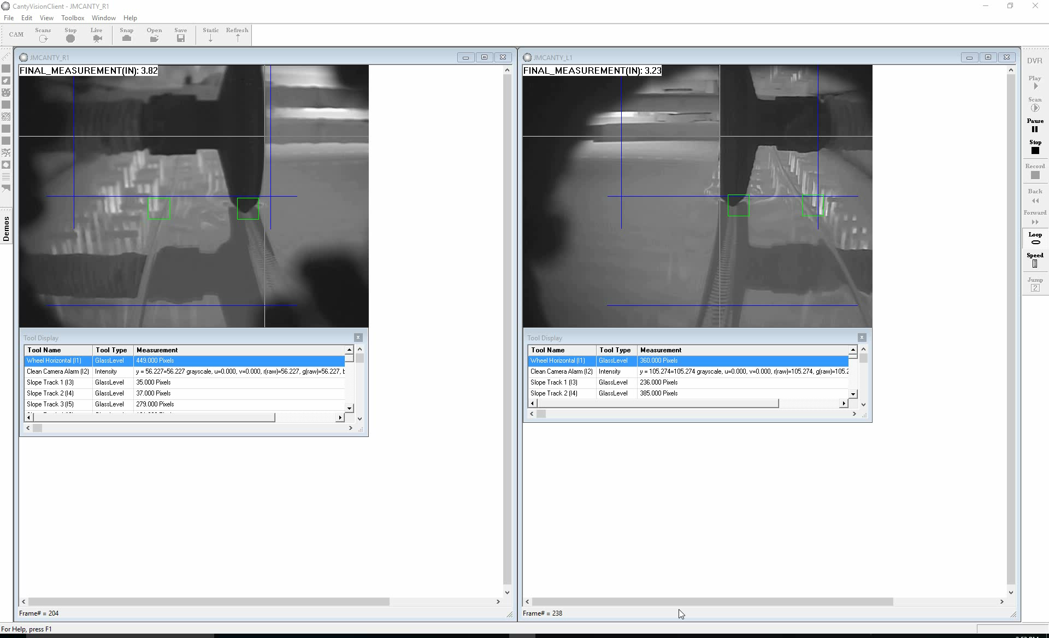
Gripper Monitor
JM Canty, Inc. · Buffalo, New York · Phone: (716) 625-4227 | JM Canty, Ltd. · Dublin, Ireland · Phone: +353 (1) 882-9621

Slide 13
Width & Knurl
Determining the position of the total width is extremely important at the end of the furnace to determine total size. To effectively accomplish this the knurl must be measured and compared to the edge. The CANTY Ethernet cameras using CANTYVISION™ will monitor both width & knurl. This results in less waste and higher productivity for the glass when it comes to cutting the knurl. The camera system is able to effectively monitor and measure real time location of the width and knurl and provide a 4-20mA output or OPC to a PLC or DCS for complete automated control.
JM Canty, Inc. · Buffalo, New York · Phone: (716) 625-4227 | JM Canty, Ltd. · Dublin, Ireland · Phone: +353 (1) 882-9621

Slide 14
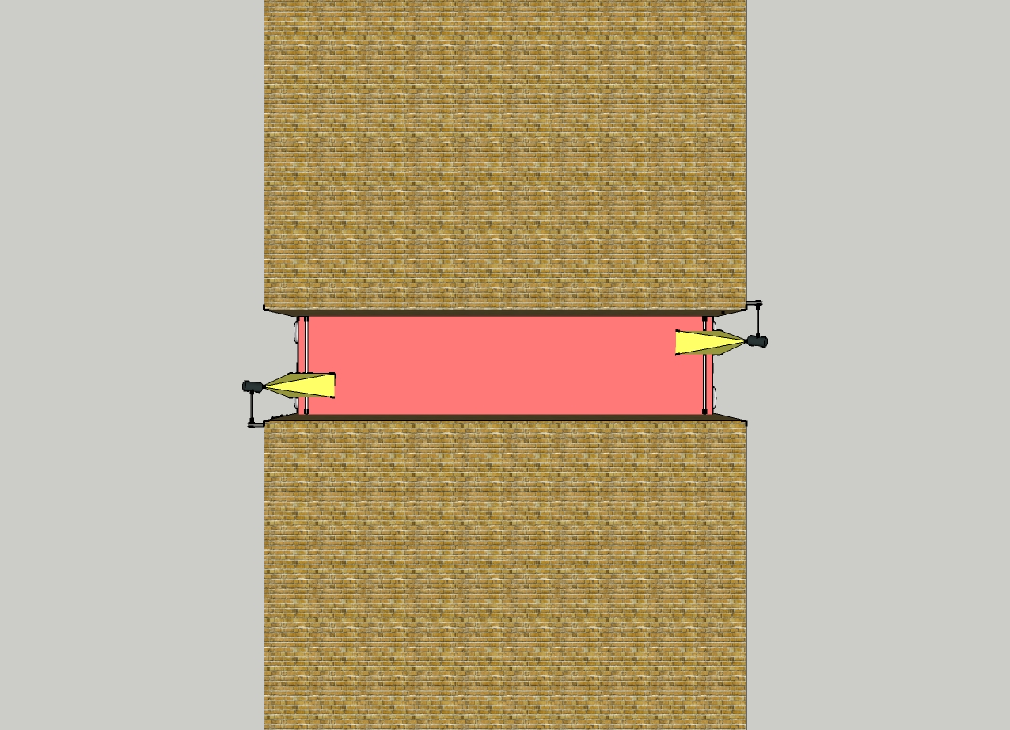
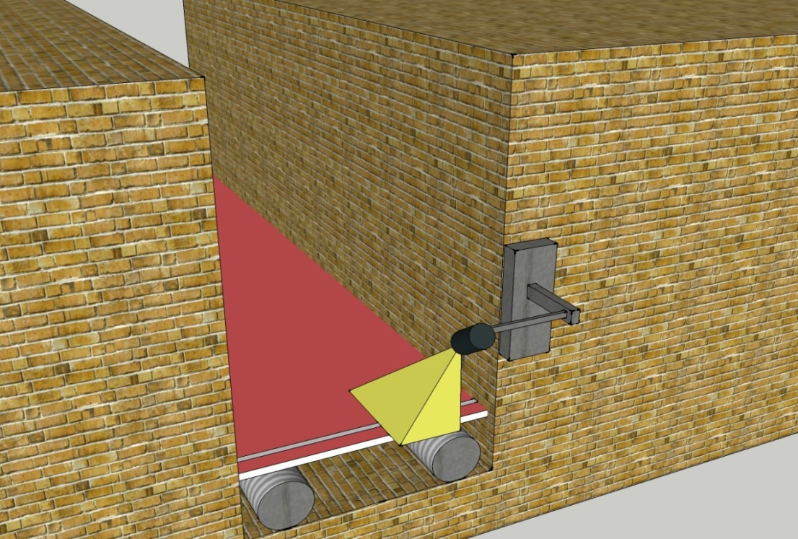
Width & Knurl
JM Canty, Inc. · Buffalo, New York · Phone: (716) 625-4227 | JM Canty, Ltd. · Dublin, Ireland · Phone: +353 (1) 882-9621

Slide 15
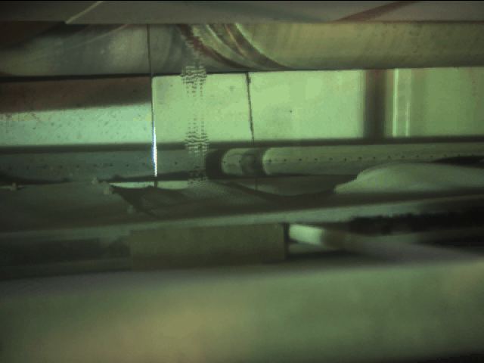
Width & Knurl
JM Canty, Inc. · Buffalo, New York · Phone: (716) 625-4227 | JM Canty, Ltd. · Dublin, Ireland · Phone: +353 (1) 882-9621

Slide 16
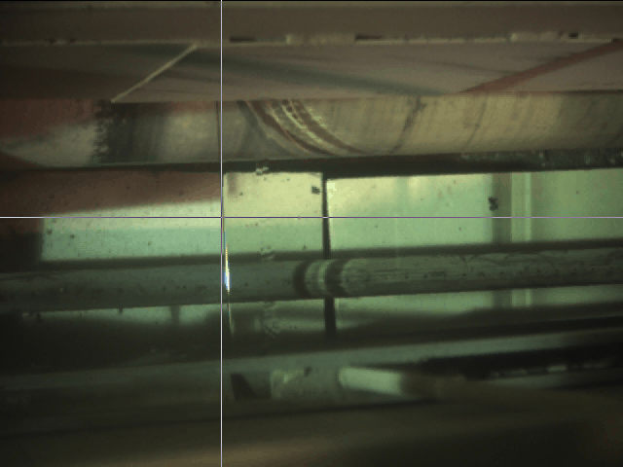
Width & Knurl
JM Canty, Inc. · Buffalo, New York · Phone: (716) 625-4227 | JM Canty, Ltd. · Dublin, Ireland · Phone: +353 (1) 882-9621

Slide 17
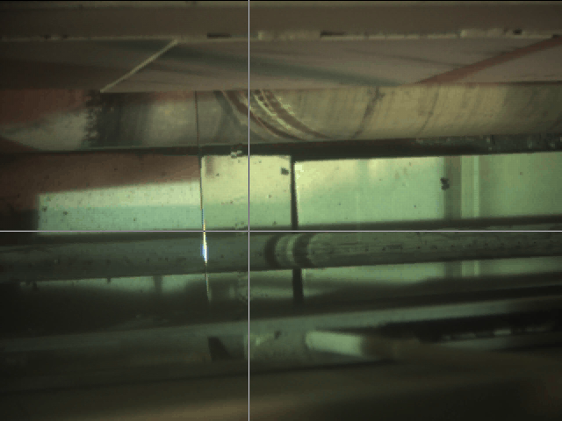
Width & Knurl
JM Canty, Inc. · Buffalo, New York · Phone: (716) 625-4227 | JM Canty, Ltd. · Dublin, Ireland · Phone: +353 (1) 882-9621

Slide 18
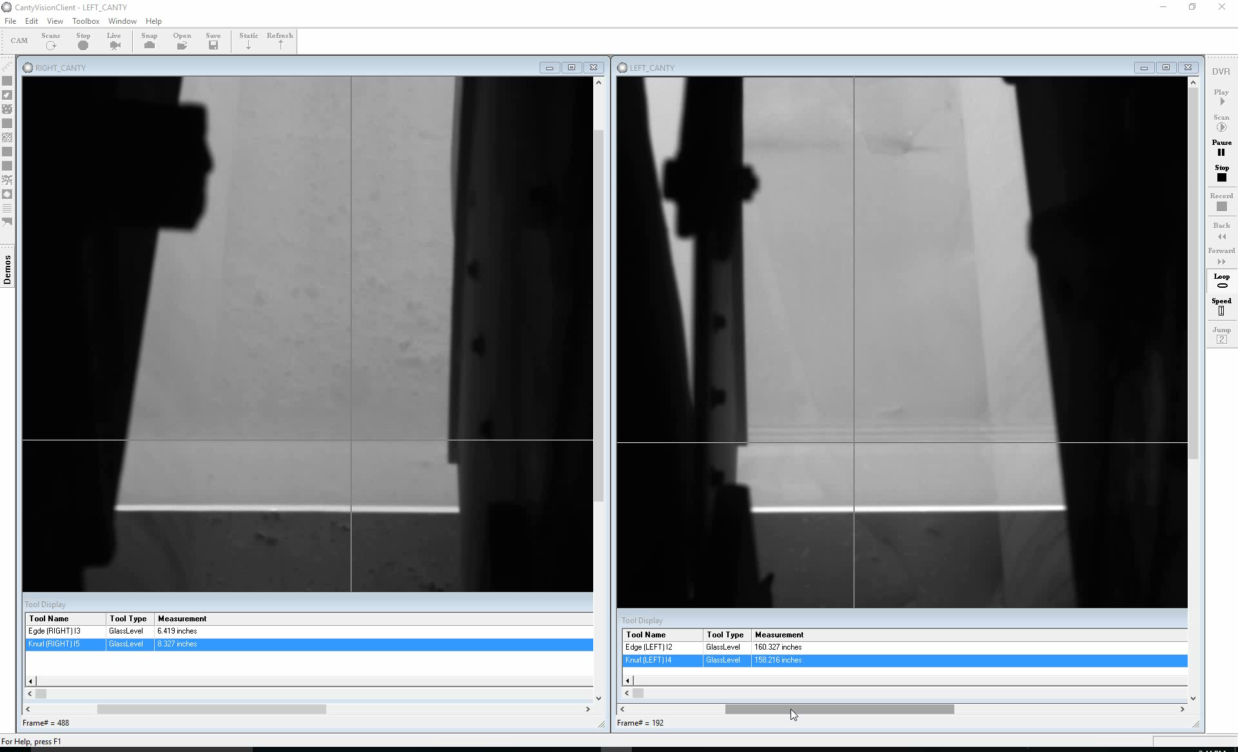
Width & Knurl Video
JM Canty, Inc. · Buffalo, New York · Phone: (716) 625-4227 | JM Canty, Ltd. · Dublin, Ireland · Phone: +353 (1) 882-9621

Slide 19
Ribbon & Stone
The purpose of the particle detection application is to determine when foreign debris has fallen onto the glass surface within the tin bath and alarm when debris is 0.125 inches in size or larger. Within the tin bath a sheet of glass floats on molten tin and occasionally a piece of refractory, insulation, etc., falls onto the glass. The debris will travel further downstream on top of the glass and the debris may hit a coater that is placed at the end of the tin bath. Typically the coater is set at height of 0.25 inches above the glass, so any debris larger than the gap between the coater and the glass can cause some major damage to the glass and the process.
JM Canty, Inc. · Buffalo, New York · Phone: (716) 625-4227 | JM Canty, Ltd. · Dublin, Ireland · Phone: +353 (1) 882-9621

Slide 20
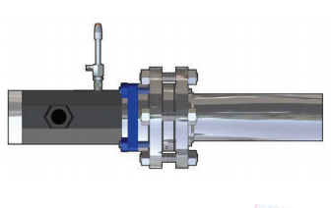
Ribbon & Stone
JM Canty, Inc. · Buffalo, New York · Phone: (716) 625-4227 | JM Canty, Ltd. · Dublin, Ireland · Phone: +353 (1) 882-9621

Slide 21
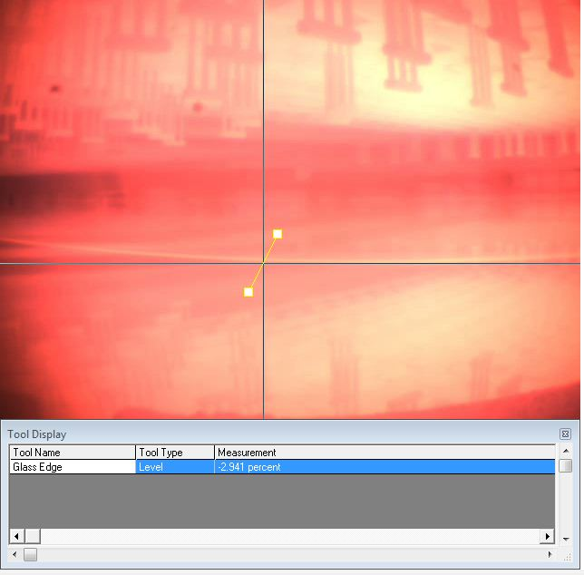
Ribbon Detection
JM Canty, Inc. · Buffalo, New York · Phone: (716) 625-4227 | JM Canty, Ltd. · Dublin, Ireland · Phone: +353 (1) 882-9621

Slide 22

Stone Detection
JM Canty, Inc. · Buffalo, New York · Phone: (716) 625-4227 | JM Canty, Ltd. · Dublin, Ireland · Phone: +353 (1) 882-9621

Slide 23
Key Features of Imaging Systems
High Temperature Reliability - Fused Glass
Maintenance – Spray Ring
Ethernet Connectivity
  Gigabit Camera
Lens Assembly
  Quartz or Sapphire Shield
High Resolution Imaging
  .001”
Integrated Software
JM Canty, Inc. · Buffalo, New York · Phone: (716) 625-4227 | JM Canty, Ltd. · Dublin, Ireland · Phone: +353 (1) 882-9621

Slide 24
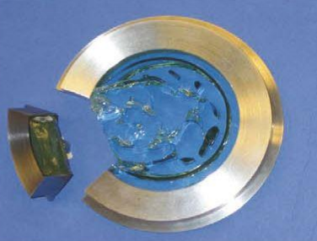
Key Features of Imaging Systems
Hermetically sealed fused glass to protect the electronics
JM Canty, Inc. · Buffalo, New York · Phone: (716) 625-4227 | JM Canty, Ltd. · Dublin, Ireland · Phone: +353 (1) 882-9621

Slide 25
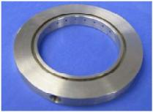
Key Features of Imaging Systems
SprayRing to keep the fused glass lens clean.
  Instrument Clean Air is needed at 30PSI min required
JM Canty, Inc. · Buffalo, New York · Phone: (716) 625-4227 | JM Canty, Ltd. · Dublin, Ireland · Phone: +353 (1) 882-9621

Slide 26
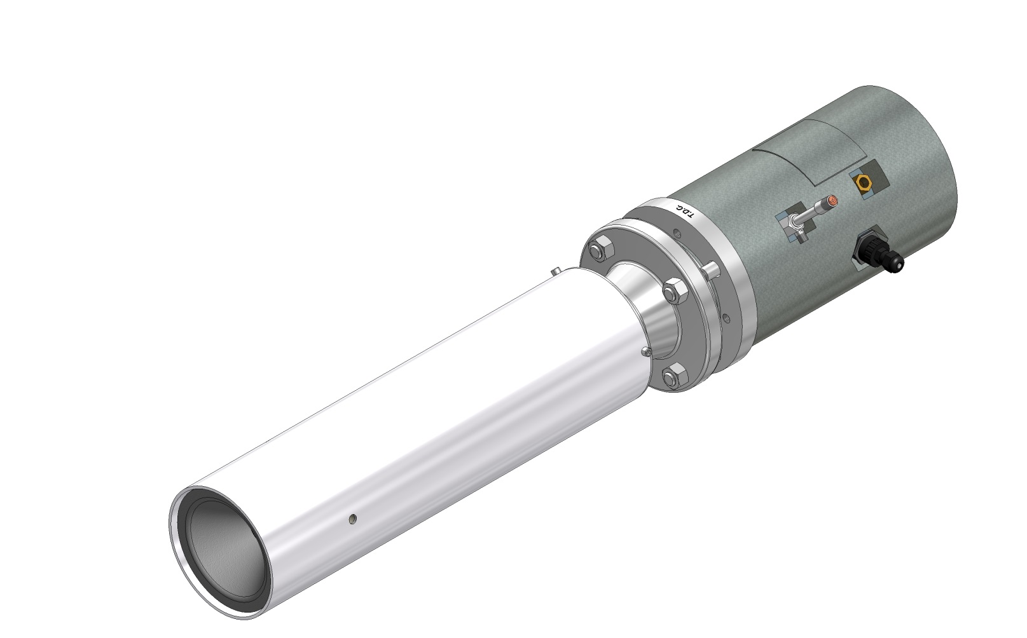
CANTY ExtremeTemp Furnace Camera

Slide 27
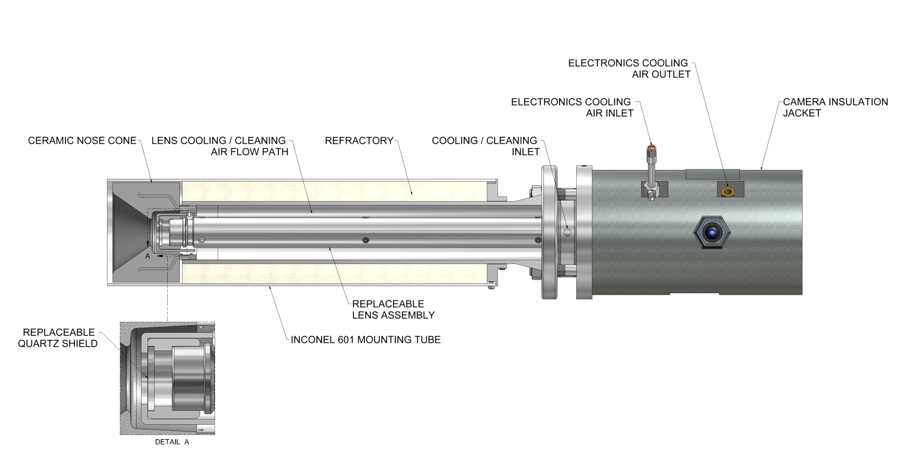
OVERVIEW

Slide 28
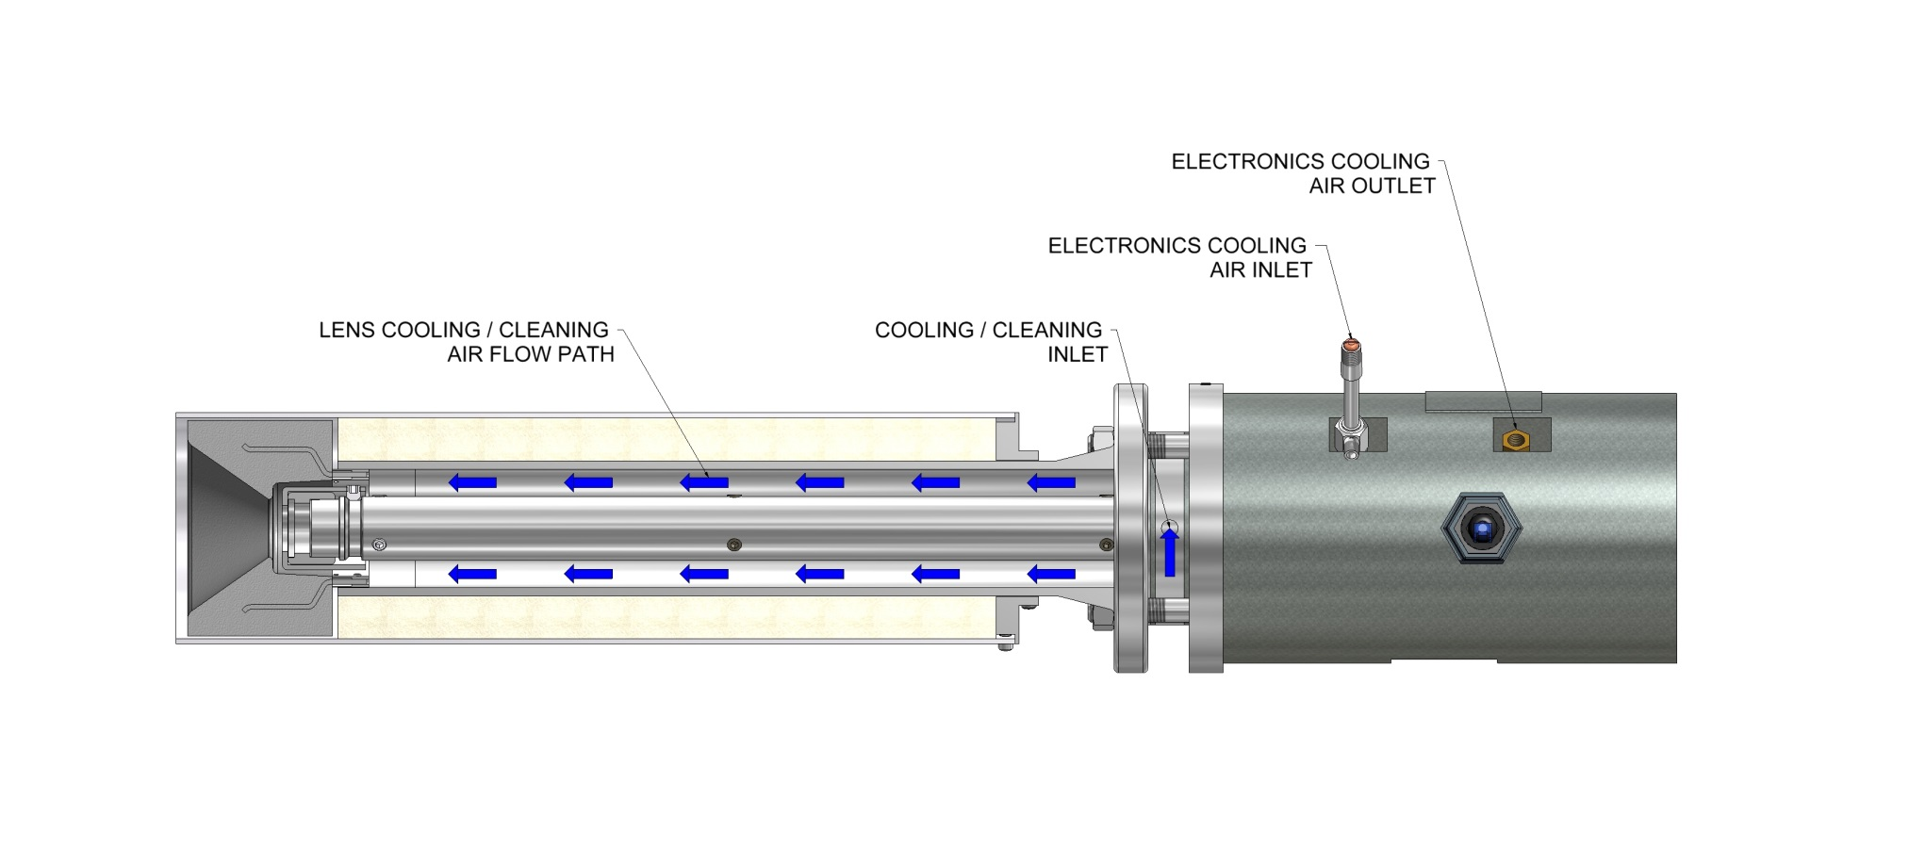
COOLING & CLEANING
  Instrument Clean Air is needed at 30PSI min required

Slide 29
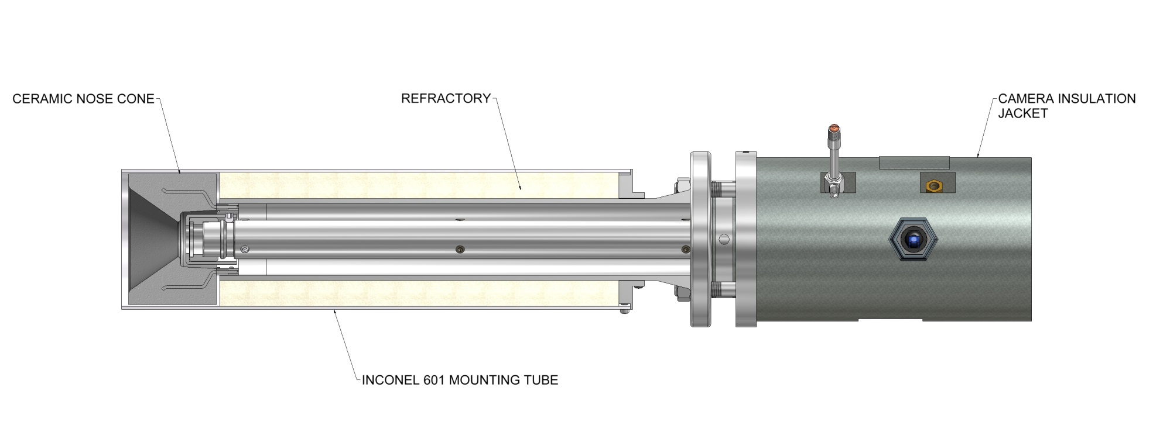
INSULATION AND REFRACTORY

Slide 30
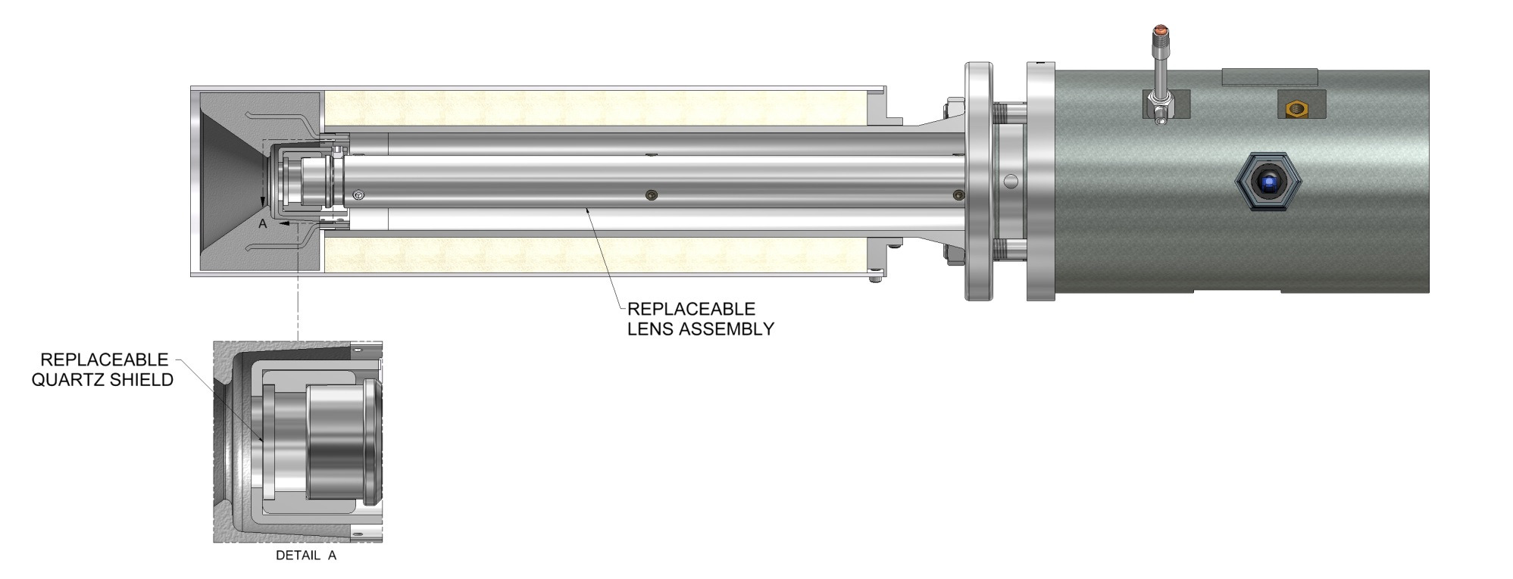
LENS ASSEMBLY
Lens assembly allows the Ethernet CCD camera to remain outside the process in ambient room temperature air vs being fixed in the higher temperature process air.

Slide 31
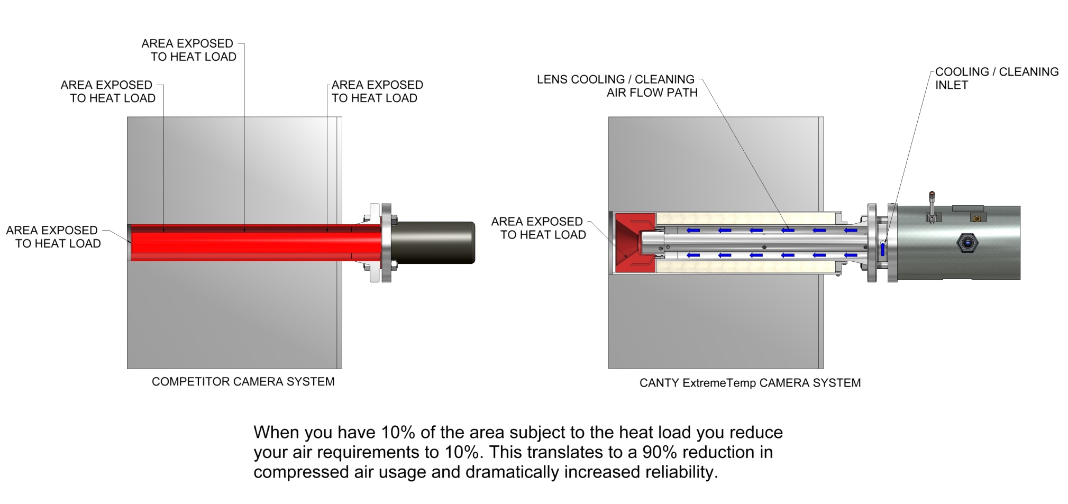

Slide 32
Benefits of vision
Less expensive
More accurate –pixel scale factor
User friendly calibration
  Visual Verification
  Not trying to line up 2 devices
JM Canty, Inc. · Buffalo, New York · Phone: (716) 625-4227 | JM Canty, Ltd. · Dublin, Ireland · Phone: +353 (1) 882-9621

Slide 33
Conclusion
Real Time Measurement
Repeatable / Accurate
Visual Verification
Output Signals-ethernet,4-20ma,OPC
Process Control
Better Quality
Higher Yield
JM Canty, Inc. · Buffalo, New York · Phone: (716) 625-4227 | JM Canty, Ltd. · Dublin, Ireland · Phone: +353 (1) 882-9621

