Slide 1

USING HIGH TEMPERATURE CAMERAS TO MEASURE:
LEVEL, WIDTH, TEMPERATURE, GOB, ONION, AND OTHER PROCESS APPLICATIONS
Tod Canty Jr.
JM Canty Inc
Buffalo NY
JM Canty, Inc. · Buffalo, New York · Phone: (716) 625-4227 | JM Canty, Ltd. · Dublin, Ireland · Phone: +353 (1) 882-9621

Slide 2
IMAGE PROCESSING APPLICATIONS
Level
Width & Knurl
Gob & Temperature
Onion
Ribbon & Stone
JM Canty, Inc. · Buffalo, New York · Phone: (716) 625-4227 | JM Canty, Ltd. · Dublin, Ireland · Phone: +353 (1) 882-9621

Slide 3
Key Features of Imaging Systems
High Temperature Reliability - Fused Glass
Maintenance – Spray Ring
Ethernet Connectivity
  Gigabit Camera
Lens Assembly
  Quartz or Sapphire Shield
High Resolution Imaging
  .001”
Integrated Software
JM Canty, Inc. · Buffalo, New York · Phone: (716) 625-4227 | JM Canty, Ltd. · Dublin, Ireland · Phone: +353 (1) 882-9621

Slide 4
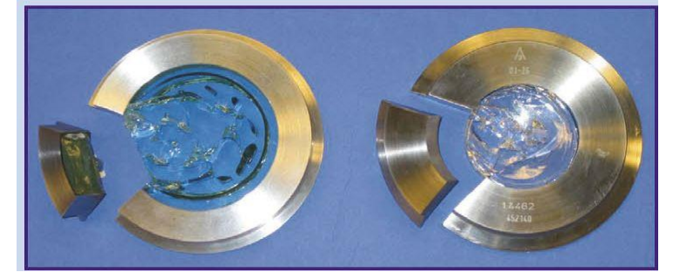
Key Features of Imaging Systems
Hermetically sealed fused glass to protect the electronics
JM Canty, Inc. · Buffalo, New York · Phone: (716) 625-4227 | JM Canty, Ltd. · Dublin, Ireland · Phone: +353 (1) 882-9621

Slide 5
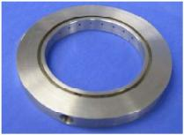
Key Features of Imaging Systems
SprayRing to keep the fused glass lens clean.
  Instrument Clean Air is needed at 30PSI min required
JM Canty, Inc. · Buffalo, New York · Phone: (716) 625-4227 | JM Canty, Ltd. · Dublin, Ireland · Phone: +353 (1) 882-9621

Slide 6
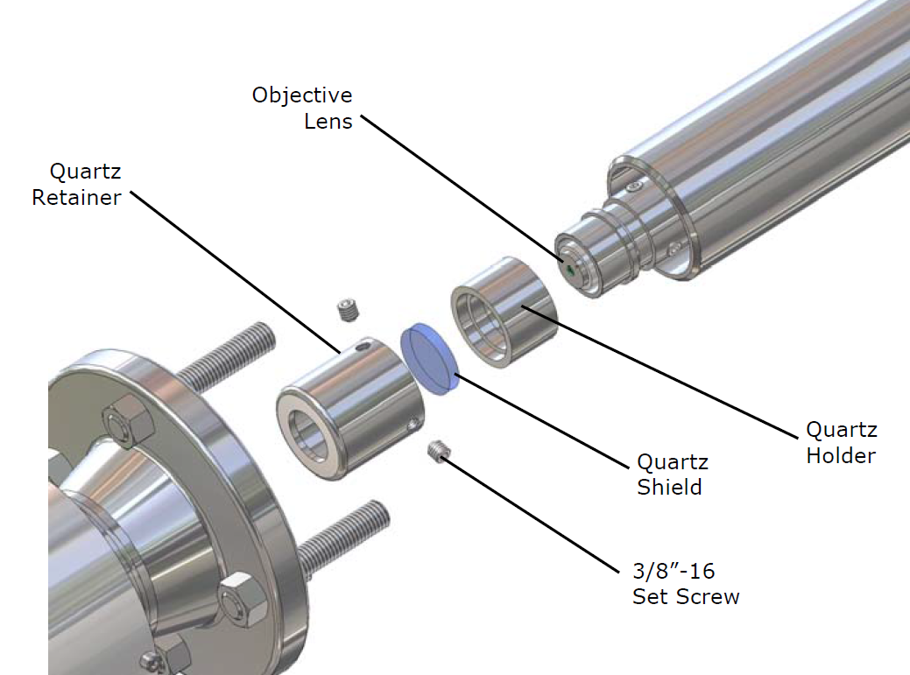
Key Features of Imaging Systems
Lens assembly allows the Ethernet CCD camera to remain outside the process in ambient room temperature air vs being fixed in the higher temperature process air.
JM Canty, Inc. · Buffalo, New York · Phone: (716) 625-4227 | JM Canty, Ltd. · Dublin, Ireland · Phone: +353 (1) 882-9621

Slide 7
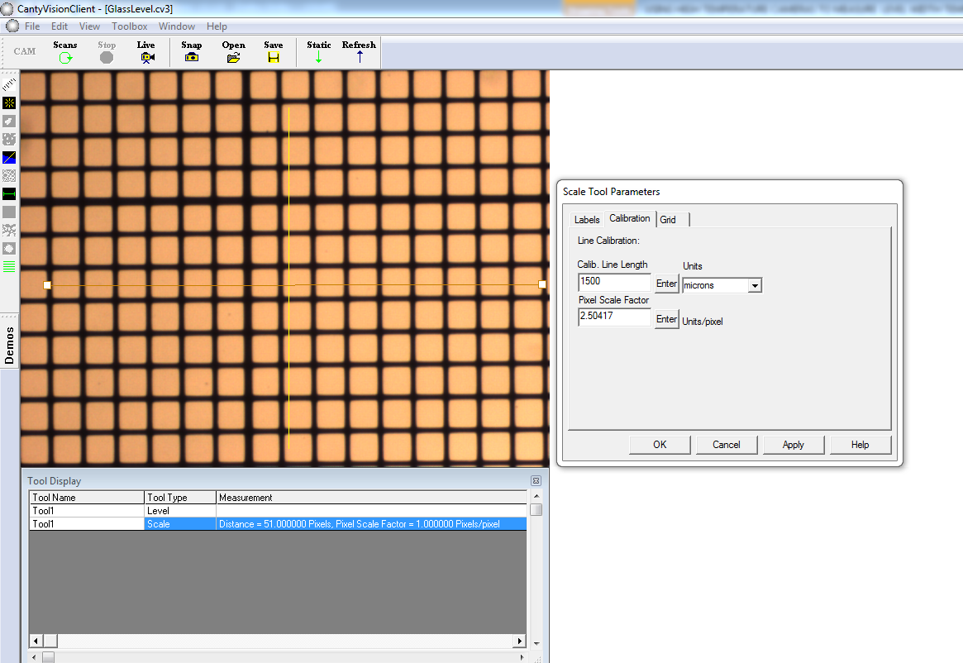
Benefits of vision
Less expensive than laser
More accurate –pixel scale factor
User friendly calibration
  Visual Verification
  Not trying to line up 2 devices
JM Canty, Inc. · Buffalo, New York · Phone: (716) 625-4227 | JM Canty, Ltd. · Dublin, Ireland · Phone: +353 (1) 882-9621

Slide 8
Level
The Canty system consists of a high temperature Ethernet process camera and incorporates special software to reduce glare along with a unique orifice plate that eliminates any debris from adhering to the lens, offering a clear view of the molten level at all times. This new low cost, no-maintenance system replaces expensive traditional platinum dipper probe systems which tend to coat over in a matter of weeks as well as nuclear gauges, which tend to drift and eliminates the need for stilling wells. Level measurements are made in real-time on a continuous basis, with a resolution of 001". CANTYVISION™ Software utilizes image based technology to continually track the edge. A crosshair is used to continually indicate the position of the edge and a numerical output is given. What’s more, your results are visually verifiable on your local area network or localized computer! 4-20mA current loop available.
JM Canty, Inc. · Buffalo, New York · Phone: (716) 625-4227 | JM Canty, Ltd. · Dublin, Ireland · Phone: +353 (1) 882-9621

Slide 9
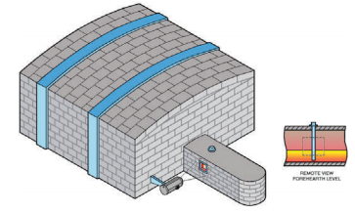
Level
JM Canty, Inc. · Buffalo, New York · Phone: (716) 625-4227 | JM Canty, Ltd. · Dublin, Ireland · Phone: +353 (1) 882-9621

Slide 10

Level
JM Canty, Inc. · Buffalo, New York · Phone: (716) 625-4227 | JM Canty, Ltd. · Dublin, Ireland · Phone: +353 (1) 882-9621

Slide 11
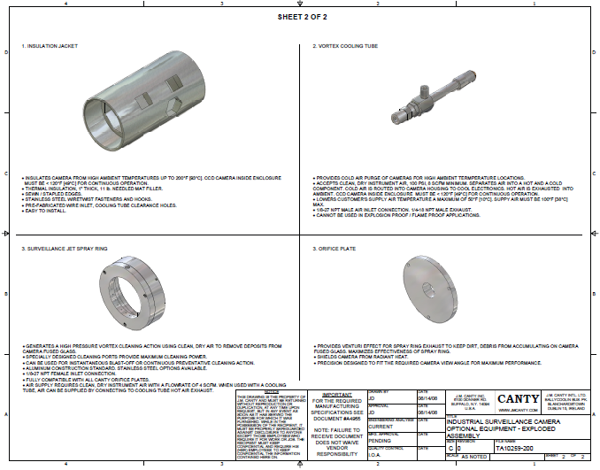
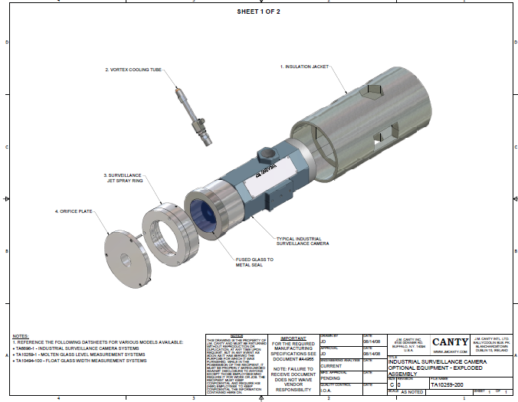
Level camera
JM Canty, Inc. · Buffalo, New York · Phone: (716) 625-4227 | JM Canty, Ltd. · Dublin, Ireland · Phone: +353 (1) 882-9621

Slide 12
Width & Knurl
Determining the position of the total width is extremely important at the end of the furnace to determine total size. To effectively accomplish this the knurl must be measured and compared to the edge. The CANTY Ethernet cameras using CANTYVISION™ will monitor both width & knurl. This results in less waste and higher productivity for the glass when it comes to cutting the knurl. The camera system is able to effectively monitor and measure real time location of the width and knurl and provide a 4-20mA output or OPC to a PLC or DCS for complete automated control.
JM Canty, Inc. · Buffalo, New York · Phone: (716) 625-4227 | JM Canty, Ltd. · Dublin, Ireland · Phone: +353 (1) 882-9621

Slide 13
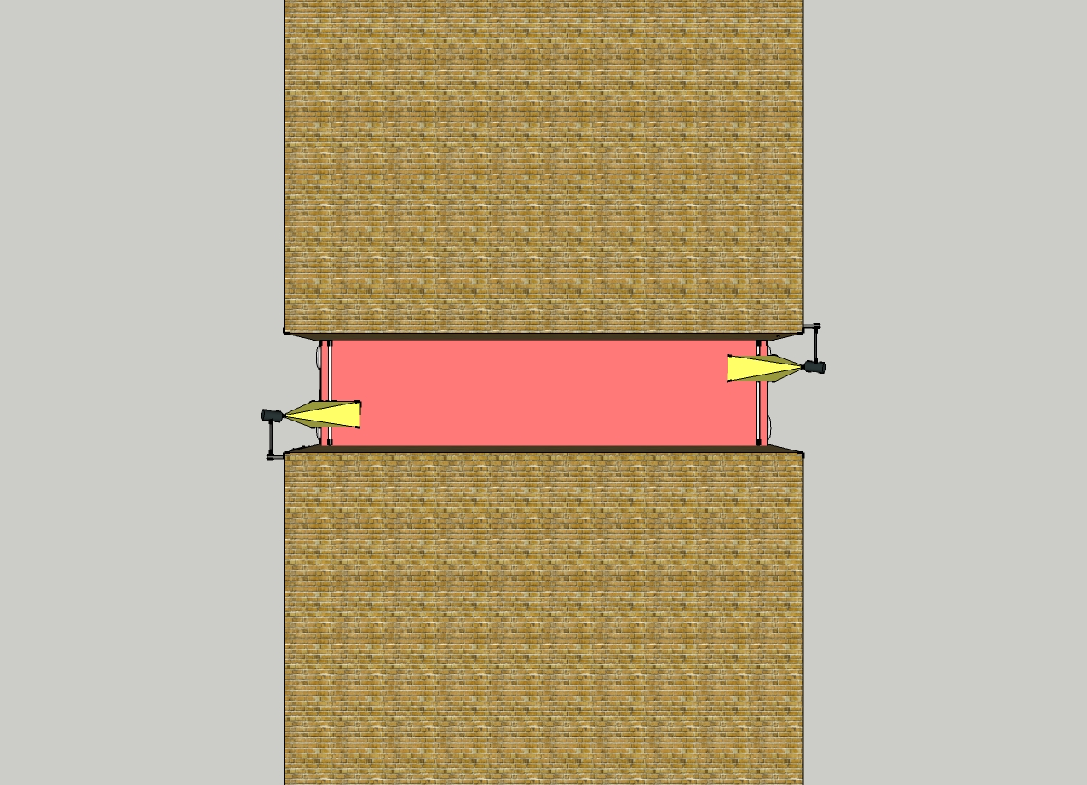
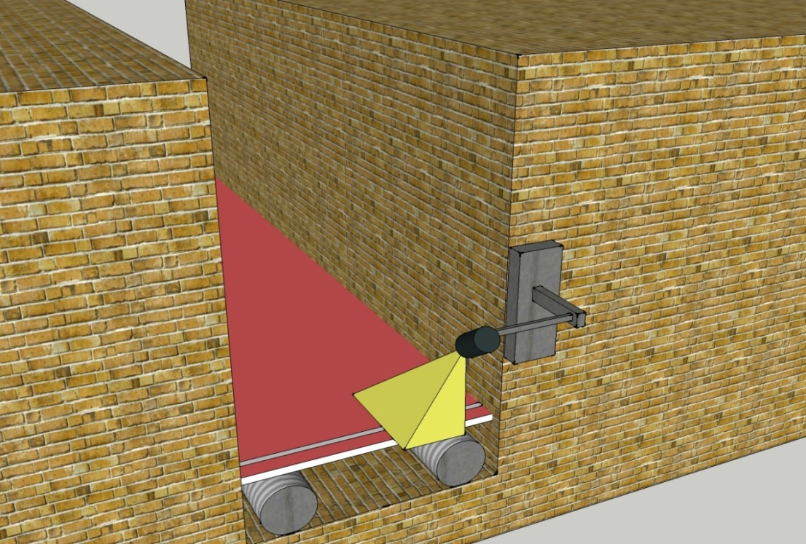
Width & Knurl
JM Canty, Inc. · Buffalo, New York · Phone: (716) 625-4227 | JM Canty, Ltd. · Dublin, Ireland · Phone: +353 (1) 882-9621

Slide 14
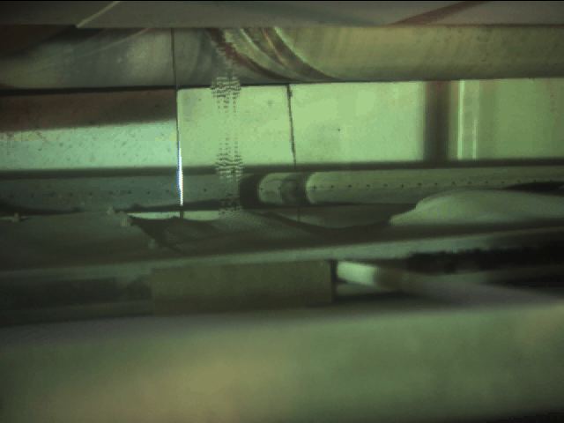
Width & Knurl
JM Canty, Inc. · Buffalo, New York · Phone: (716) 625-4227 | JM Canty, Ltd. · Dublin, Ireland · Phone: +353 (1) 882-9621

Slide 15
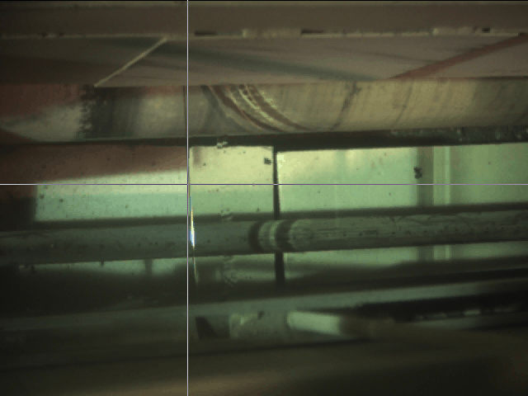
Width & Knurl
JM Canty, Inc. · Buffalo, New York · Phone: (716) 625-4227 | JM Canty, Ltd. · Dublin, Ireland · Phone: +353 (1) 882-9621

Slide 16
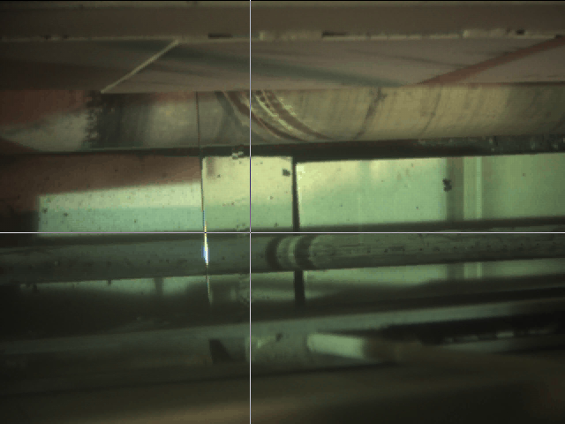
Width & Knurl
JM Canty, Inc. · Buffalo, New York · Phone: (716) 625-4227 | JM Canty, Ltd. · Dublin, Ireland · Phone: +353 (1) 882-9621

Slide 17
Gob & Temperature
The CANTYVISION™ System is positioned on a glass bottle production line to monitor and control the glass gob volume and temperature. A glass gob is a still drop of molten glass formed by cutting a stream of glass as it flows from the fore hearth through a feeder of variable diameters. These gobs free fall into molds and create glass bottles. The volume and temperature of the gobs are critical to quality control and with the Canty Glass Gob analysis system all of these parameters can be controlled.
JM Canty, Inc. · Buffalo, New York · Phone: (716) 625-4227 | JM Canty, Ltd. · Dublin, Ireland · Phone: +353 (1) 882-9621

Slide 18
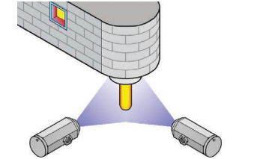
Gob & Temperature
JM Canty, Inc. · Buffalo, New York · Phone: (716) 625-4227 | JM Canty, Ltd. · Dublin, Ireland · Phone: +353 (1) 882-9621

Slide 19
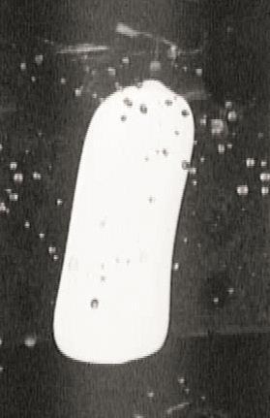
Gob & Temperature
JM Canty, Inc. · Buffalo, New York · Phone: (716) 625-4227 | JM Canty, Ltd. · Dublin, Ireland · Phone: +353 (1) 882-9621

Slide 20
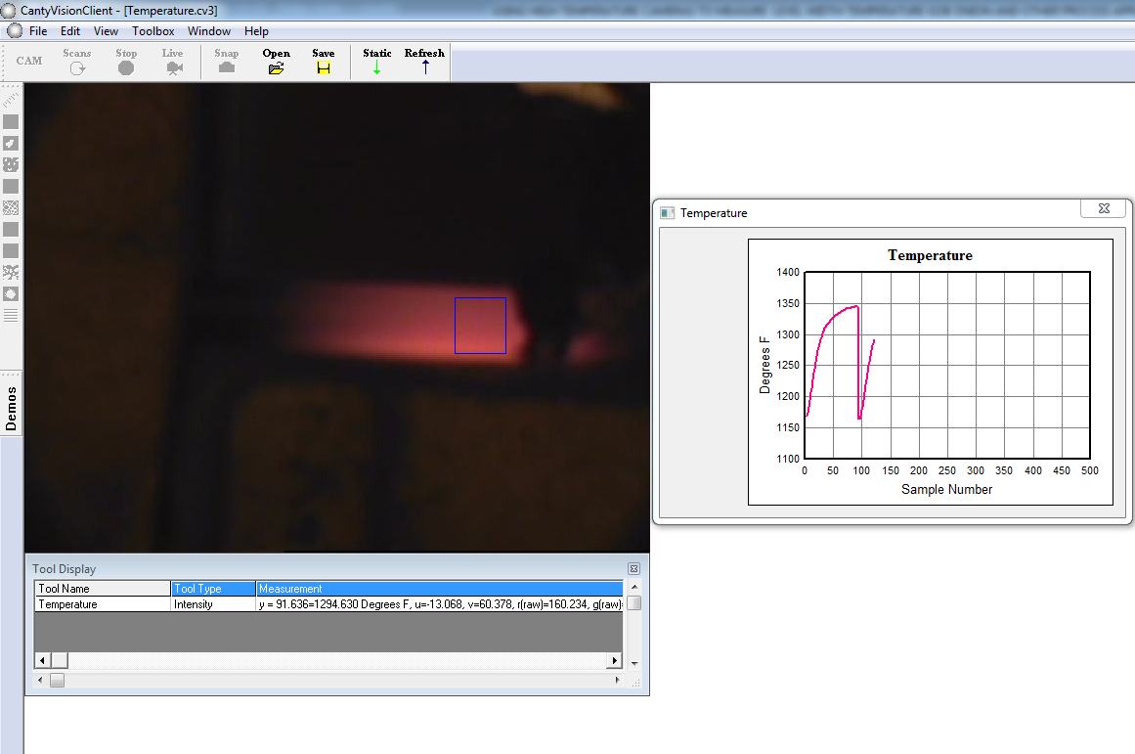
Temperature
JM Canty, Inc. · Buffalo, New York · Phone: (716) 625-4227 | JM Canty, Ltd. · Dublin, Ireland · Phone: +353 (1) 882-9621

Slide 21
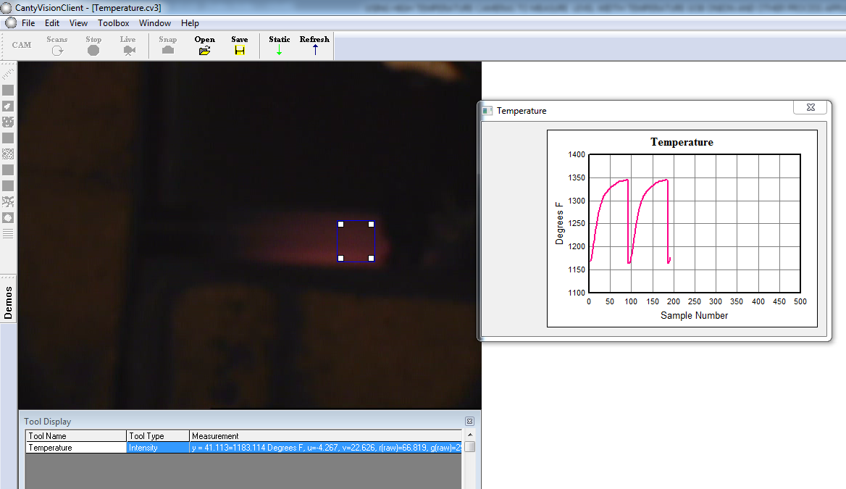
Temperature
Through CantyVisionClient software the user can calibrate temperature measurements made with a handheld pyrometer through the software to produce real time temperature measurements.
A one-time calibration allows for continuous and accurate temperature feedback. Same as multi-wave pyrometers – except no emissivity problem.
JM Canty, Inc. · Buffalo, New York · Phone: (716) 625-4227 | JM Canty, Ltd. · Dublin, Ireland · Phone: +353 (1) 882-9621

Slide 22
Onion
By controlling the position and shape at the initial draw in the front of the tin bath (also known as Onion Skin) results in more uniform pull. This results in less waste and higher efficiency for the glass. The camera system is able to effectively monitor and measure real time location of the onion and provide a 4-20mA output or OPC to a PLC or DCS for complete automated control.
JM Canty, Inc. · Buffalo, New York · Phone: (716) 625-4227 | JM Canty, Ltd. · Dublin, Ireland · Phone: +353 (1) 882-9621

Slide 23
Onion
JM Canty, Inc. · Buffalo, New York · Phone: (716) 625-4227 | JM Canty, Ltd. · Dublin, Ireland · Phone: +353 (1) 882-9621

Slide 24
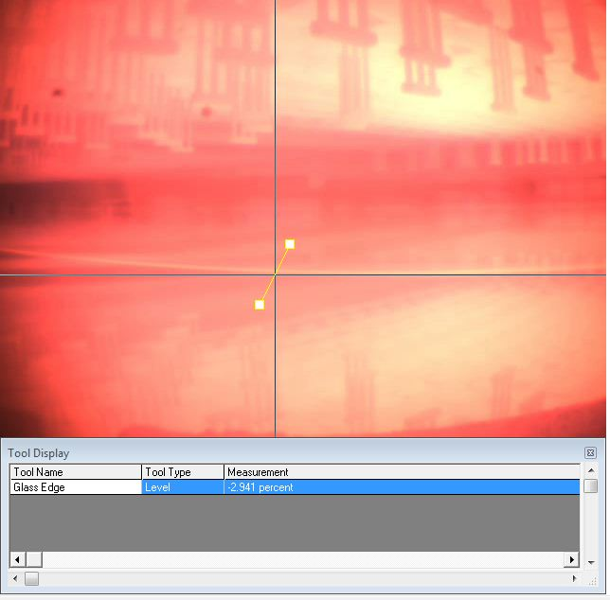
Onion
JM Canty, Inc. · Buffalo, New York · Phone: (716) 625-4227 | JM Canty, Ltd. · Dublin, Ireland · Phone: +353 (1) 882-9621

Slide 25
Ribbon & Stone
The purpose of the particle detection application is to determine when foreign debris has fallen onto the glass surface within the tin bath and alarm when debris is 0.125 inches in size or larger. Within the tin bath a sheet of glass floats on molten tin and occasionally a piece of refractory, insulation, etc., falls onto the glass. The debris will travel further downstream on top of the glass and the debris may hit a coater that is placed at the end of the tin bath. Typically the coater is set at height of 0.25 inches above the glass, so any debris larger than the gap between the coater and the glass can cause some major damage to the glass and the process.
JM Canty, Inc. · Buffalo, New York · Phone: (716) 625-4227 | JM Canty, Ltd. · Dublin, Ireland · Phone: +353 (1) 882-9621

Slide 26
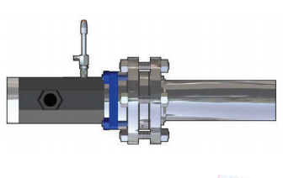
Ribbon & Stone
JM Canty, Inc. · Buffalo, New York · Phone: (716) 625-4227 | JM Canty, Ltd. · Dublin, Ireland · Phone: +353 (1) 882-9621

Slide 27

Ribbon & Stone
JM Canty, Inc. · Buffalo, New York · Phone: (716) 625-4227 | JM Canty, Ltd. · Dublin, Ireland · Phone: +353 (1) 882-9621

Slide 28
Conclusion
Real Time Measurement
Repeatable / Accurate
Visual Verification
Output Signals-ethernet,4-20ma,OPC
Process Control
Better Quality
Higher Yield
JM Canty, Inc. · Buffalo, New York · Phone: (716) 625-4227 | JM Canty, Ltd. · Dublin, Ireland · Phone: +353 (1) 882-9621

