Slide 1
Novel Dynamic Imaging Probe for Real Time Analysis of Cell Density in CHO Cell Culture to Enhance Understanding of Cell Growth and Viability
Claudia Corredor, Yongqi Wu, Alvin Togonon, Nobel Vale, Dimuthu Jayawickrama, Frank Ritacco and Douglas Both
Innovative Process Analytical Sciences (iPAS), Drug Product Science and Technology (DPST), New Brunswick, NJ,
¥Biologics Development & Operations, Global Manufacturing & Supply (GMS), Bloomsbury, NJ, Bristol-Myers Squibb Co

Slide 2
Outline
Cell Viability, %viable cell density (%VCD) and Apoptosis
Four Different methods to measure cell viability and %VCD:
  Imaging Analysis with Trypan Blue exclusion
  Capacitance measurements
  Flow cytometry
  Imaging analysis without Trypan Blue Dye
Comparison of 4 different methods to measure %VCD
Comparison of Canty Imaging systems and Caspase and Nexin biomarkers for apoptosis
Conclusions
Future Work

Slide 3
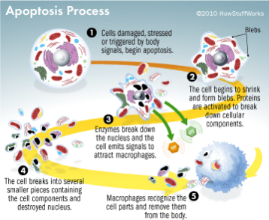
Apoptosis and VCD
Product yield (titer) strongly depends on the cell concentration
Apoptosis can also influence the quality attributes of the product (e.g. glycosylation pattern).
Viable Cell Density (VCD),
Total Cell Density (TCD)
Glucose, lactate, glutamate, glutamine
pO₂, pCO₂, DO
NH4+, Na+, K+, Ca2+
pH
Apoptosis has been reported to be the major cause of cell death in CHO cells
Notes:
A decrease in the viable cell density by apoptosis can easily reduce the final yield
Apoptosis can be induced by:
Depletion of substrates, pH alteration, Hypo-, and hyperoxia, mechanical shear, hydrodynamic stress, toxic ammonium concentration or viral infections

Slide 4
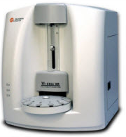
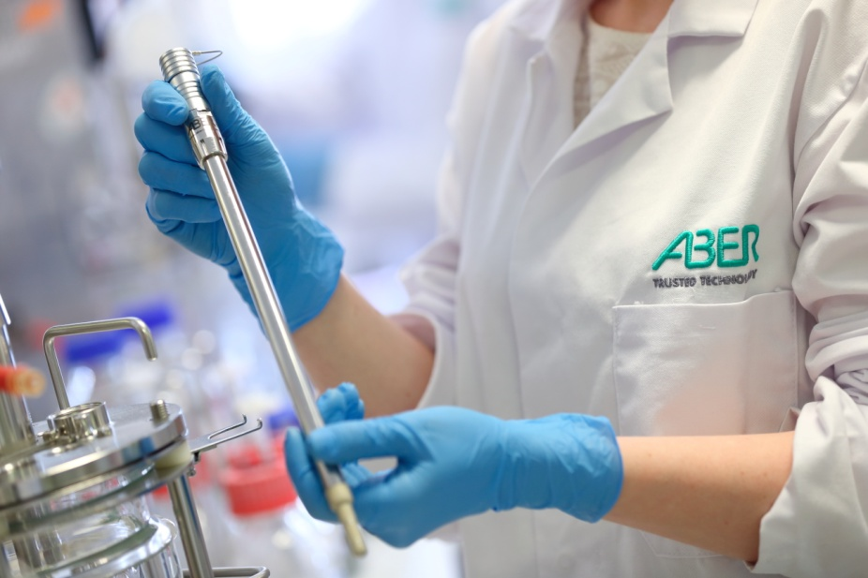
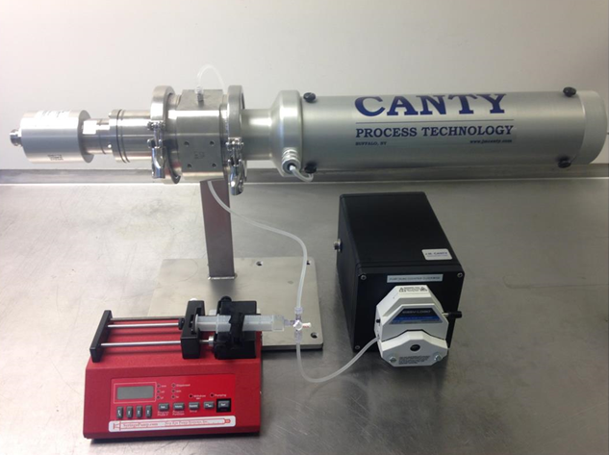
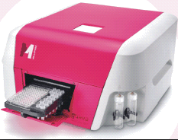




Evaluation of 4 Different Cell Counting Methods
METHODS
Image
Analysis
Flow
Cytometry
Dielectric
Image
Analysis-No Dye
Trypan blue
exclusion
Annexin V
Capacitance
probe
Dynamic imaging
analysis
Caspase
7-AAD
Notes:
When comparing different methods of determining live and dead cells, keep in mind that the principles of measurement are different

Slide 5
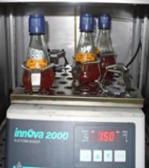
Experimental Design
CHO cells seeded at:
25 mM Glucose, 1 mM glutamine, 4 mM Glutamax, Density= 2 x 10⁵ cells/mL; 37 ⁰C; 10% CO_{2;} 120-160 rpm
Shake flask for 13 days
Cells were sampled everyday from Day 3 to Day 13
Image
Analysis
Flow
Cytometry
Dielectric
Image
Analysis-No Dye
Trypan blue
exclusion
Annexin V
Aber Capacitance
probe
Pharmaflow
imaging
analyzer
Caspase
Min 0.5 mL with up to 10 x 10⁶ cells/mL were used
7-AAD
Probe submerge in 80 mL of sample to measure capacitance
8 mL of sample
2x10⁵ cells were used for Caspase and Nexin assay within 1h

Slide 6
Image-Based Analysis with Trypan Blue Exclusion

Slide 7
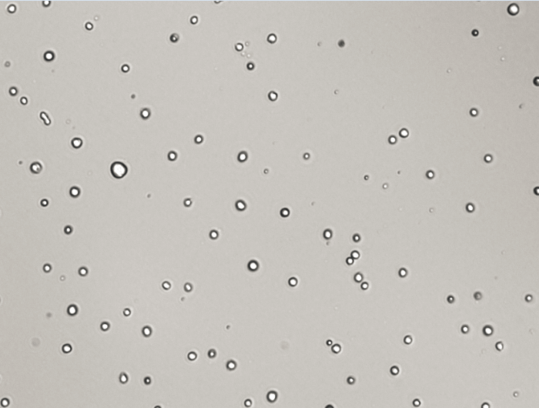
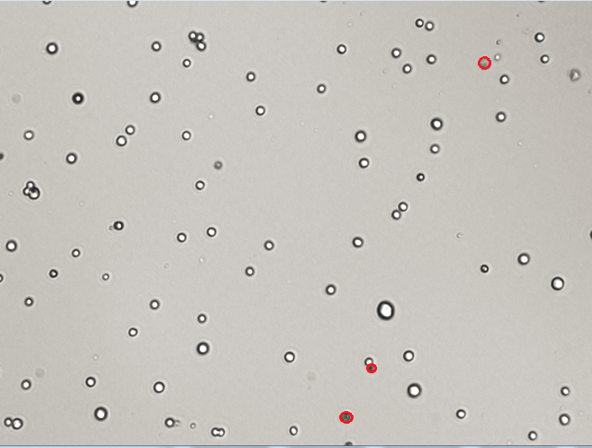
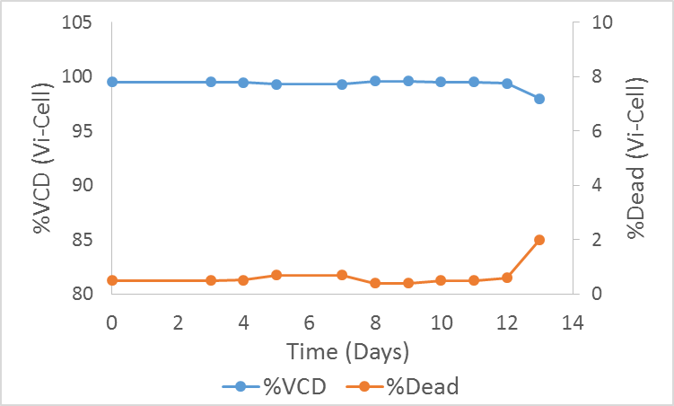
Vi-cell XR Image Analysis
Day 5
Day 11
Image Parameter | Vi-Cell XR
CCD Resolution | 1394x 1040
Size Range | 2 – 70 μm
Concentration Range | 0.5 x 10⁶ – 10 x 10⁶ cells/mL
Viability Detection | Trypan blue dye exclusion method
Analysis Time | 2.5 min
Apoptosis detection | NA
Analyzed images/sample | 50
In-line analysis | NA
Quantitative information | Cell density Cell Viability Average cell diameter
%VCD determined by Vi-cell remains high (99%) for almost the entire experimental
Notes:
Cell viability is typically measured in daily bioreactor samples using a trypan blue-based test. This method cannot provide insights into cell health and the progress of apoptosis in the cell culture

Slide 8
Capacitance Measurements

Slide 9
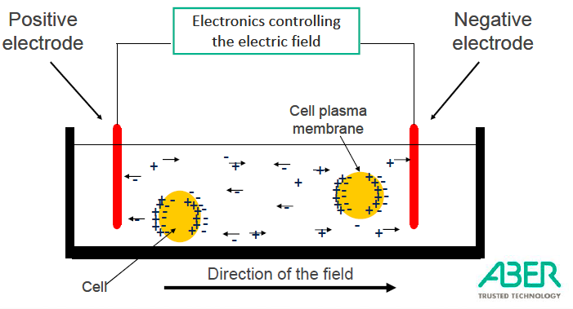
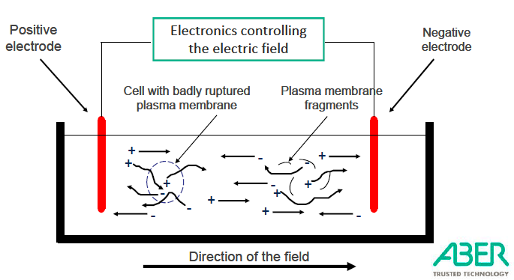
Principle of Capacitance Measurements
Live cells with intact membranes become polarized and thus measured
Dead cells with leaky membranes with respect to charge are not measured
The charge of the cells are measured by the capacitance sensor in picofarads/cm (pF/cm)
The system is insensitive to cells with leaky membranes, gas bubbles and other debris
The resulting capacitance is directly proportional to the total membrane bound volume:
  -the number of the cells and the size of the cells

Slide 10
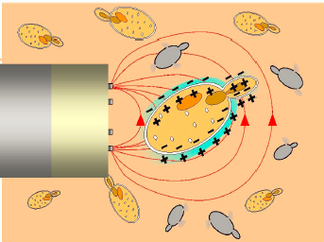
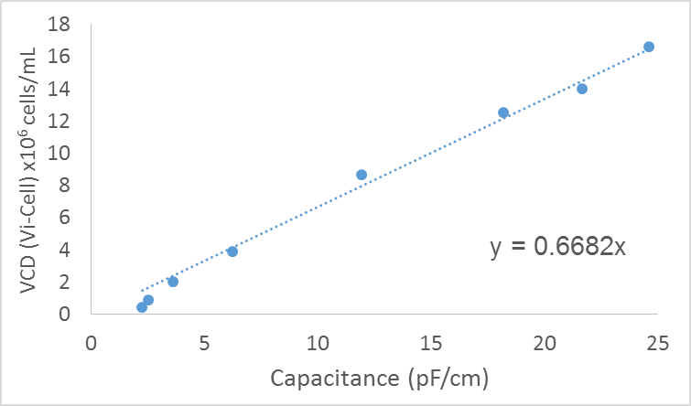
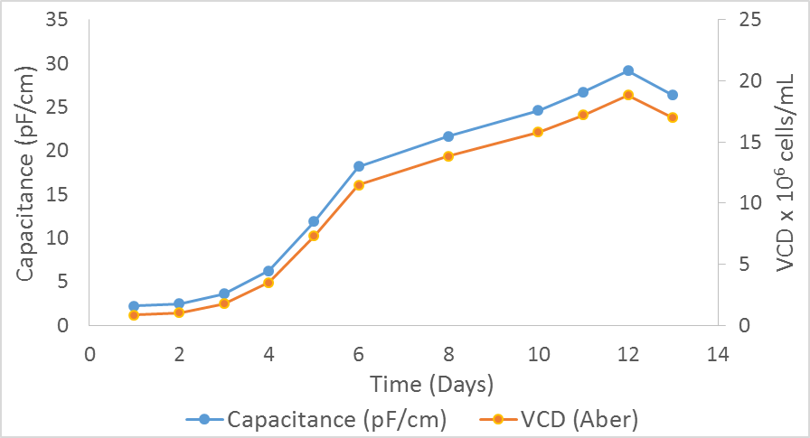
Capacitance Measurement Probe
Calibration
The electric field typically projects about 30 mm from the probe into the liquid
Raw data from Dual-Frequency Measurement Mode is compared to off-line equipment (i.e. Vi-Cell)
Using this offline data, a coefficient is obtained that is specific for that particular cell-line
This cell factor is a multiplier that is incorporated to the raw measurement data to obtain a VCD value

Slide 11
Flow Cytometry

Slide 12
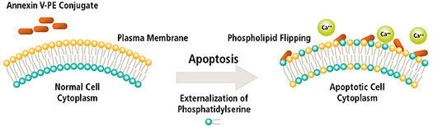
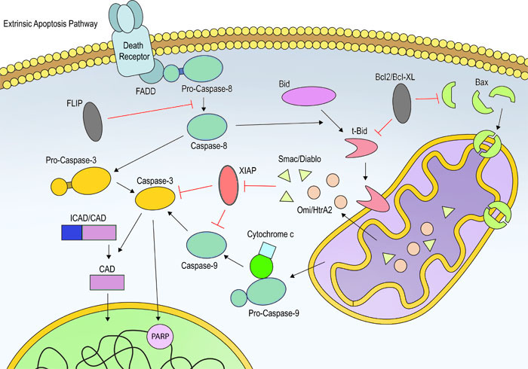
Monitoring Apoptosis Using Fluorescent Markers
Nexin Analysis
Annexin V-PE conjugate: measures externalization of phosphatidylserine to the cell surface
Caspase Analysis
Caspases form a family of enzymes:
Initiate the apoptotic cascade
Carry out cellular break down
Process cytokines
Uncleaved Caspase 3
Cleaved Caspase 3
7-AAD
7-AAD is an indicator of membrane structural integrity:
  Excluded from live, healthy cells and early apoptotic cells
  permeates later stage apoptotic and dead cells

Slide 13
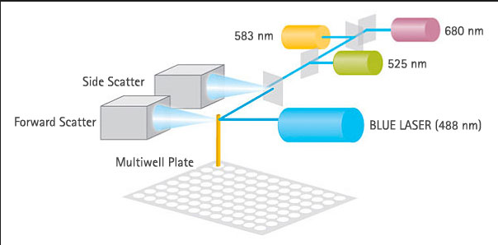
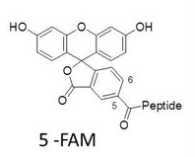
Multicaspase and Nexin Staining Test
FAM by blue lasers
only (EasyCyte Systems)
5-FAM: 5-Carboxyfluorescein peptide
7-aminoactinomycin D (7-AAD) is a fluorescent intercalator that undergoes a spectral shift upon association with DNA
7-AAD/DNA complexes can be excited by the 488 nm laser and has an emission maxima of 647 nm
# | Assay | Target / Label | Apoptotic Stage
1 | Multi-Caspase Flow Cytometry Assay | Cleaved Caspase 3, 7, 8, 9 / FAM double-stranded DNA / 7-AAD | Early-mid Stage
2 | Nexin Flow Cytometry Assay | Annexin V of Exposed PS / PE double-stranded DNA / 7-AAD | Early Stage

Slide 14
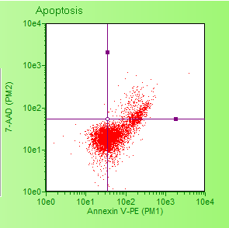
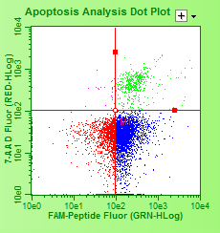
Flow cytometry: Early, Middle and Late apoptosis
Nexin
Caspase
IV
III
IV
III
I
II
I
II
No Apoptosis (I): Annexin (-) /Caspase (-), 7-AAD-,
Early/mid Apoptosis (II): Annexin (+)/ Caspase (+), 7-AAD (-),
Dead or late Apoptosis (III): Annexin (+) / Caspase (+), 7-AAD (+)
Necrosis (IV): Annexin / Caspase (-), 7-AAD (+)

Slide 15
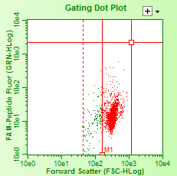
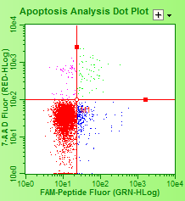
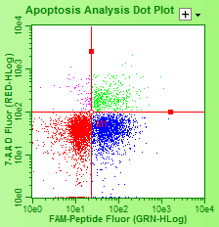
Flow Cytometry: Control and Gating
Healthy Control
Same Gating (Apoptotic Control)
Apoptotic control:
2x10⁶ cells/ml with 50mM camptothecin/24h
Viability 60-85%
VCD > 1x10⁶ cells/ml
Healthy Control
Shake flask 1-2 days after passaging.
Viability > 95% and VCD > 0.8x10⁶ cells/ml
Each flow cytometry test includes a healthy control and an apoptosis control
Gating is based on the healthy control

Slide 16
Dynamic Imaging Analysis Without Dye

Slide 17
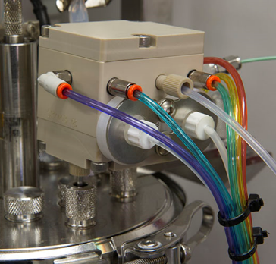
Canty Pharmaflow Imaging Analyzer
Parameter | Vi-Cell XR | Canty
CCD Resolution | 1394x 1040 | 1900x1200
Size Range | 2 – 70 μm | 1 – 250 μm
Concentration Range | 0.5 – 10 mill cells/mL | 0.5 – 30 mill cells/mL
Viability Detection | Trypan blue dye exclusion method | No dye required
Automated dilution | No | Yes
Analysis Time | 2.5 min | 2.5 min
Apoptosis detection | NA | Yes
Analyzed images /sample | 50 | 2000
In-line analysis | NA | In implementation
Bend MAST will be used in the future
Software controlled syringe pump and peristaltic dilution pump
Cell dilution is automatically controlled from CantyVision software

Slide 18
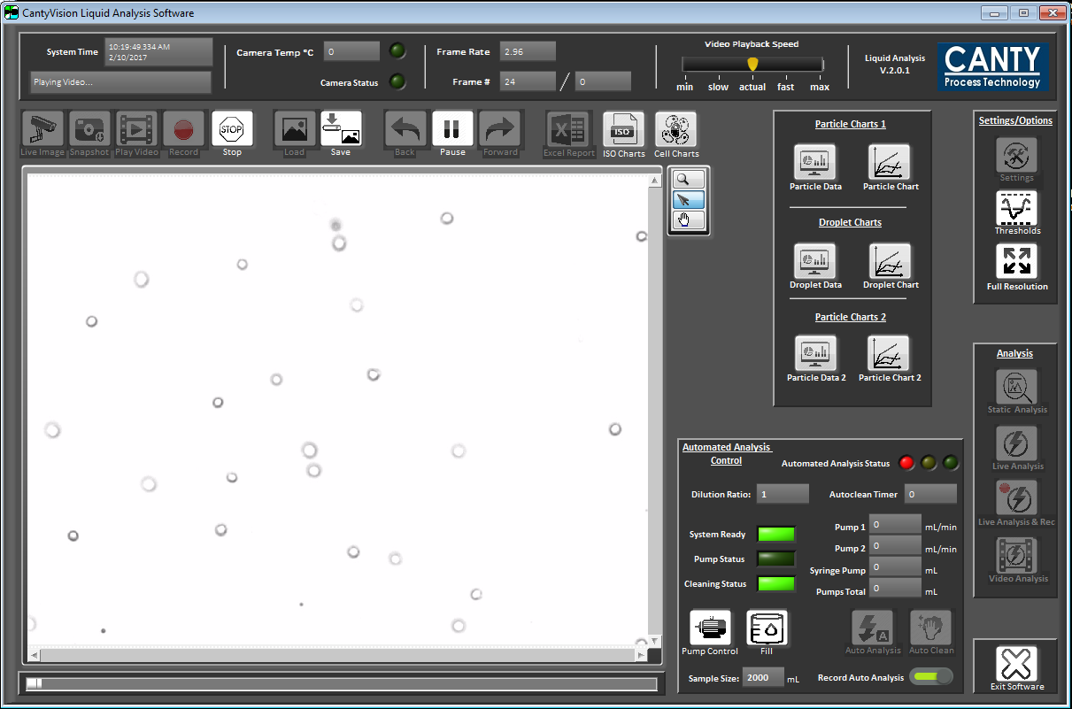
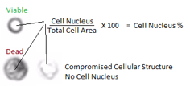
Image Retrieval and Analysis
The Canty Cell Analysis Software along with a syringe pump and a peristaltic pump automatically dilutes concentrated cells to the appropriate optimal imaging density
The software then calculates a dilution ratio based on the amount of cells to the amount of dilution buffer
The dilution process is performed automatically at a rate of 15 frames per second
With auto-dilution of samples it was found that no saturation point was reached for the cell densities tested up to 30 x 10⁶ cells/mL

Slide 19

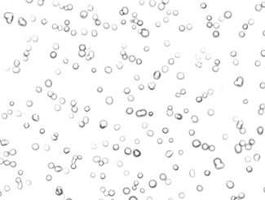
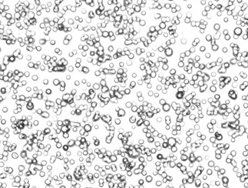

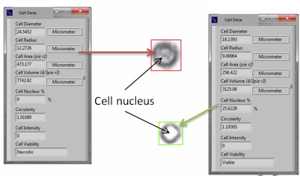
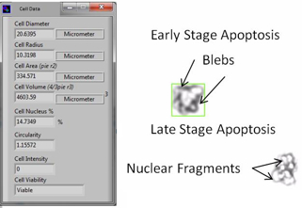


Canty Pharmaflow Dynamic Imaging Analyzer
5 days
8 days
11 days
Death cells: low cell nucleous%
Viable cells: high cell nucleous %.
A typical value of >12% is viable

Slide 20
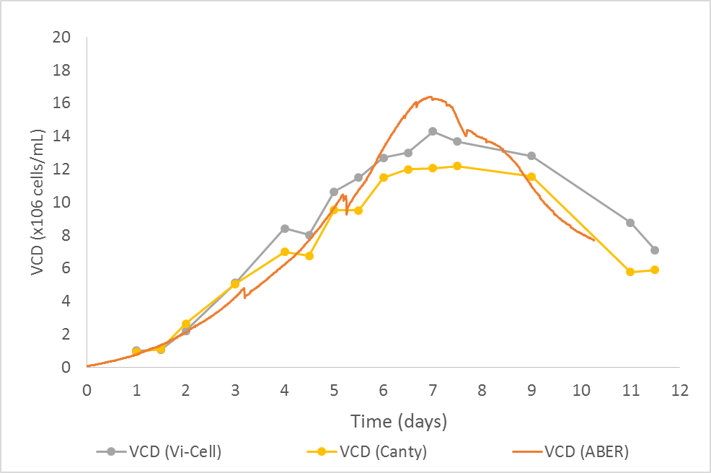
Bioreactor Data: Canty Pharmaflow vs. Capacitance
Initial bioreactor run for 11 days demonstrated the ability of Canty analyzer to determine %VCD
There was a marked offset at the end of the bioreactor run, suggesting the ability of the Canty analyzer to correlated to early and late stages of apoptosis

Slide 21
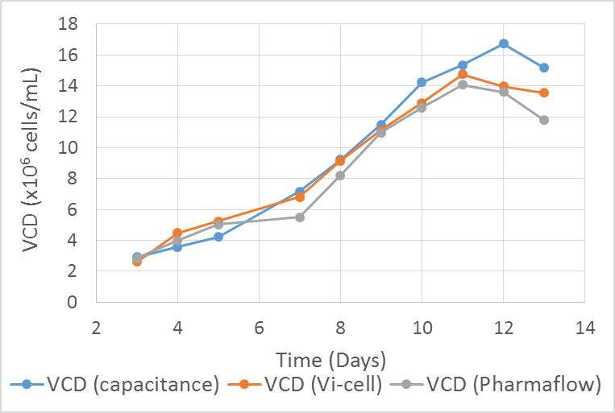
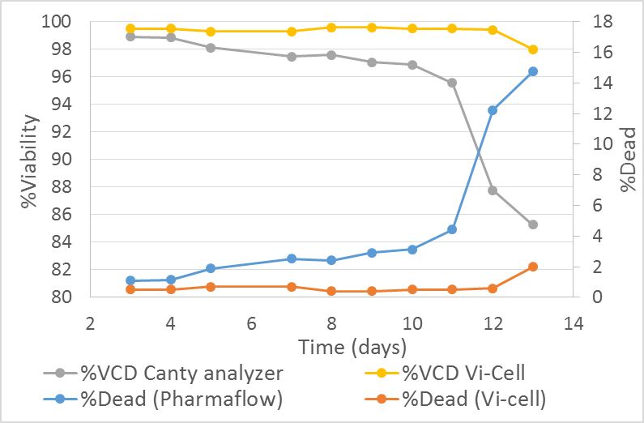
Comparison of Different Methods for VCD
VDC determined by capacitance, Canty imaging and Vi-cell methods closely correlated during growth (day 0 to day 6)
Deviations were evident after day 6 with increase of apoptosis and cell death
Canty Pharmaflow analyzer shows a marked decrease in viability starting at day 6
The D7-D13 high viability count with Vi-Cell didn’t correlate to sharp increase on late stage %apoptosis

Slide 22
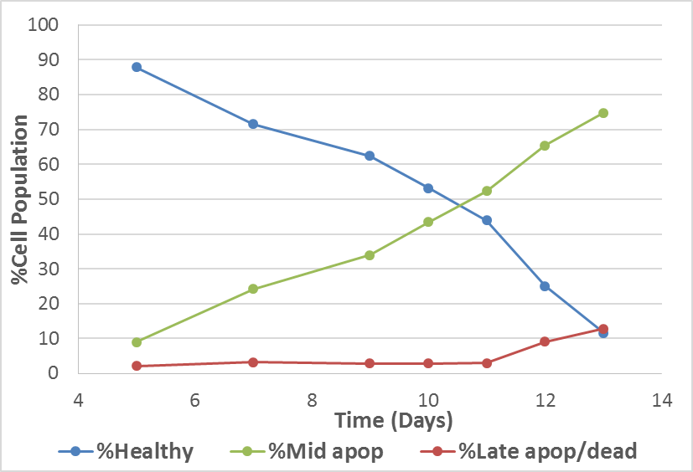
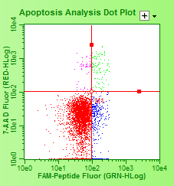
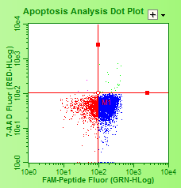
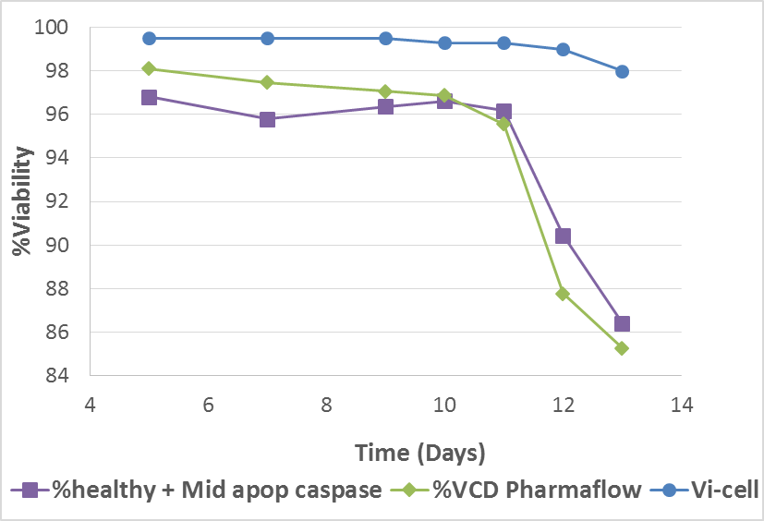
Caspase Profile vs. Canty Pharmaflow
Day 5
Day 11
I
IV
III
IV
III
II
I
II
I
II
III
%Healthy (apoptosis-free) dramatically decreases on Day 7 (↓I)
%Middle apoptosis rises on Day 7 (↑ II)
%Late apoptosis + dead rises on Day 11 (↑ III)
Canty imaging system closely correlates with the combined %healthy + %Middle apoptosis (I + II)
I + II

Slide 23
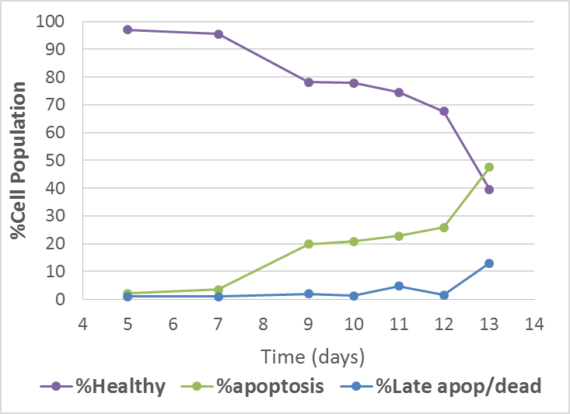
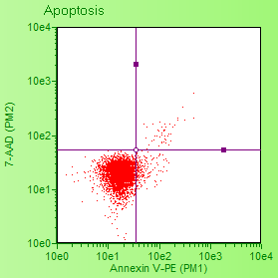
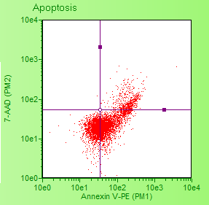
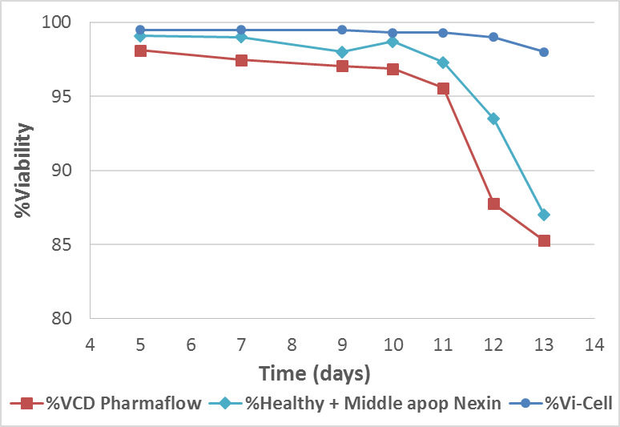
Nexin Profile vs. Canty Pharmaflow
Day 5
Day 13
I
IV
III
IV
III
II
III
I
II
I
II
%Healthy (apoptosis-free) dramatically decreases on Day 7
%Late apoptosis percentage rises on Day 9
%Late apoptosis + dead rises on Day 11 (↑ III)
Canty imaging system seems to correlate with the combined %healthy + %middle apoptosis (I + II)
I + II

Slide 24
Conclusions
Four different methods were compared for the determination of viable cell density
Canty Pharmaflow Imaging analyzer demonstrated the ability to measure early and late apoptosis, correlating to biomarkers such as Caspase and Nexin
Markers of early apoptosis were observed several days prior to a drop in viability as measured by Vi-cell (the most common method used)
%VCD DIA = %Healthy + %Early/late apoptotic Caspase
An-in-line method to measure apoptosis can greatly simplify the current protocol of apoptotic off-line analysis by reducing operator time and cost of reagents

Slide 25
Future work
In-line implementation of Canty imaging analyzer is under way with the goal to integrate fully automated Bend Research MAST sampling .
Develop a quantitative in-line apoptotic analysis that correlates with Caspase and Nexin biomarkers to determine the cell health in bioreactor as a criterion for process optimization

