Slide 1
American Association of Drilling Engineers
Automation Drilling Fluid Particulates analysis
Tod Canty Sr., PE
JM Canty Inc

Slide 2
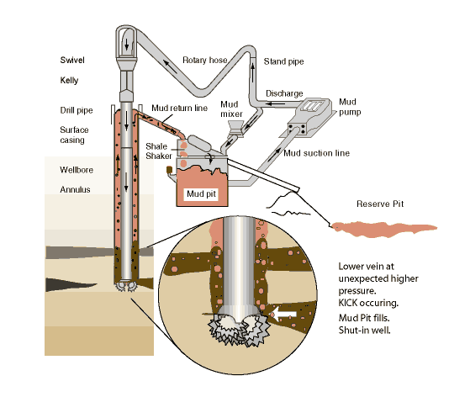
Particle Size Analysis of Drilling Fluids
Introduction
  Drilling muds or fluids are complex aqueous or oil-based suspensions designed to fulfill a number of important functions during the oil extraction process.
  Main Functions
      Provide hydrostatic pressure to prevent formation fluids from entering the well bore
      Keep the drill bit cool and clean during drilling
      Carry out drill cuttings
      Suspending drill cuttings while drilling is paused and while drilling assembly is brought in and out of the hole
      Avoid formation damage and limit corrosion
Typical Drilling Mud System

Slide 3
Why Drilling Fluid Particle Size Distribution is Important
  Mud performance controlled by manipulating the mud composition and the properties of the constituents through the addition of different additives.
  Particle size significantly affects the way in which the mud interacts with the surrounding geology.
  Particle size measurements play an important role in the formulation of high performance drilling muds.
  Particles smaller than the pore size of the surrounding geological formation will bridge rock pores during mud circulation, leading to the formation of a filter cake that prevents the egress of fluids from the well during drilling.
  This “filter cake” protects the surrounding rock from damage while simultaneously preventing fluid loss and achieving well stabilization.

Slide 4
Industry Techniques for Particle Size Analysis of Drilling Fluid
History of various techniques
  Sieves
  Laser
  Imaging

Slide 5
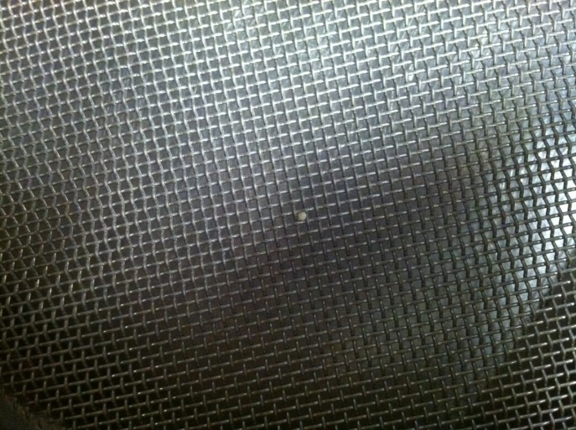
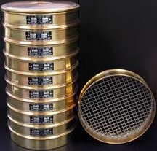
Industry Techniques for Particle Size Analysis of Drilling Fluid
Sieve Analysis
  Used for many years, simple & inexpensive
    Disadvantages:
      Time (Sedimentation and Sieving are both slow and time consuming processes)
      Particle Size ( Particles too small for separation by sieving to be practical)
      Error (Over-energetic sieving causes attrition of the particles and thus changes the calculated particle size distribution)

Slide 6
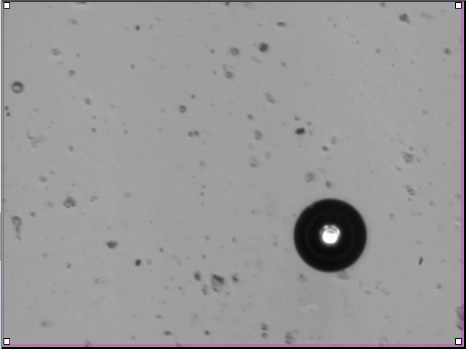
Industry Techniques for Particle Size Analysis of Drilling Fluid
Laser Diffraction
  Quickness and ease of use
  Disadvantages:
    Water droplets (in oil based) Oil droplets (in water based ) mud measured as particles.
    Non-spherical objects (large discrepancy between laser measurements)
    Laser 1D (equivalent sphere) and not recommended for large aspect ratio.
    Distortion of Measurements (existence of “ghost” particles caused by sharp edges on the objects which produce high angle diffraction
    Acicular particles (shows much larger sizes compared to laser diffraction, undercounts events generated by major chord
    Laser diffraction intrinsically biased towards the smaller edge of spectrum.

Slide 7
Laser Sampling Problems
Laser diffraction typically only uses a sample size of around 1mL to 2mL. The problem with this is the steps necessary to break down a sample small enough for laser diffraction from the original sample gathered at the process line. Some possible issues are:
Does the sample container harbor particles not wanted within the sample?
By the time the sample is drawn have particles began to settle out of solution?
Is there a large difference in particle density between a sample drawn from the top of the container to the bottom?
Is a few mL sufficient for proper particle analysis?
      With the Canty Cross-Cut Sampling Valve none of these potential sampling issues come into play.

Slide 8
Imaging Advantage
Drilling Mud System
CANTY’s Drilling Mud particle Analysis system has many distinct advantages over Laser Diffraction systems and sieve
  Real time 2Dimensional particle shape analysis.
  The particles are oriented in the fluid dynamically designed flow cell to measure the largest length and widest section of the particles. All aspect ratios are measured correctly
  Direct measure of particle area – a two dimensional measurement.
  Direct measurement of particle perimeter – a two dimensional measurement.
  Direct measure of major axis and minor axis – a two dimensional measurement.
  Able to separately measure various particles separately water, barite, polymer using size shape and color data
  Direct measurement of particle color.
  Large particle range – 2” down to .7 micron

Slide 9
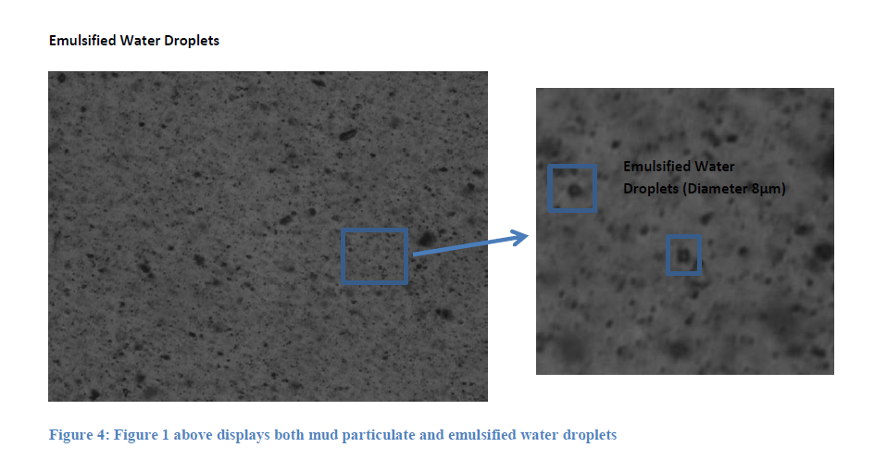
How it Works
Fiber optic lighting
Fused glass safety barrier
EXP & ATEX available
High pressure / temperature ratings
Auto-dilution

Slide 10

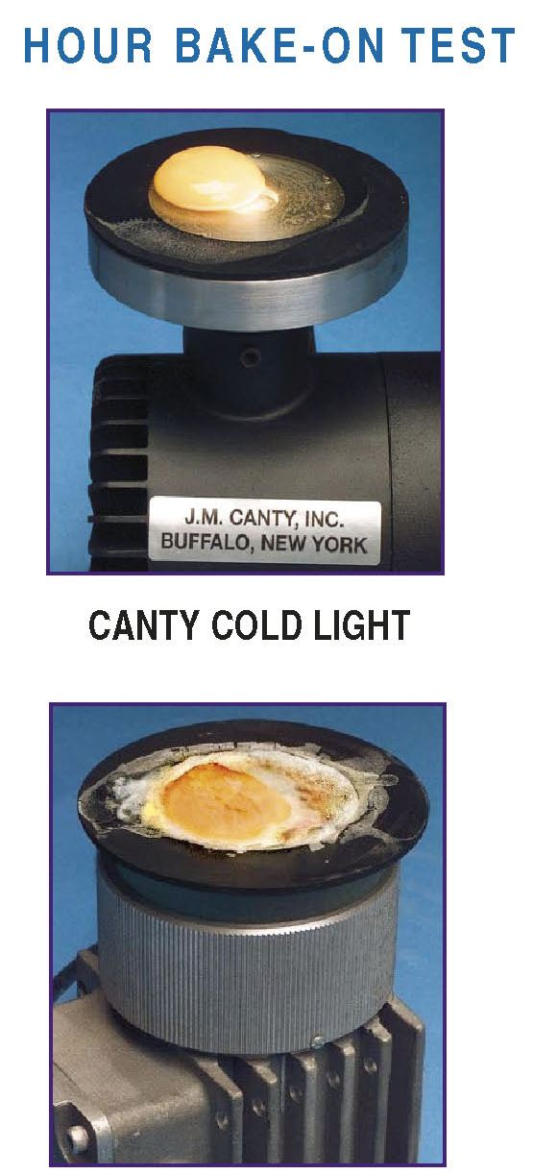
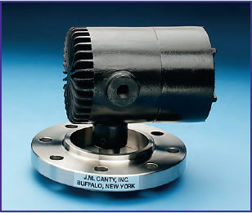
How it Works
Lighting is critical for any vision based system
Canty have being doing process lighting for well over 30 years – part of our core business
Would not be so confident in our vision based technique without our lighting expertise
JM Canty, Inc. · Buffalo, New York · Phone: (716) 625-4227 | JM Canty, Ltd. · Dublin, Ireland · Phone: +353 (1) 882-9621

Slide 11
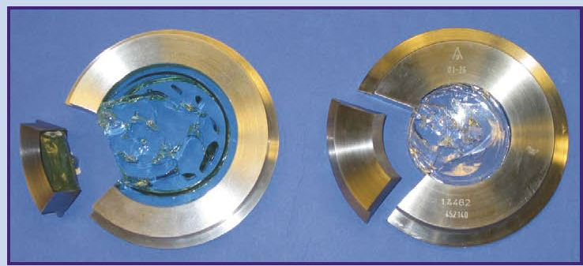
CANTY’s Fused Glass Technology
Fusion of glass to metal – one piece construction
Critical to our vision based technique
Pressures to 10,000 PSI, Temp -450 to 800ºF
JM Canty, Inc. · Buffalo, New York · Phone: (716) 625-4227 | JM Canty, Ltd. · Dublin, Ireland · Phone: +353 (1) 882-9621

Slide 12
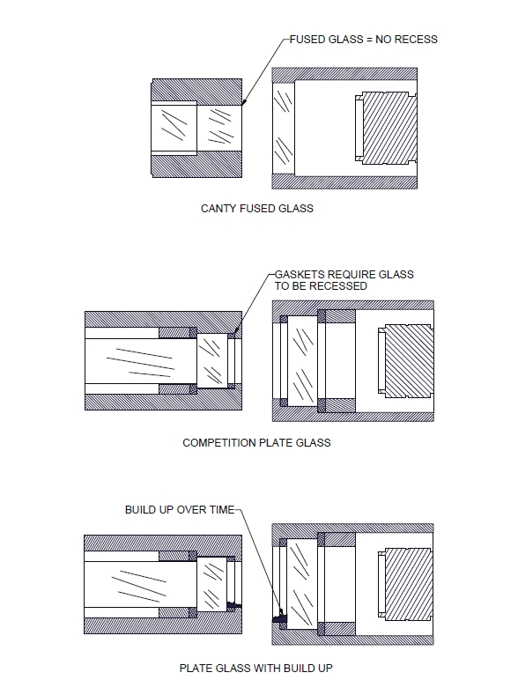
Importance of fused glass technology
Hermetically sealed one piece construction means no recesses or gaps where product can adhere to and start to build up
Self cleaning unit
JM Canty, Inc. · Buffalo, New York · Phone: (716) 625-4227 | JM Canty, Ltd. · Dublin, Ireland · Phone: +353 (1) 882-9621

Slide 13
CANTY MICROFLOW
Lab System
“How it works”
JM Canty, Inc. · Buffalo, New York · Phone: (716) 625-4227 | JM Canty, Ltd. · Dublin, Ireland · Phone: +353 (1) 882-9621

Slide 14
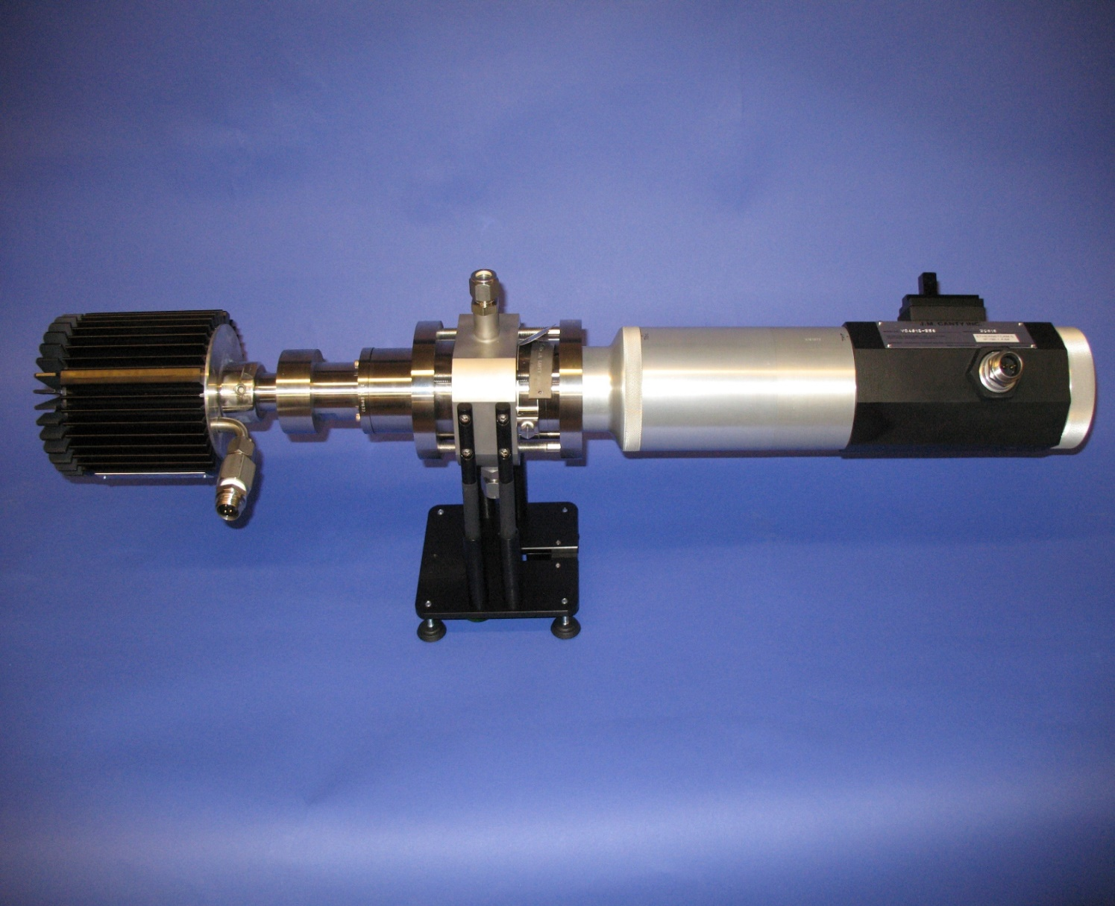

Slide 15
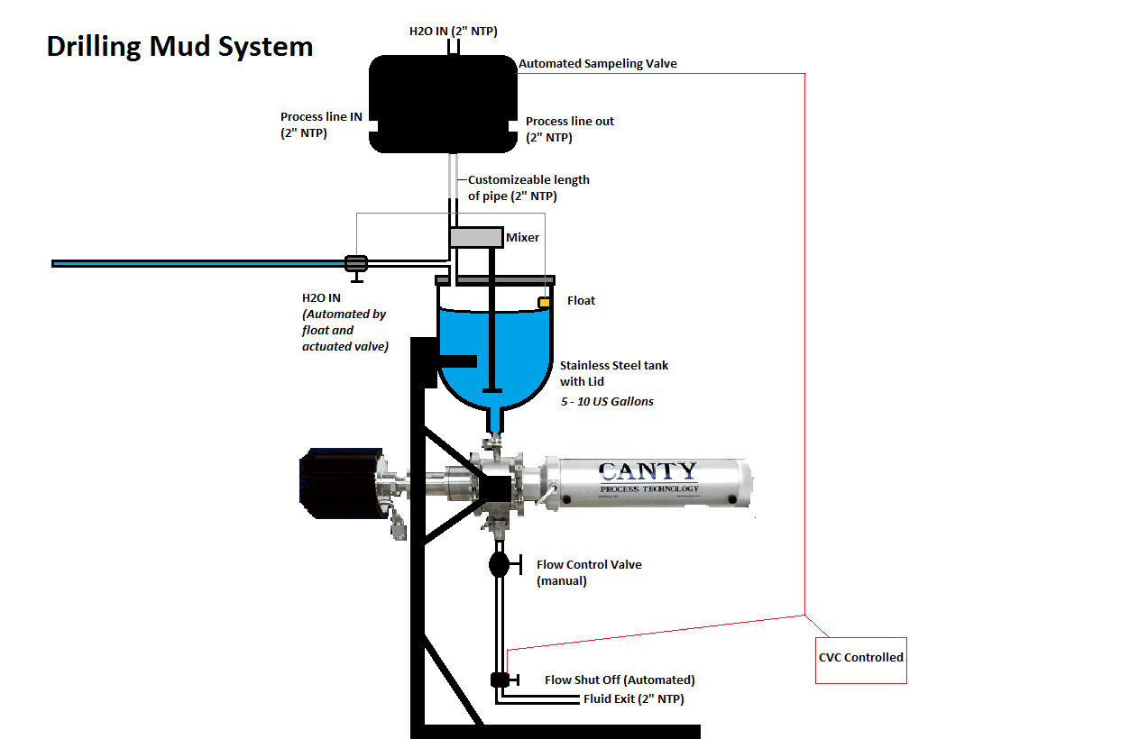
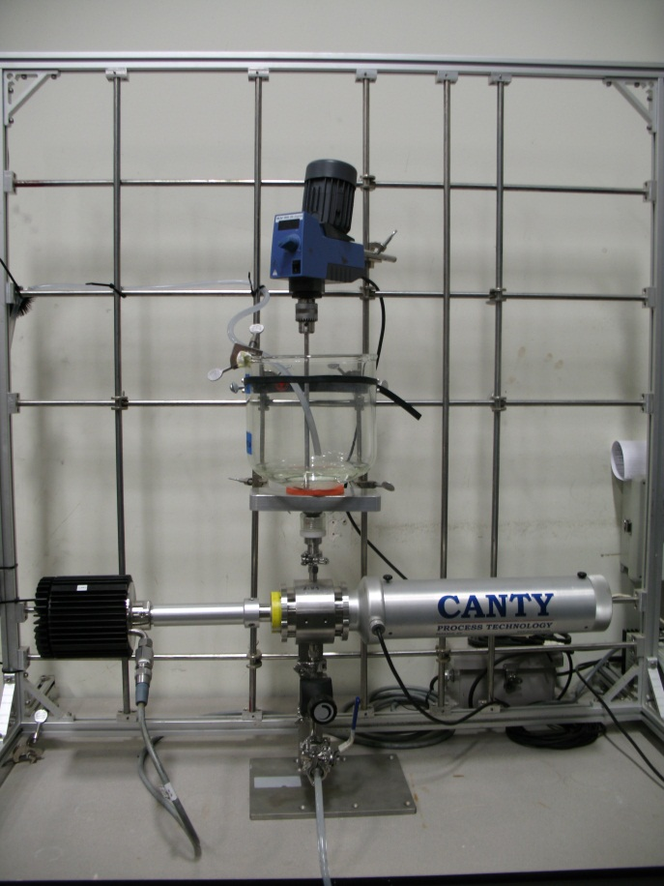
Canty Laboratory Drilling Fluid System

Slide 16
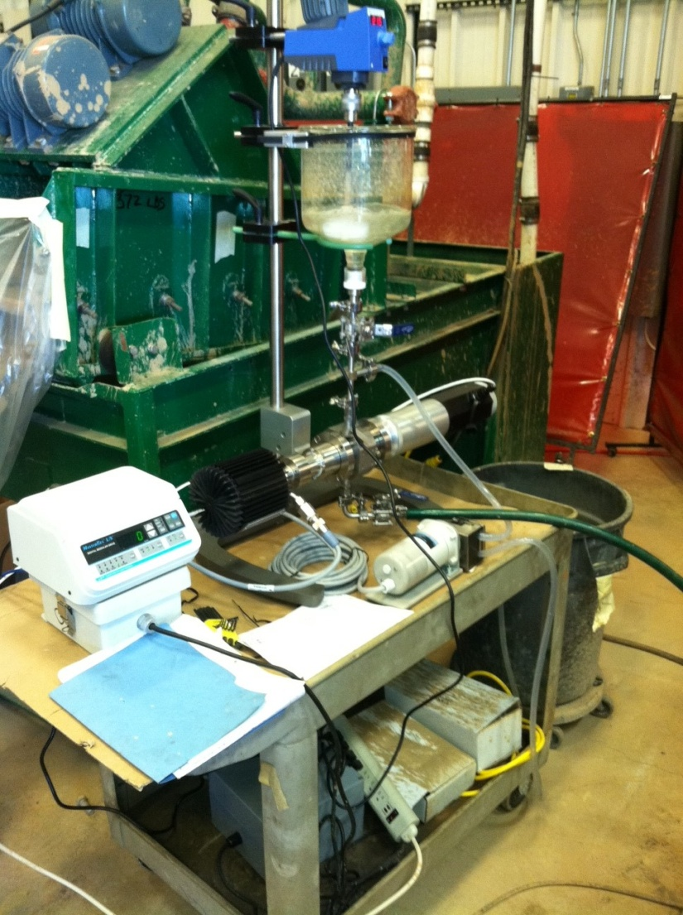
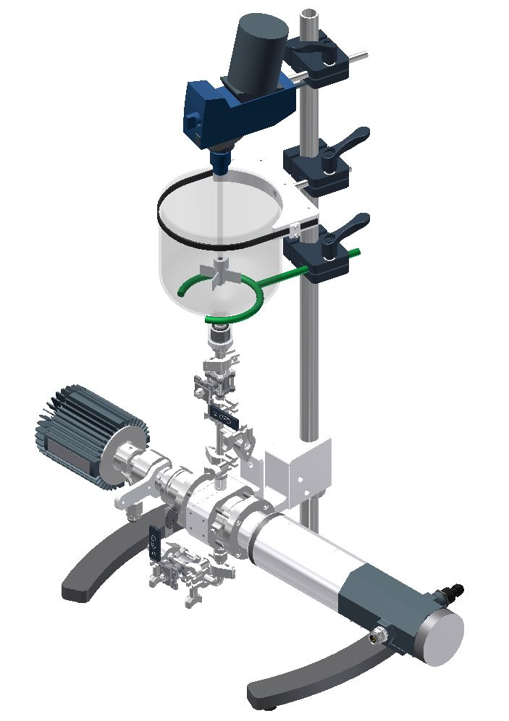
Lab = Online

Slide 17
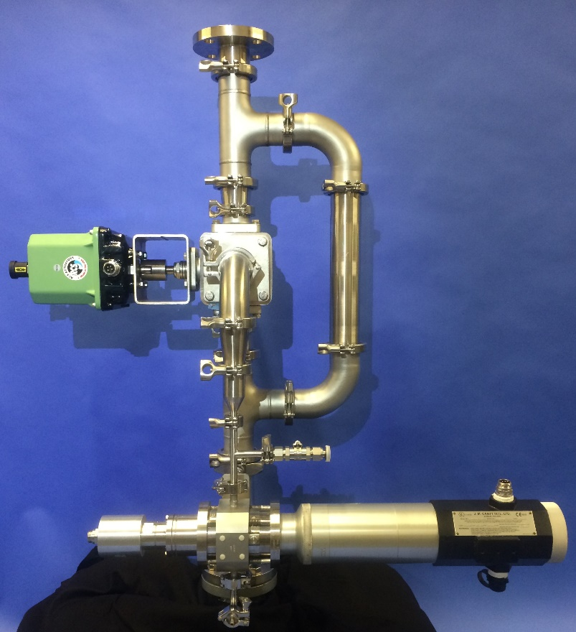
CANTY In-Line Drilling Fluid System
The Canty In-Line Drilling Fluid System allows for the analysis of drilling fluids by a direct in-line process connection.

Slide 18
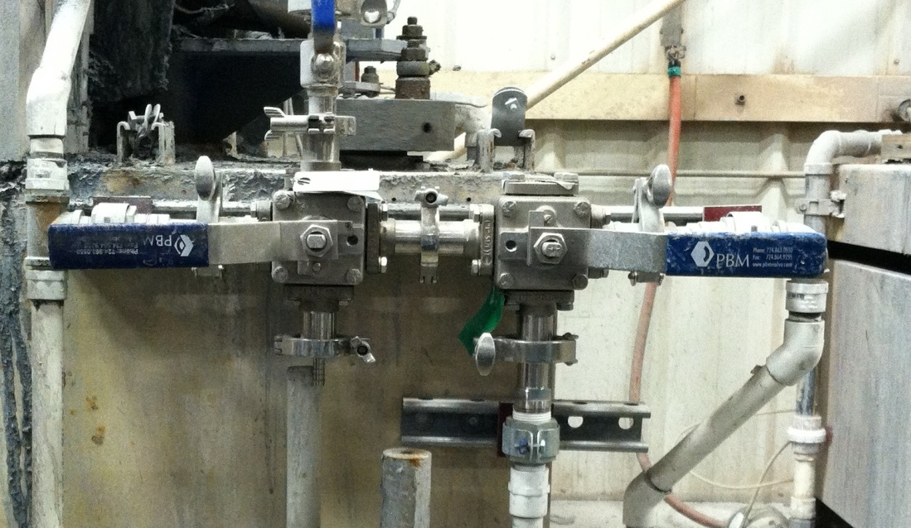
CANTY Cross-Cut Sampling Valve
  CANTY’s cross-cut sampling valve system allows for quick consistent and repeatable sampling of a drilling fluid process line.
  The valve system directly samples a cut of fluid from the center of a process line.
  That full “cut” is then diluted in water and directly run through the analysis equipment.
  This method allows for direct testing of a representative “cut” of drilling fluid.
Analyzer Connection
(sample outlet)

Slide 19
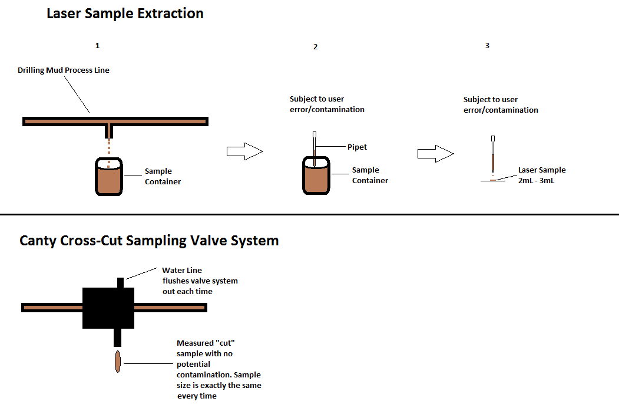
Sample Extraction Comparison

Slide 20
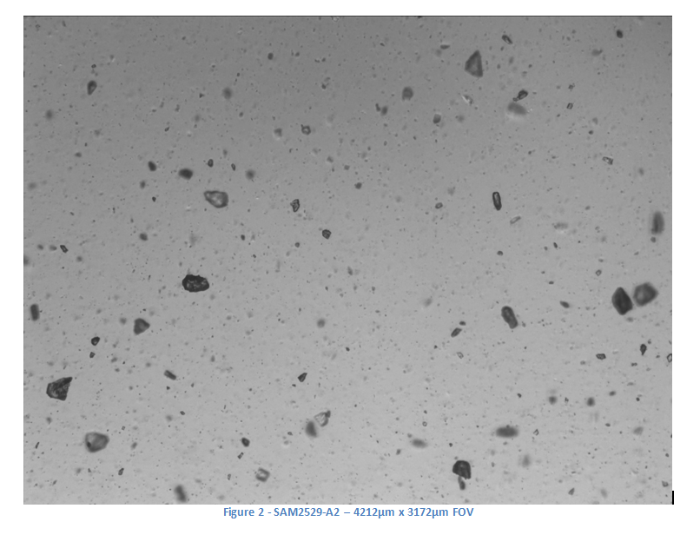
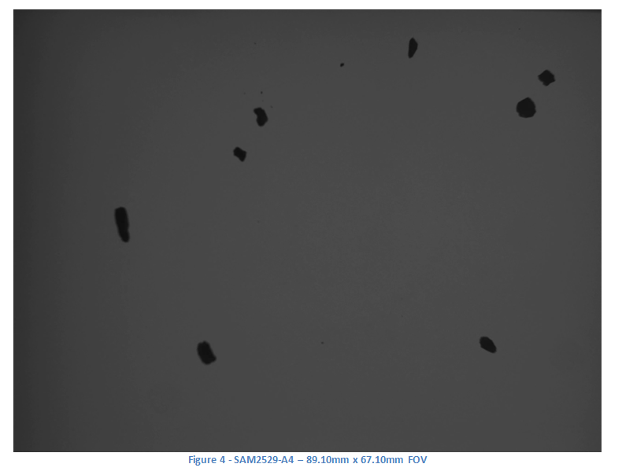
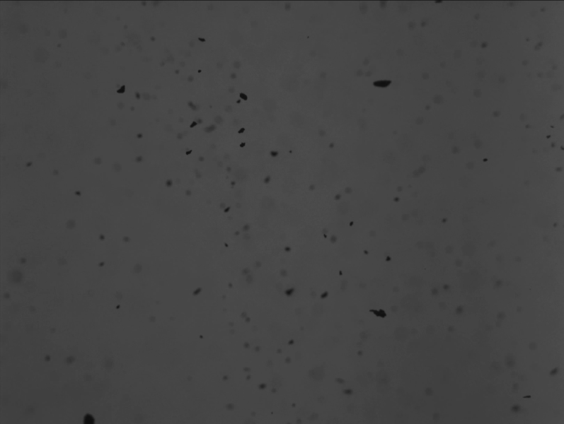

Slide 21
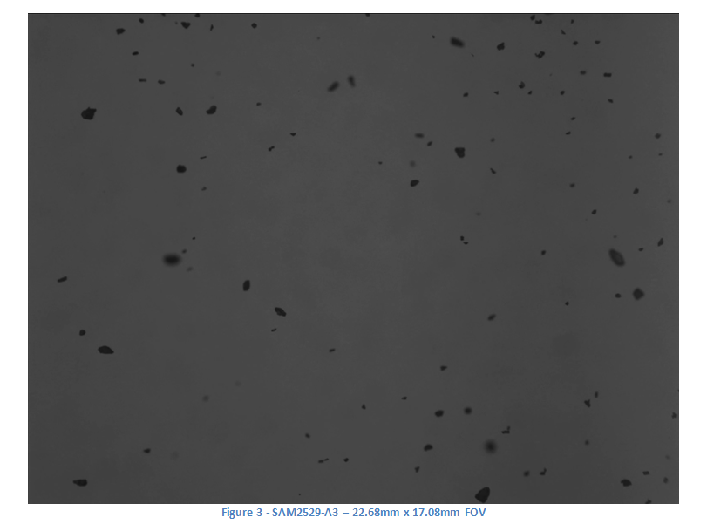
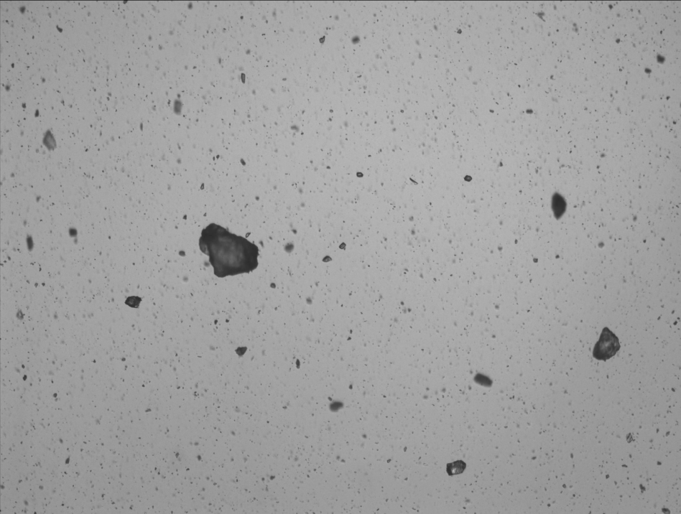

Slide 22
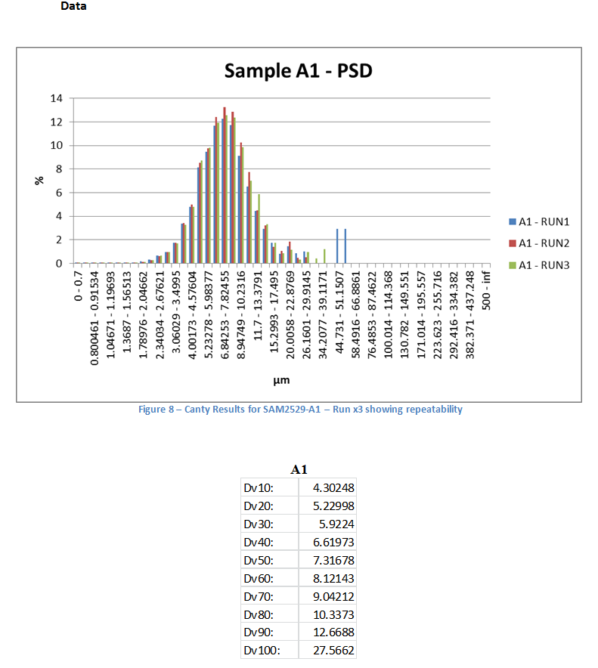
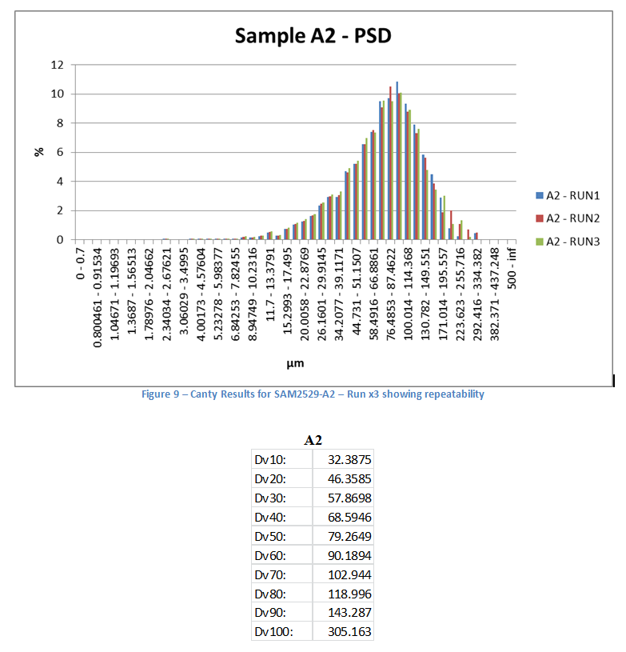

Slide 23
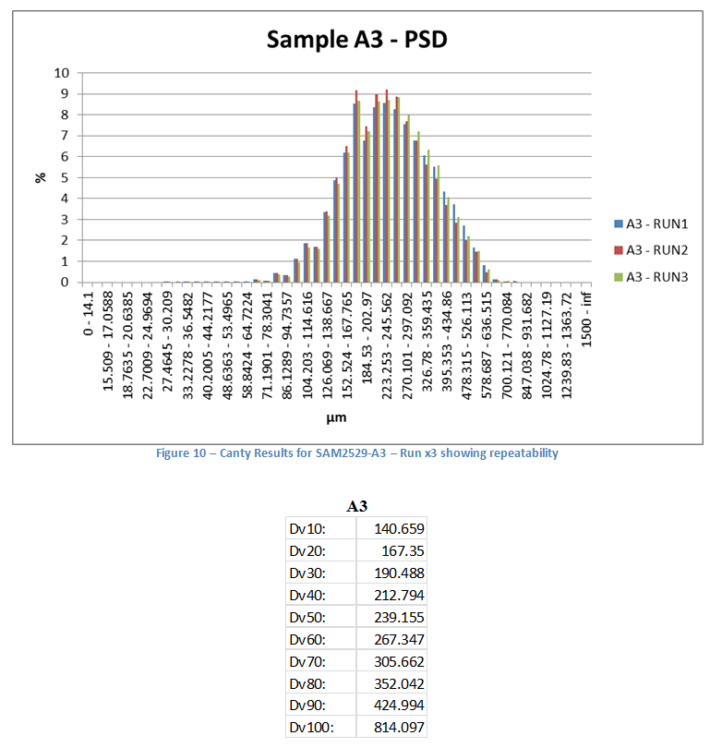
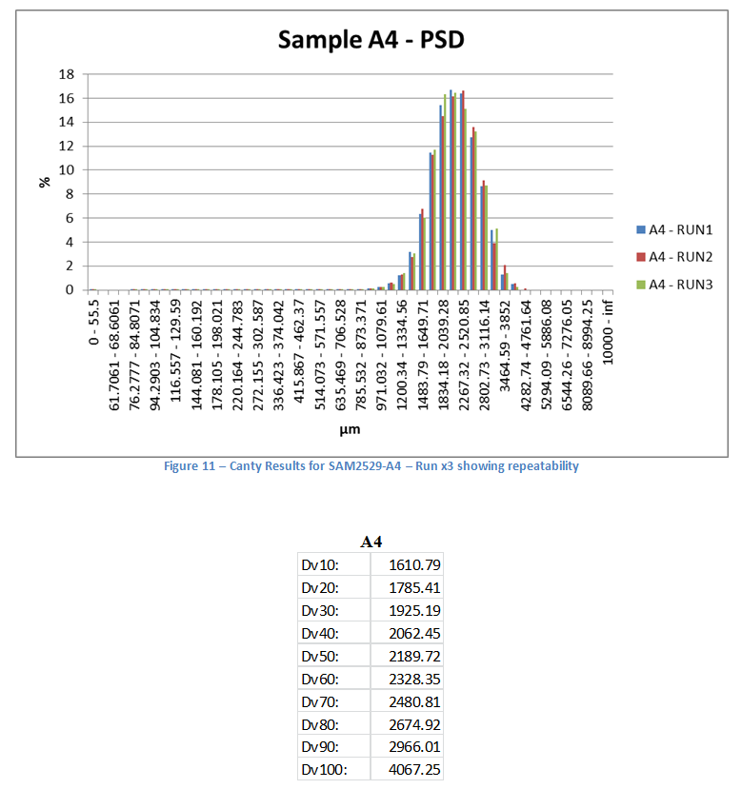

Slide 24
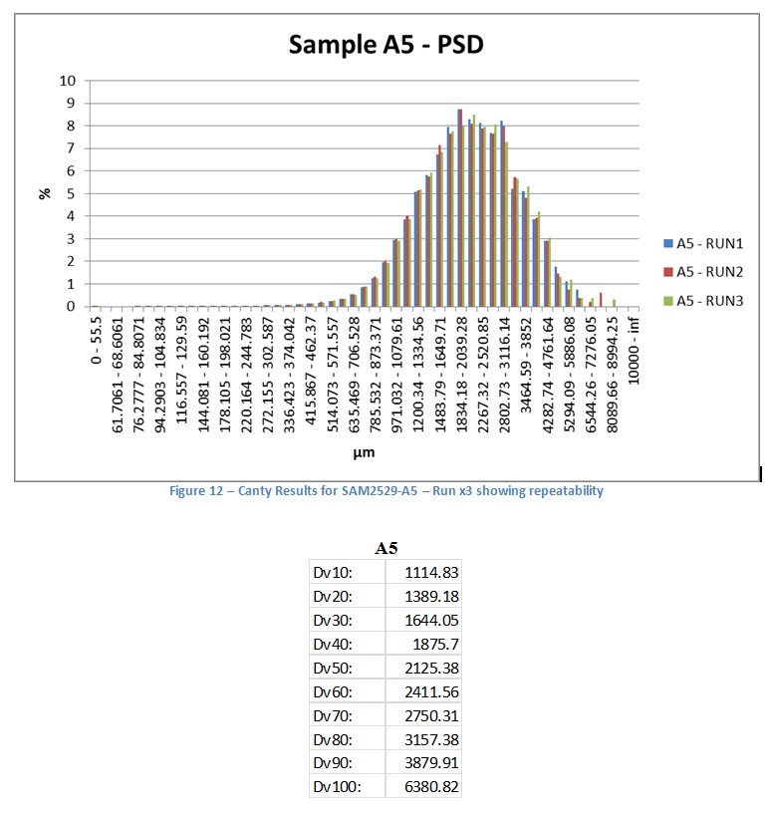
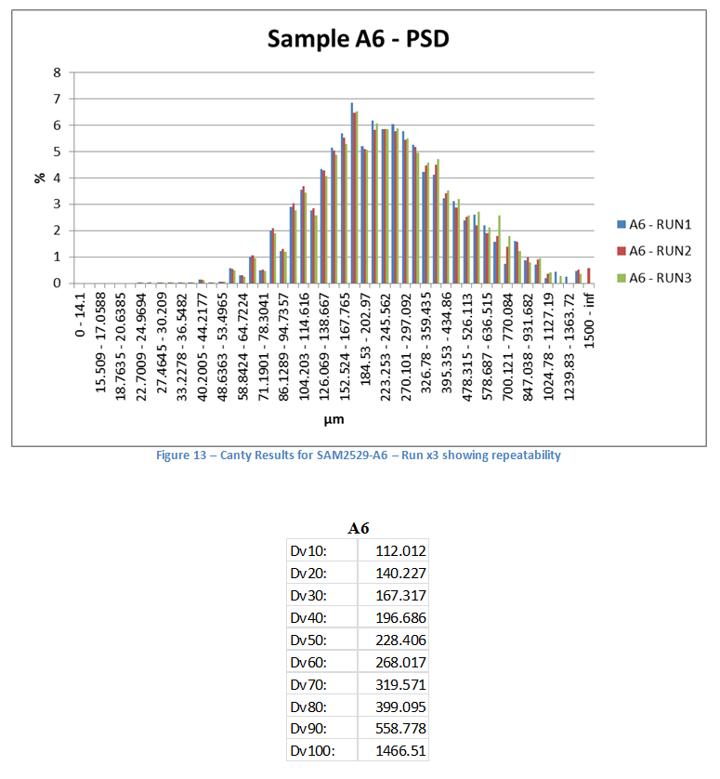

Slide 25
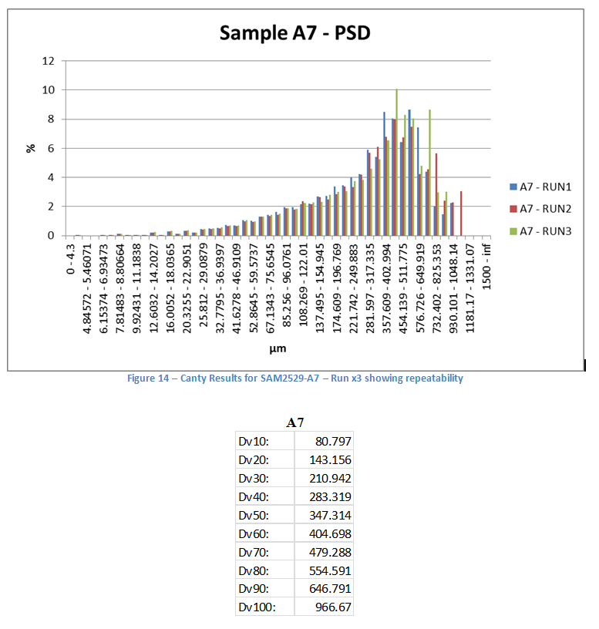

Slide 26
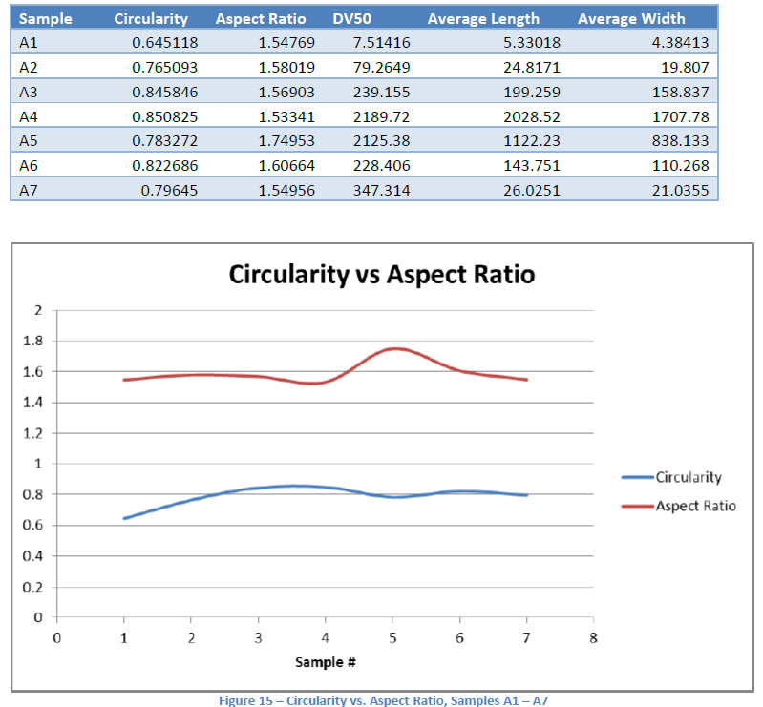
LCM Data

Slide 27
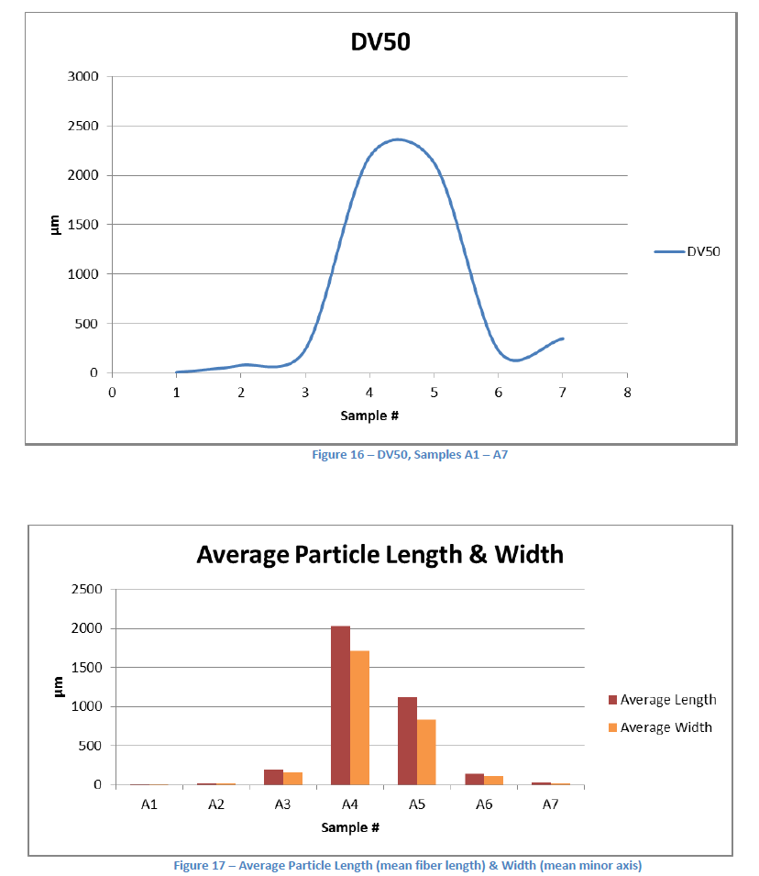

LCM Data

Slide 28
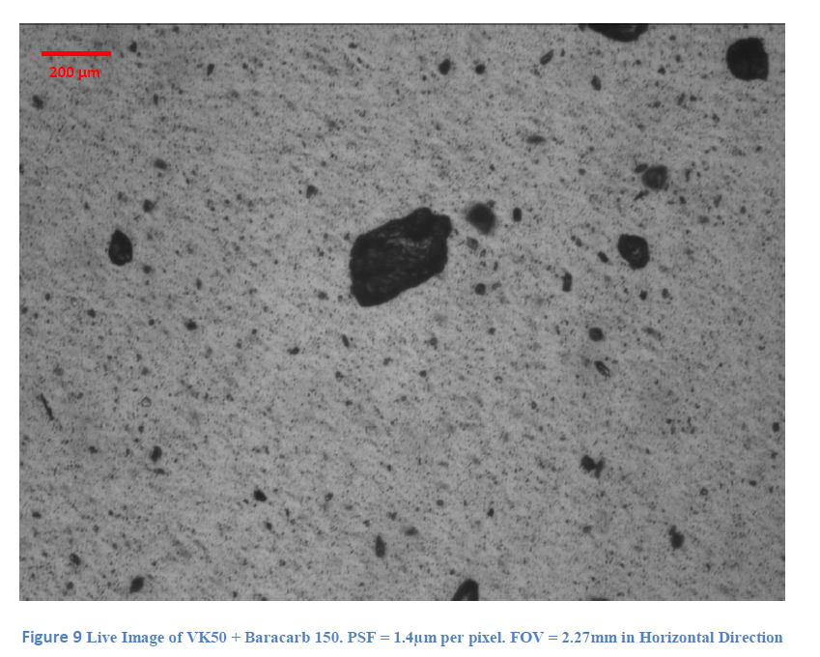

Slide 29
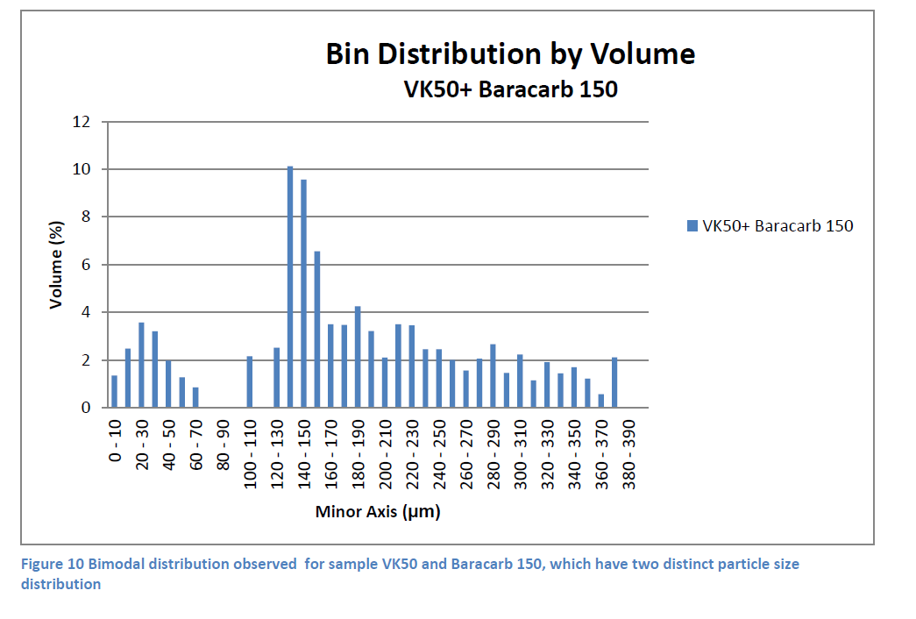

Slide 30
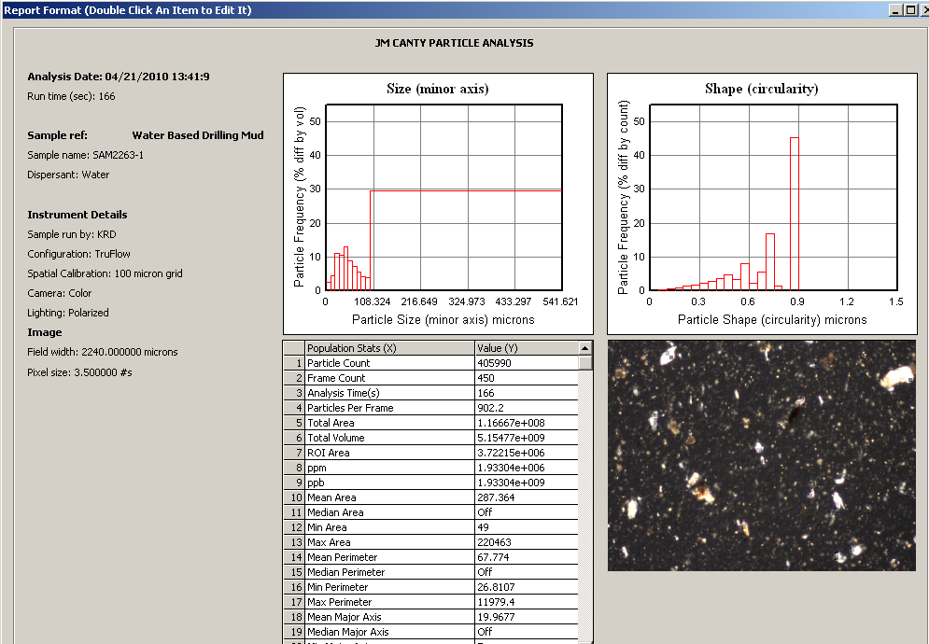
Drilling Mud Testing
Drilling mud spiked with Barite + Mica + Gseal + LCF + Carb + Poly
(Cross-polarized lighting used to optimize difference in particles types)

Slide 31
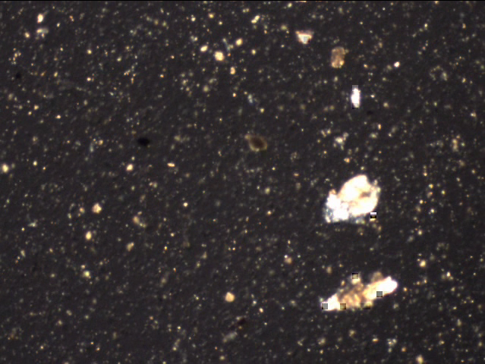
Drilling Mud Testing
640 x 480 color image oil based drilling mud
(Cross-polarized lighting used to optimize difference in particles types)

Slide 32

Drilling Mud Testing
Water based mud
Water based mud spiked with – carb
Notice increase in “white” particles

Slide 33
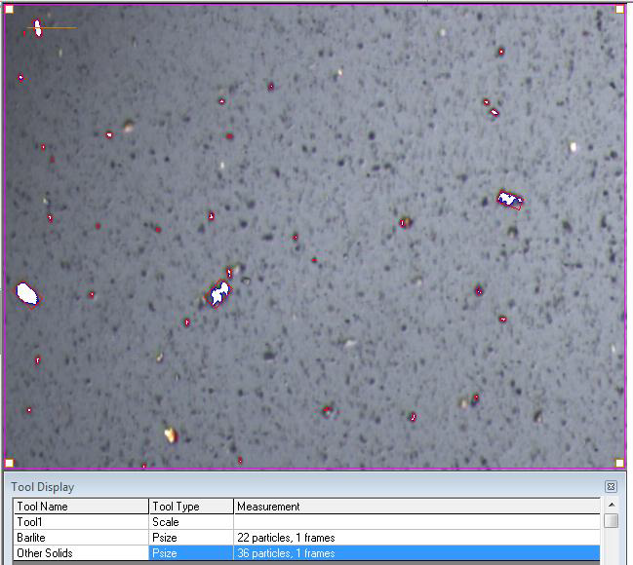
CANTY Software Analysis
Canty Vision Software Package Individually analyzes particles
(water based drilling mud / polarized lighting)

Slide 34
Conclusion
CANTY’s Drilling Fluid Particle Analyzer is a system capable of high precision drilling fluid analysis. Our analyzers offers many unique advantages over laser diffraction technology.
With the ability for high resolution color analysis the Canty Drilling Mud System can be a unique tool for drilling fluid engineers to aide in the microscopic examination of drill cuttings.
Questions?

