Slide 1

INFLOWTM
OIL in WATER / WATER in OIL
PPM & TSS
OIL / WATER / SOLIDS / GAS
JM Canty, Inc. · Buffalo, New York · Phone: (716) 625-4227 | JM Canty, Ltd. · Dublin, Ireland · Phone: +353 (1) 882-9621

Slide 2
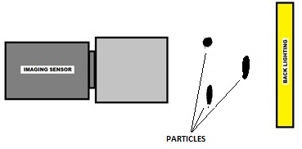
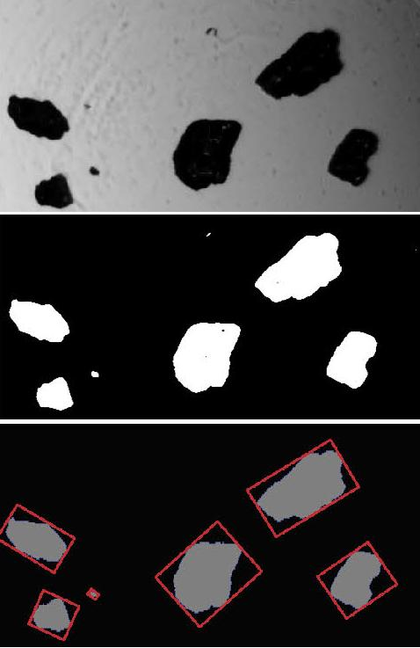
Dynamic Imaging Basic Principle
CANTY’s Dynamic Imaging based technique works on the basic principle of presenting the fluid (hydrocarbon or water stream) between a high intensity light source, and microscopic camera
The captured images are analysed in real time by CantyVision, which differentiates between Water Droplets in Oil, Oil Droplets in Water, Solid Particles and Gas Bubbles, and simultaneously provides concentration and size data for each
JM Canty, Inc. · Buffalo, New York · Phone: (716) 625-4227 | JM Canty, Ltd. · Dublin, Ireland · Phone: +353 (1) 882-9621

Slide 3
Gigabit Camera with Microscopic Lens
LED Light Source
Flow Cell
Sample In
JM Canty, Inc. · Buffalo, New York · Phone: (716) 625-4227 | JM Canty, Ltd. · Dublin, Ireland · Phone: +353 (1) 882-9621

Slide 4
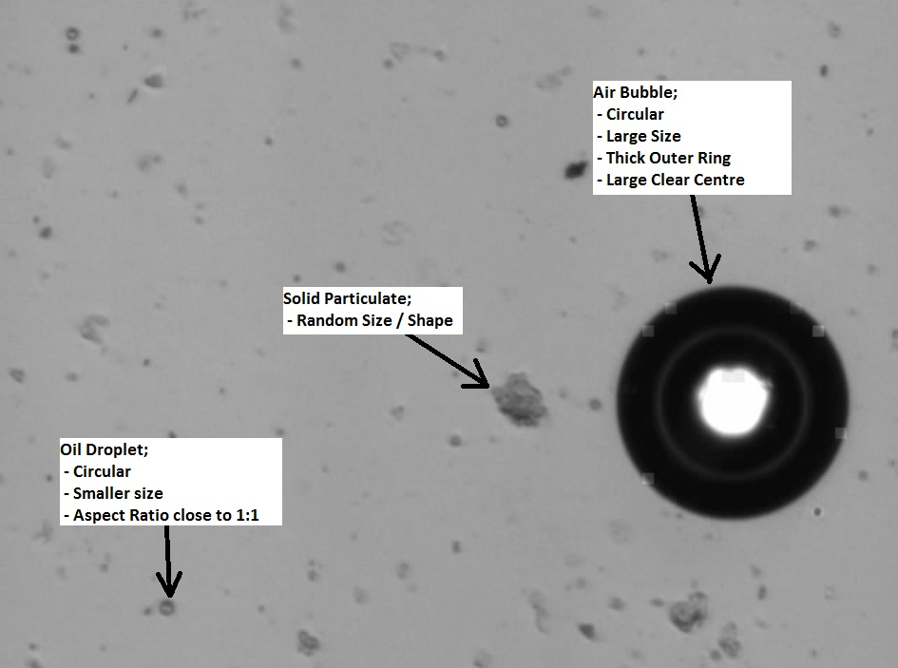
JM Canty, Inc. · Buffalo, New York · Phone: (716) 625-4227 | JM Canty, Ltd. · Dublin, Ireland · Phone: +353 (1) 882-9621

Slide 5
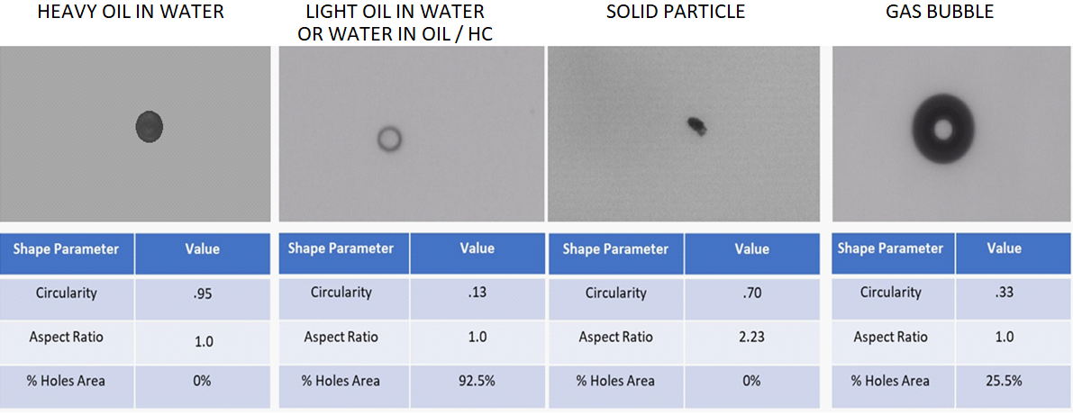
JM Canty, Inc. · Buffalo, New York · Phone: (716) 625-4227 | JM Canty, Ltd. · Dublin, Ireland · Phone: +353 (1) 882-9621

Slide 6
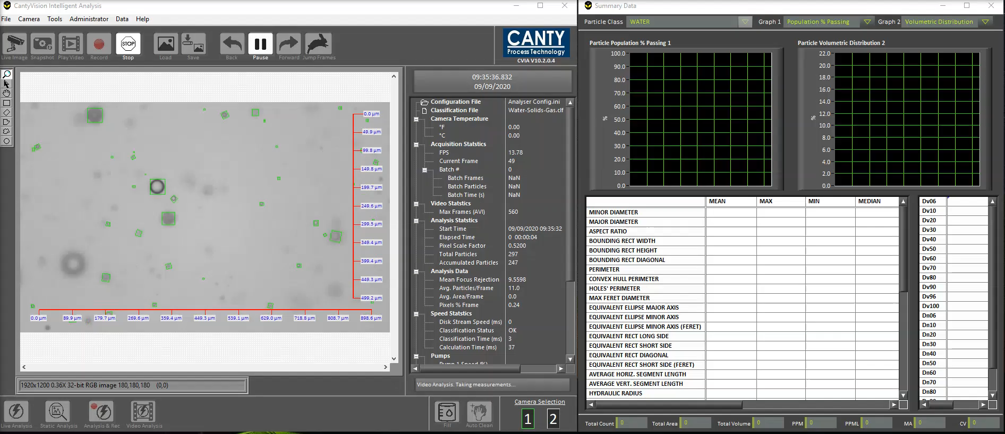
Image Analysis – CantyVision Software – Oil Droplet Sizing
JM Canty, Inc. · Buffalo, New York · Phone: (716) 625-4227 | JM Canty, Ltd. · Dublin, Ireland · Phone: +353 (1) 882-9621

Slide 7
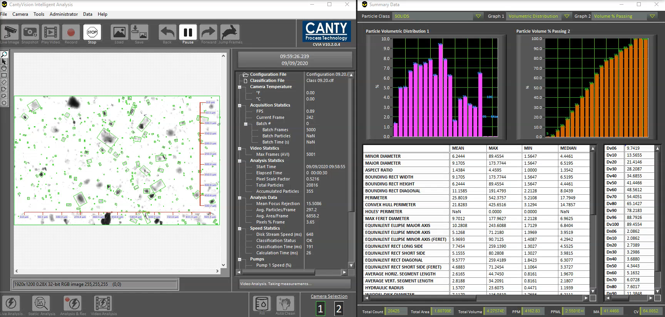
Image Analysis – CantyVision Software – Solids PSD
JM Canty, Inc. · Buffalo, New York · Phone: (716) 625-4227 | JM Canty, Ltd. · Dublin, Ireland · Phone: +353 (1) 882-9621

Slide 8
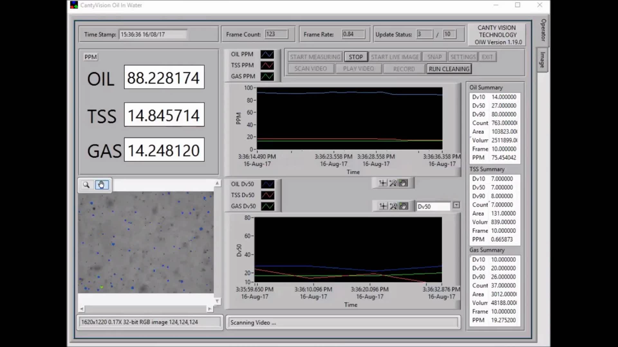
Image Analysis – CantyVision Software – Concentration / Size
JM Canty, Inc. · Buffalo, New York · Phone: (716) 625-4227 | JM Canty, Ltd. · Dublin, Ireland · Phone: +353 (1) 882-9621

