Slide 1

Monitoring
Oil & TSS in Water
&
BS & W in Oil
Through Dynamic Imaging Technology
JM Canty International
JM Canty, Inc. · Buffalo, New York · Phone: (716) 625-4227 | JM Canty, Ltd. · Dublin, Ireland · Phone: +353 (1) 882-9621

Slide 2
Oil & Sand in Produced Water - Background
Produced Water Analysis
Oil in Water
Environmental
TSS in Water
Process Control & Optimisation
Process Control & Optimisation
Separation Equipment / Chemical Performance Analysis
30ppm Dispersed Oil in Water
Separation Equipment Performance Analysis
WFI – TSS Size & Concentration Analysis to Avoid Well Plugging
Well Formation Studies – Core Sample Testing
JM Canty, Inc. · Buffalo, New York · Phone: (716) 625-4227 | JM Canty, Ltd. · Dublin, Ireland · Phone: +353 (1) 882-9621

Slide 3
Crude Oil Analysis - Background
- Water in Oil (PPM Concentration, Droplet Size)
Process Control & Optimisation
- Separator Performance Analysis
- Pipe Line Transfer Issues / Adherence to Refinery Standards
- Solids in Oil (PPM Concentration, Particle Size)
Pipe Line Transfer Issues / Adherence to Refinery Standards
JM Canty, Inc. · Buffalo, New York · Phone: (716) 625-4227 | JM Canty, Ltd. · Dublin, Ireland · Phone: +353 (1) 882-9621

Slide 4
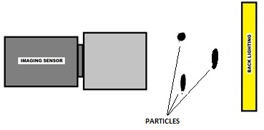
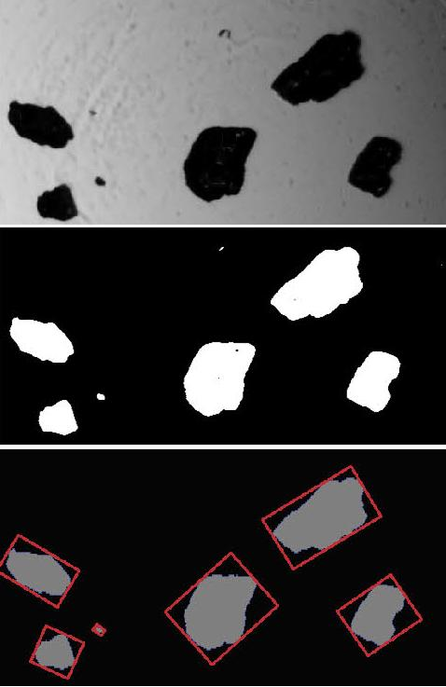
Vision Based Particle Analysis Basic Principle
JM Canty’s vision based technique works on the basic principle of presenting the fluid between a high intensity light source, and microscopic camera
The captured images are then sent to CantyVision Client Software for analysis, where the suspended particulate (oil or water, solids, gas bubbles etc.) is measured under a number of different parameters to provide size, shape and concentration data
JM Canty, Inc. · Buffalo, New York · Phone: (716) 625-4227 | JM Canty, Ltd. · Dublin, Ireland · Phone: +353 (1) 882-9621

Slide 5

Image Retrieval – Hardware – CCD Camera
Gigabit Ethernet technology for optimum image retrieval
1900 x 1200 Pixel Array configurable to 0.23µm per Pixel Resolution
Particle / Droplet Size to 0.7µm
Simple RJ45 Network Connection to Control PC
Sand in Water
JM Canty, Inc. · Buffalo, New York · Phone: (716) 625-4227 | JM Canty, Ltd. · Dublin, Ireland · Phone: +353 (1) 882-9621

Slide 6
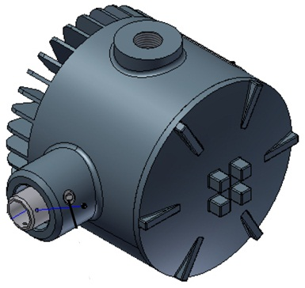
Image Retrieval – Hardware– Lighting System
High flow rates inline require an increased shutter speed and so an increased amount of light to capture particulate in “freeze frame” in order to perform software analysis
High Intensity LED Light Source
5+ Years Continuous Operation
Flow velocity up to 5m/s
JM Canty, Inc. · Buffalo, New York · Phone: (716) 625-4227 | JM Canty, Ltd. · Dublin, Ireland · Phone: +353 (1) 882-9621

Slide 7
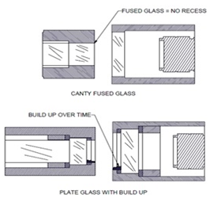
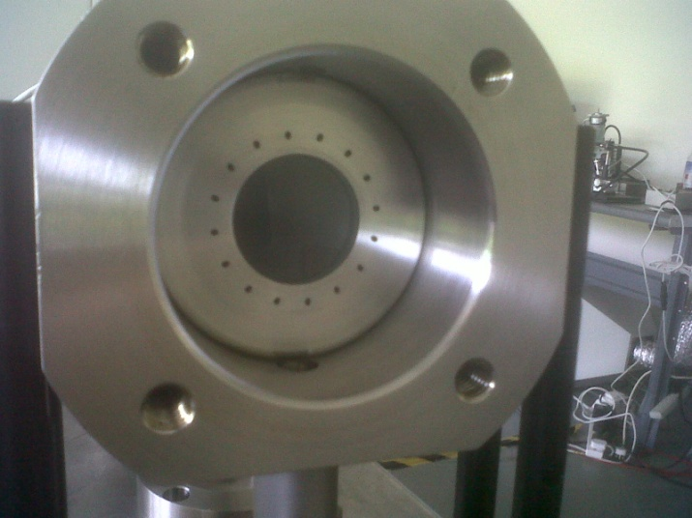
Image Retrieval – Hardware – Fused Glass Flow Path
Fused one piece construction with no recesses or steps where product can adhere to and build up
Pressures to 600 BAR
Integral Jet Spray Ring
Adjustable Gap Size dependent on sample present
JM Canty, Inc. · Buffalo, New York · Phone: (716) 625-4227 | JM Canty, Ltd. · Dublin, Ireland · Phone: +353 (1) 882-9621

Slide 8
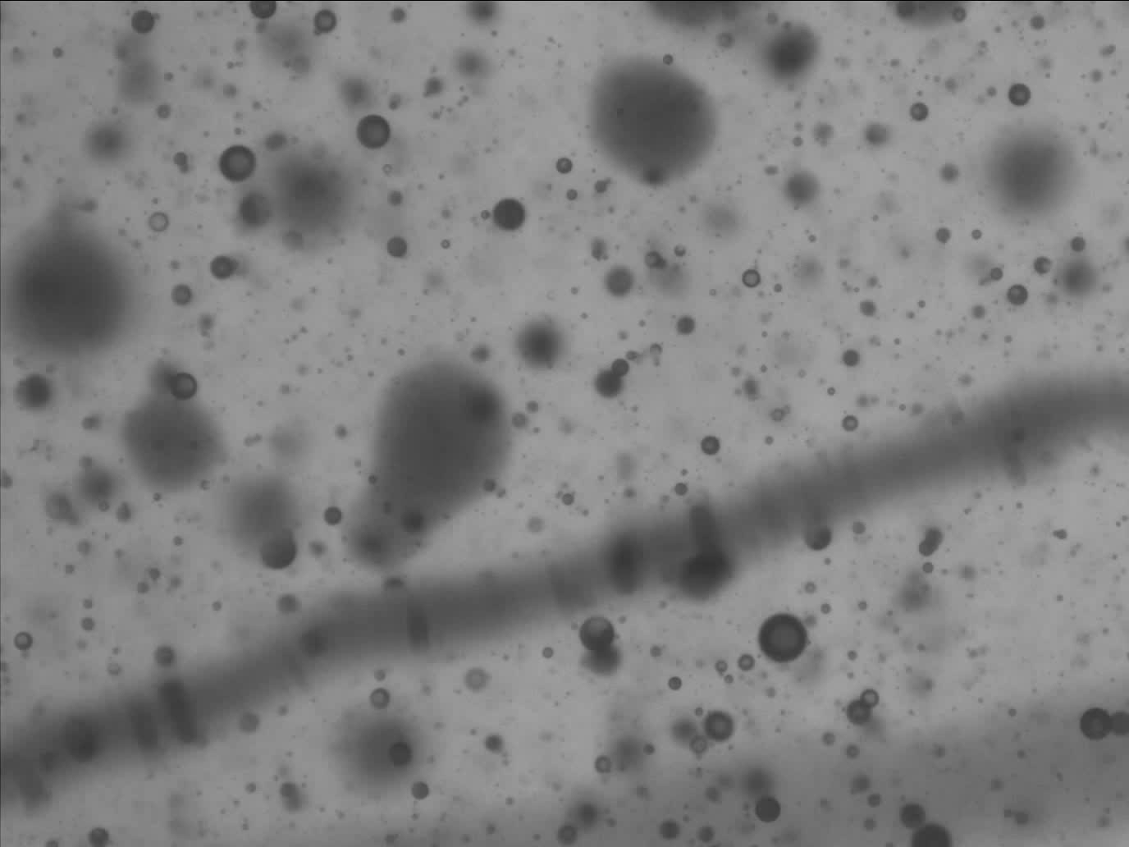
JM Canty, Inc. · Buffalo, New York · Phone: (716) 625-4227 | JM Canty, Ltd. · Dublin, Ireland · Phone: +353 (1) 882-9621

Slide 9
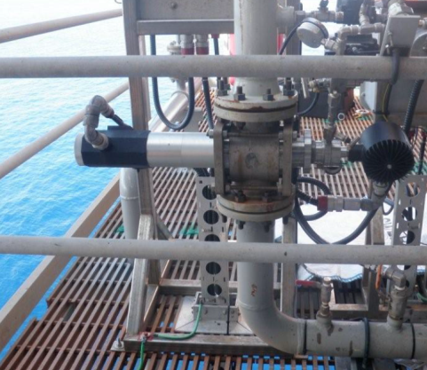
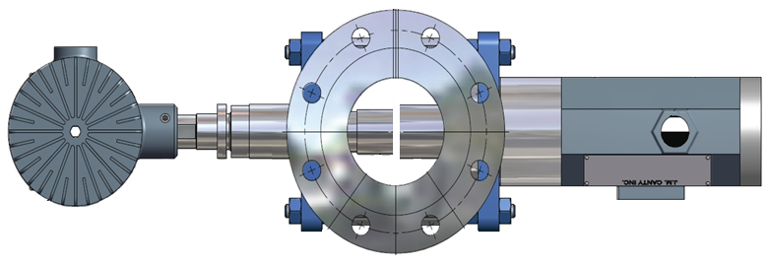
InFlow – Inline Permanent Installations
Inline InFlow mounts as permanent spool piece in main process pipeline
Can also be mounted on fast loop bypass line for larger process lines
JM Canty, Inc. · Buffalo, New York · Phone: (716) 625-4227 | JM Canty, Ltd. · Dublin, Ireland · Phone: +353 (1) 882-9621

Slide 10
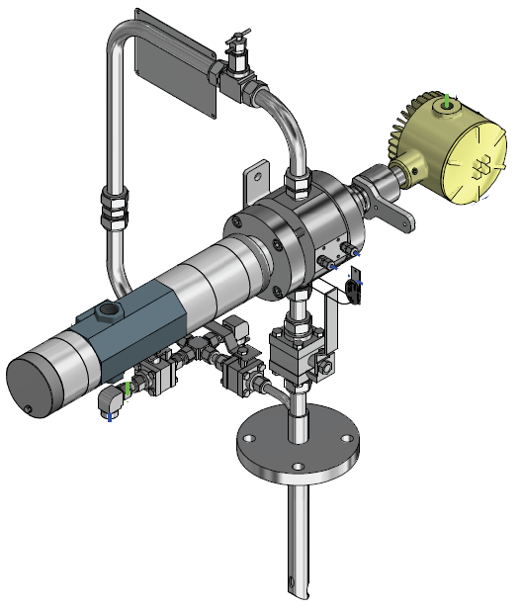
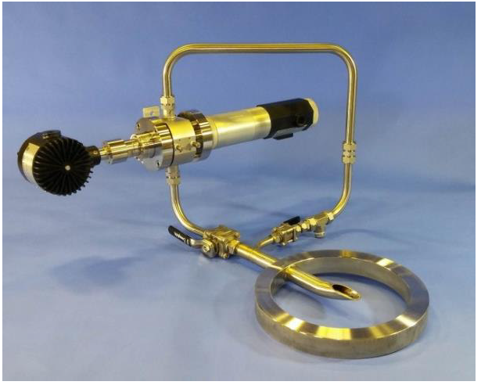
InFlow – At-Line Permanent Installation
InFlow mounts in compact flow loop – wafer or flange mount to pipeline
Single fluid take off & return point on pipeline
JM Canty, Inc. · Buffalo, New York · Phone: (716) 625-4227 | JM Canty, Ltd. · Dublin, Ireland · Phone: +353 (1) 882-9621

Slide 11
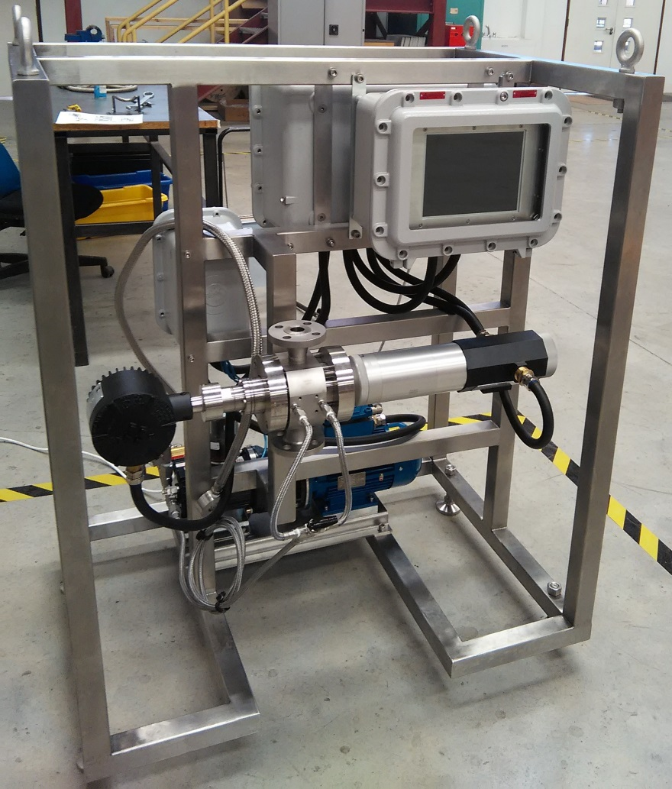
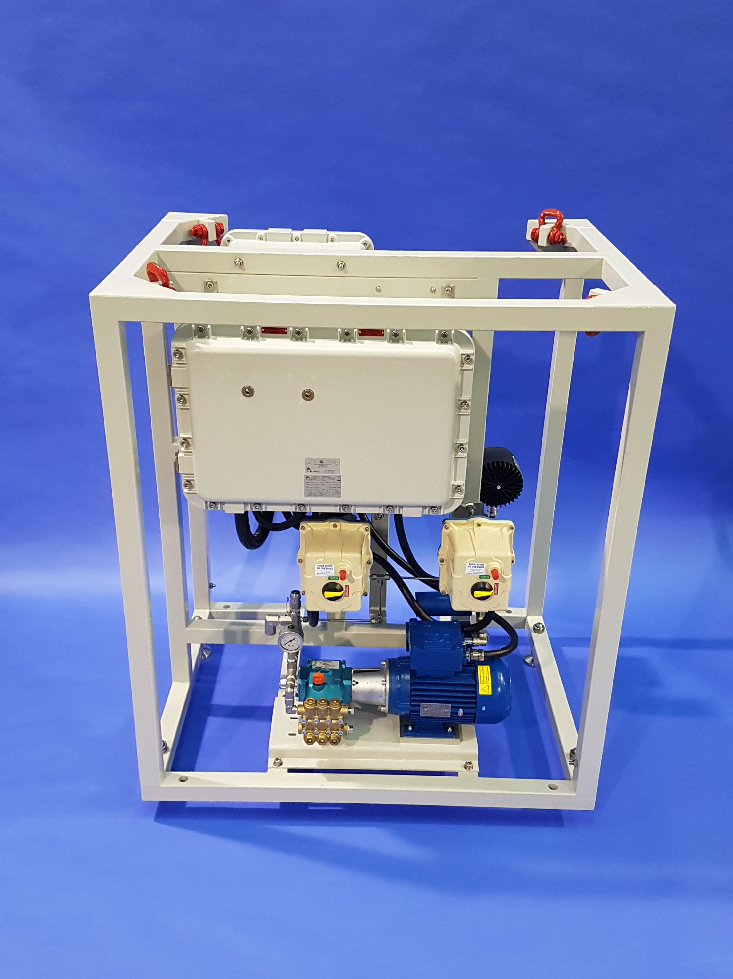
Inline / At-Line InFlow with Local Image Processing
JM Canty, Inc. · Buffalo, New York · Phone: (716) 625-4227 | JM Canty, Ltd. · Dublin, Ireland · Phone: +353 (1) 882-9621

Slide 12
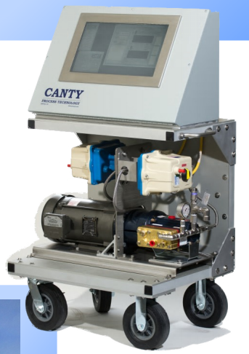
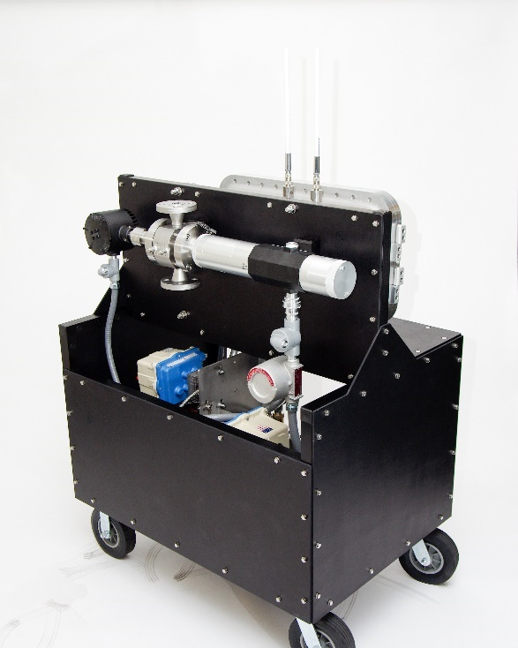
Mobile InFlow Cart with Local Image Processing
JM Canty, Inc. · Buffalo, New York · Phone: (716) 625-4227 | JM Canty, Ltd. · Dublin, Ireland · Phone: +353 (1) 882-9621

Slide 13
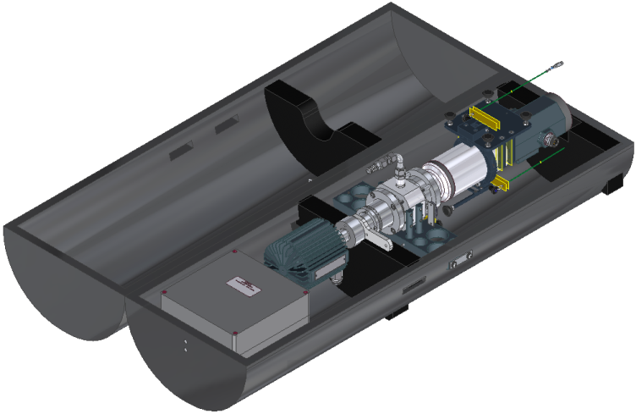
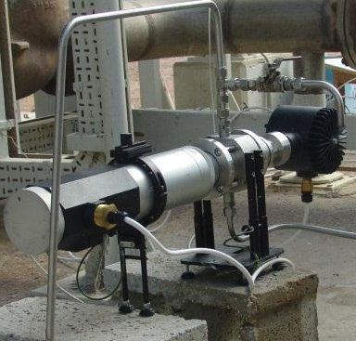
WP Portable InFlow – Temporary Test / Troubleshooting
½” Swagelok Connection (typical pipeline sample points)
Outlet flow to open drain or lower pressure return point (ensure flow through analyser)
Analysis software on local laptop
JM Canty, Inc. · Buffalo, New York · Phone: (716) 625-4227 | JM Canty, Ltd. · Dublin, Ireland · Phone: +353 (1) 882-9621

Slide 14
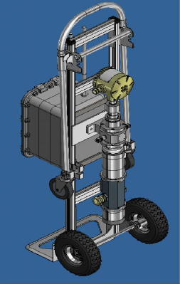
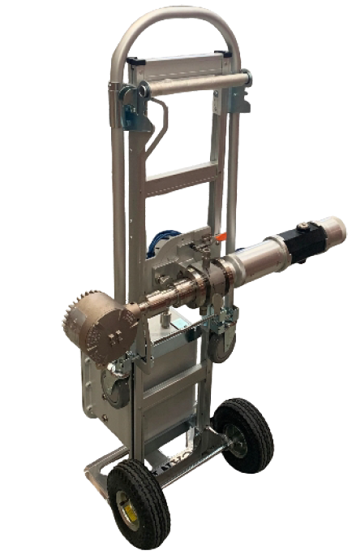
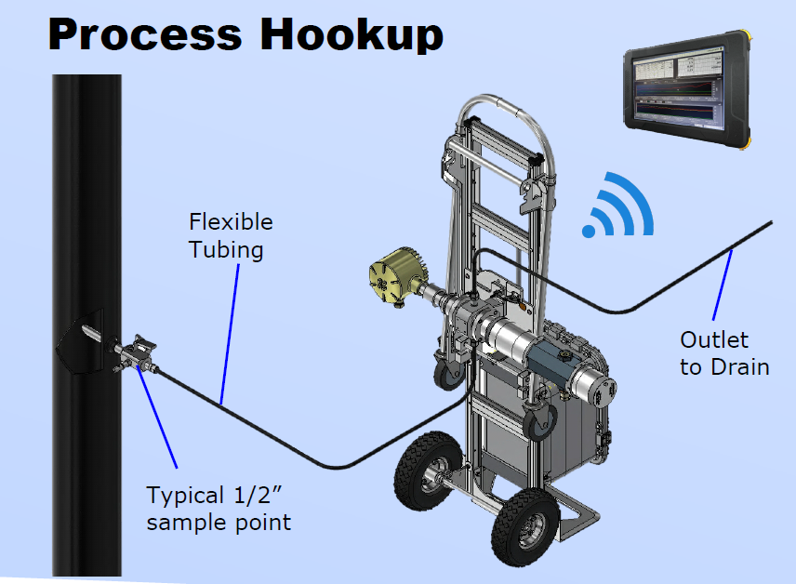
ATEX ZONE 1 Transportable InFlow
Dimensions: Width: 520mm, Depth: 570mm, Height: 1580mm (Inflow in vertical position during transportation).
Width during operation: 1000mm (Inflow in horizontal position)
JM Canty, Inc. · Buffalo, New York · Phone: (716) 625-4227 | JM Canty, Ltd. · Dublin, Ireland · Phone: +353 (1) 882-9621

Slide 15
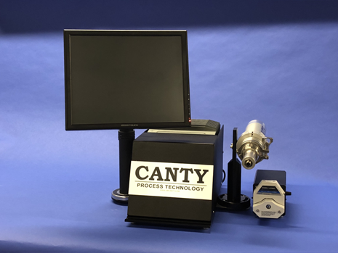
Lab Mini Cell Core Unit
Lab system for TSS particle size and count.
JM Canty, Inc. · Buffalo, New York · Phone: (716) 625-4227 | JM Canty, Ltd. · Dublin, Ireland · Phone: +353 (1) 882-9621

Slide 16
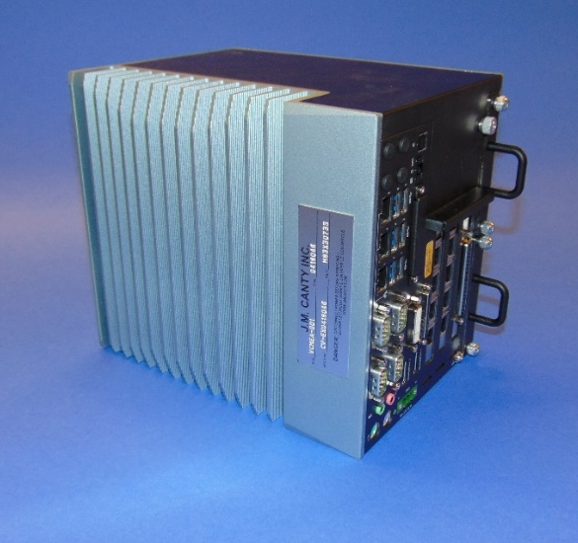
Image Analysis – Hardware – Vector Control Module
CantyVision Intelligent Analysis Software Pre-Installed and configured
Rackmount VCM can support two particle analysis systems
Multiple outputs
-4-20mA
-OPC (OPC UA now available)
-TCP/IP Modbus
-Video Display
Remote Support Functionality
JM Canty, Inc. · Buffalo, New York · Phone: (716) 625-4227 | JM Canty, Ltd. · Dublin, Ireland · Phone: +353 (1) 882-9621

Slide 17
Image Analysis – CantyVision Intelligent Analysis Software (CVIA)
The retrieved images are analysed by the Vector Control Modle (VCM) running the CantyVision Intelligent Analysis Software
Each particle is analysed under a number of different parameters (major axis, minor axis, area, perimeter, circularity, aspect ratio….)
Software filters (size / shape) can be applied so only particles with the characteristics of oil, solids, or air bubbles are individually analysed
Developed new self teaching software algorithm for identifying oil droplets, solids and gas bubbles.
JM Canty, Inc. · Buffalo, New York · Phone: (716) 625-4227 | JM Canty, Ltd. · Dublin, Ireland · Phone: +353 (1) 882-9621

Slide 18
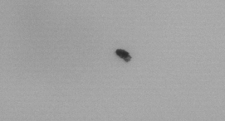
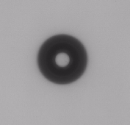
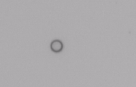

Differentiating between Solids, Liquids and Bubbles
Based on index of refraction; solid particles, water/oil droplets and gas bubbles can all be distinguished by Canty software based on the direct 2D images.
Delivering the TRUE particle size of the particles.
Solid Particle
Gas
Water/Light Oil Droplet
Heavy Oil Droplet
Shape Parameter | Value
Circularity | .70
Aspect Ratio | 2.23
% Holes Area | 0%
Shape Parameter | Value
Circularity | .33
Aspect Ratio | 1.0
% Holes Area | 25.5%
Shape Parameter | Value
Circularity | .13
Aspect Ratio | 1.0
% Holes Area | 92.5%
Shape Parameter | Value
Circularity | 1
Aspect Ratio | 1.0
% Holes Area | 0%
JM Canty, Inc. · Buffalo, New York · Phone: (716) 625-4227 | JM Canty, Ltd. · Dublin, Ireland · Phone: +353 (1) 882-9621

Slide 19
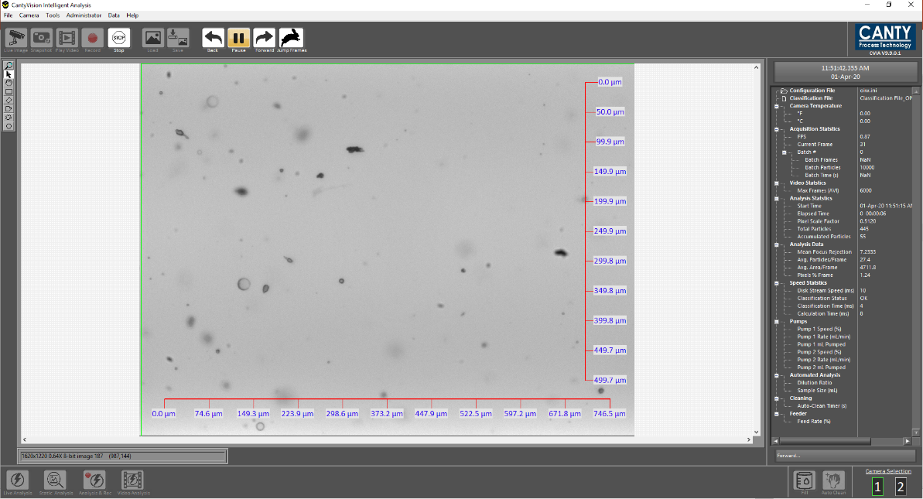
Canty Intelligent Analysis Software Interface
CantyVision Software is able to process images at high speed real time.
Software provides graphical trends in charts with statistical data for particles, droplets and gas.
Individual data charts and outputs.
- Particle size distribution,
- Particle shape
- Concentrations - counts per ml, ppm
Customized reporting feature for excel data output.
JM Canty, Inc. · Buffalo, New York · Phone: (716) 625-4227 | JM Canty, Ltd. · Dublin, Ireland · Phone: +353 (1) 882-9621

Slide 20
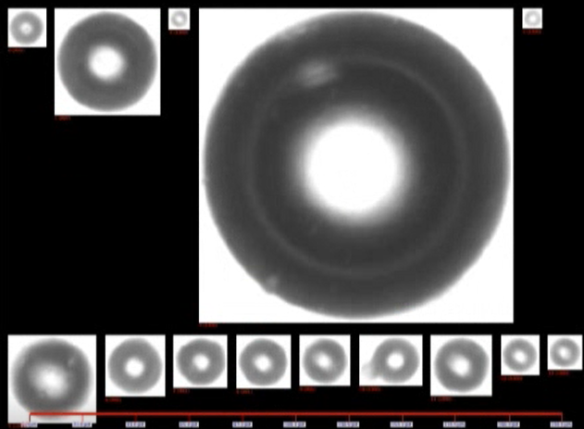
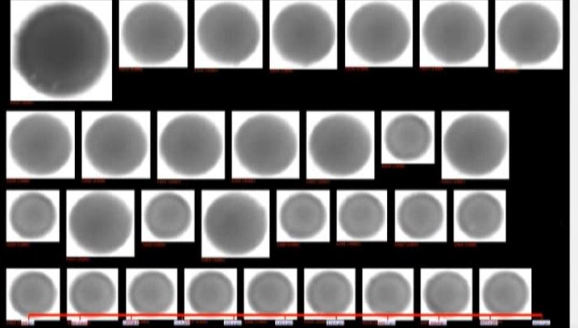
Image Analysis – CantyVision Intelligent Analysis Software
Droplets
Particles are automatically classified using machine learning classification feature to identify and distinguish between solids, droplets and bubbles based 37 different measurements parameters (shape, particle intensity, surface roughness …..).
System self classifies removing operator error
Gas Bubbles
Solids
JM Canty, Inc. · Buffalo, New York · Phone: (716) 625-4227 | JM Canty, Ltd. · Dublin, Ireland · Phone: +353 (1) 882-9621

Slide 21
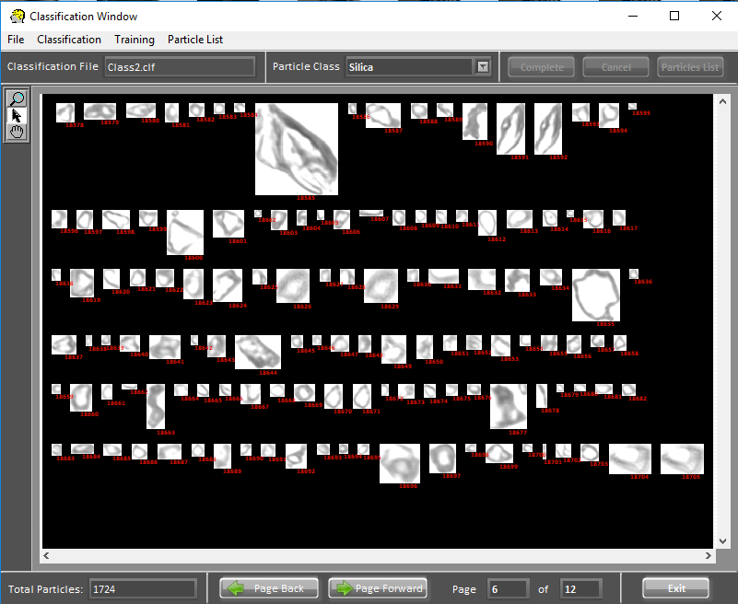
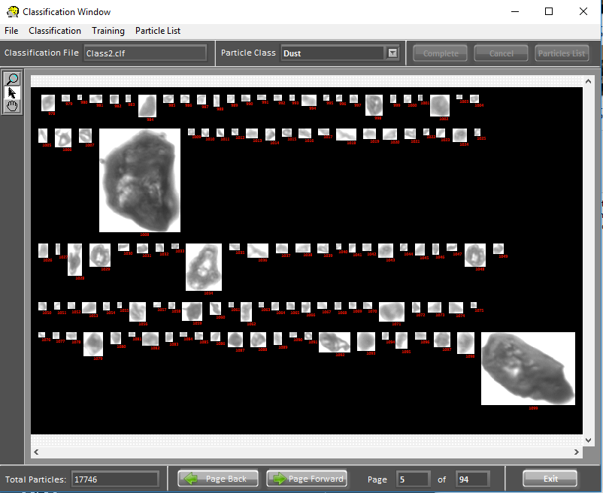
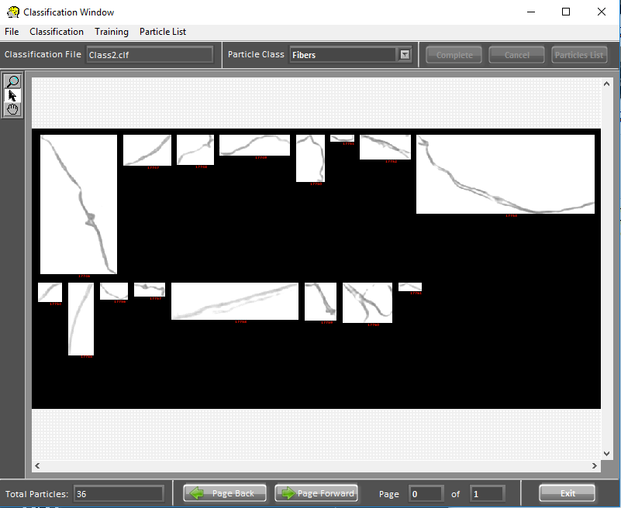
Image Analysis – CantyVision Intelligent Analysis Software
Software can be set up with multiple classification parameters to detect the difference between different types of particles.
Easy to use graphical interface allows user to click on particles within the class they want to measure and sort particles by their individual classes.
Machine learning algorithms build a database of particle shape characteristics.
JM Canty, Inc. · Buffalo, New York · Phone: (716) 625-4227 | JM Canty, Ltd. · Dublin, Ireland · Phone: +353 (1) 882-9621

Slide 22
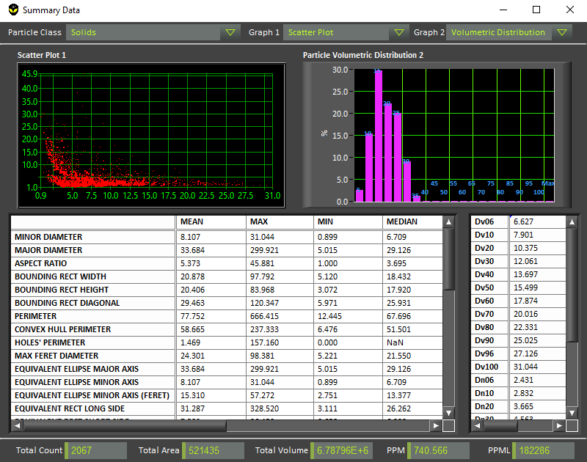
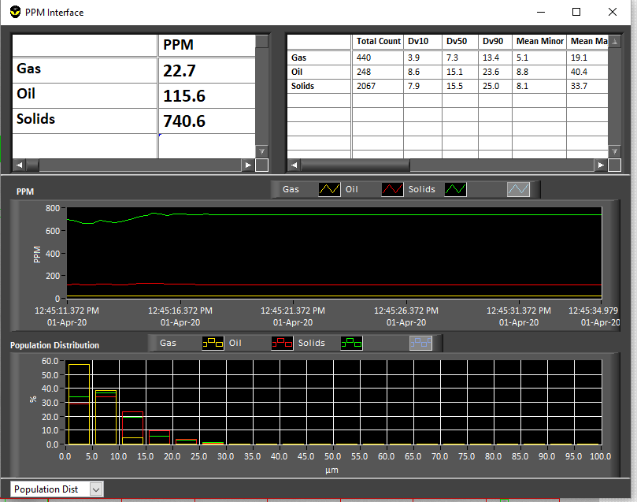
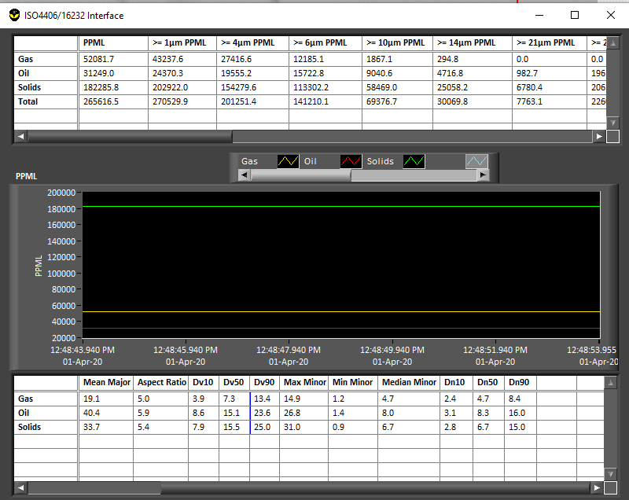
Image Analysis – CantyVision Intelligent Analysis Software
Multiple Charts depending on information required
Real time volumetric concentration measurements charts
Real time particle size distribution and shape information charts
Particle count per ml charts
JM Canty, Inc. · Buffalo, New York · Phone: (716) 625-4227 | JM Canty, Ltd. · Dublin, Ireland · Phone: +353 (1) 882-9621

Slide 23


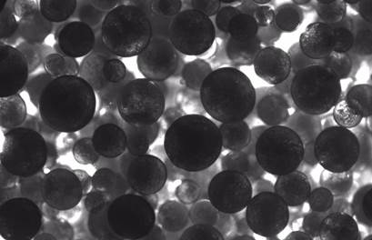
OIW/WIO Concentration
OIW < 0.5%
OIW 2%
OIW 40%
JM Canty, Inc. · Buffalo, New York · Phone: (716) 625-4227 | JM Canty, Ltd. · Dublin, Ireland · Phone: +353 (1) 882-9621

Slide 24
Case Study 1: Survey of Produced Water Plant
Objectives were to assess;
droplet shearing effect of Booster Pumps and Liquid Cylinder Valve
equipment performance for removal of oil droplets of varying size
effectiveness of coalescing chemical dosing
Test | Description
1 | Upstream & Downstream of Booster Pumps with Chemical Dosing
2 | Upstream & Downstream of Booster Pumps without Chemical Dosing
3 | Upstream & Downstream of Hydrocyclone with Chemical Dosing
4 | Upstream & Downstream of Hydrocyclone without Chemical Dosing
5 | Upstream & Downstream of LCV with Chemical Dosing
6 | Upstream & Downstream of LCV without Chemical Dosing
7 | Upstream & Downstream of CFU with Chemical Dosing
8 | Upstream & Downstream of CFU without Chemical Dosing
JM Canty, Inc. · Buffalo, New York · Phone: (716) 625-4227 | JM Canty, Ltd. · Dublin, Ireland · Phone: +353 (1) 882-9621

Slide 25
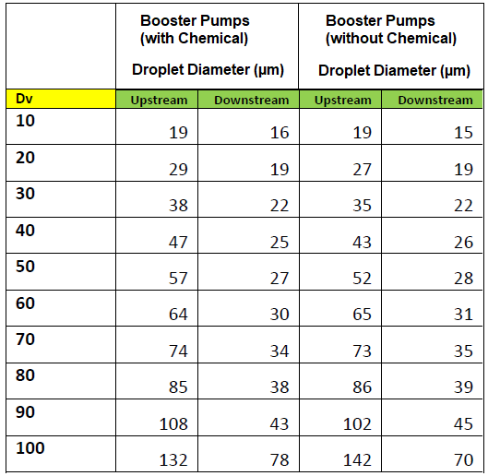
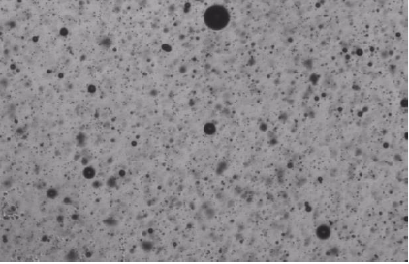
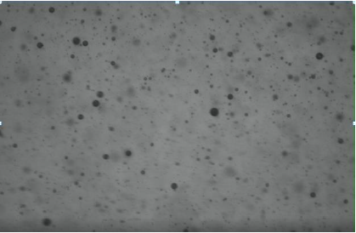
- Reduction in droplet size downstream vs upstream - pump shearing droplets
- Chemical dosing shown to have little influence on droplet size
JM Canty, Inc. · Buffalo, New York · Phone: (716) 625-4227 | JM Canty, Ltd. · Dublin, Ireland · Phone: +353 (1) 882-9621

Slide 26
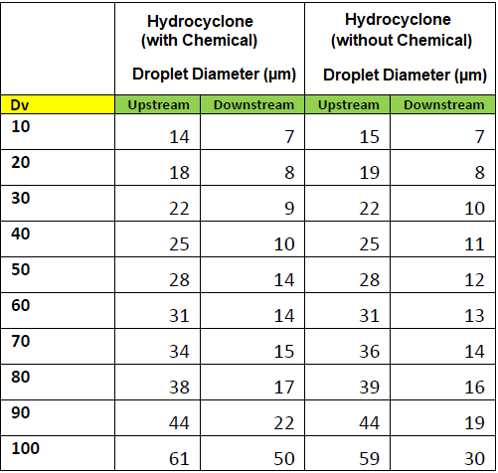

- Reduction in droplet size downstream vs upstream as expected
- Chemical dosing shown to have little influence on droplet size
JM Canty, Inc. · Buffalo, New York · Phone: (716) 625-4227 | JM Canty, Ltd. · Dublin, Ireland · Phone: +353 (1) 882-9621

Slide 27
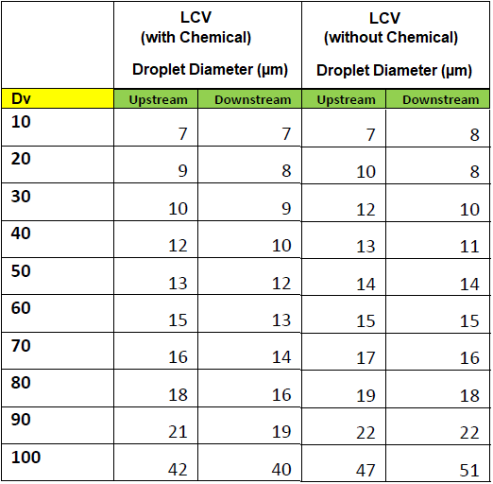
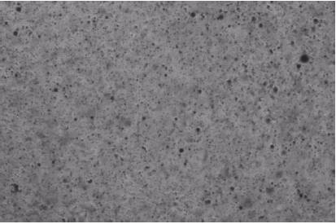
- No notable reduction in droplet size (no shearing) downstream vs upstream
- Chemical dosing shown to have little influence on droplet size
JM Canty, Inc. · Buffalo, New York · Phone: (716) 625-4227 | JM Canty, Ltd. · Dublin, Ireland · Phone: +353 (1) 882-9621

Slide 28
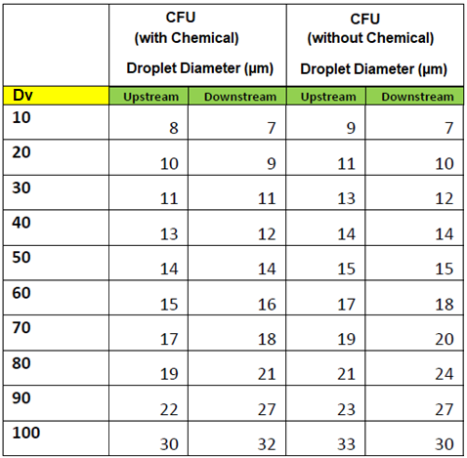

- No notable reduction in droplet size downstream vs upstream
- Chemical dosing shown to have little influence on droplet size
JM Canty, Inc. · Buffalo, New York · Phone: (716) 625-4227 | JM Canty, Ltd. · Dublin, Ireland · Phone: +353 (1) 882-9621

Slide 29
Case Study 2: Survey of an IGF & Nutshell Filter
The Canty Portable InFlow unit was connected to 3 different sampling points to determine if the inlet / outlet oil & solids were within specification;
IGF Inlet
IGF Outlet / Filter Inlet
Filter Outlet (Discharge Water)
JM Canty, Inc. · Buffalo, New York · Phone: (716) 625-4227 | JM Canty, Ltd. · Dublin, Ireland · Phone: +353 (1) 882-9621

Slide 30
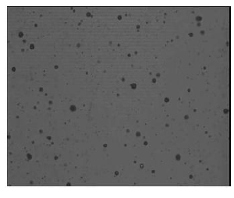
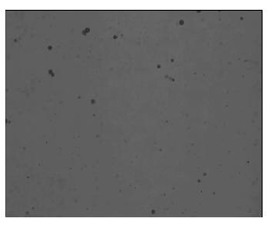
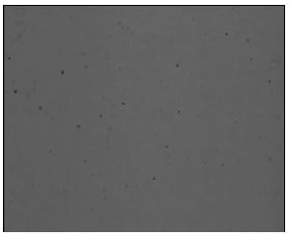
Case Study 2: Oil in Water
Dynamic Imaging Applied to IGF & Filtration Performance Analysis
IGF Inlet IGF Outlet / Filter Inlet Filter Outlet
JM Canty, Inc. · Buffalo, New York · Phone: (716) 625-4227 | JM Canty, Ltd. · Dublin, Ireland · Phone: +353 (1) 882-9621

Slide 31
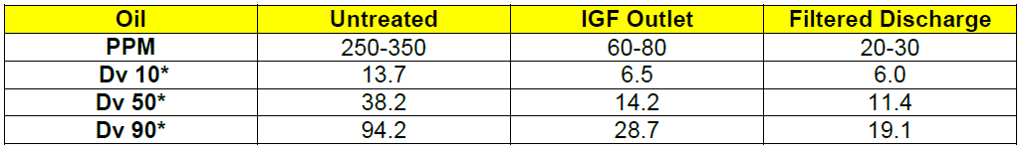
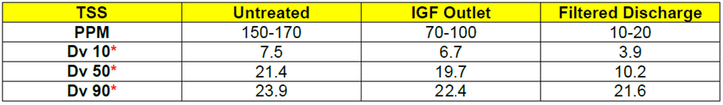
Case Study 2: Survey of an IGF & Nutshell Filter
JM Canty, Inc. · Buffalo, New York · Phone: (716) 625-4227 | JM Canty, Ltd. · Dublin, Ireland · Phone: +353 (1) 882-9621

Slide 32
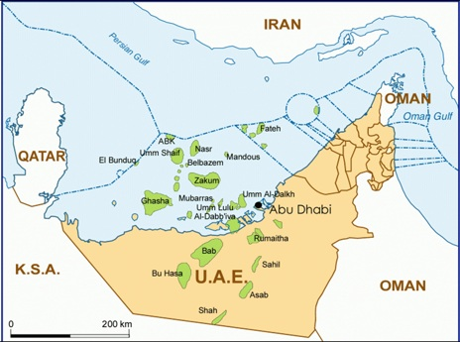
Case Study 3: Sand / TSS in WFI
Bu Hasa Field UAE, 200km SW of Abu Dhabi
Approximately 700 wells in total, with approximately 300 injection wells
Injection water is primarily taken from separate water supply well, some produced water injected also
Portable Inflow installed at sample points for approximately 2 hrs at a time
Real time results obtained compared with operator’s offline lab method
JM Canty, Inc. · Buffalo, New York · Phone: (716) 625-4227 | JM Canty, Ltd. · Dublin, Ireland · Phone: +353 (1) 882-9621

Slide 33
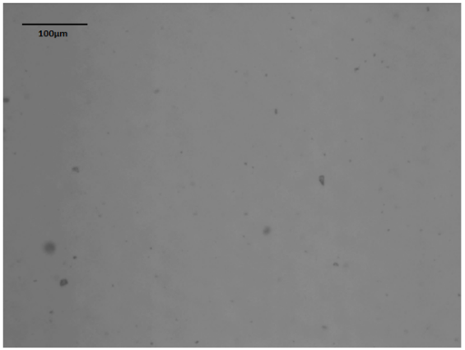
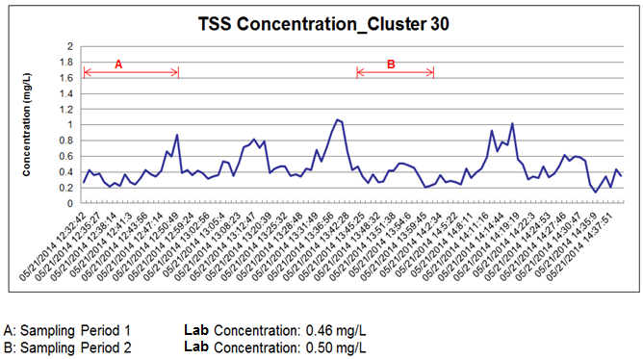
Case Study 3: Sand / TSS in WFI
TSS Size Data
Dv | Size (µm)
10 | 2.7
20 | 3.5
30 | 3.9
40 | 4.7
50 | 5.1
60 | 5.6
70 | 6.0
80 | 6.9
90 | 8.1
100 | 11.8
Sample Point 1: Cluster 30
TSS Shape Data (Aspect Ratio)
Dv
10 | 1.19
20 | 1.27
30 | 1.33
40 | 1.40
50 | 1.51
60 | 1.61
70 | 1.69
80 | 1.76
90 | 1.88
100 | 2.84
JM Canty, Inc. · Buffalo, New York · Phone: (716) 625-4227 | JM Canty, Ltd. · Dublin, Ireland · Phone: +353 (1) 882-9621

Slide 34
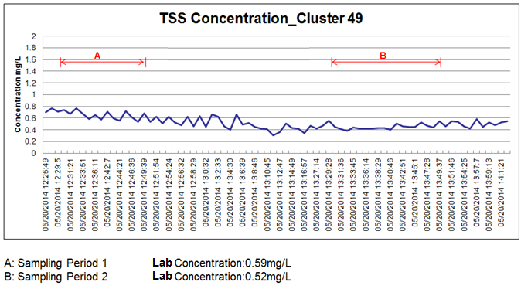
Case Study 3: Sand / TSS in WFI
TSS Size Data
Dv | Size (µm)
10 | 2.6
20 | 3.2
30 | 3.9
40 | 4.5
50 | 4.9
60 | 5.3
70 | 5.9
80 | 6.5
90 | 7.4
100 | 9.4
Sample Point 2: Cluster 49
TSS Shape Data (Aspect Ratio)
Dv
10 | 1.27
20 | 1.30
30 | 1.36
40 | 1.44
50 | 1.52
60 | 1.59
70 | 1.68
80 | 1.74
90 | 1.84
100 | 2.69
JM Canty, Inc. · Buffalo, New York · Phone: (716) 625-4227 | JM Canty, Ltd. · Dublin, Ireland · Phone: +353 (1) 882-9621

Slide 35

Case Study 3: Sand / TSS in WFI
TSS Size Data
Dv | Size (µm)
10 | 2.7
20 | 3.9
30 | 3.9
40 | 5.1
50 | 5.8
60 | 6.3
70 | 7.1
80 | 9.1
90 | 12.8
100 | 14.8
Sample Point 3: Cluster 51
TSS Shape Data (Aspect Ratio)
Dv
10 | 1.24
20 | 1.28
30 | 1.33
40 | 1.39
50 | 1.45
60 | 1.60
70 | 1.59
80 | 1.73
90 | 1.88
100 | 3.33
JM Canty, Inc. · Buffalo, New York · Phone: (716) 625-4227 | JM Canty, Ltd. · Dublin, Ireland · Phone: +353 (1) 882-9621

Slide 36
Case Study 4: Measurement of Water Droplets in Crude
Recently , there have been intensive studies to determine water droplet size distribution along the 800 mile Alyeska Pipeline stretching from Purdue Bay to Valdez Alaska.
Over the years, crude flow has decreased significantly from the original design of 2 million barrels per day to the present 700,000 barrels per day.
This decrease in flow is a major cause of concern for water dropout. The volume of water, water droplet size and crude temperature are the major variables which determine the amount of water dropout in low-lying areas.
If water happens to accumulate in low-lying areas from reduction in flow or a pipeline shutdown, it could freeze and cause major restart issues and equipment damage.
JM Canty, Inc. · Buffalo, New York · Phone: (716) 625-4227 | JM Canty, Ltd. · Dublin, Ireland · Phone: +353 (1) 882-9621

Slide 37


JM Canty, Inc. · Buffalo, New York · Phone: (716) 625-4227 | JM Canty, Ltd. · Dublin, Ireland · Phone: +353 (1) 882-9621

Slide 38
Case Study 5: Effect of Pressure Reduction Valves on Water Droplets in Crude
As the crude reaches East Meters in Valdez, the line pressure ranges between 750 to 850 psi
The crude enters East Meters and passes through pressure reduction valves, dropping the pressure to approximately 120 psi
The Canty was installed to determine the effect of this pressure drop on water droplet size. This application also demonstrates the importance of choosing the correct process location to study droplet size
The Canty was installed at both the high pressure and low pressure side of the pressure reduction valves
JM Canty, Inc. · Buffalo, New York · Phone: (716) 625-4227 | JM Canty, Ltd. · Dublin, Ireland · Phone: +353 (1) 882-9621

Slide 39


Before Pressure Reduction Valves
Water Droplets Clearly Visible
After Pressure Reduction Valves
Water Droplets Have Been Sheared
JM Canty, Inc. · Buffalo, New York · Phone: (716) 625-4227 | JM Canty, Ltd. · Dublin, Ireland · Phone: +353 (1) 882-9621

Slide 40

Questions
&
Answers
JM Canty, Inc. · Buffalo, New York · Phone: (716) 625-4227 | JM Canty, Ltd. · Dublin, Ireland · Phone: +353 (1) 882-9621

