Slide 1

CANTY
PROCESS TECHNOLOGY
Drilling Mud Automation
ADVANCED MUD FLOW system – LOW FLOW TO HIGH FLOW
WWW.JMCANTY.COM

Slide 2
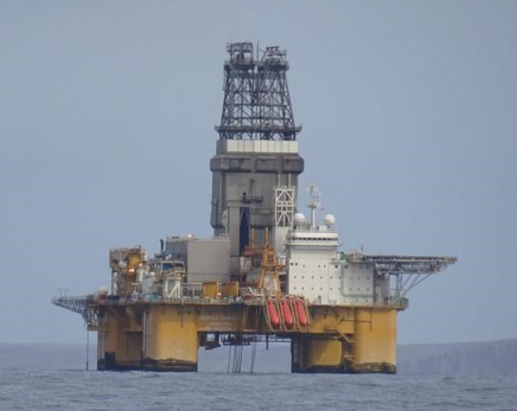
WWW.JMCANTY.COM
CANTY
CANTY
PROCESS TECHNOLOGY
PROCESS TECHNOLOGY
Introduction
Drilling operators have many safety factors that must be monitored. Typically, rig instrumentation or data monitoring services (mud loggers) will hook up a variety of mechanical measuring sensors that help provide safety warning and optimization for operational conditions. One of the most important, yet often carried our poorly is fluid flow out of the wellbore.
Two systems widely in use today.
- Flow Paddle - low cost, inexpensive
- Coriolis - high cost, expensive operations
Fundamental problems with both systems
J.M. CANTY INC. | BUFFALO NY | (716) 625-4227  J.M. CANTY INTL. | DUBLIN, IRELAND | +353 (1) 882-9621  J.M. CANTY ASIA OFFICE | PHUKET THAILAND

Slide 3
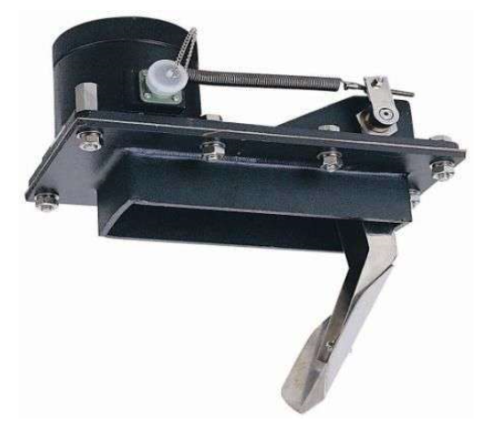
WWW.JMCANTY.COM
CANTY
CANTY
PROCESS TECHNOLOGY
PROCESS TECHNOLOGY
Flow Paddle
The sensor is mounted to the top of the pipe with the paddle extending into the mud flow.
- Poor accuracy
- Intrusive
- Subject to major solids build up
- Random accuracy
- No low flow capability
J.M. CANTY INC. | BUFFALO NY | (716) 625-4227  J.M. CANTY INTL. | DUBLIN, IRELAND | +353 (1) 882-9621  J.M. CANTY ASIA OFFICE | PHUKET THAILAND

Slide 4
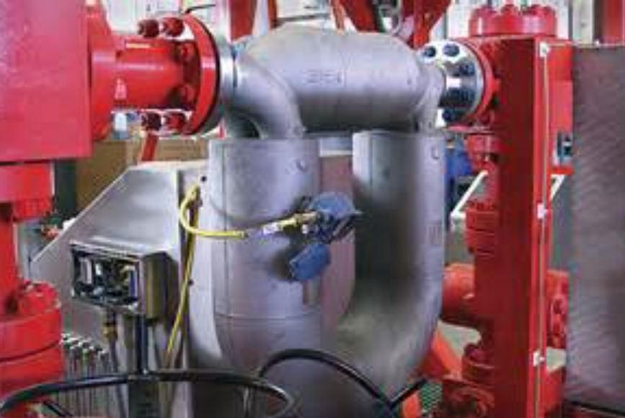
WWW.JMCANTY.COM
CANTY
CANTY
PROCESS TECHNOLOGY
PROCESS TECHNOLOGY
Coriolis
Mounted directly into the pipeline.
- Highly intrusive requiring major rig modifications
- Clogging issues
- Measurements effected by solids & gas
- No low flow capability
- Expensive
J.M. CANTY INC. | BUFFALO NY | (716) 625-4227  J.M. CANTY INTL. | DUBLIN, IRELAND | +353 (1) 882-9621  J.M. CANTY ASIA OFFICE | PHUKET THAILAND

Slide 5
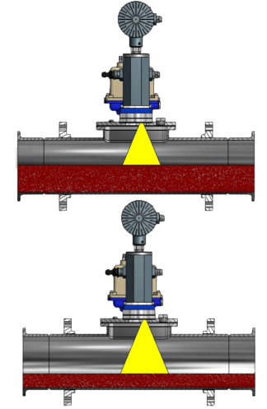
WWW.JMCANTY.COM
CANTY
CANTY
PROCESS TECHNOLOGY
PROCESS TECHNOLOGY
Canty Advanced Mud Flow System
Canty Mud Flow Camera System is set up to view the mud going down the pipe after it rises from the drill pipe.
Rugged ATEX Zone 0/1 industrial turn key system mounts to the top of the pipe and allows for Non-Contact measurement of flow and level of the mud.
The combination of a Canty high Intensity LED light coupled with the digital Ethernet camera allows for optimal view into this dirty dark environment for visual verification of the flow and quality.
CANTYVISION™ Software is used to analyze the level and the measurement results can be outputted through 4-20mA, TCP/IP MODBUS or OPC DA/UA to the control system. This system is a replacement for the Mud Flow Flapper/Paddle style units.
J.M. CANTY INC. | BUFFALO NY | (716) 625-4227  J.M. CANTY INTL. | DUBLIN, IRELAND | +353 (1) 882-9621  J.M. CANTY ASIA OFFICE | PHUKET THAILAND

Slide 6
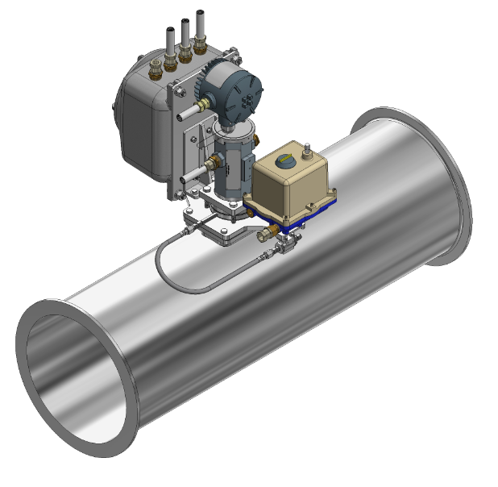
WWW.JMCANTY.COM
CANTY
CANTY
PROCESS TECHNOLOGY
PROCESS TECHNOLOGY
Canty Advanced Mud Flow System Advantage
- Visual Verification allowing operators an unparalleled view into the process
- Non-contact, no drift in calibration over time.
- Direct Measurement
  - multiphase fluid flow of liquids, solids & gas
- High accuracy ultra low flow to high flow measurements independent of fluid
- Detect fluid foaming and gas
- Easily retrofitted and installed onto existing pipework – replacing paddle system
- View and confirm the mud flow and mud surface condition and low flow pressure test leak condition
J.M. CANTY INC. | BUFFALO NY | (716) 625-4227  J.M. CANTY INTL. | DUBLIN, IRELAND | +353 (1) 882-9621  J.M. CANTY ASIA OFFICE | PHUKET THAILAND

Slide 7
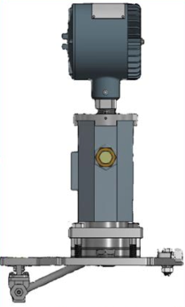
WWW.JMCANTY.COM
CANTY
CANTY
PROCESS TECHNOLOGY
PROCESS TECHNOLOGY
Hardware – Camera
Gigabit Ethernet Technology
High Speed, High Resolution CCD Camera system
Simple RJ45 Network Connection to Control VCM
J.M. CANTY INC. | BUFFALO NY | (716) 625-4227  J.M. CANTY INTL. | DUBLIN, IRELAND | +353 (1) 882-9621  J.M. CANTY ASIA OFFICE | PHUKET THAILAND

Slide 8
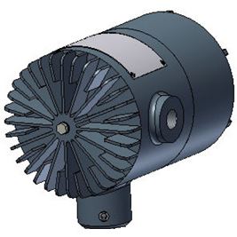
WWW.JMCANTY.COM
CANTY
CANTY
PROCESS TECHNOLOGY
PROCESS TECHNOLOGY
Hardware – Light Source
Light Source – Long life (50,000+ hours) LED
Integrated onto camera housing
Fibre Optic light guide ensures uniform lighting for the camera image
J.M. CANTY INC. | BUFFALO NY | (716) 625-4227  J.M. CANTY INTL. | DUBLIN, IRELAND | +353 (1) 882-9621  J.M. CANTY ASIA OFFICE | PHUKET THAILAND

Slide 9
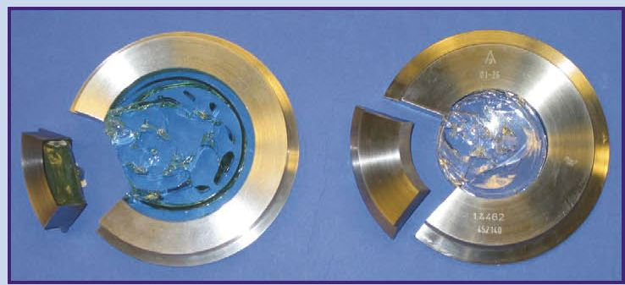
WWW.JMCANTY.COM
CANTY
CANTY
PROCESS TECHNOLOGY
PROCESS TECHNOLOGY
Hardware – Fused Glass Process Window
Camera front cap features CANTY’s unique glass to metal fusion technology
One piece construction
Provides a high pressure impenetrable process barrier
Pressures to 600 BAR, Temp -200 to 300ºC
J.M. CANTY INC. | BUFFALO NY | (716) 625-4227  J.M. CANTY INTL. | DUBLIN, IRELAND | +353 (1) 882-9621  J.M. CANTY ASIA OFFICE | PHUKET THAILAND

Slide 10
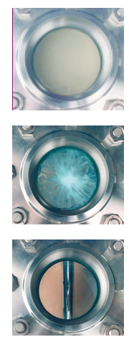
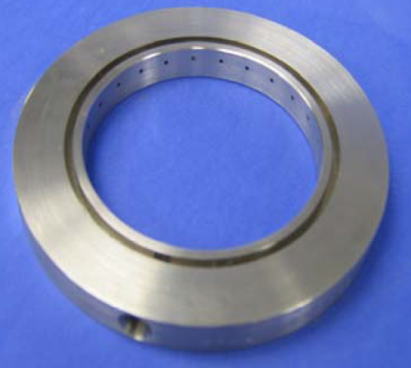
WWW.JMCANTY.COM
CANTY
CANTY
PROCESS TECHNOLOGY
PROCESS TECHNOLOGY
Hardware – Jet Spray Ring
Jet Spray ring is used to keep the front of the camera clean to ensure
a constant clear view
Generates a high pressure vortex rinsing action to remove tough
deposits from mud flow camera system process window
Fully automated cleaning system
J.M. CANTY INC. | BUFFALO NY | (716) 625-4227  J.M. CANTY INTL. | DUBLIN, IRELAND | +353 (1) 882-9621  J.M. CANTY ASIA OFFICE | PHUKET THAILAND

Slide 11
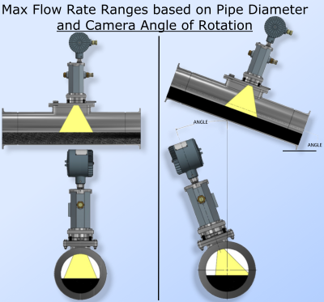
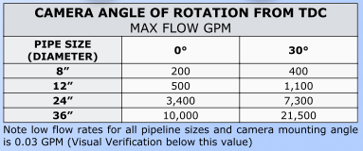
WWW.JMCANTY.COM
CANTY
CANTY
PROCESS TECHNOLOGY
PROCESS TECHNOLOGY
Mounting Configuration
AI Software algorithm measures the height of the fluid from the internal wall of the pipe
Surface Velocity Tracking
Non Contact Measurement – No drift in calibration over time
J.M. CANTY INC. | BUFFALO NY | (716) 625-4227  J.M. CANTY INTL. | DUBLIN, IRELAND | +353 (1) 882-9621  J.M. CANTY ASIA OFFICE | PHUKET THAILAND

Slide 12
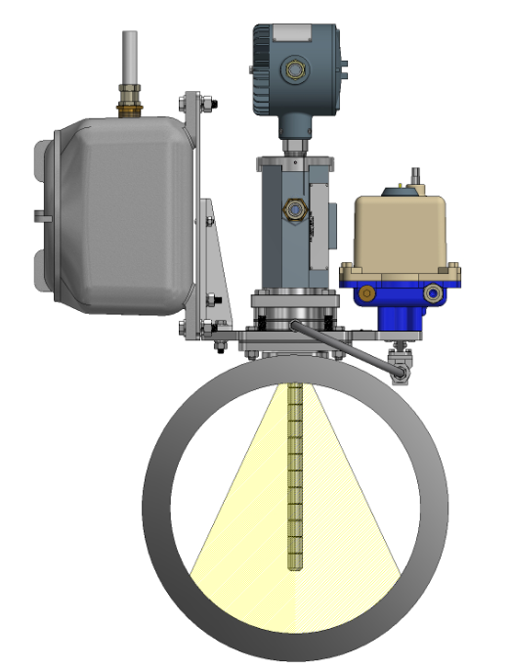
WWW.JMCANTY.COM
CANTY
CANTY
PROCESS TECHNOLOGY
PROCESS TECHNOLOGY
Mounting Configuration
Reference probe (optional) for camera installation at top dead centre (TDC) of the pipe.
Increased Max Flow Rate measurement.
J.M. CANTY INC. | BUFFALO NY | (716) 625-4227  J.M. CANTY INTL. | DUBLIN, IRELAND | +353 (1) 882-9621  J.M. CANTY ASIA OFFICE | PHUKET THAILAND

Slide 13
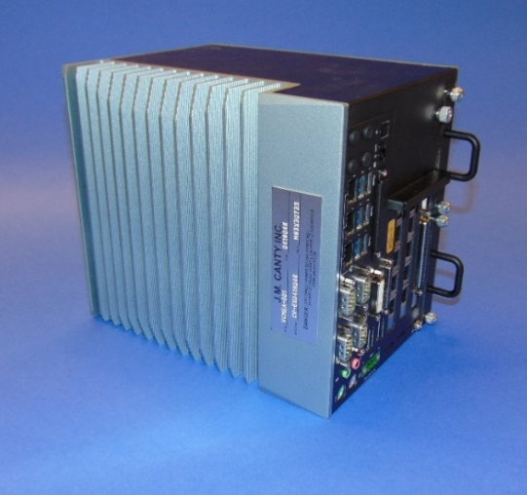
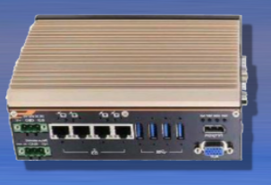
WWW.JMCANTY.COM
CANTY
CANTY
PROCESS TECHNOLOGY
PROCESS TECHNOLOGY
Vector Control Module
CantyVision Industrial Toolbox Software Pre-Installed and configured
Control up to maximum 6 camera system
Multiple outputs
-4-20mA
-OPC (OPC DA/UA)
-TCP/IP Modbus
-Video Display
Remote Support Functionality
J.M. CANTY INC. | BUFFALO NY | (716) 625-4227  J.M. CANTY INTL. | DUBLIN, IRELAND | +353 (1) 882-9621  J.M. CANTY ASIA OFFICE | PHUKET THAILAND

Slide 14
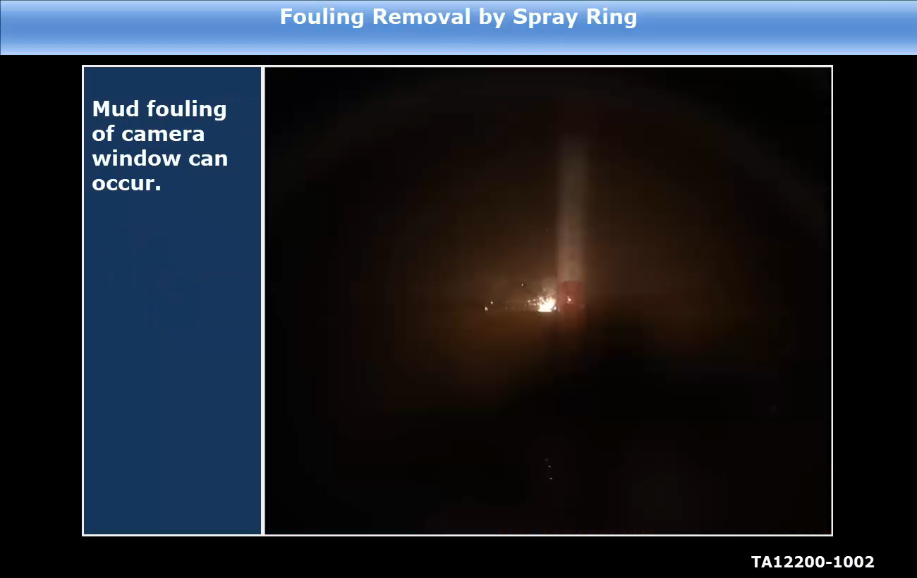
WWW.JMCANTY.COM
CANTY
CANTY
PROCESS TECHNOLOGY
PROCESS TECHNOLOGY
Measurement Analysis - CantyVision Software
J.M. CANTY INC. | BUFFALO NY | (716) 625-4227  J.M. CANTY INTL. | DUBLIN, IRELAND | +353 (1) 882-9621  J.M. CANTY ASIA OFFICE | PHUKET THAILAND

Slide 15
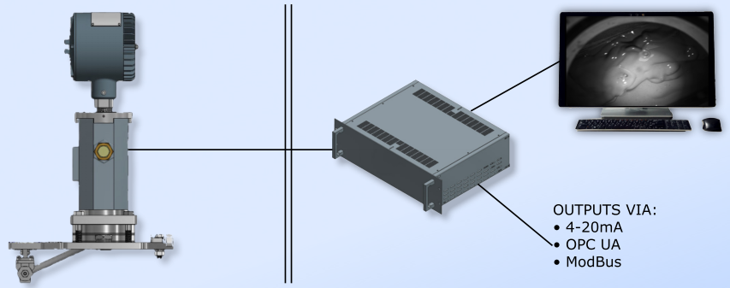
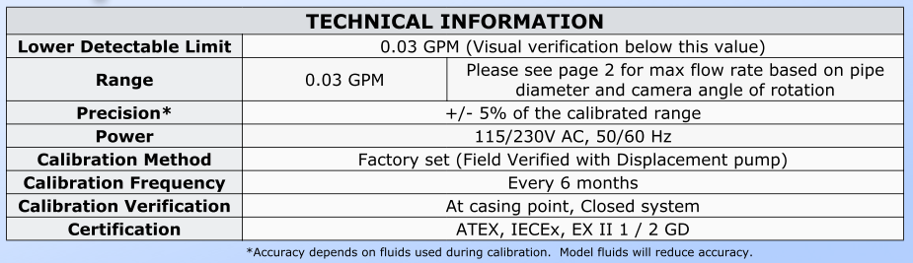
WWW.JMCANTY.COM
CANTY
CANTY
PROCESS TECHNOLOGY
PROCESS TECHNOLOGY
Typical Installation
Hazardous Area
Safe Area
J.M. CANTY INC. | BUFFALO NY | (716) 625-4227  J.M. CANTY INTL. | DUBLIN, IRELAND | +353 (1) 882-9621  J.M. CANTY ASIA OFFICE | PHUKET THAILAND

Slide 16
WWW.JMCANTY.COM
CANTY
CANTY
PROCESS TECHNOLOGY
PROCESS TECHNOLOGY
Comparison- Canty Vs Coriolis
J.M. CANTY INC. | BUFFALO NY | (716) 625-4227  J.M. CANTY INTL. | DUBLIN, IRELAND | +353 (1) 882-9621  J.M. CANTY ASIA OFFICE | PHUKET THAILAND

Slide 17
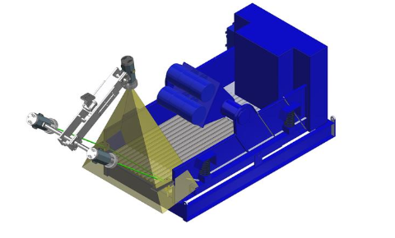
WWW.JMCANTY.COM
CANTY
CANTY
PROCESS TECHNOLOGY
PROCESS TECHNOLOGY
Shaker Screen Cuttings Volume Flow & Fluid Front
Monitoring of the cutting flow over the shaker screens is an indicator of what is occurring in the drilling operation. Mud is recovered through the screens while cuttings flow over the end.
Imaging provides a robust solution for detection of the cuttings and the change in the rate of flow over time by monitoring the changing profile of the screen caused by the changing height of the cuttings as they flow over the end.
Vision technology has the advantage of being somewhat remote from the shaker (cleanliness) and does not require recalibration once set in place.
J.M. CANTY INC. | BUFFALO NY | (716) 625-4227  J.M. CANTY INTL. | DUBLIN, IRELAND | +353 (1) 882-9621  J.M. CANTY ASIA OFFICE | PHUKET THAILAND

Slide 18
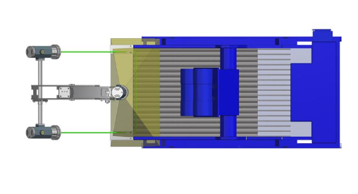
WWW.JMCANTY.COM
CANTY
CANTY
PROCESS TECHNOLOGY
PROCESS TECHNOLOGY
Shaker Screen Cuttings Volume Flow & Fluid Front
Safe, green laser line is projected across the screen
Camera views screen surface including laser line
As cutting particles come along they intercept the laser line. When they do the camera sees a shift in the line position which is directly proportional to the height of the particle(s).
Several hundred measurement zones are positioned across the screen thereby assuring a high resolution detection of cuttings height on the screen in each zone which are integrated together to create the material profile
J.M. CANTY INC. | BUFFALO NY | (716) 625-4227  J.M. CANTY INTL. | DUBLIN, IRELAND | +353 (1) 882-9621  J.M. CANTY ASIA OFFICE | PHUKET THAILAND

Slide 19
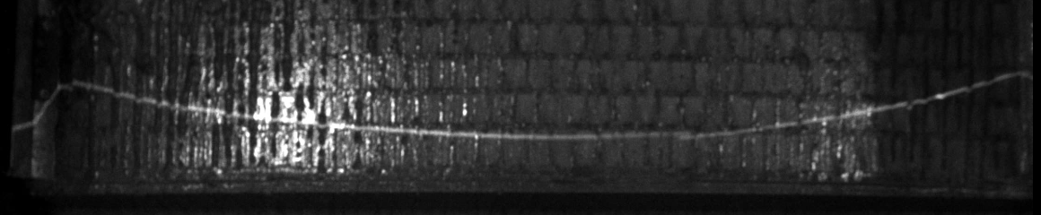
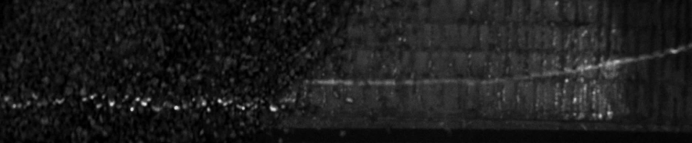
WWW.JMCANTY.COM
CANTY
CANTY
PROCESS TECHNOLOGY
PROCESS TECHNOLOGY
Laser Line – No Cuttings vs Cuttings
J.M. CANTY INC. | BUFFALO NY | (716) 625-4227  J.M. CANTY INTL. | DUBLIN, IRELAND | +353 (1) 882-9621  J.M. CANTY ASIA OFFICE | PHUKET THAILAND

Slide 20
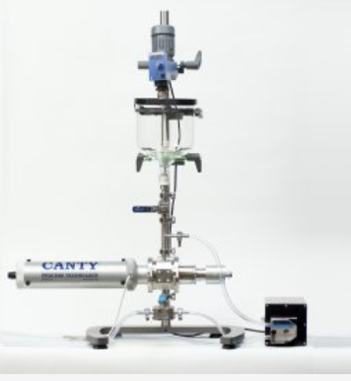
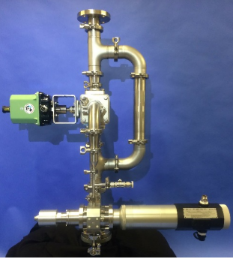
WWW.JMCANTY.COM
CANTY
CANTY
PROCESS TECHNOLOGY
PROCESS TECHNOLOGY
Drilling MUD PSA
Laboratory or At-Line drilling mud dynamic imaging particle size analysis systems
Direct 2D measurement of the particle is of extreme importance
Ability to distinguish between solid particles and water droplets in oil based mud (OBM), or solid particles and oil droplets in water based mud (WBM) sets the system apart from any other particle analysis systems
Laboratory System
At-Line system
J.M. CANTY INC. | BUFFALO NY | (716) 625-4227  J.M. CANTY INTL. | DUBLIN, IRELAND | +353 (1) 882-9621  J.M. CANTY ASIA OFFICE | PHUKET THAILAND

Slide 21
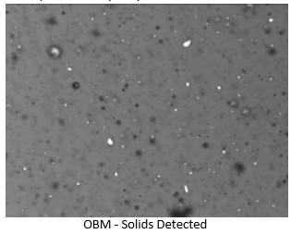
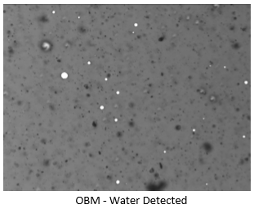
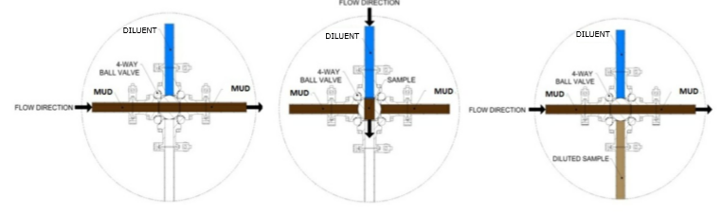
WWW.JMCANTY.COM
CANTY
CANTY
PROCESS TECHNOLOGY
PROCESS TECHNOLOGY
Drilling MUD PSA
At-line system features a unique fully automated cross cut sampler which ensures that a representative sample of drilling mud is taken from the process, even in horizontal pipelines where larger solids would tend to travel along the bottom of the line.
J.M. CANTY INC. | BUFFALO NY | (716) 625-4227  J.M. CANTY INTL. | DUBLIN, IRELAND | +353 (1) 882-9621  J.M. CANTY ASIA OFFICE | PHUKET THAILAND

Slide 22
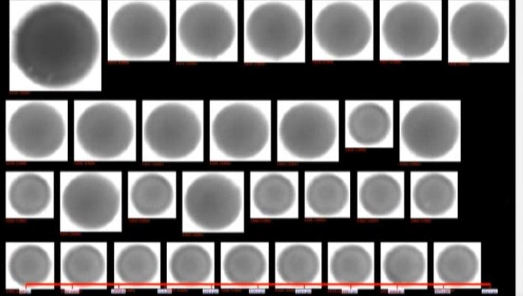
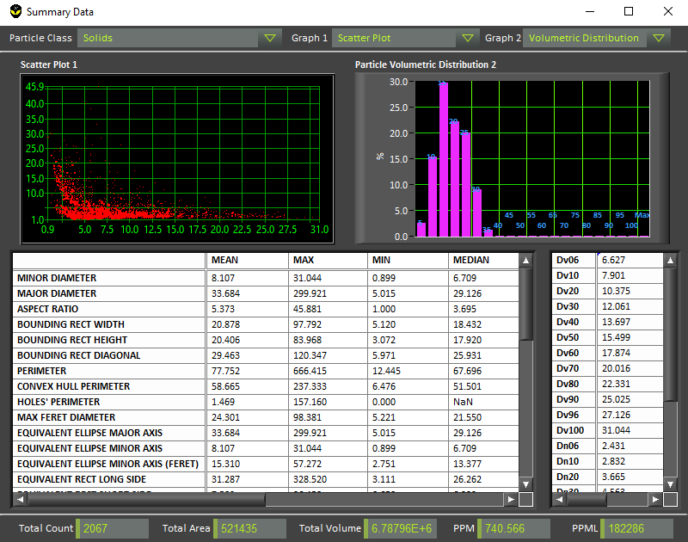
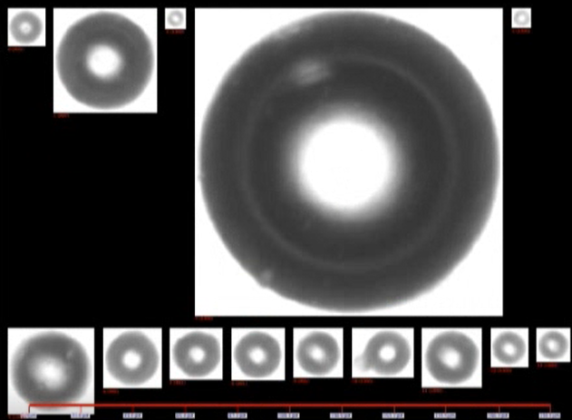
WWW.JMCANTY.COM
CANTY
CANTY
PROCESS TECHNOLOGY
PROCESS TECHNOLOGY
Drilling MUD PSA
CantyVision Intelligent Analysis Software is able to process images at high speed real time.
Software provides graphical trends in charts with statistical data for particles, droplets and gas.
Individual data charts and outputs.
- Particle size distribution,
- Particle shape
- Concentrations - counts per ml, ppm
Customized reporting feature for excel data output.
Easy to use graphical interface allows user to click on particles within the class they want to measure and sort particles by their individual classes.
Machine learning algorithms build a database of particle shape characteristics.
J.M. CANTY INC. | BUFFALO NY | (716) 625-4227  J.M. CANTY INTL. | DUBLIN, IRELAND | +353 (1) 882-9621  J.M. CANTY ASIA OFFICE | PHUKET THAILAND

Slide 23
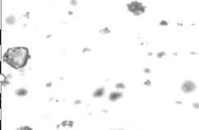
WWW.JMCANTY.COM
CANTY
CANTY
PROCESS TECHNOLOGY
PROCESS TECHNOLOGY
% TSS Measurement of Brine during Displacements
Minimising costs is an ongoing concern in the drilling industry.
Potential for costs to be reduced in the Wellbore clean up phase.
Brine has a high cost (depending on the type of brine used).
Important to recover /reclaim the brine.
During brine displacements, the % TSS of the brine returning from the wellbore needs to be within specification < 0.05%.
Current Rig-Site methods collect samples for offline %TSS measurement using an electric centrifuge. Sample collection and measurement is time consuming.
Need for online real time monitoring of the %TSS during brine displacement.
J.M. CANTY INC. | BUFFALO NY | (716) 625-4227  J.M. CANTY INTL. | DUBLIN, IRELAND | +353 (1) 882-9621  J.M. CANTY ASIA OFFICE | PHUKET THAILAND

Slide 24
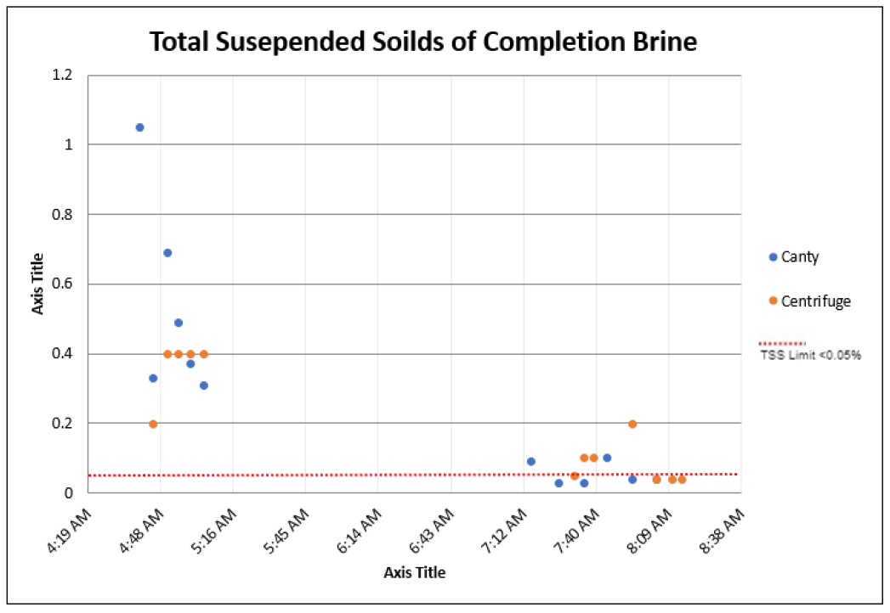
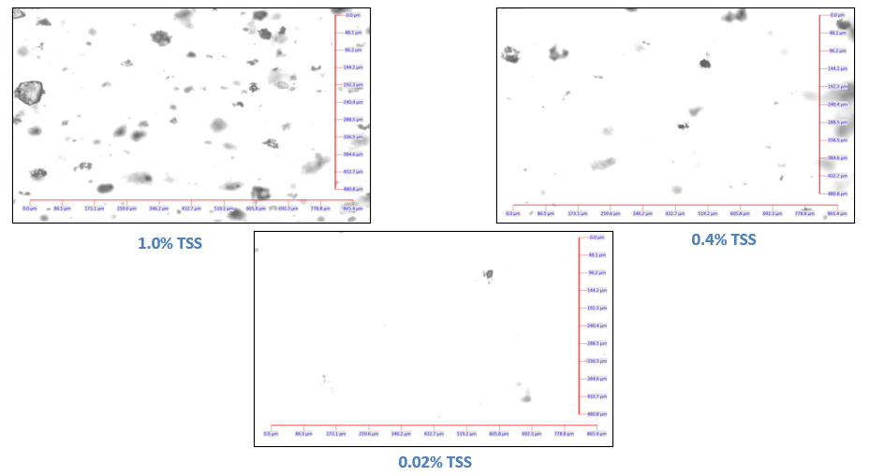
WWW.JMCANTY.COM
CANTY
CANTY
PROCESS TECHNOLOGY
PROCESS TECHNOLOGY
% TSS Measurement of Brine during Displacements
J.M. CANTY INC. | BUFFALO NY | (716) 625-4227  J.M. CANTY INTL. | DUBLIN, IRELAND | +353 (1) 882-9621  J.M. CANTY ASIA OFFICE | PHUKET THAILAND

Slide 25
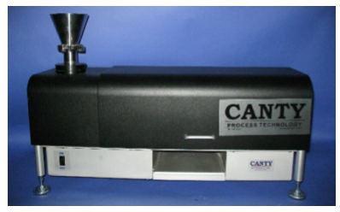
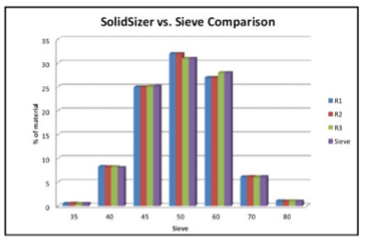
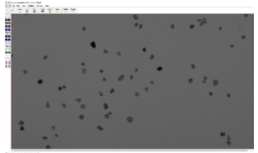
WWW.JMCANTY.COM
CANTY
CANTY
PROCESS TECHNOLOGY
PROCESS TECHNOLOGY
Frac Sand PSA
Canty SolidSizer is used to determine the particle size and shape distributions of frac sand samples.
Direct 2-Dimensional particle size information delivering both the true size and shape of the particulate.
Size distribution data can be directly correlated to sieve analysis.
J.M. CANTY INC. | BUFFALO NY | (716) 625-4227  J.M. CANTY INTL. | DUBLIN, IRELAND | +353 (1) 882-9621  J.M. CANTY ASIA OFFICE | PHUKET THAILAND

Slide 26
WWW.JMCANTY.COM
CANTY
CANTY
PROCESS TECHNOLOGY
PROCESS TECHNOLOGY
Questions
and
Answers
J.M. CANTY INC. | BUFFALO NY | (716) 625-4227  J.M. CANTY INTL. | DUBLIN, IRELAND | +353 (1) 882-9621  J.M. CANTY ASIA OFFICE | PHUKET THAILAND

