Slide 1

Real Time Monitoring of Total Suspended Solids in Brine During Casing Displacements
CANTY
PROCESS TECHNOLOGY
TA12500-1032_REV1
WWW.JMCANTY.COM

Slide 2

Introduction
Minimising costs is an ongoing concern in the drilling industry.
Potential for costs to be reduced in the Wellbore clean up phase.
Casing clean-up is a crucial stage during the completion phase of the well.
Particulate/debris not removed, have the ability to travel down the wellbore and potentially damage the reservoir reducing well productivity.
JM Canty, Inc. · Buffalo, New York · Phone: (716) 625-4227 | JM Canty, Ltd. · Dublin, Ireland · Phone: +353 (1) 882-9621

Slide 3
%TSS of Brine During Displacements
Brine has a high cost (depending on the type of brine used).
Important to recover /reclaim the brine.
During brine displacements, the % TSS of the brine returning from the wellbore needs to be within specification < 0.05%.
Current Rig-Site methods collect samples for offline %TSS measurement using an electric centrifuge. Sample collection and measurement is time consuming.
Need for online real time monitoring of the %TSS during brine displacement.
JM Canty, Inc. · Buffalo, New York · Phone: (716) 625-4227 | JM Canty, Ltd. · Dublin, Ireland · Phone: +353 (1) 882-9621

Slide 4
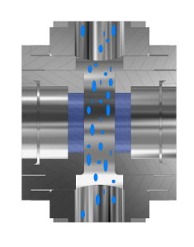

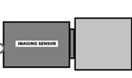
Canty Approach – Real Time Particle Analysis
Vision Based Particle Analysis Basic Principle
JM Canty’s vision based technique works on the basic principle of presenting the fluid between a high intensity light source, and microscopic camera
The captured images are then sent to CantyVision Client Software for analysis, where the suspended particulate (oil, solids, gas bubbles etc.) is measured under a number of different parameters to provide size, shape and concentration data
JM Canty, Inc. · Buffalo, New York · Phone: (716) 625-4227 | JM Canty, Ltd. · Dublin, Ireland · Phone: +353 (1) 882-9621

Slide 5
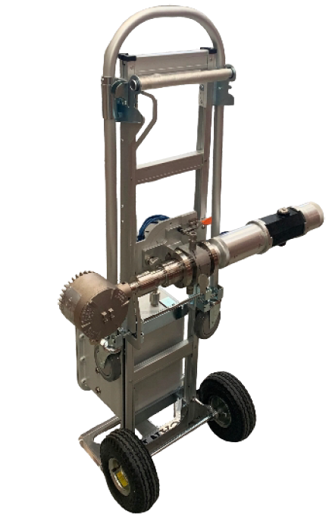
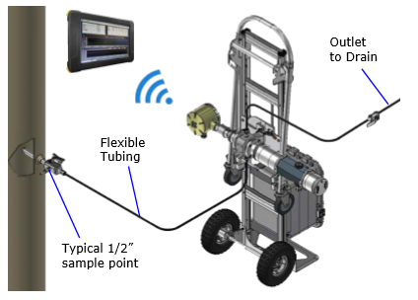
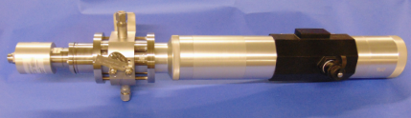
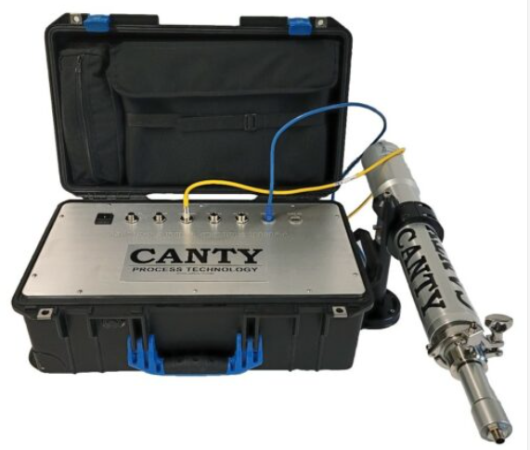
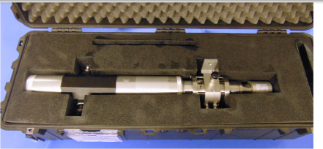
Canty Transportable/Portable Systems
Canty Transportable System
½” Swagelok Connection (typical pipeline sample points)
System is designed for multi point surveys in the process facility. System can be easily moved to different sample points.
Outlet flow to open drain or lower pressure return point (ensure flow through analyser)
System is fully configured and operated by ATEX/IECEx Zone 1 rated wireless tablet
Canty Portable System
WP/IP66 Portable system with pelican case
JM Canty, Inc. · Buffalo, New York · Phone: (716) 625-4227 | JM Canty, Ltd. · Dublin, Ireland · Phone: +353 (1) 882-9621

Slide 6
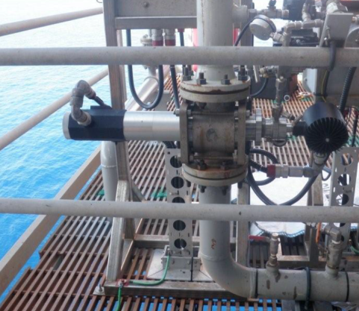
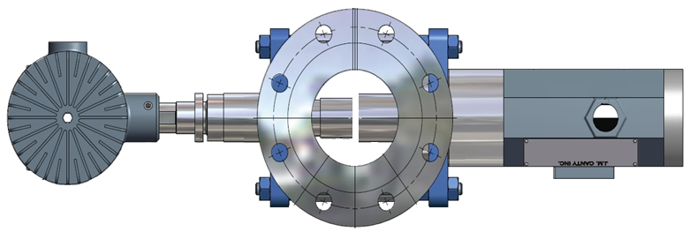
InFlow – Inline Permanent Installations
Inline InFlow mounts as permanent spool piece in main process pipeline
Can also be mounted on fast loop bypass line for larger process lines
JM Canty, Inc. · Buffalo, New York · Phone: (716) 625-4227 | JM Canty, Ltd. · Dublin, Ireland · Phone: +353 (1) 882-9621

Slide 7
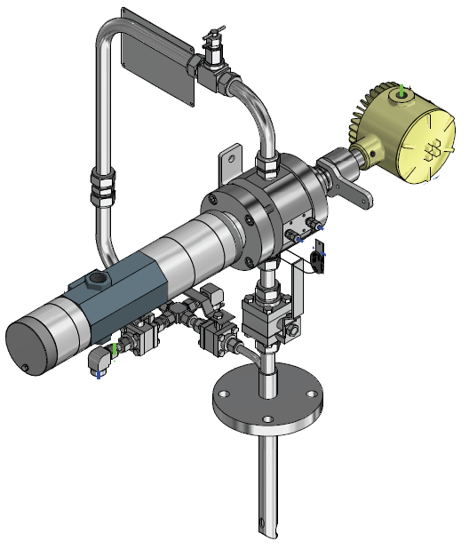
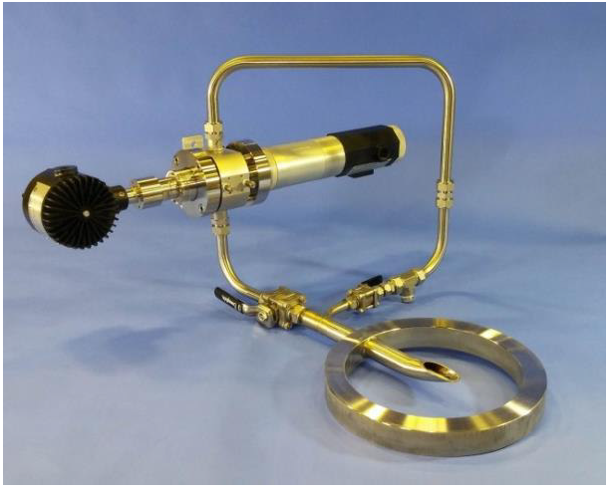
InFlow – At-Line Permanent Installation
InFlow mounts in compact flow loop – wafer or flange mount to pipeline
Single fluid take off & return point on pipeline
JM Canty, Inc. · Buffalo, New York · Phone: (716) 625-4227 | JM Canty, Ltd. · Dublin, Ireland · Phone: +353 (1) 882-9621

Slide 8

Image Retrieval – Hardware – CCD Camera
Gigabit Ethernet technology for optimum image retrieval
9MP CCD
Particle / Droplet Size to 0.7µm
Simple RJ45 Network Connection to Control PC
JM Canty, Inc. · Buffalo, New York · Phone: (716) 625-4227 | JM Canty, Ltd. · Dublin, Ireland · Phone: +353 (1) 882-9621

Slide 9
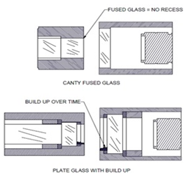
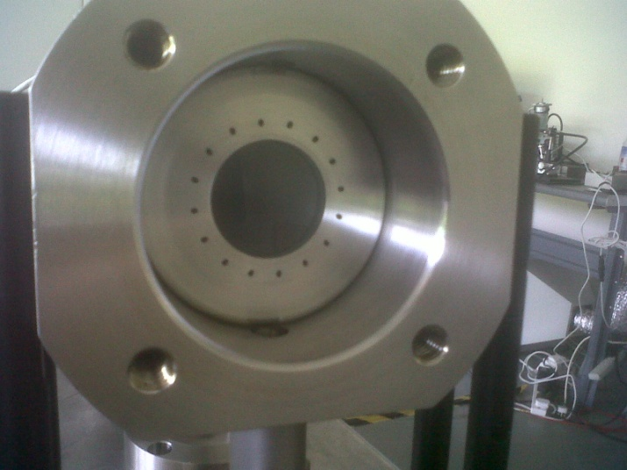
Image Retrieval – Hardware – Fused Glass Flow Path
Fused one piece construction with no recesses or steps where product can adhere to and build up
Pressures to 600 BAR
Integral Jet Spray Ring
Adjustable Gap Size dependent on sample present
JM Canty, Inc. · Buffalo, New York · Phone: (716) 625-4227 | JM Canty, Ltd. · Dublin, Ireland · Phone: +353 (1) 882-9621

Slide 10
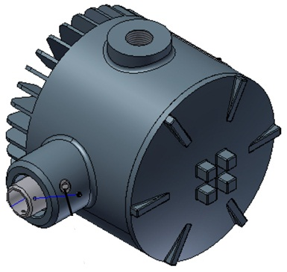
Image Retrieval – Hardware– Lighting System
High flow rates inline require an increased shutter speed and so an increased amount of light to capture particulate in “freeze frame” in order to perform software analysis
High Intensity LED Light Source
5+ Years Continuous Operation
Flow velocity up to 5m/s
JM Canty, Inc. · Buffalo, New York · Phone: (716) 625-4227 | JM Canty, Ltd. · Dublin, Ireland · Phone: +353 (1) 882-9621

Slide 11
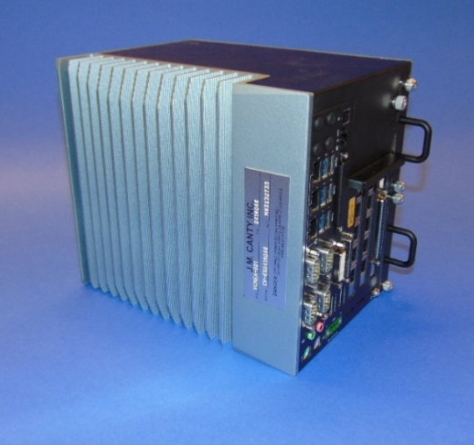
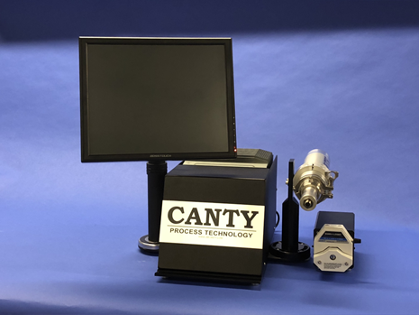
Image Analysis – Hardware – Vector Control Module
CantyVision Intelligent Analysis Software Pre-Installed and configured
Rackmount VCM can support two particle analysis systems
Multiple outputs
-4-20mA
-OPC (OPC UA now available)
-TCP/IP Modbus
-Video Display
Remote Support Functionality
JM Canty, Inc. · Buffalo, New York · Phone: (716) 625-4227 | JM Canty, Ltd. · Dublin, Ireland · Phone: +353 (1) 882-9621

Slide 12
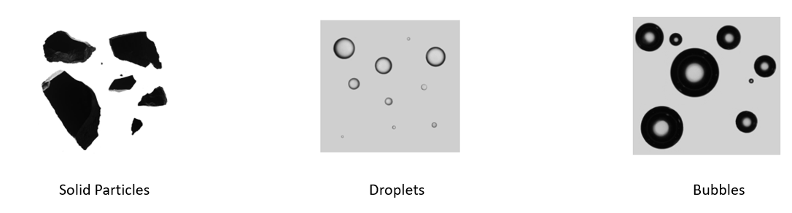
Differentiating between Solids, Liquids and Bubbles
Based on index of refraction; solid particles, water/oil droplets and gas bubbles can all be distinguished by Canty software based on the direct 2D images.
Delivering the TRUE particle size of the particles.
JM Canty, Inc. · Buffalo, New York · Phone: (716) 625-4227 | JM Canty, Ltd. · Dublin, Ireland · Phone: +353 (1) 882-9621

Slide 13
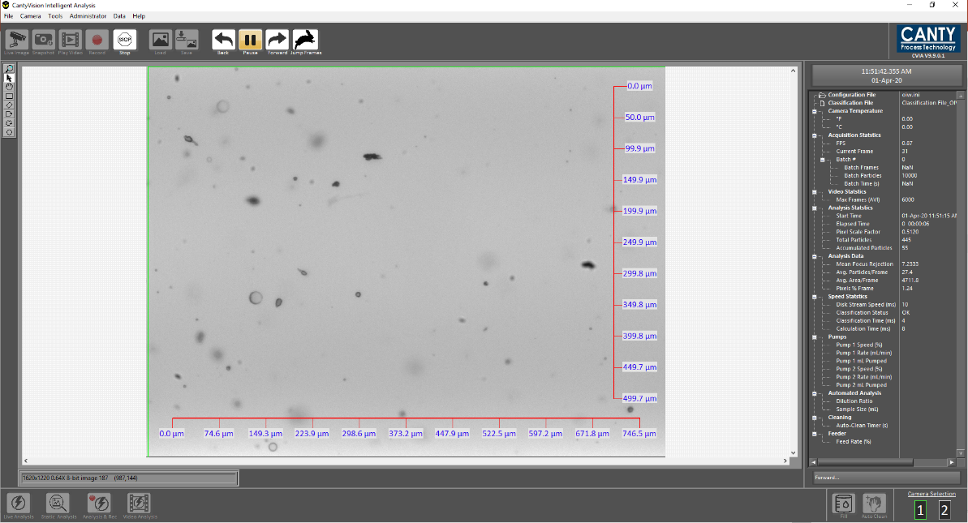
Canty Intelligent Analysis Software
CantyVision Software is able to process images at high speed real time.
Software provides graphical trends in charts with statistical data for particles, droplets and gas.
Individual data charts and outputs.
- Particle size distribution,
- Particle shape
- Concentrations – PPM,
Customized reporting feature for excel data output.
JM Canty, Inc. · Buffalo, New York · Phone: (716) 625-4227 | JM Canty, Ltd. · Dublin, Ireland · Phone: +353 (1) 882-9621

Slide 14
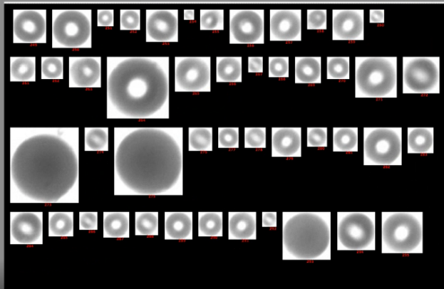
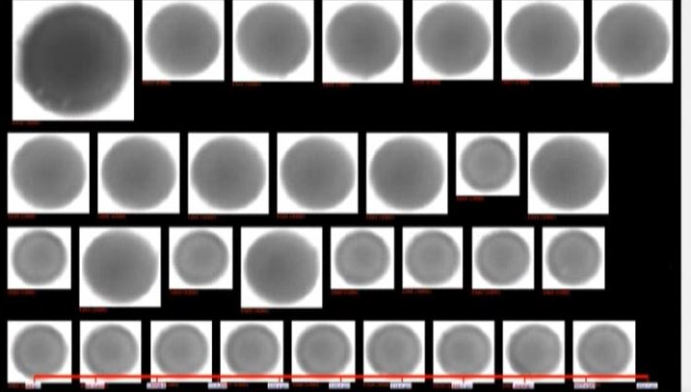
Image Analysis – CantyVision Intelligent Analysis Software
Particles are automatically classified using machine learning classification feature to identify and distinguish between solids, droplets and bubbles based 37 different measurements parameters (shape, particle intensity, surface roughness …..).
System self classifies removing operator error
JM Canty, Inc. · Buffalo, New York · Phone: (716) 625-4227 | JM Canty, Ltd. · Dublin, Ireland · Phone: +353 (1) 882-9621

Slide 15
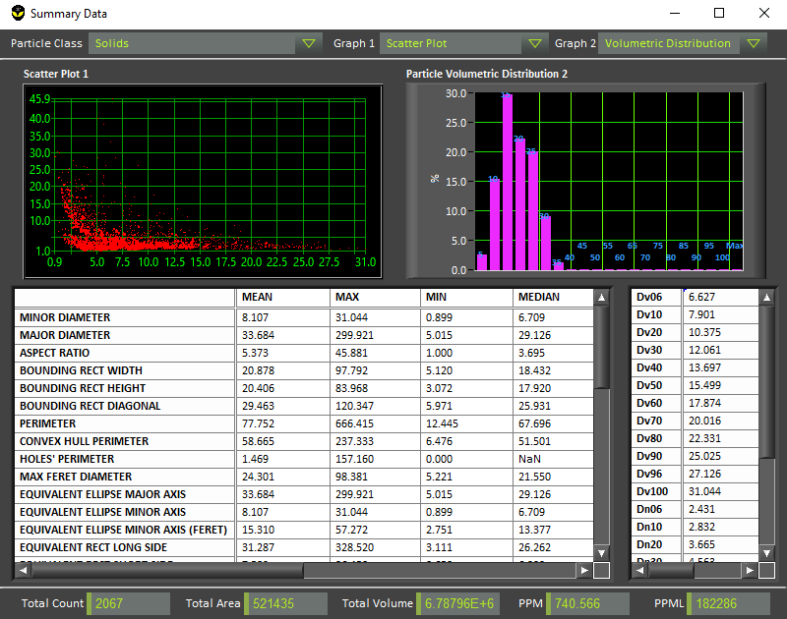
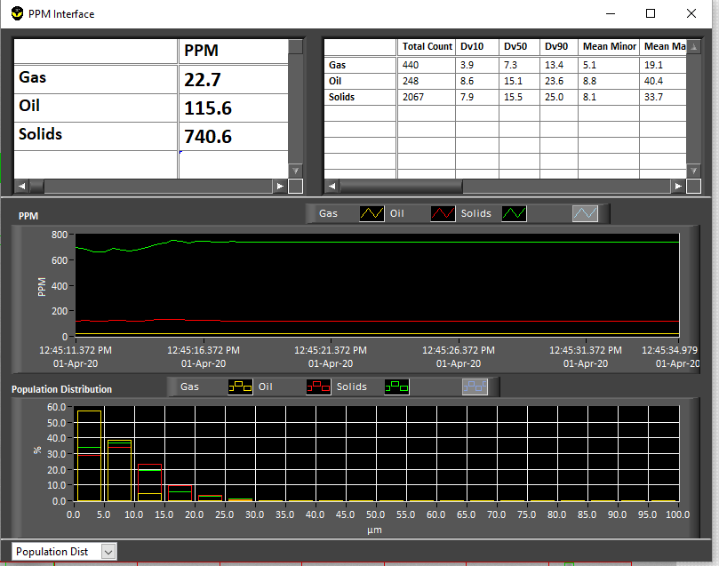
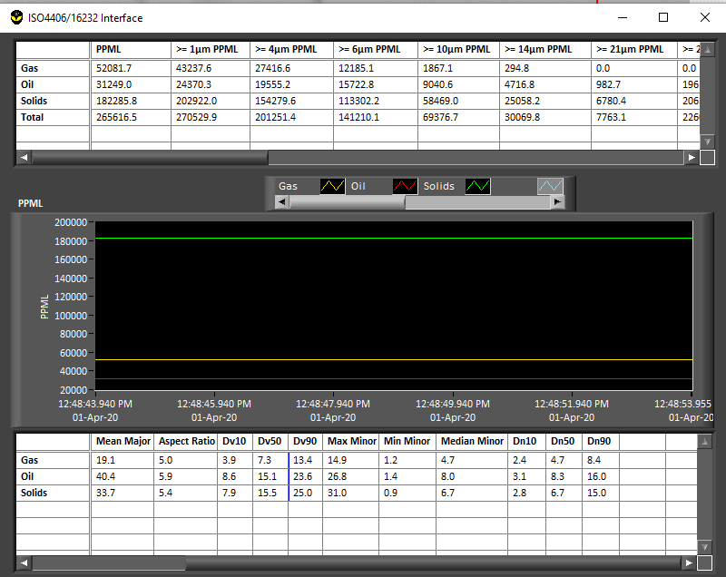
Image Analysis – CantyVision Intelligent Analysis Software
Multiple Charts depending on information required
Real time volumetric concentration measurements charts
Real time particle size distribution and shape information charts
Particle count per ml charts
JM Canty, Inc. · Buffalo, New York · Phone: (716) 625-4227 | JM Canty, Ltd. · Dublin, Ireland · Phone: +353 (1) 882-9621

Slide 16
Field Trial: %TSS Measurement of Completion Brine
An offshore trial was carried out on a drilling rig to measure the % TSS of the brine during displacements with the Canty dynamic imaging system.
Canty % TSS measurements were compared against the Rig site’s current manual method (Electric Centrifuge).
Samples were also collected for post analysis onshore as per API Recommended Practice 13J – Testing of Heavy Brines, using glass fibre filters.
JM Canty, Inc. · Buffalo, New York · Phone: (716) 625-4227 | JM Canty, Ltd. · Dublin, Ireland · Phone: +353 (1) 882-9621

Slide 17
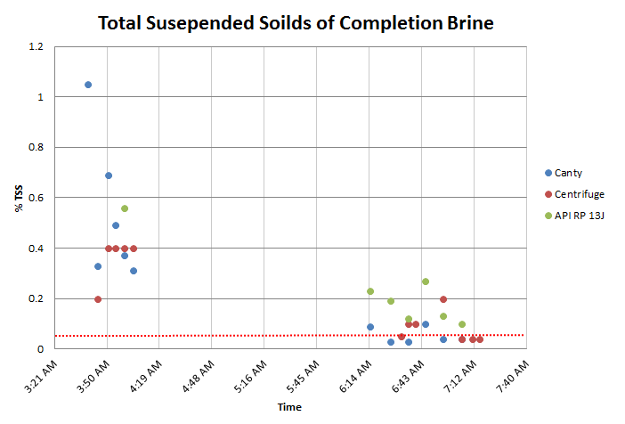
TSS Limit <0.05%
Higher TSS values were observed from the API filtration method, however,
the relative trend of TSS against time is comparable to Canty’s measurements .
JM Canty, Inc. · Buffalo, New York · Phone: (716) 625-4227 | JM Canty, Ltd. · Dublin, Ireland · Phone: +353 (1) 882-9621

Slide 18
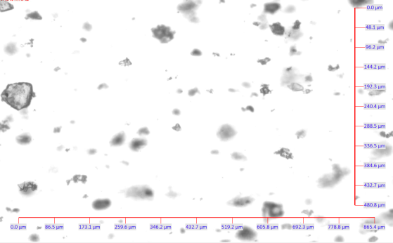
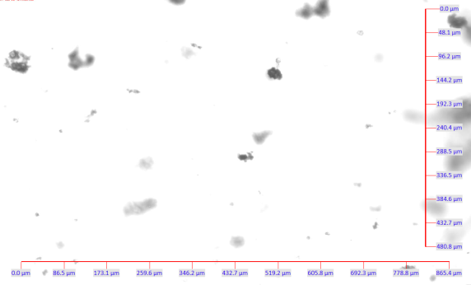
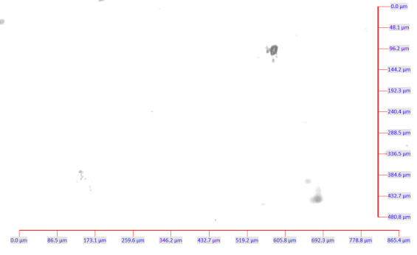
Canty Dynamic Imaging Analysis System- %TSS in Brine
1.0% TSS
0.4% TSS
0.02% TSS
JM Canty, Inc. · Buffalo, New York · Phone: (716) 625-4227 | JM Canty, Ltd. · Dublin, Ireland · Phone: +353 (1) 882-9621

Slide 19
Advantages of Real-Time Monitoring Vs Existing Rigsite Method
Canty Online System | Centrifuge
Measure percent solids down to 0.0001% | Measure percent solids down to 0.05%.
Real time monitoring for quick response in detecting when the brine %TSS is in specification. Allows operations to make timely decisions to avoid downtime and minimize the volume of brine used during displacements. | Response time to determining the %TSS of the brine is within specification will be at least 15 minutes. Three consecutive samples need to have a reading below 0.05% in order for displacements to stop.
The system has greater concentration measurement resolution, which allows tracking trends in TSS concentration to determine if the TSS concentration is reducing or not. This allows operations to make more informed decisions on whether to continue with the brine displacements or suspend and re-filter the brine. | Insufficient concentration measurement resolution. It is difficult for operations to track the trend of the TSS concentration of the brine. This reduces operations ability to make an informed decision to continue with the brine displacement or suspend and re-filter.
In addition to concentration, particle size information is also reported. This is crucial to identify the size of the particles prior to re-filtering the brine. | No particle size information.
JM Canty, Inc. · Buffalo, New York · Phone: (716) 625-4227 | JM Canty, Ltd. · Dublin, Ireland · Phone: +353 (1) 882-9621

Slide 20
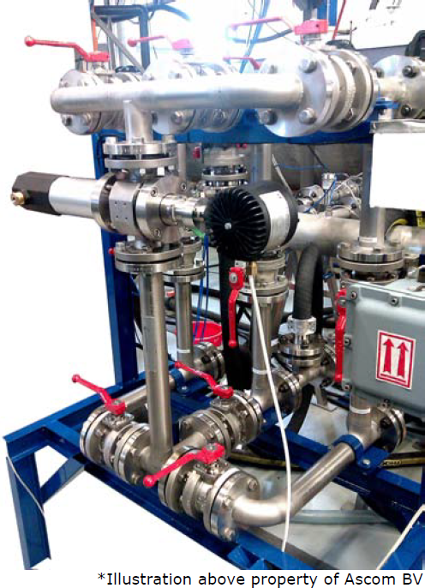
Questions
&
Answers
JM Canty, Inc. · Buffalo, New York · Phone: (716) 625-4227 | JM Canty, Ltd. · Dublin, Ireland · Phone: +353 (1) 882-9621

