Slide 1
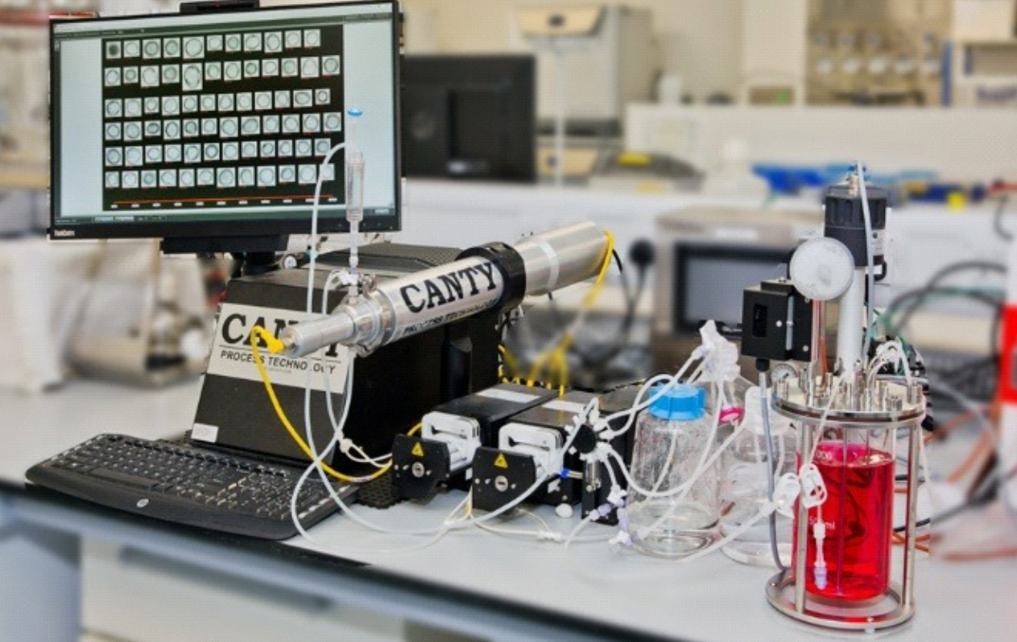
The Application of Dynamic Imaging for Mammalian Cell Analysis

Slide 2
Cell Viability Analysis
The assay of cell cultures for viability counts is a crucial measurement to determine the health of a culture overall.
Cell viability counts are employed for a range of applications:
  In the screening of compounds to determine the effect of test molecules on cell proliferation.
  Demonstrating direct cytotoxic effects of agents that will induce cell death.
  Determination what steps need to be taken in biopharmaceutical cell culture applications.

Slide 3
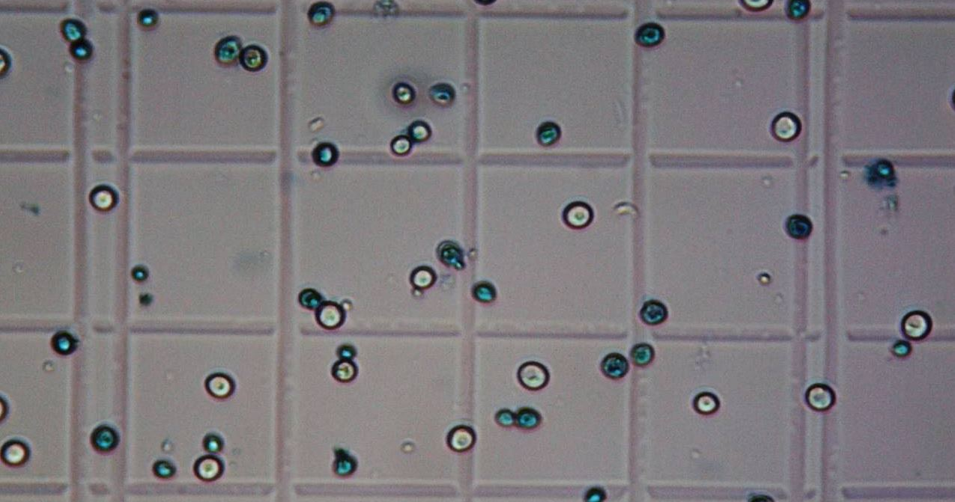
Cell Viability Analysis
Current Method: Flow Cytometry
Rapid multiple laser analysis of single cells in solution for visible light scattering.
Visible light scatter measured in forward direction for shape and at 90° for granularity.
Coupled with fluorescence analysis for parameters other than size/shape.
Current Method: Exclusion Dyes
Dyes that are excluded from the cell (Propidium iodide, DAPI)
Dyes that bind amines within cell to indicate a compromised cell membrane (trypan blue).
Used with a hemocytometer or an automated system for counts.

Slide 4
Dynamic Imaging Analysis
JM Canty’s vision based technique works on the basic principle of presenting the product between a high intensity light source and a microscopic camera.
The captured images are sent to the CantyVision Intelligent Analysis (CVIA) software suite for cell detection and analysis. Multiple size and shape parameters are detected for every imaged cell including cell diameter, radius, area, volume, nucleus size, circularity and intensity.
The software outputs cell viability, concentration and detailed size and shape data.

Slide 5
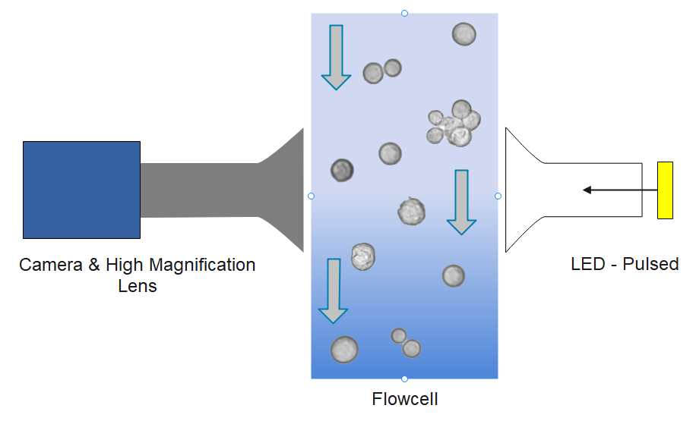
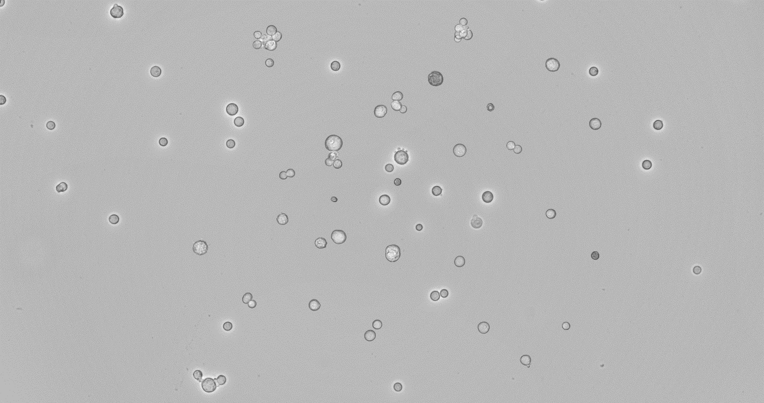
Dynamic Imaging Analysis
Bright even lighting allows for cells to be easily detected, measured and classified.
Pulsed LED synced to camera allows for bright transmitted light microscopy without heat.
Advanced flow-cell dynamics allow cells to be imaged in high resolution with exceptional focus quality.

Slide 6
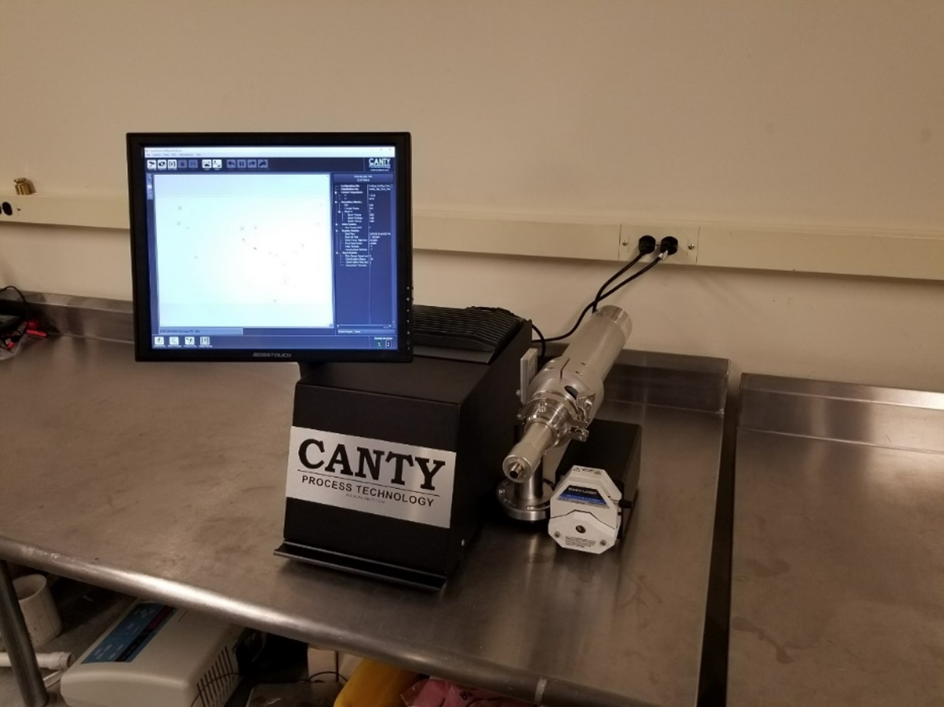
Hardware
CORE system is designed for laboratory use. Complete system can easily fit in fume hood or on a small bench.
Analyser
Ultra high intensity strobed LED.
Up to 8.9 Megapixel Camera coupled with ultra high resolution optics (12x) for measurements down to 0.7µm.
Max particle concentration up to 100x10⁶ cells/mL using automated dilution.
Sample size down to 500 µl
Label Free - System does not use expensive reagents or toxic dyes.
Core Unit
System power, computer (VCM), pumps and touch-screen monitor all incorporated into one design.
Software controlled pumps allow for easy sampling.
Software measures total cell density, viability %, viable cell density, apoptosis cell density, apoptosis %, agglomerates and cellular fragments and much more!
18” L x 16” W x 24” H

Slide 7
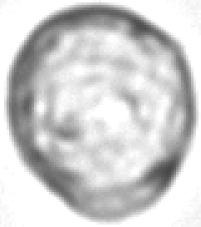
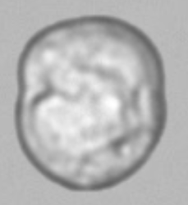
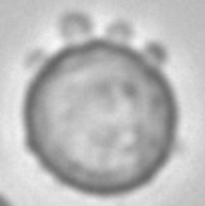
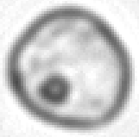
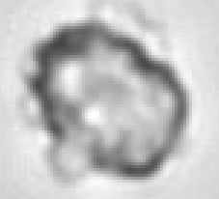
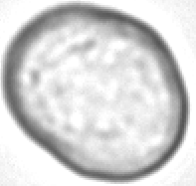
Hardware – Resolution Advantage
Cell images on left taken with 8.9 Megapixel camera versus image on right taken with standard 1.4 megapixel camera. Zoomed in 100%.
Canty CORE
Standard Image
8.9 Megapixel
4x the Resolution of Typical Cameras
Allows for extreme cell size accuracy when measuring very small cells as well as advanced cell classification based on morphology.
1.4 Megapixel
Standard camera
Not possible to classify cells based on morphology

Slide 8
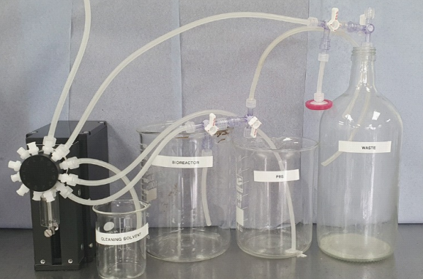
Hardware – Automated Sampling
The Canty CORE system can be purchased with and automated sampling system that provides automated bioreactor sampling for up to 7 bioreactors per Canty analyzer.
The system preforms automated sampling of cells on a user input time basis and also preforms cleaning and sterilizing functions automatically throughout your bioreactor run.
The system saves all data, video and images automatically!

Slide 9
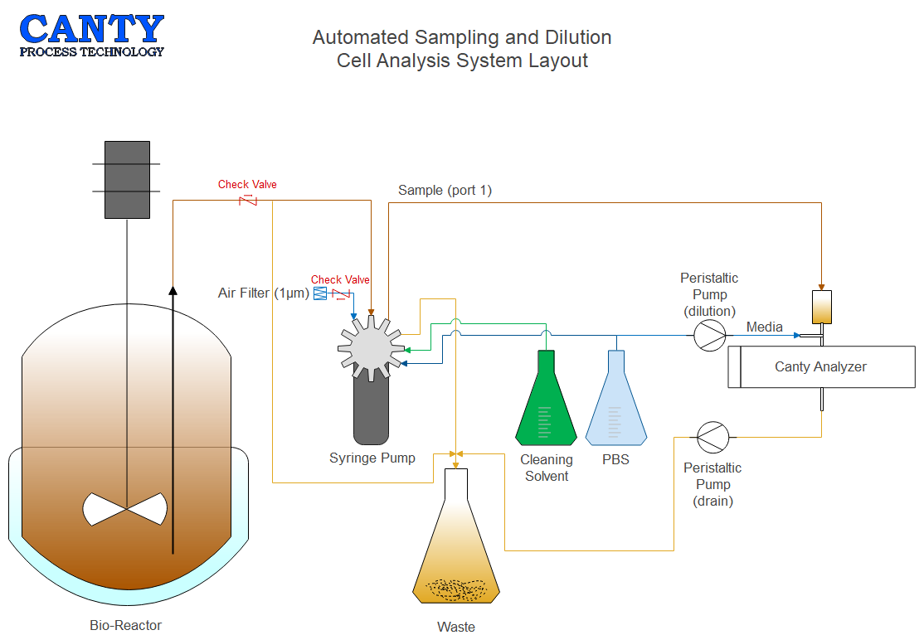
Hardware – Automated Sampling

Slide 10
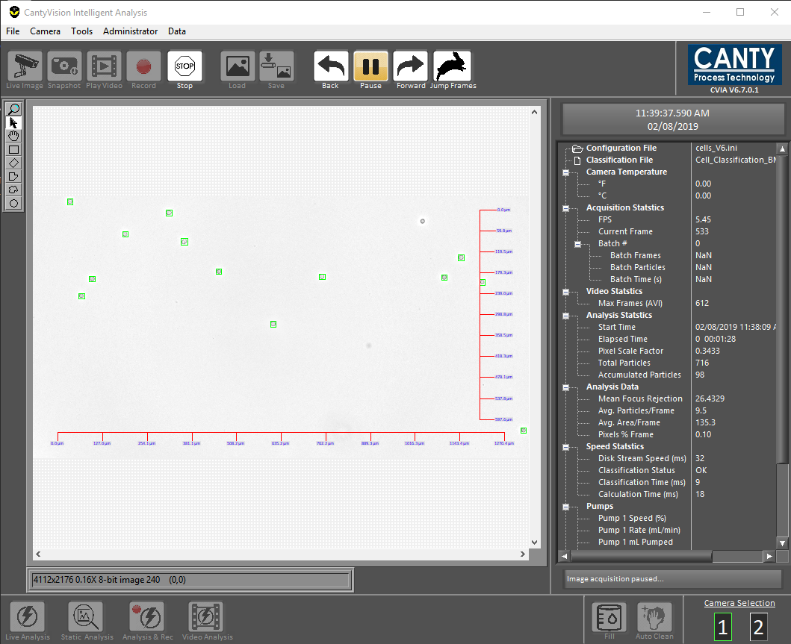
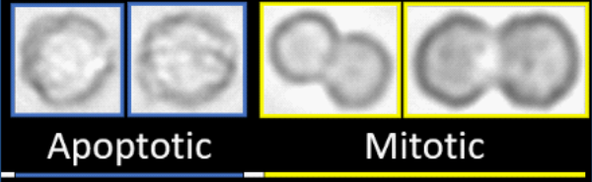
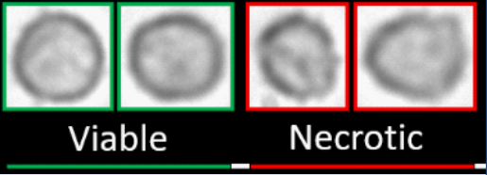
Software
CantyVision software identifies cells within the retrieved images through advanced thresholding algorithm.
Cells are separated from the background and a pixel scale factor is applied to provide information on different shape, size and concentration parameters.
Particles are then classified into multiple classes based on a neural classification system. Thousands of cells are fed into a AI machine learning system that then determines viable, necrotic, apoptosis and agglomerated cells and cell density.

Slide 11
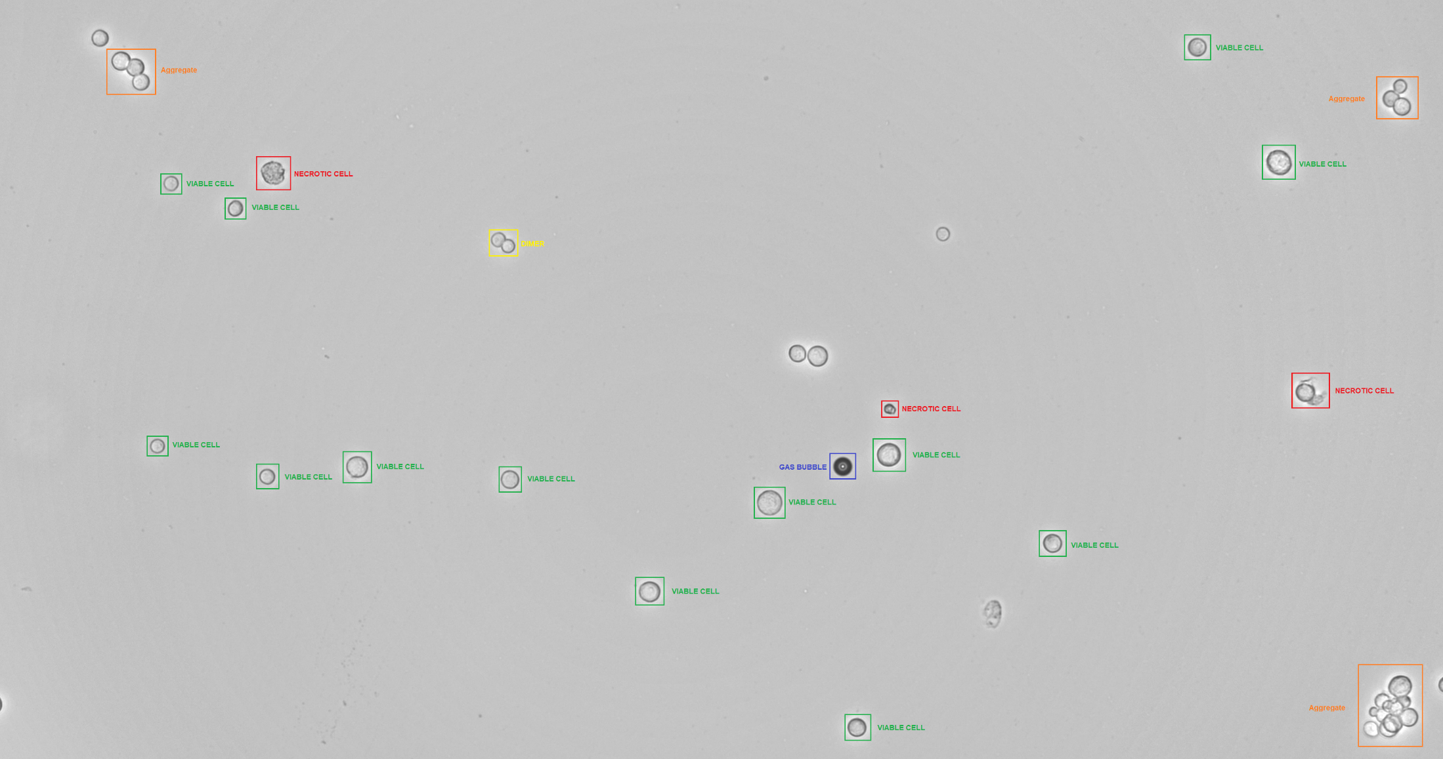
Software

Slide 12
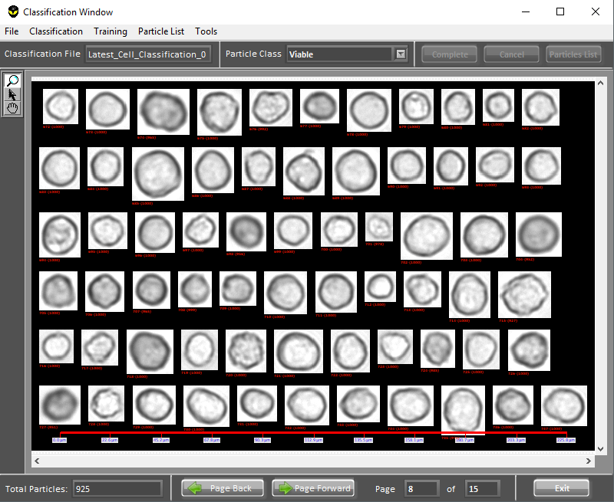
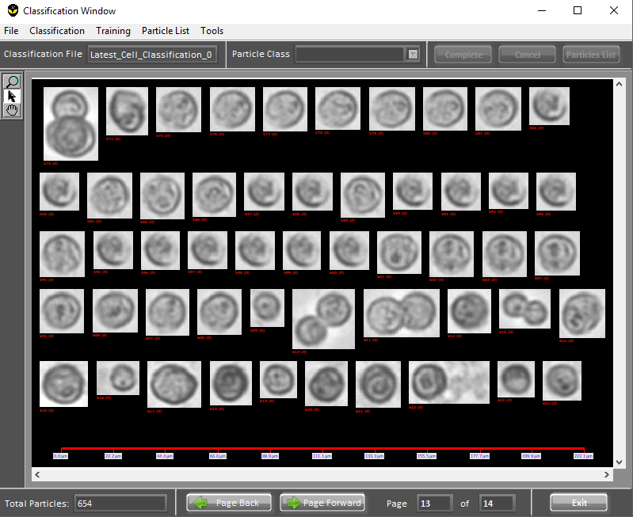
Software – Cell Classification
Viable Cells in Classification Window
Necrotic Cells in Classification Window

Slide 13
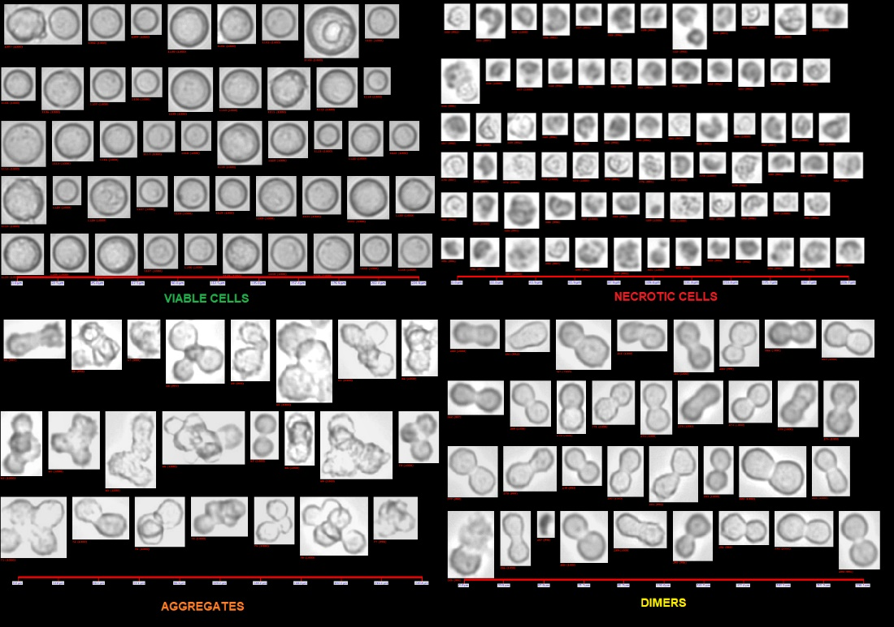
Software – Viability Determination
Using an advanced machine learning classification system the CantyVision software can determine morphological, color and size differences between various cell types at the same time.
Distinguishes between Viable, Necrotic, Apoptotic, Mitotic and Aggregated cells.
Cell counts and viability analysis can be conducted without any additive reagents or exclusion dyes like Trypan Blue.

Slide 14
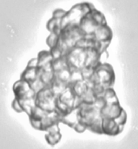
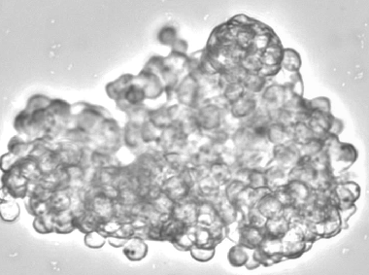
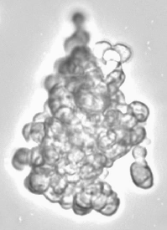


Software – Aggregates
Canty uses a gentile dilution and flow cell system which purposely prevents the break up of cell aggregates.
Cell aggregates are measured and quantified using a specialized algorithm to determine the approximate number of cells within an aggregate; therefore samples with high cell aggregation can still be measured.
The amount of cell aggregation gives specific insight into the bioreactor process. High cell aggregation prevents clustered cells from obtaining necessary nutrients and oxygen which can in turn lead to cell stress and necrosis.

Slide 15
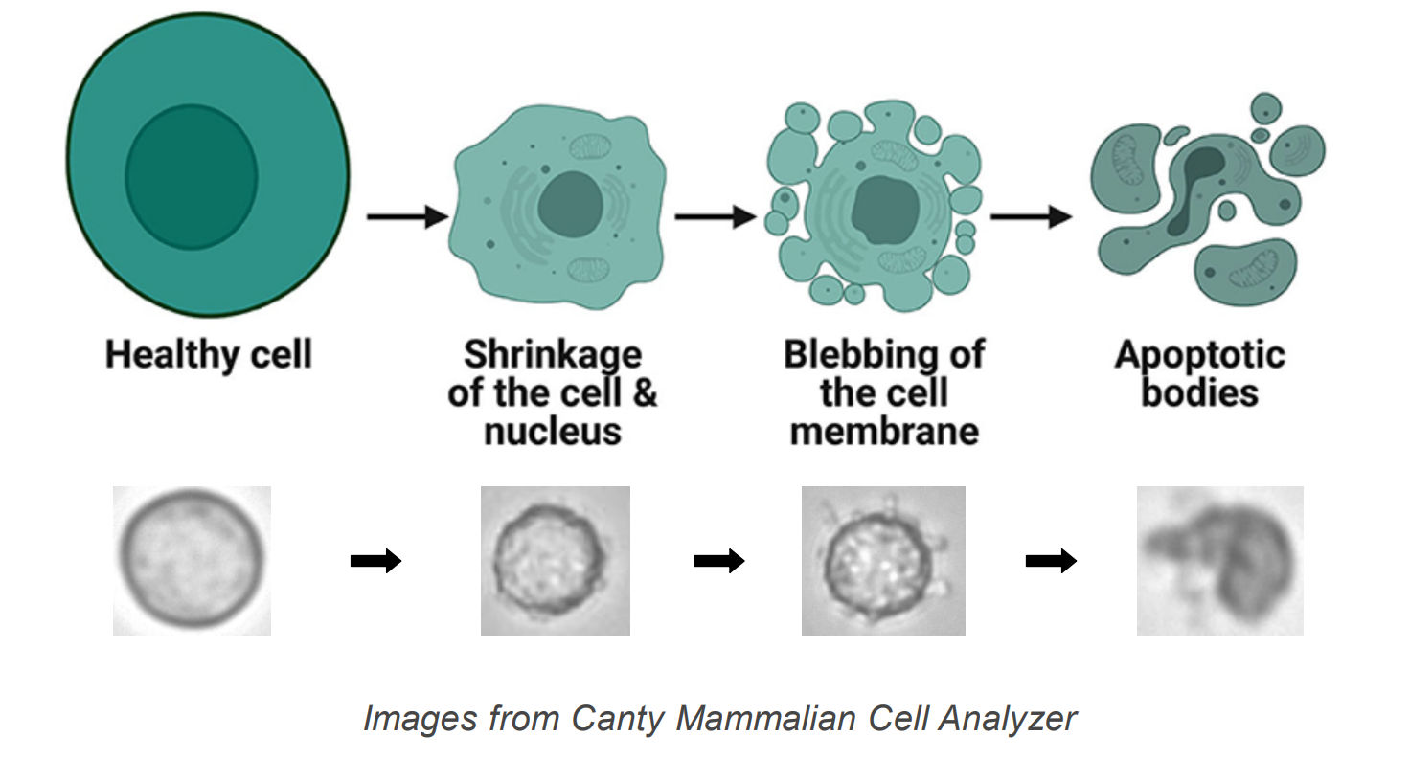
Software – Morphology Resolution

Slide 16
Case Study - NIBRT
Collaborative research with the National Institute for Bioprocessing Research and Training (NIBRT) of Ireland.
Periodic samples were taken over the course of CHO-EG2 cell cultures and analyzed using both an automated trypan blue based cell counter and the Canty MiniCell.
In Cell Viability %, Cell Density, Canty system gave comparable data to that obtained from Trypan Blue dye exclusion assays.

Slide 17
Case Study - NIBRT
Collaborative research with the National Institute for Bioprocessing Research and Training (NIBRT) of Ireland.
Periodic samples were taken over the course of CHO-EG2 cell cultures and analyzed using both an automated trypan blue based cell counter and the Canty MiniCell.
In Cell Viability %, Cell Density, Canty system gave comparable data to that obtained from Trypan Blue dye exclusion assays.

