Slide 1
Canty Process Technology
Glass Applications
Colleen Kelley, JM Canty Inc

Slide 2
Overview
Brief Introduction to Canty
Molten Glass Level
Onion Skin Width
Exit End Width/Ribbon Width
ADS Edge Tracking
Hot End Melt Line
Questions

Slide 3
Molten Glass Level
How it works?
CantyVision software has the capability to track the position of any edge.
For normal vessel applications it would track the edge between the vessel wall and the top of the process fluid.
Reflection issues with molten glass make it difficult to track the edge between the furnace wall and the surface of the molten glass.
Canty has developed a method whereby we measure the movement of a reflection of a stationary object such as a missing brick from the furnace wall.

Slide 4
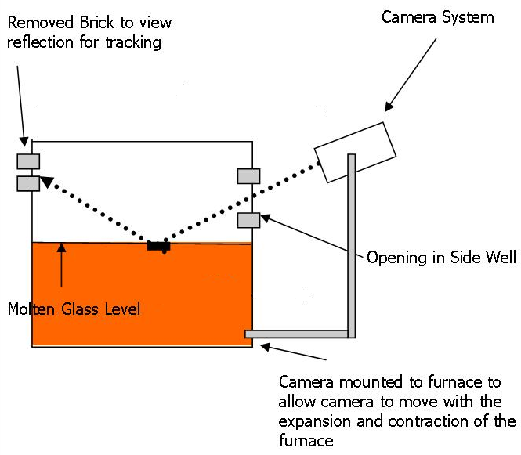
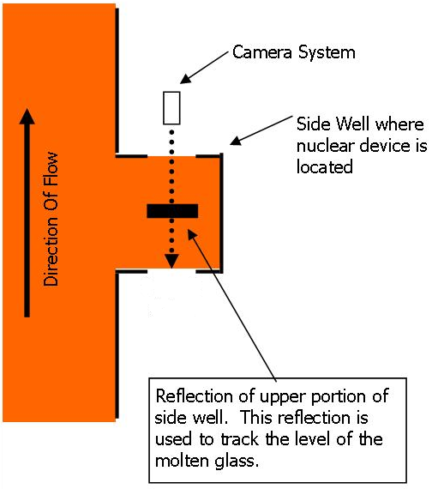
Molten Glass Level

Slide 5
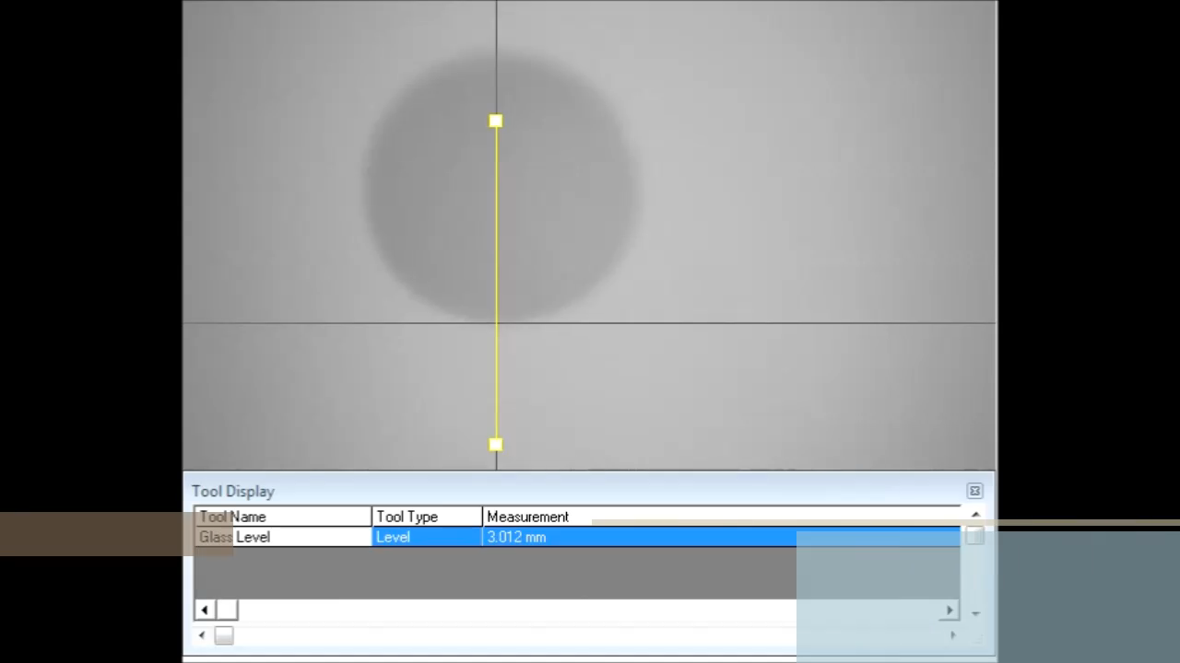

Slide 6
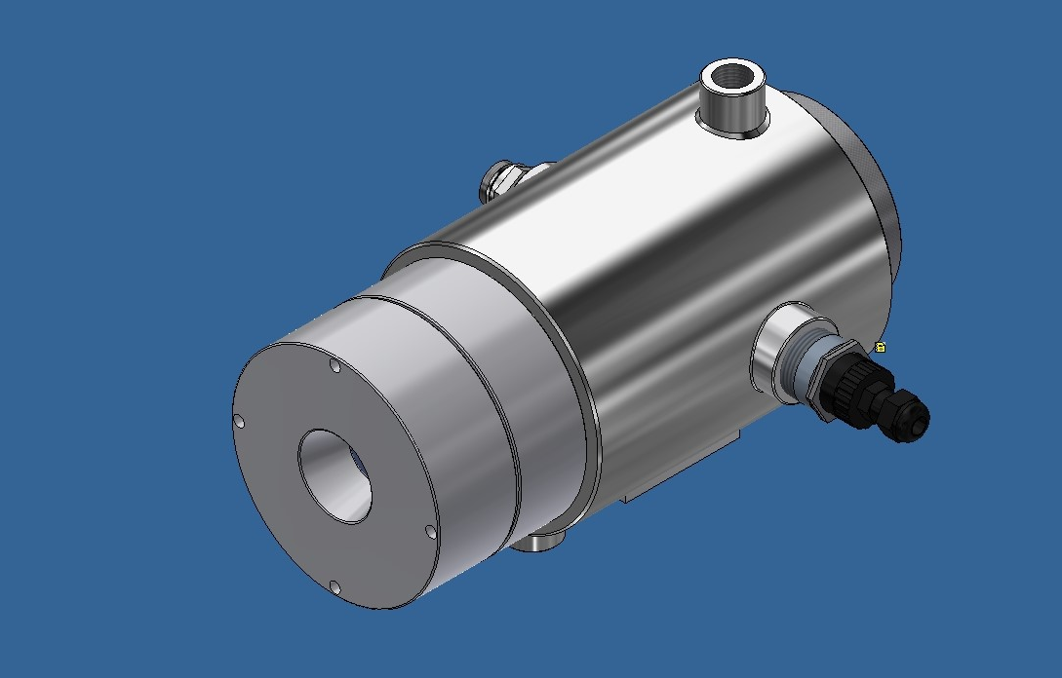
Onion Skin Width
Camera allows for the automated control of the position and shape at the initial draw in front of the tin bath (also known as the onion skin) resulting in a more uniform pull.
Result is less waste and higher efficiency for the glass.

Slide 7
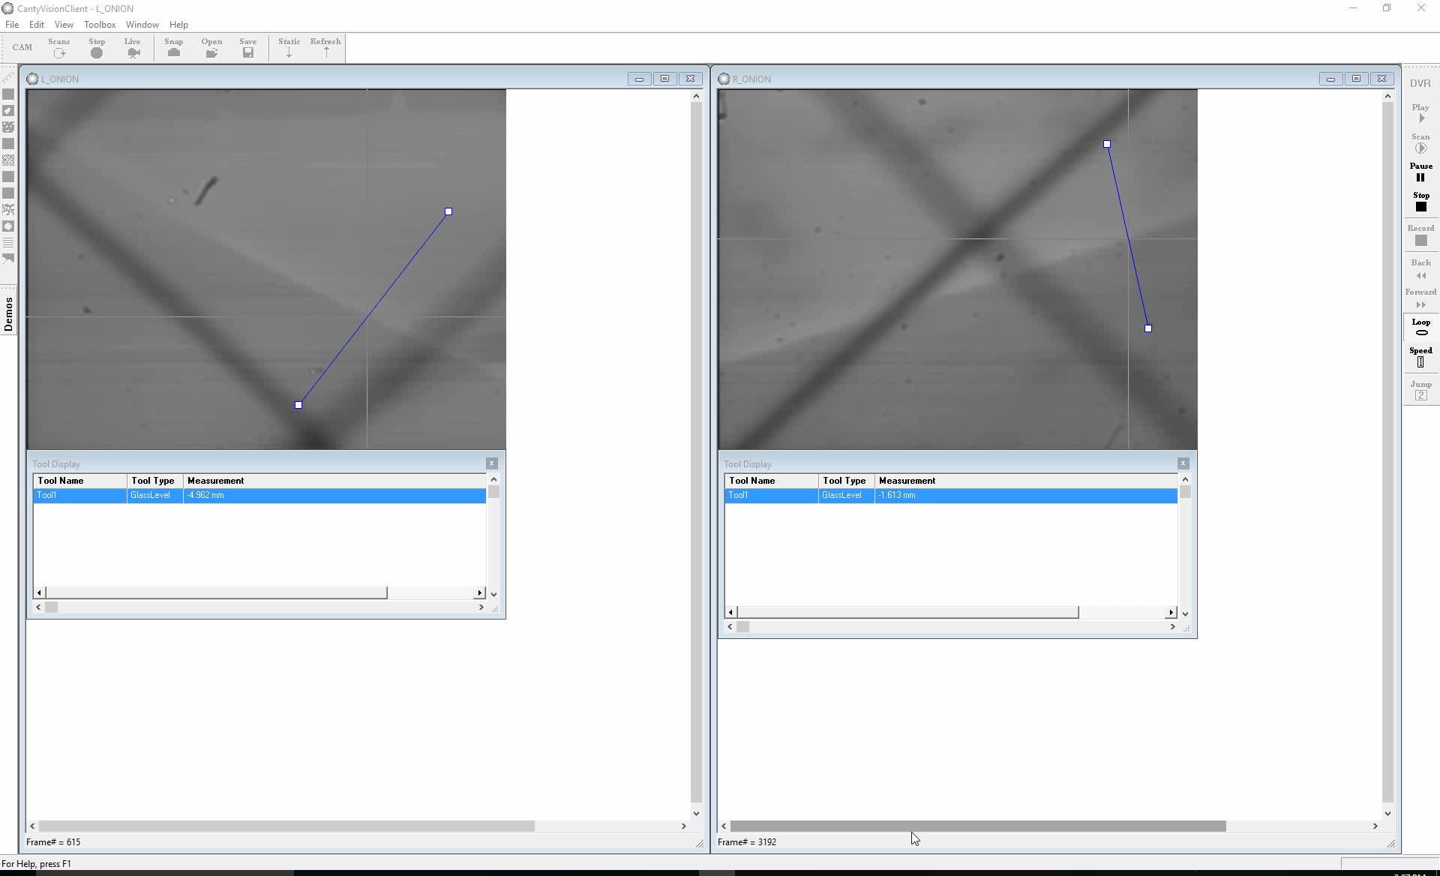
Onion Skin Video

Slide 8
Glass Width

Slide 9
Overview
Minimize trim loss – The Canty float glass system consists of a high temperature Ethernet process camera and incorporates special software to reduce glare along with a unique orifice plate that prevents debris from adhering to the lens, resulting in a clear view of the glass ribbon at all times.
This system is a non-contact web width control system which positions Ethernet cameras over the two glass edges and provides continuous real time measurement of web width as glass enters the Lehr annealing chamber after exiting the furnace chamber.
Width measurements are made in real-time on a continuous basis, with a resolution of .015". CantyVision™ Client Software utilizes image based technology to continually track the extreme edge of the glass ribbon and also the edge of the knurled region formed by the top roll machines used in the float bath furnace to shape and stabilize the glass ribbon.

Slide 10
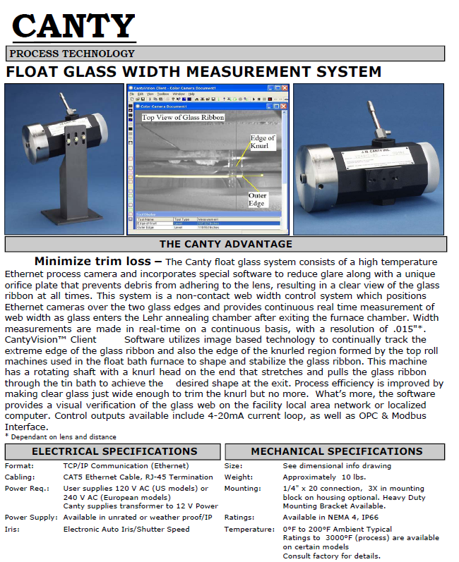
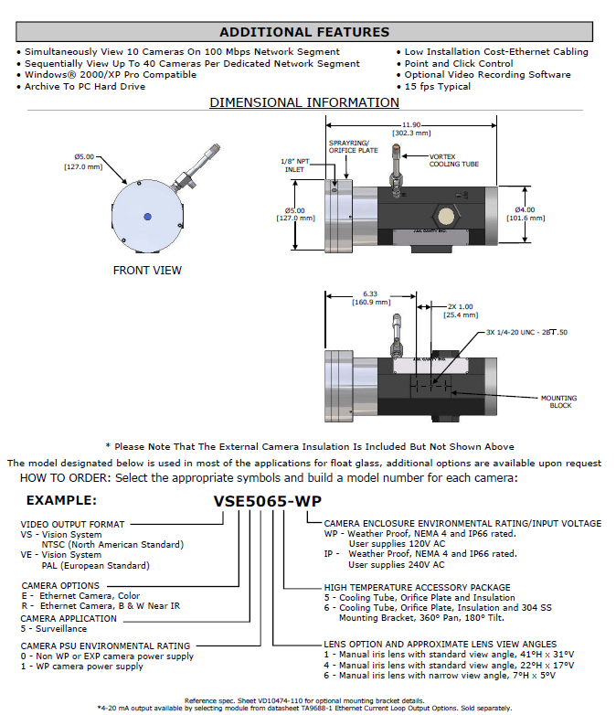
Technical Application

Slide 11
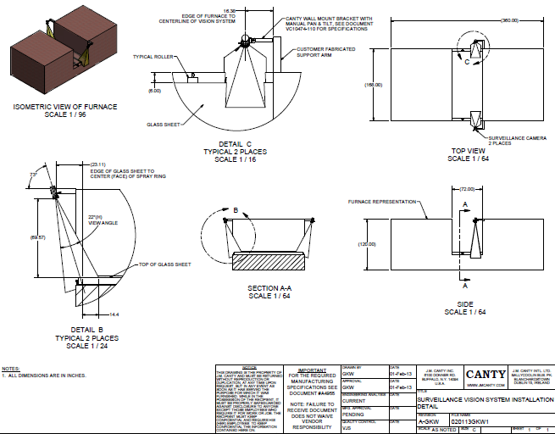
Application Illustration & Layout

Slide 12
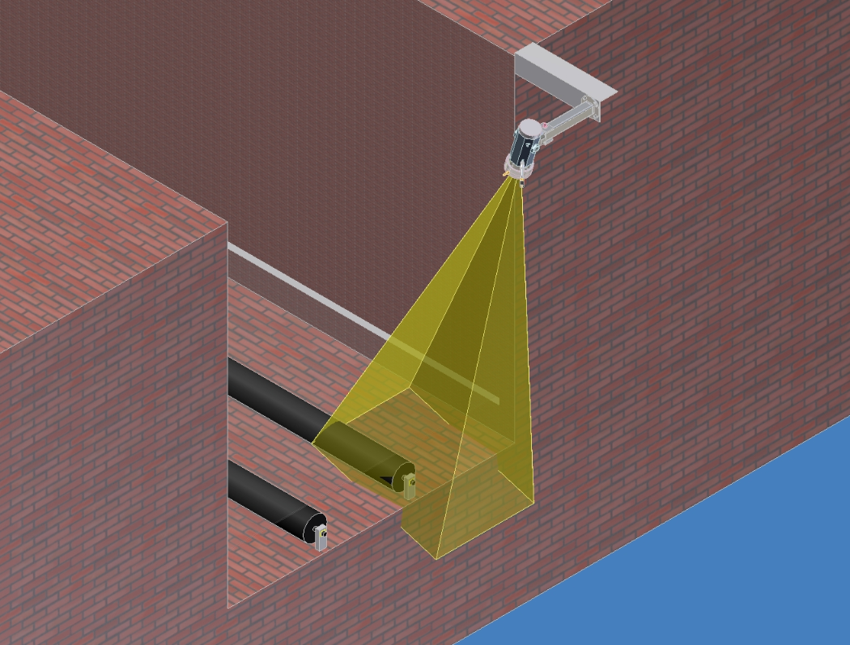
Camera Installation & Orientation

Slide 13
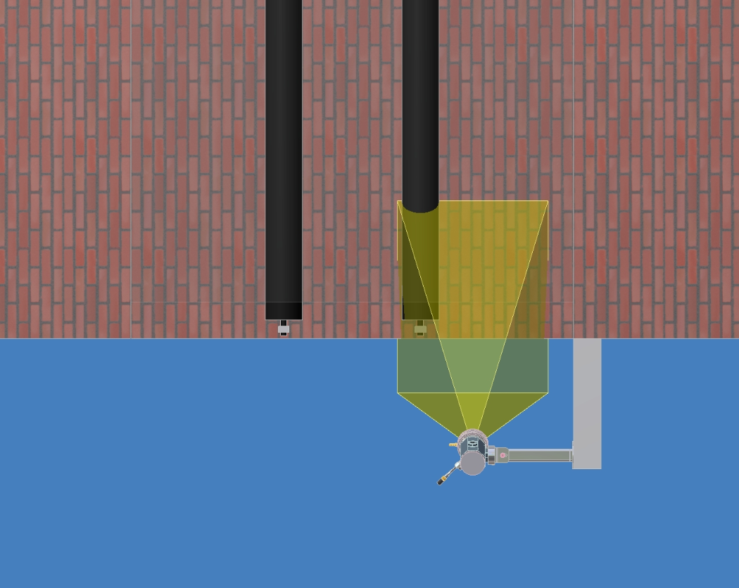
Camera Installation & Orientation
Top Down View

Slide 14
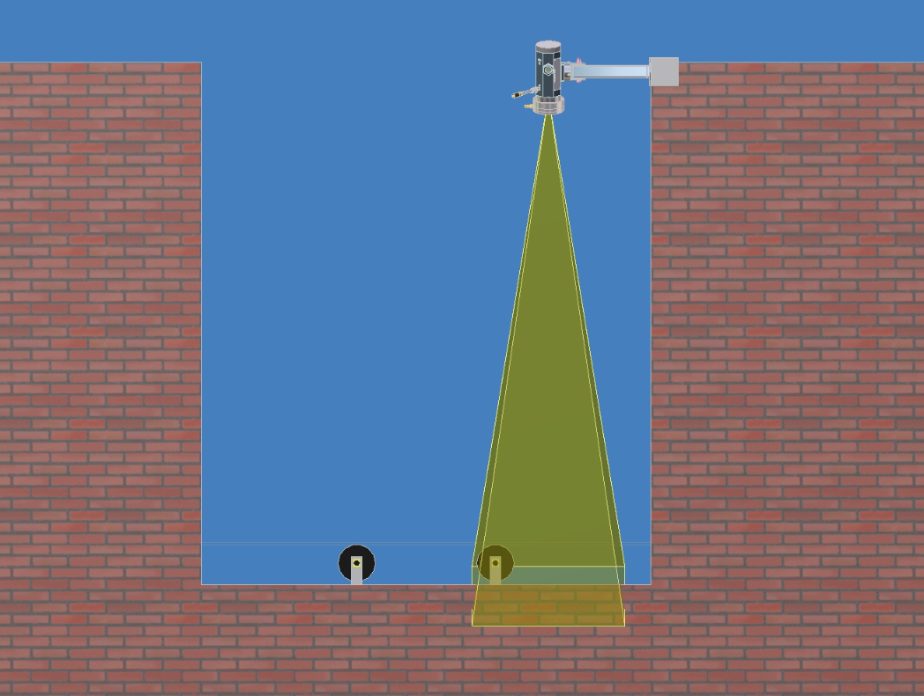
Camera Installation & Orientation
Horizontal View

Slide 15
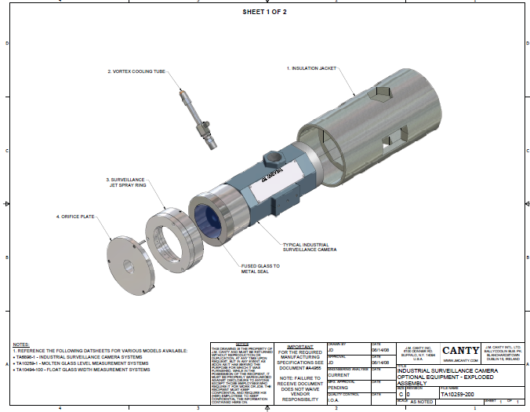
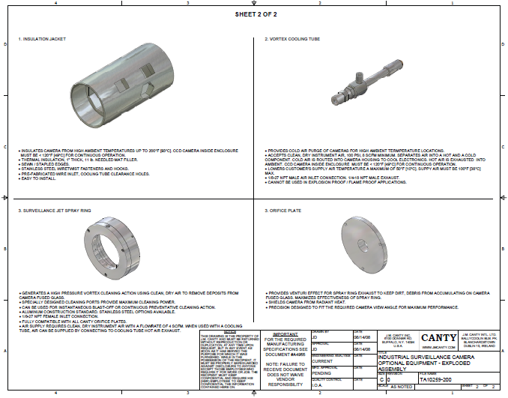
Industrial Surveillance Camera
Exploded Assembly

Slide 16
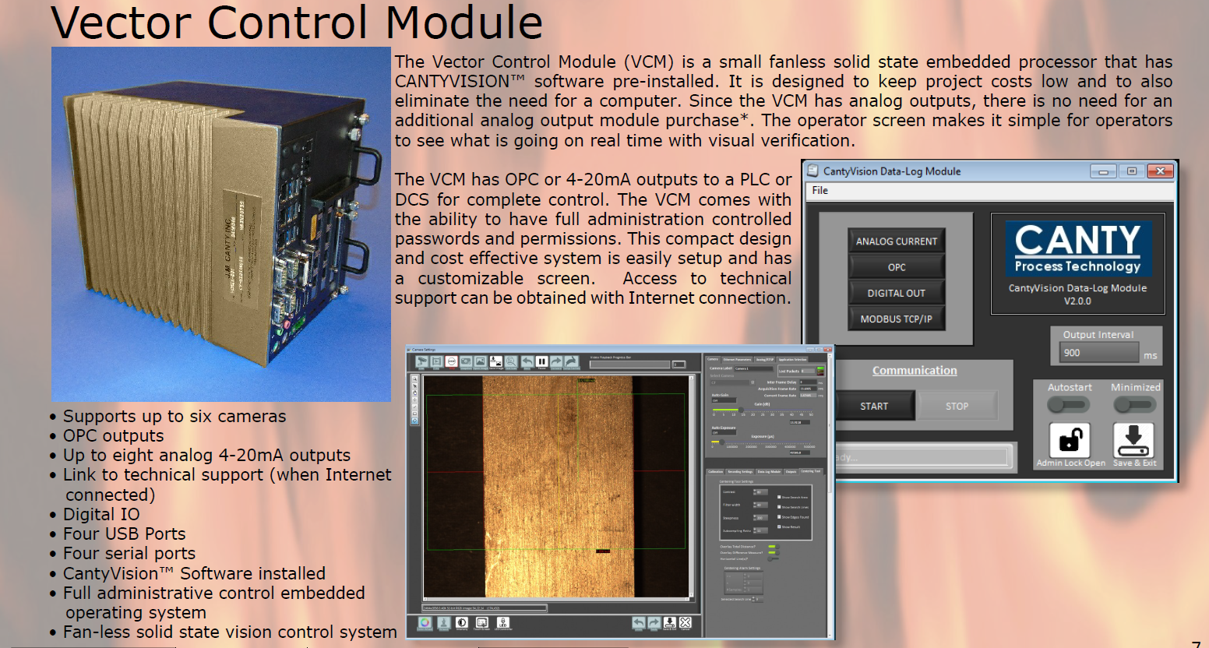
VCM

Slide 17
Vector Control Module Advantages
Allows for input up to 6 cameras
Allows for Cameras to run on Power Over Ethernet (POE) when directly connected via Cat 6 ethernet cable
Multiple outputs
-4-20mA
-OPC (OPC UA now available)
-Modbus
-Video Display
Camera heartbeat/Temperature Alarm
Ease of Remote Support

Slide 18
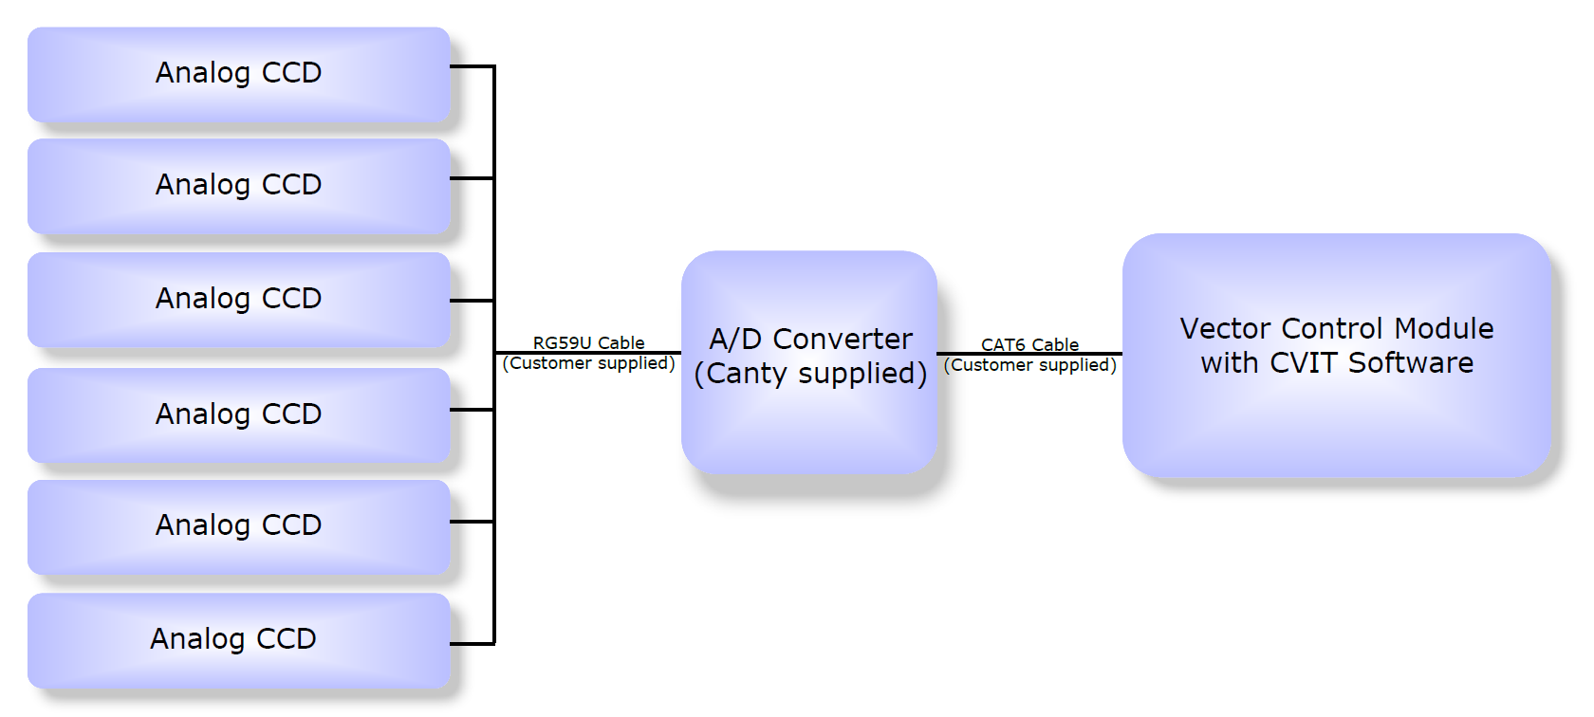
ADS Edge Tracing
Control of Puller Utilizing existing periscope cameras, no additional cameras needed

Slide 19
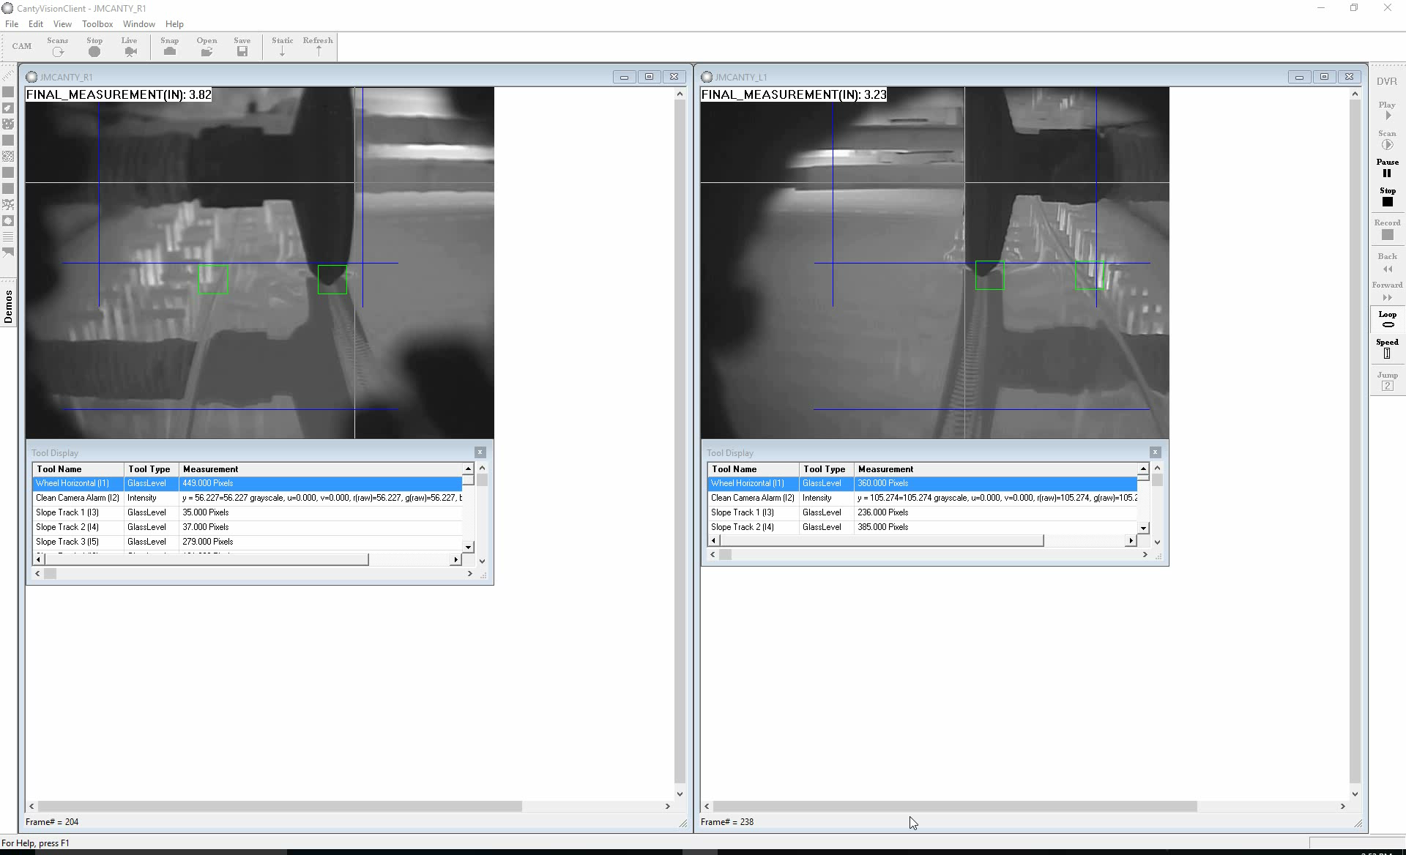

Slide 20
Hot End Melt Line

Slide 21
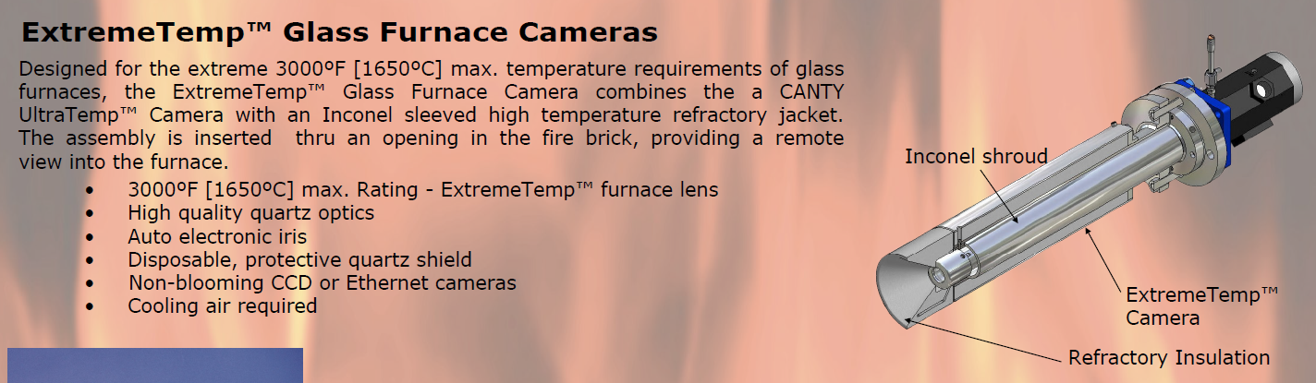
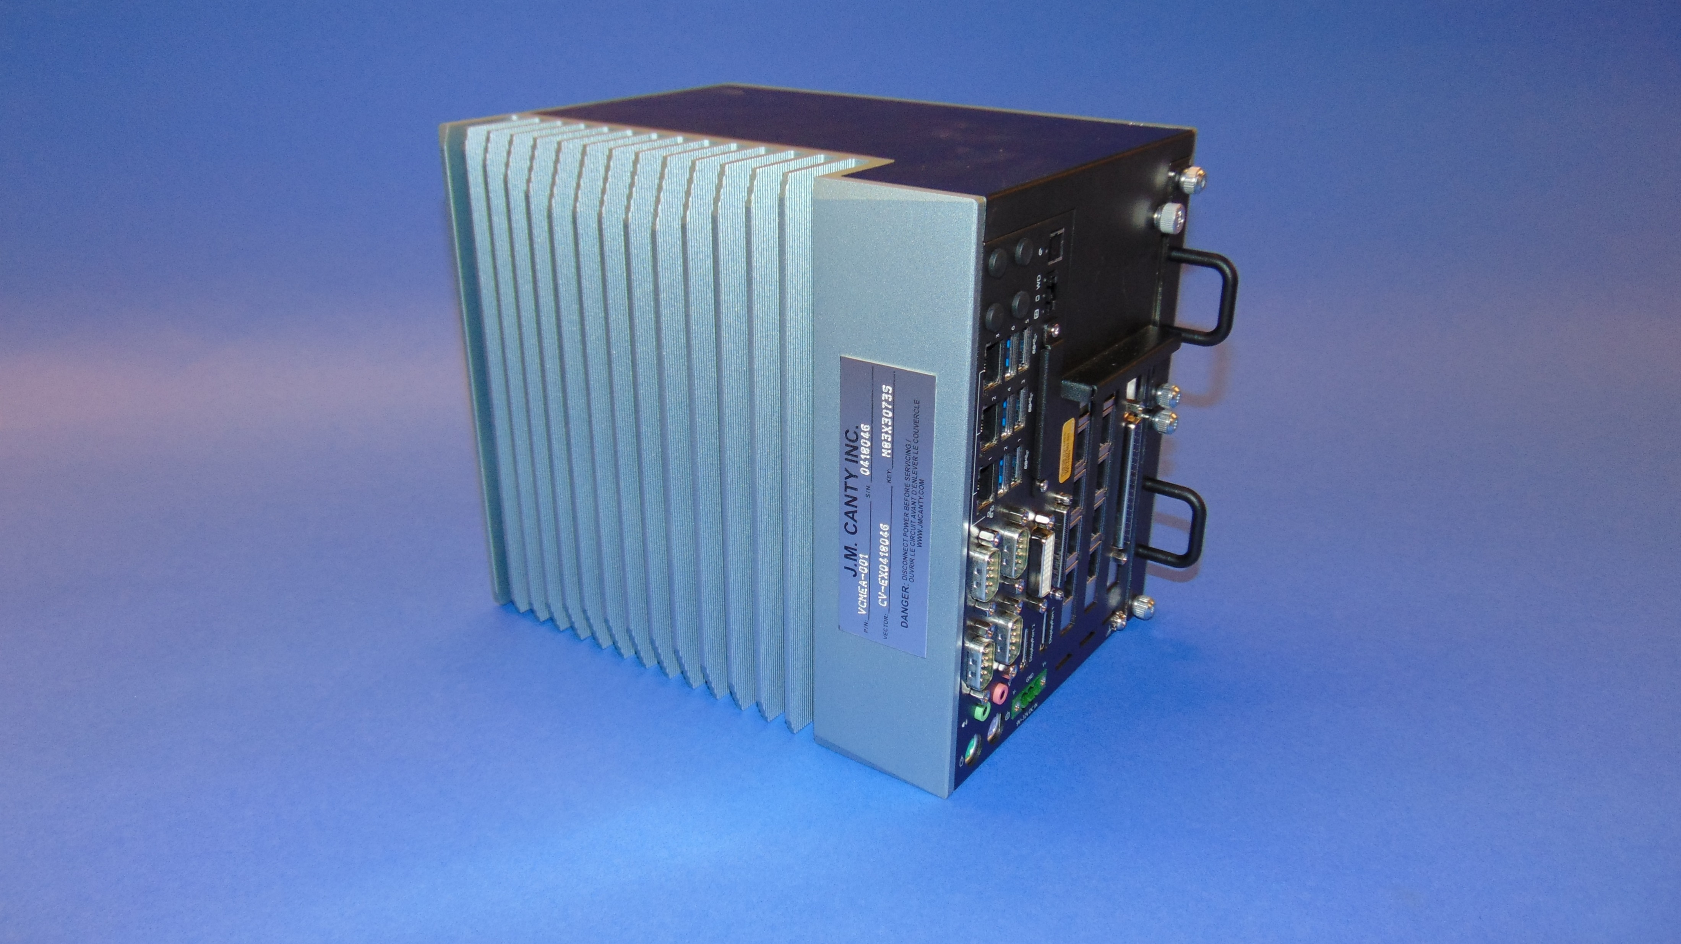
Hardware
Canty ExtremeTemp™ Camera to view bath
Canty VCM for analysis

Slide 22


Slide 23
Questions?

