Slide 1

Lime Kiln Monitoring
High Temperature Cameras
Burner Flame Detection
Wall and Bed Monitoring

Slide 2
LIME KILN CAMERA
A LIME KILN is used to produce quicklime by the calcination of limestone that is calcium carbonate. The rotary kiln that is used operates around 900°C-1000°C. This operation needs to be monitored and reported on to make sure the producers are making good useable product. If the product does not reach the required state to make the chemical reaction then is just stays as limestone. If the kiln over heats it will start to make unusable burnt product.
A key feature that must be maintained is the fire in which they are using to cause the calcination of the material. This can be achieved by monitoring the fire by its temperature. Another key item to monitor on the fire is its size and shape to make sure the kiln is having uniform heating. CANTYVISION can be used to monitor the temperature of the flame and also give visual verification of size.
The rotation of the kiln plays a key role in making sure the product is distributed correctly and that the product is not creeping up the side walls too high or too low as that will affect the rate at which the limestone is heating up and ultimately affect the calcination process. CANTYVISION can be used to give visual verification of product. This will be a critical feature for the operator.
JM Canty, Inc. · Buffalo, New York · Phone: (716) 625-4227 | JM Canty, Ltd. · Dublin, Ireland · Phone: +353 (1) 882-9621

Slide 3
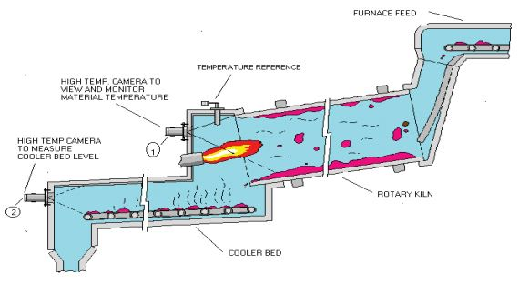
KILN CAMERA
JM Canty, Inc. · Buffalo, New York · Phone: (716) 625-4227 | JM Canty, Ltd. · Dublin, Ireland · Phone: +353 (1) 882-9621

Slide 4
Applications in Lime Kilns
Vision enables temperature analysis capability to all portions of the viewing screen.
Temperature Measurement
  Flame
  Bed
  Wall
Grate Monitoring for Large Rock “Klunkers”
Particle Size Analysis

Slide 5
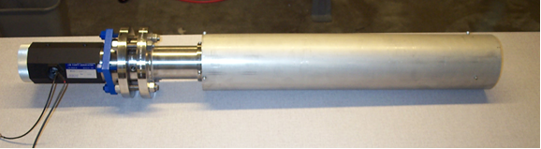
Typical High Temp Camera System

Slide 6
CANTY ADVANTAGES
High Temperature Reliability - Fused Glass
Maintenance – Spray Ring
Ethernet Connectivity
  Gigabit Camera
Lens Assembly
  Quartz or Sapphire Shield
    Replaceable
High Resolution Imaging
  .001”
Integrated Software
Camera Heartbeat
  Gives Temperature reading of electronics on the software
  Alarm when there is a problem

Slide 7
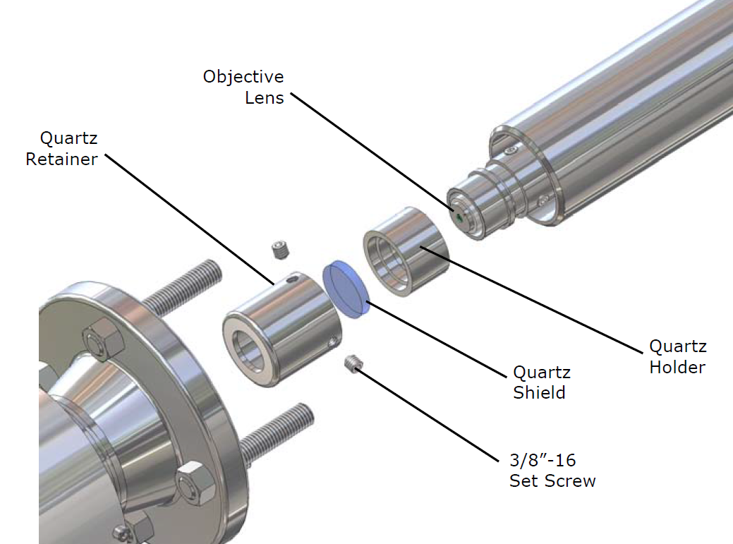
Key Features of Imaging Systems
Lens assembly allows the Ethernet CCD camera to remain outside the process in ambient room temperature air vs being fixed in the higher temperature process air.
JM Canty, Inc. · Buffalo, New York · Phone: (716) 625-4227 | JM Canty, Ltd. · Dublin, Ireland · Phone: +353 (1) 882-9621

Slide 8
Thermal Design
Correct installation is a critical component of the thermal design.
Location of lens tip back in the refractory minimizes the radiation and convective exposure and thus the heat load.

Slide 9
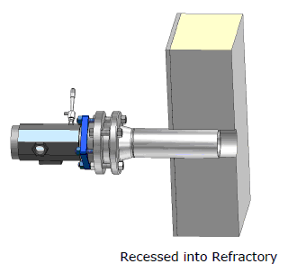
Typical Installation Detail

Slide 10
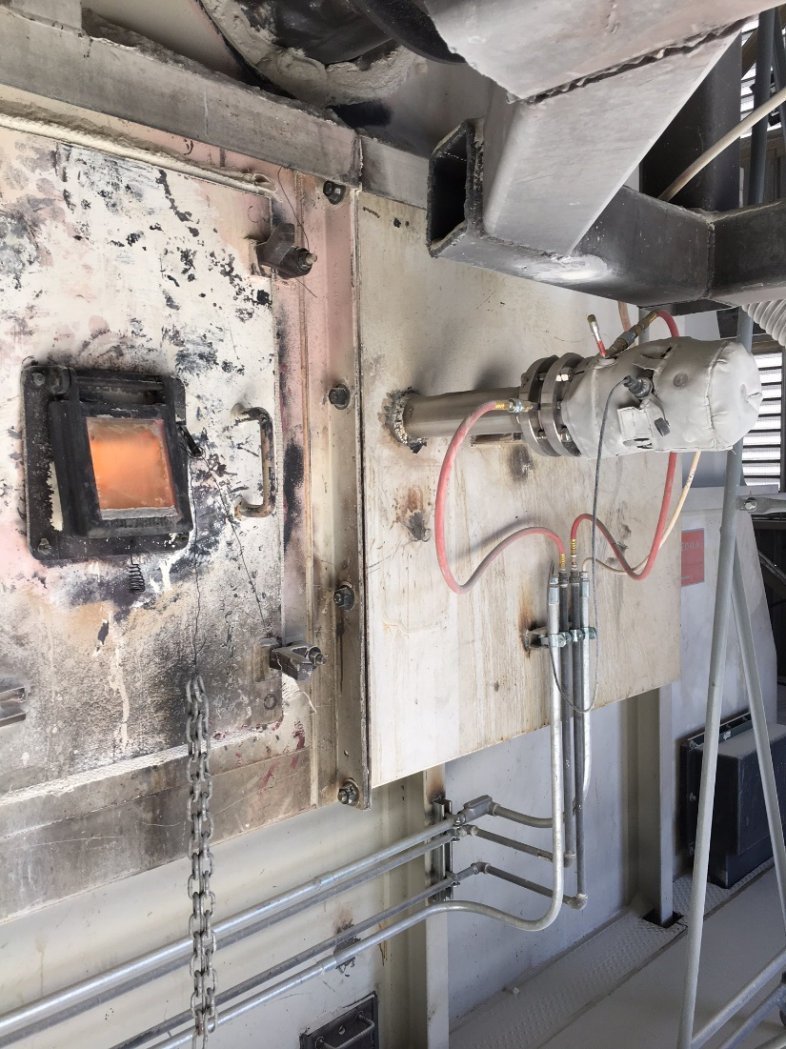
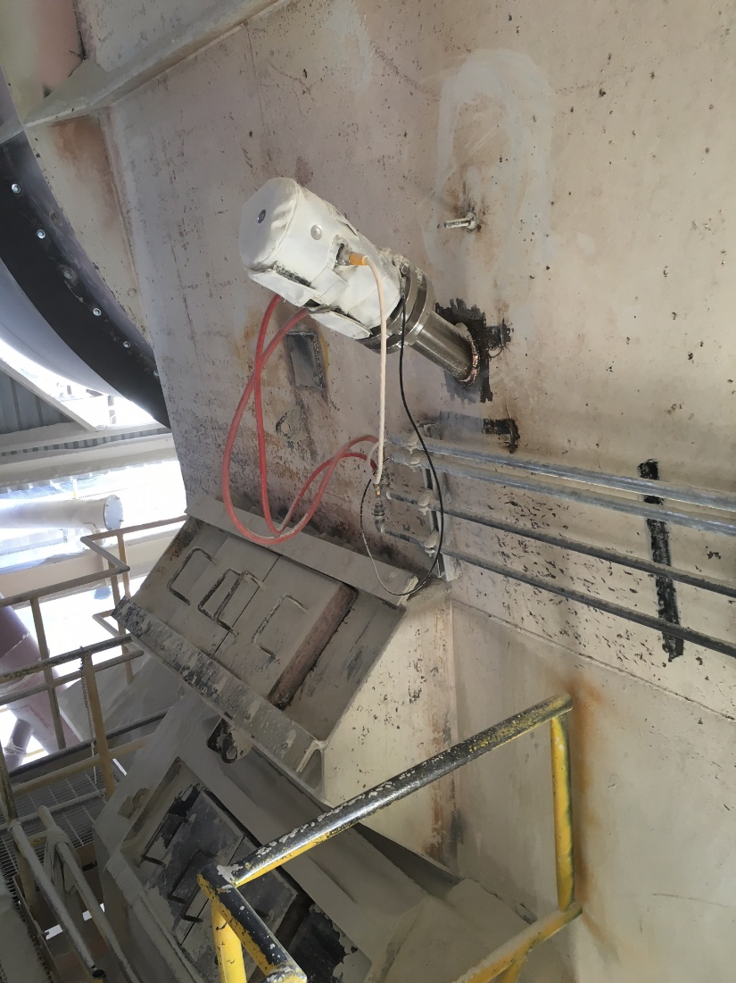
Typical Instillations
Kiln
Grate

Slide 11
Installation and Calibration
Once the vision system is installed it remains stationary in relation to the inside of the furnace.
After initial calibration system does not require recalibration if it remains in place.
Initial calibration is done in reference to thermocouple or pyrometer reading.

Slide 12
Vision Features
Analysis of any portion of the screen.
Multiple analysis zones available
Can measure temperature, flame size or flame detection in any zone. Zone area is analyzed, not just one point.
Visual aspect of the technology allows operator to optimize detection settings. Measurement area is the same each time.
Visual verification of upset conditions.

Slide 13
Temperature Method
Camera technology can evaluate temperature in two ways; Intensity measurement or RGB calibrated.
In most cases intensity, especially over a short range, suffices.
Camera can also be calibrated to the CIE scale and measure by color (Wavelength).

Slide 14
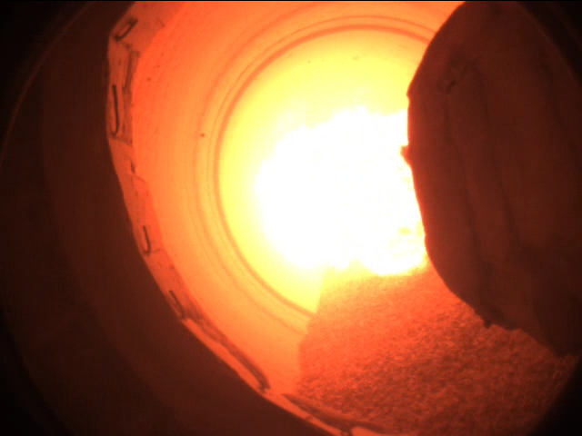
Flame Size and Detection
Rotary Kiln

Slide 15
Grate Monitoring
Rotary Kiln
Typically monitored by a person opening up the doors based on time
Causes cooling of the system
Very hot & dusty
Operators don’t like to do it
CANTY can set an image to alarm when a “Klinker” is on the grate to tell the operator to remove it so it doesn’t damage the grates.
Grates are very expensive

Slide 16
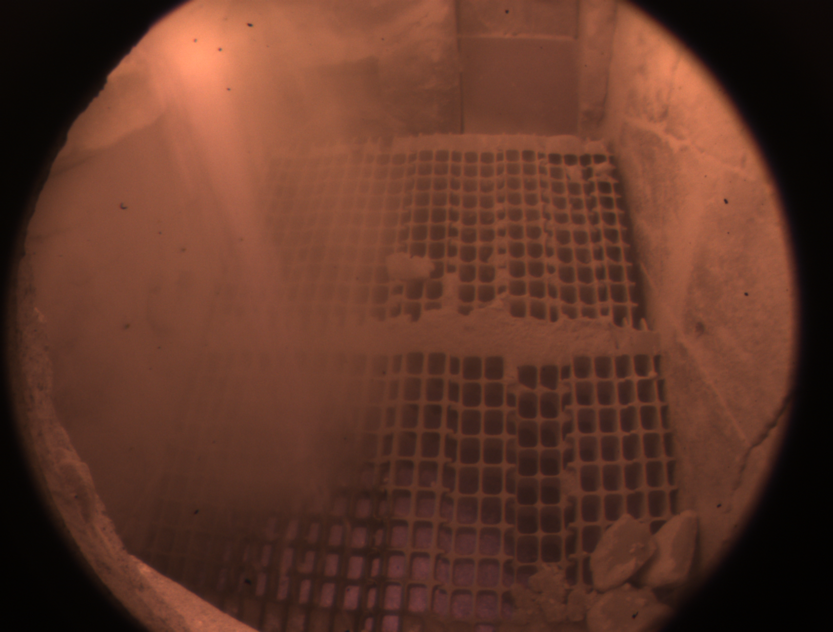

Slide 17
Particle Size
50mm to 100mm
Particle Size can be done in lab or online
Typically they use sieves for the measurement in the lab

Slide 18
Conclusion
Vision presents features and options that expand the capability of high temperature thermography. Visual confirmation of the system set up and results are enormous benefits in trusting data. Two dimensional capability of the system is also beneficial in assessing temperature on a locally average basis and not by a single point.
Particle Size analysis can be done inline or lab to make sure correct product is passing through the kiln

