Slide 1

Advancements in Fuel and Lube Oil Inspection Technology
Using Shape Recognition Capacity of Dynamic Imaging to Achieve a More Accurate Analysis of Fluids
By
Thomas M. Canty, P.E.
President, J.M. Canty Inc.
&
Paul J. O’Brien
Engineering Manager, J.M. Canty Inc
JM Canty, Inc. · Buffalo, New York · Phone: (716) 625-4227 | JM Canty, Ltd. · Dublin, Ireland · Phone: +353 (1) 882-9621

Slide 2
Introduction
Vision is now used to monitor and analyze a wide range of multiphase mixtures such as oil and solids in produced water, solids and water in fuels and lube oils, percent solids in separation and filter break applications .
Technology is effective because it:
- can survive the extreme process conditions
- can detect and discern between solids, water droplets and air bubbles and thereby eliminate error and inform the operator.
- Crude oil particulate, water ,wax and hydrates

Slide 3
Dynamic Imaging Fundamentals
High Speed, High Resolution and High Magnification images result in particle count and categorization capability in one measurement.
LED advancements have improved particle detections due to brighter, more consistent lighting fields, as well as the ability to analyze high speed flows.
Shape parameters allow software to discern between solid particles, water droplets and air bubbles revealing a more complete condition of the analyzed fluid.
Shape parameters also enable engineers to assess the type of particles present according to their shape, and to perhaps determine a source of the contamination.

Slide 4
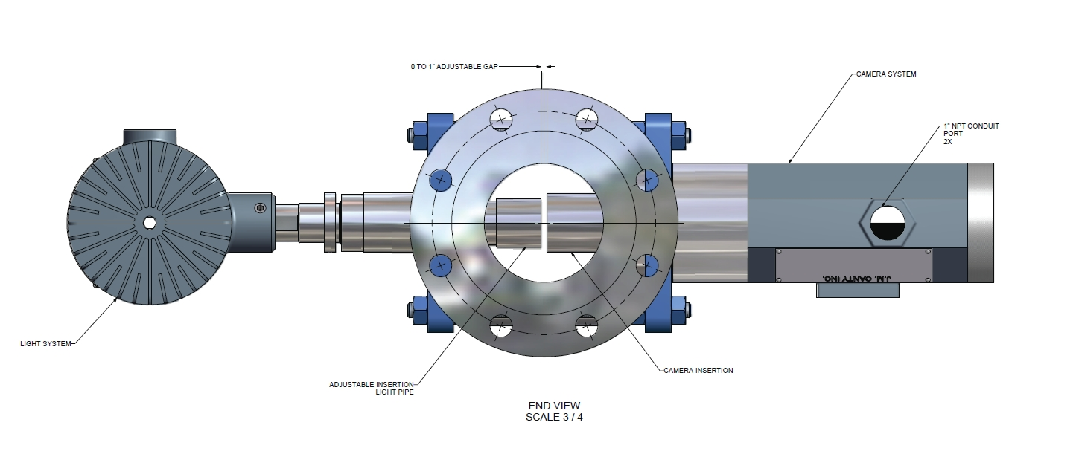
Typical Vision System:
Light, Flow Body, Camera
Light / Camera probes form measurement zone

Slide 5
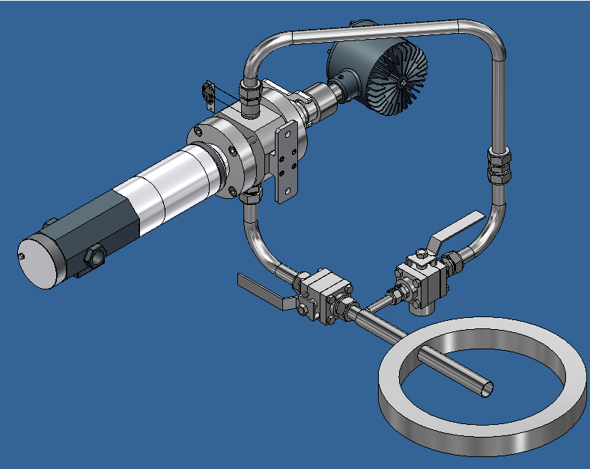
At-Line Instrument

Slide 6
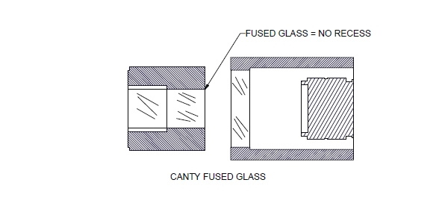
Contact Surfaces
Notes:
Discuss cleanliness of fused construction

Slide 7
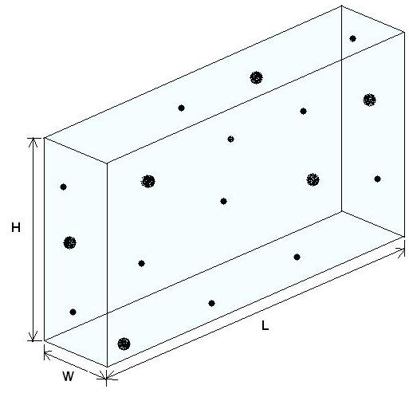
Measurement Zone Volume
Notes:
Discuss Volume and per mL Calc.

Slide 8

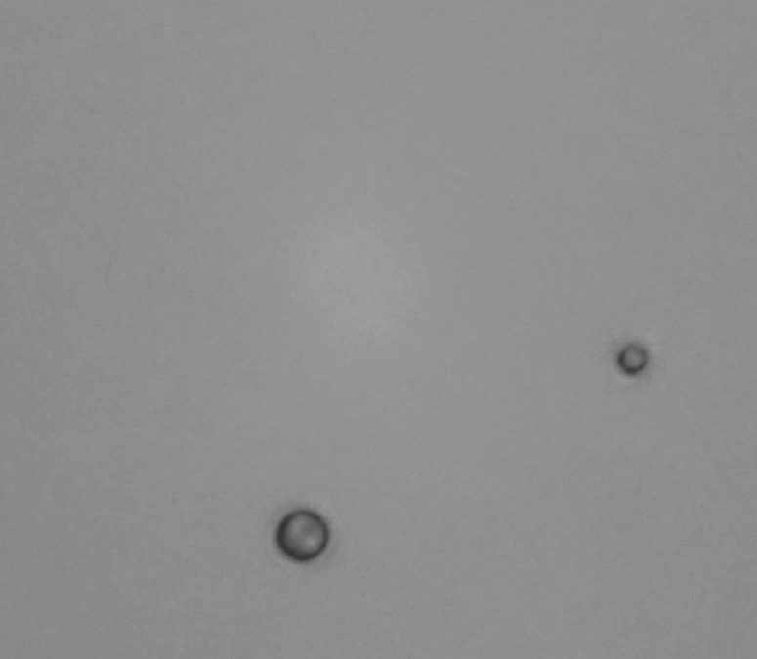
Solid Particle and Water Droplet in Fuel
Solid Particle Water Droplet

Slide 9
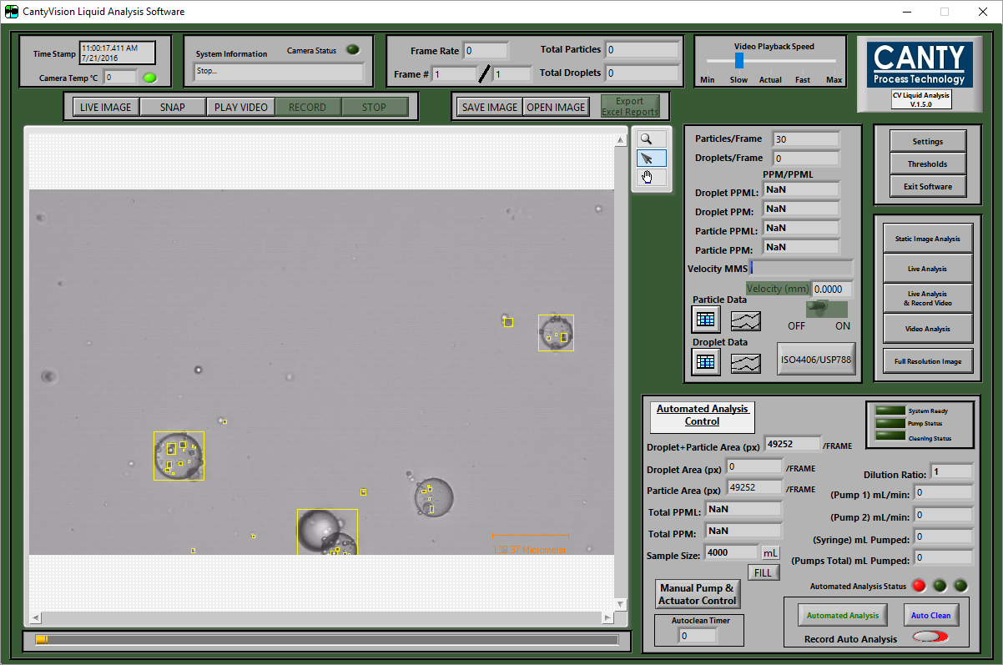
Anti Foam in Lube Oil
Silcon Droplets

Slide 10
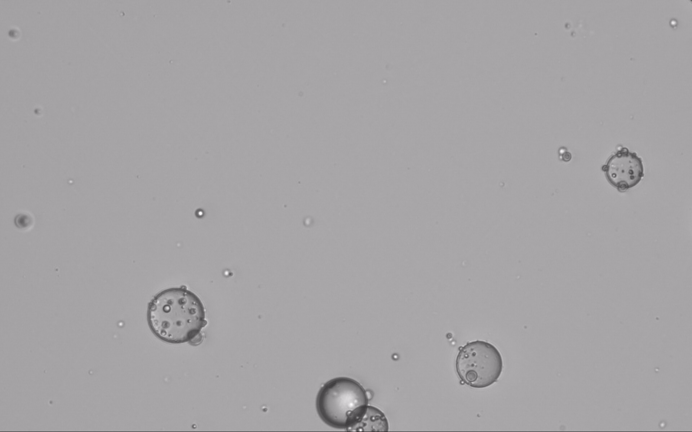
Anti Foam in Lube Oil
Silcon Droplets

Slide 11
Section 1
FUELS
Primary Concerns:
- Detect Solid Particles – clog filters and injection ports
- Detect Water Droplets and report accordingly – can freeze at altitude clogging lines and filters, reduce combustion efficiency of fuel.
- Screen Air Bubbles – cause error for in-line measurements mostly.
- Rapid, Representative Analysis

Slide 12
Technology Trend
Inspection throughout the supply chain is required, right up to the point of vehicle load in which is the critical point where fuel must be clean and dry. This is currently not the case on a widespread basis.
Rapid, near real time analysis is required to make field applications feasible. Toward that end the following improvements have come on line:
- Rapid frame analysis – traditional CCD camera technology can
process frames up to 20 per second at a reasonable cost.
- Camera resolution continues to improve
- LED technology is now advanced enough to provide bright
illumination and consistent field lighting (Std Dev < ½%). Timed, pulse lighting controls thermal generation enabling very long life cycle.

Slide 13
Field Testing – Shipboard
Testing was conducted shipboard to search for contamination source in the vehicle fuel supply chain. Canty / TARDEC were present for the testing.
Fuel was tested on-line and off line.
At the fueling hose (after filtration) and prior to filtration.
Canty instrument tested both ways. Off line test was compared to a light obscuration particle counting unit.
Solids vs Water detection is also illustrated.

Slide 14
Samples Tested Both Instruments
Sample 6A Sample 6B Sample 414-1 Sample 414-2
Sample 6A | ISO4406 Solids | Water
Canty InFlow | 17/17/15 | 4.76 ppm
Light Obscuration | 19/18/14 | NA
Sample 6B | ISO4406 Solids | Water
Canty InFlow | 15/14/12 | 1.06 ppm
Light Obscuration | 18/16/11 | NA
Sample 414-1 | ISO4406 Solids | Water
Canty InFlow | 14/13/7 | 0 ppm
Light Obscuration | 15/14/10 | NA
Sample 414-2 | ISO4406 Solids | Water
Canty InFlow | 13/12/11 | 0.01 ppm
Light Obscuration | 15/13/10 | NA

Slide 15

Air Bubbles in Fueling Hoses Require Screening Out

Slide 16
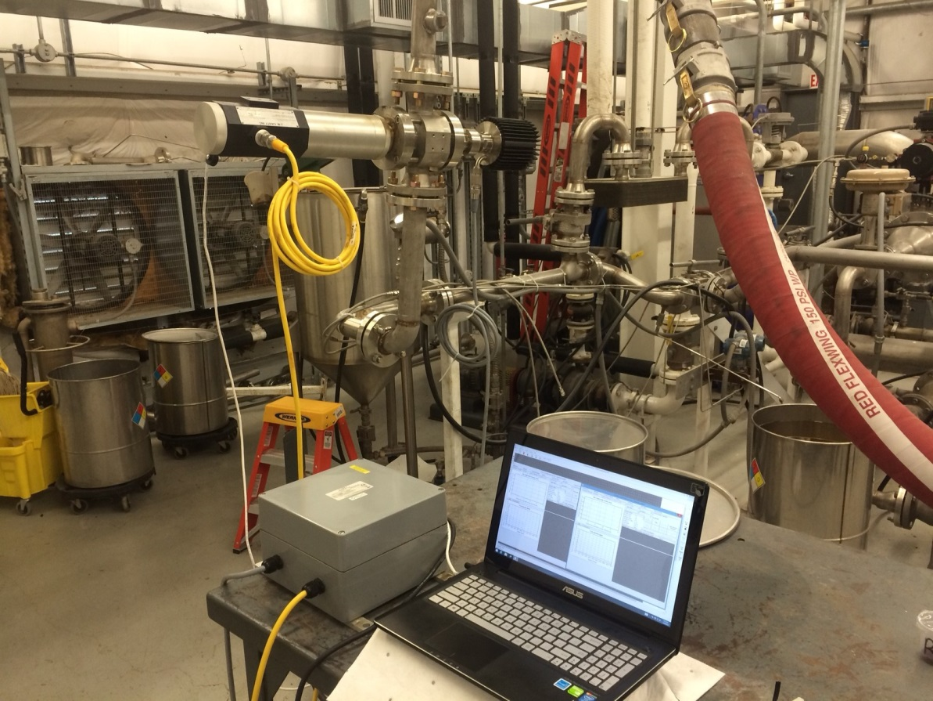
USN Fuel Test – Pax River Naval Station

Slide 17
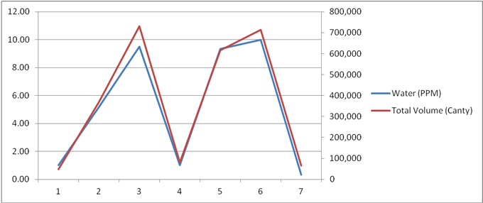
In-Line Water in Fuel Testing

Slide 18
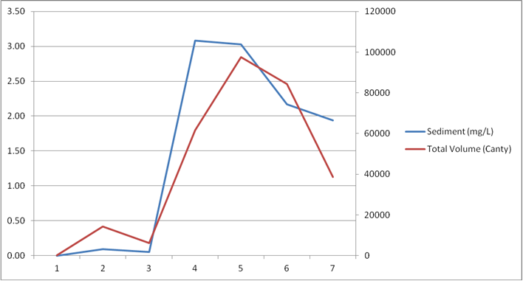
In-Line Solids in Fuel Testing - USN

Slide 19
Vision vs Light Obscuration Comparison
Water Detection
Vision: Dry Fuel and ‘Wet’ Fuel (5 ppm water). Solid particle counts are reported in counts over the time period and are stable from dry to wet
Ref: TARDEC report: Utilization of Automated Imaging for the Detection of Fuel Contamination

Slide 20
Vision vs Light Obscuration Comparison;
Water Detection
Light Obscuration Dry Fuel vs ‘Wet’ Fuel. Solid particle counts are reported per mL and increase with the addition of water.
Ref: TARDEC report: Utilization of Automated Imaging for the Detection of Fuel Contamination

Slide 21
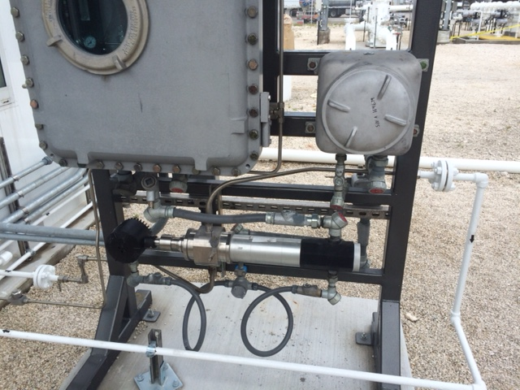
Typical At-Line Installation

Slide 22
ASTM Fuel & Lube Oil Standards for Imaging
D8049 – Standard Method for analyzing distillate fuels for solid particle and water content.
D8072 – Standard Classification for reporting imaging results for solid particle and water content in hydrocarbon based petroleum products.
D7596-Standard Test Method for Automatic Particle Counting and Classification of Oils Using a Direct Imaging Tester

Slide 23
Reporting of Solids and Water per D8072
If using D8049 for fuel analysis, solids and water would be reported:
    D8049 W / X / Y / Z – Water content
    W, X, Y and Z represent the >1 um, >4 um, >6 um and >14 um ranges and their values
    are drawn from a chart with count per mL values (see next slide)
    Water content is reported in ppm
    So a typical fuel reading might be:
    D8049 14/13/11/9 – 1.3

Slide 24
Greater than | Less than or equal to |  | Range Identifying Number
2,500,000 |  |  | 28
1300000 | 2500000 |  | 28
640000 | 1300000 |  | 27
320000 | 640000 |  | 26
160000 | 320000 |  | 25
80000 | 160000 |  | 24
40000 | 80000 |  | 23
20000 | 40000 |  | 22
10000 | 20000 |  | 21
5000 | 10000 |  | 20
2500 | 5000 |  | 19
1300 | 2500 |  | 18
640 | 1300 |  | 17
320 | 640 |  | 16
160 | 320 |  | 15
80 | 160 |  | 14
40 | 80 |  | 13
20 | 40 |  | 12
10 | 20 |  | 11
5 | 10 |  | 10
2.5 | 5 |  | 9
1.3 | 2.5 |  | 8
0.64 | 1.3 |  | 7
0.32 | 0.64 |  | 6
0.16 | 0.32 |  | 5
0.08 | 0.16 |  | 4
0.04 | 0.08 |  | 3
0.02 | 0.04 |  | 2
0.01 | 0.02 |  | 1
0 | 0.01 |  | 0

Slide 25
Section 2
Lubricating Oils
Primary Concerns:
- Solids indicate system wear; cause wear as long as they remain suspended in the oil (Vehicles, Machinery etc…)
- Identifying source of wear is important in order to address any degrading issues within the equipment’s engine or propulsion.
- Identifying water which can lead to corrosion and the reduction of lubricating capacity of the oil.

Slide 26
Advancements in Lubricating Oils
High Speed Camera and LED Illumination
Flexibility of imaging allows for count by equivalent diameter, but classification by actual particle measurements – minor/major diameter, aspect ratio, circularity etc… in order to determine particle shape.
Small cell volume for best response
Analysis Standard ASTM D7596
Reporting Standard ASTM D8072 available for imaging instruments provides a similar structure as ISO4406 however includes the reporting of water content.

Slide 27
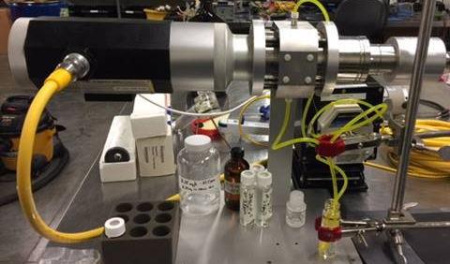
New, Small Cell InFlow
InFLow
Pump
Reservoir

Slide 28
THANK YOU

