Slide 1
IN-LINE VISUAL ANALYSIS OF LUBE OILS FOR SOLIDS AND WATER DETECTION ON A CONTINUAL BASIS
Thomas M. Canty, P.E.
J.M. Canty Inc.
Buffalo, NY

Slide 2
Introduction
Fundamentals of a good vision system
- Illumination
- Camera
- Clean, Clear, Rugged process connection
(Fused Glass-to-Metal)
Advantages of vision technology
- can survive the extreme process conditions
- can detect and discern shapes
- can separate water from solids
- visual verification

Slide 3
Vision Technology Background
Technology has been developed over 25 years achieving wide acceptance into the process industries.
More recent system improvements include:
Control and advancement of illumination systems (LED)
High resolution, fast frame rate cameras which have increased data collection by an order of magnitude.
Software to analyze increasingly complex images, discern solids from water/gas to eliminate this error source.

Slide 4
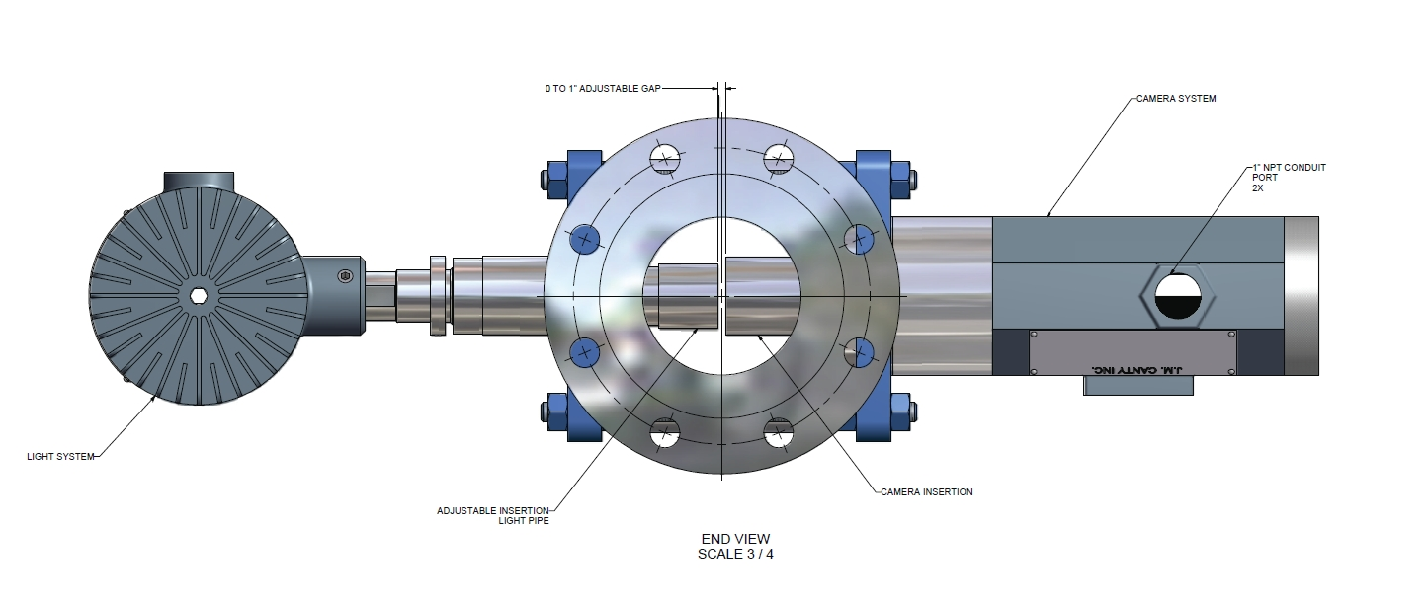
Typical Vision System:
Light, Flow Body, Camera
Light / Camera probes form measurement zone

Slide 5
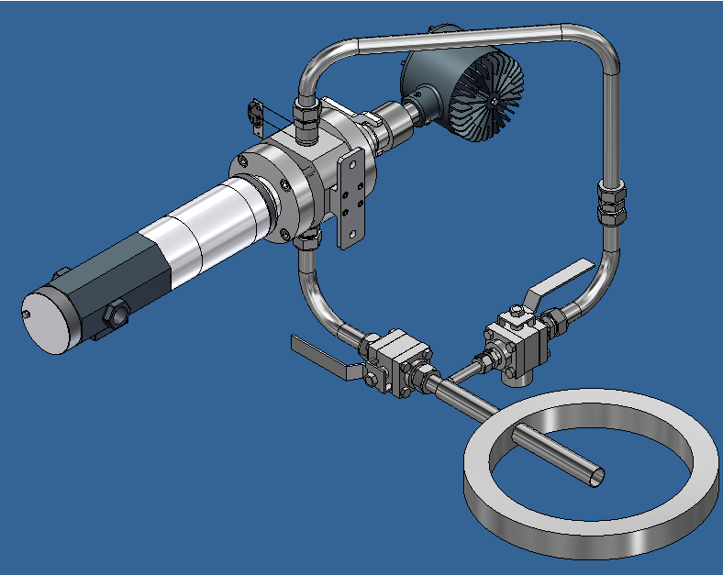
At-Line Instrument

Slide 6
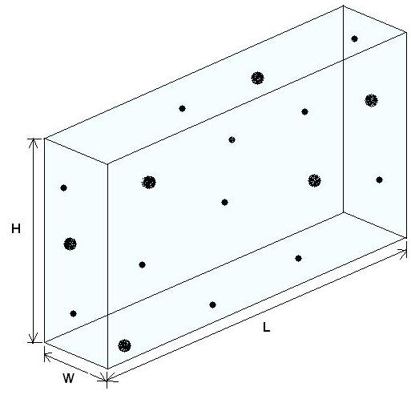
Measurement Zone Volume
Notes:
Discuss Volume and per mL Calc.

Slide 7
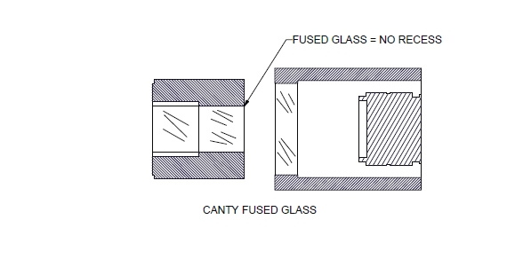
Contact Surfaces
Notes:
Discuss cleanliness of fused construction

Slide 8
Particle Detection
Knowledge of particle size, shape and type can be of great benefit in determining the source of contamination and the resolution to the problem.
The visual component allows the software to classify by Minor Diameter, Major Diameter, Aspect Ratio and other shape features such as circularity: Area/Perimeter

Slide 9
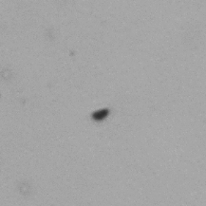
Solid Particle in Lube Oil
Notes:
Discuss visual differences in water, air, solids and detection modes

Slide 10
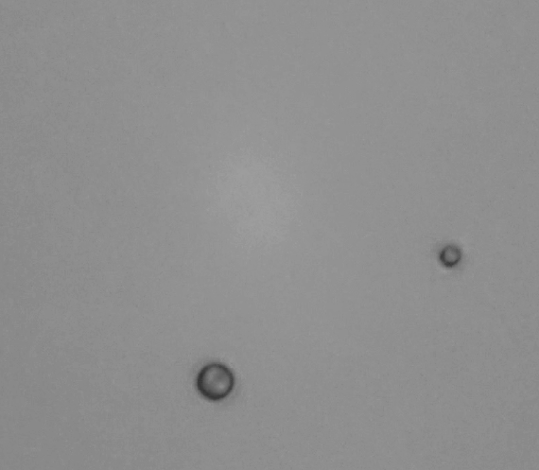
Water Droplets in Lube Oil
Circularity = Area / (Perimeter)^2; for circle = 1 / 4 pi

Slide 11
Oil & Coolant Analysis
Vision can provide solid particle and droplet detection capability whereas other technologies do not discern the difference and provide a total count.
Vision is ideal for on-line application in a storage facility or as a custody transfer monitor.
Recently approved standard method by ASTM

Slide 12
In field Test Comparison Water in Hydrocarbon
Testing was performed to compare the visual method and Karl Fischer method in determining water content in a API 34.88 Diesel fuel.
A single pass flow loop was used to simulate on-line conditions and water was injected in small concentrations. Samples were taken for lab determination and compared to the on-line visual results.

Slide 13
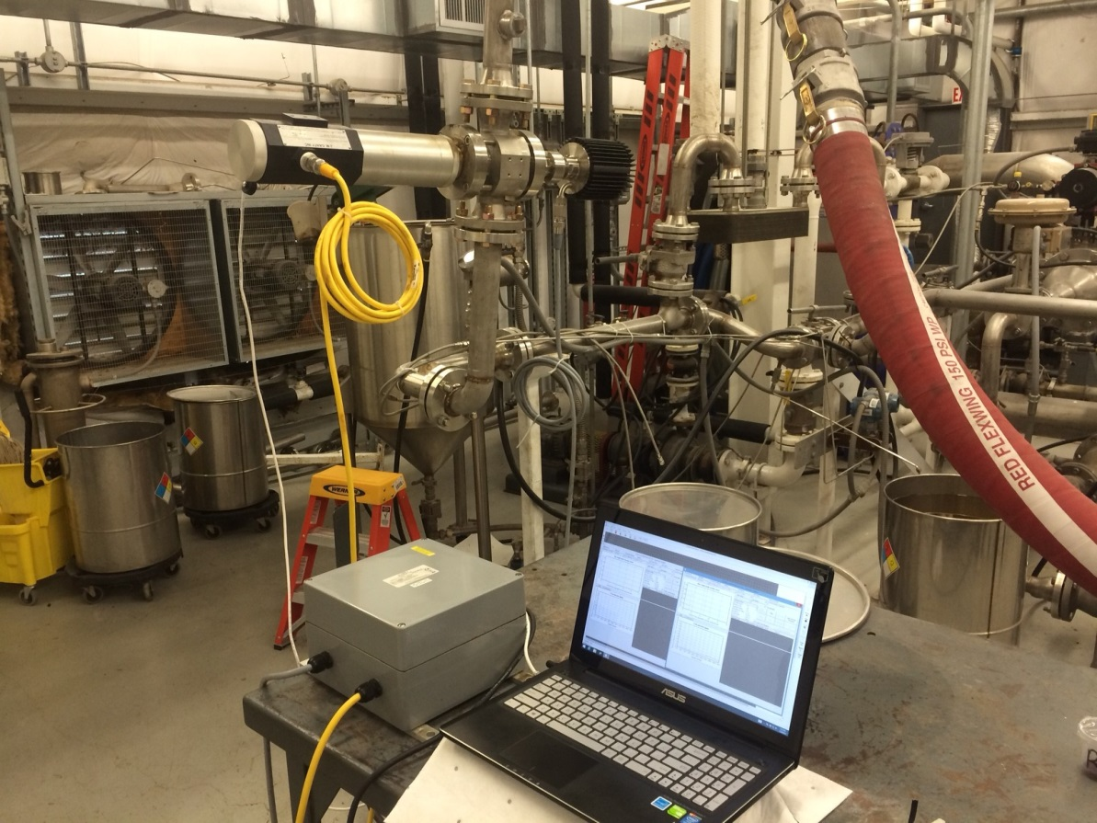
USN Flow Loop w/Analyzer

Slide 14
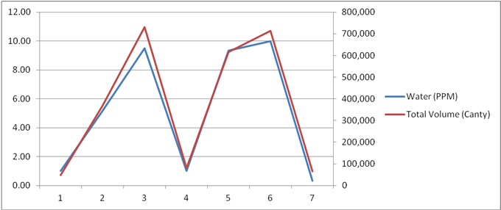
In-Line Water in Fuel Testing - USN

Slide 15
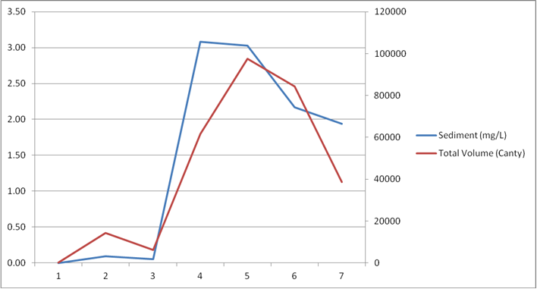
In-Line Solids in Fuel Testing - USN

Slide 16
Vision vs APC Comparison;
Water Detection
Vision: Dry Hydrocarbon and ‘Wet’ Hydrocarbon (5 ppm water)
Ref: TARDEC report: Utilization of Automated Imaging for the Detection of Fuel Contamination

Slide 17
Vision vs APC Comparison;
Water Detection
APC Dry vs ‘Wet’
Ref: TARDEC report: Utilization of Automated Imaging for the Detection of Fuel Contamination

Slide 18
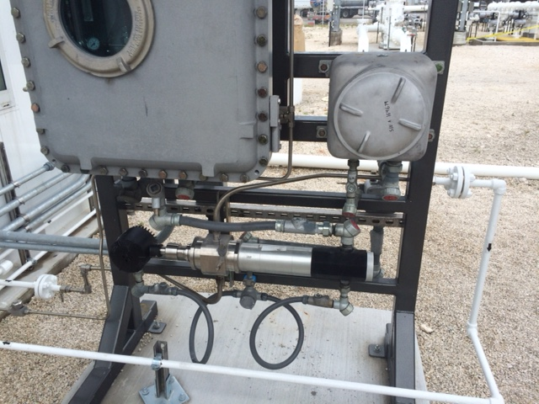
In-Line Installation
In-Line Fuel Analysis Operating in Southern Florida

Slide 19
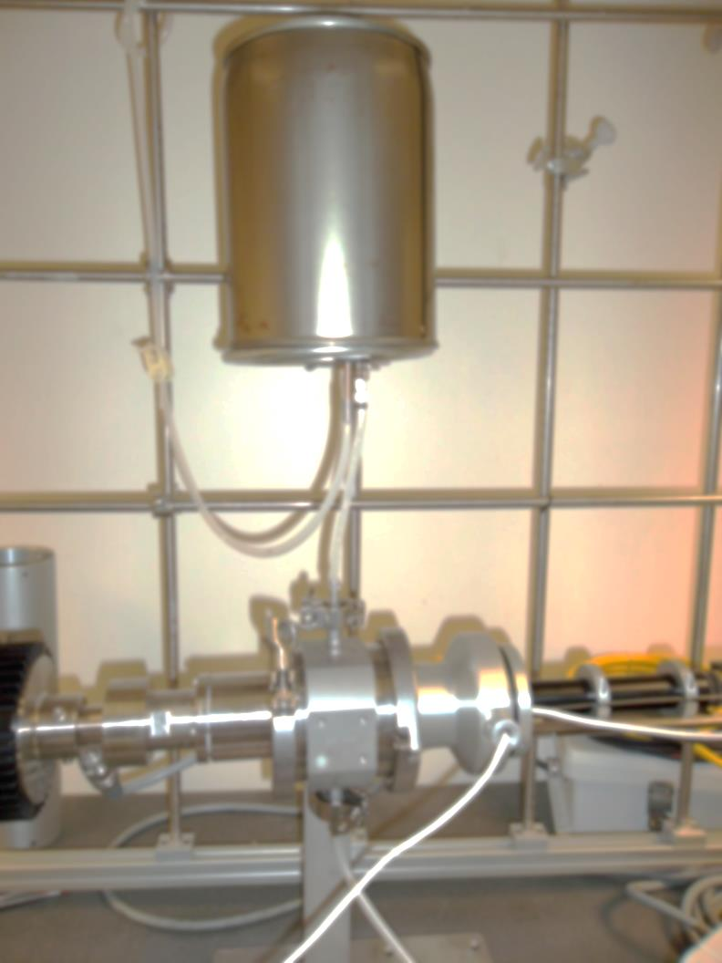
Typical Lab Set Up
Notes:
Discuss Operation

Slide 20
Contaminated Hydrocarbon
Solid Particle Test Results
Data presented in particle counts / mL

Slide 21
Grease Analysis
Canty is developing a method with MRG to quickly and objectively analyze grease using a vision system modified for the particular task.
Images are included to show what samples look like in the instrument and how the particulate can be detected.
The system will use the MRG Grease Theif and extruder to present the material to the vision system.

Slide 22
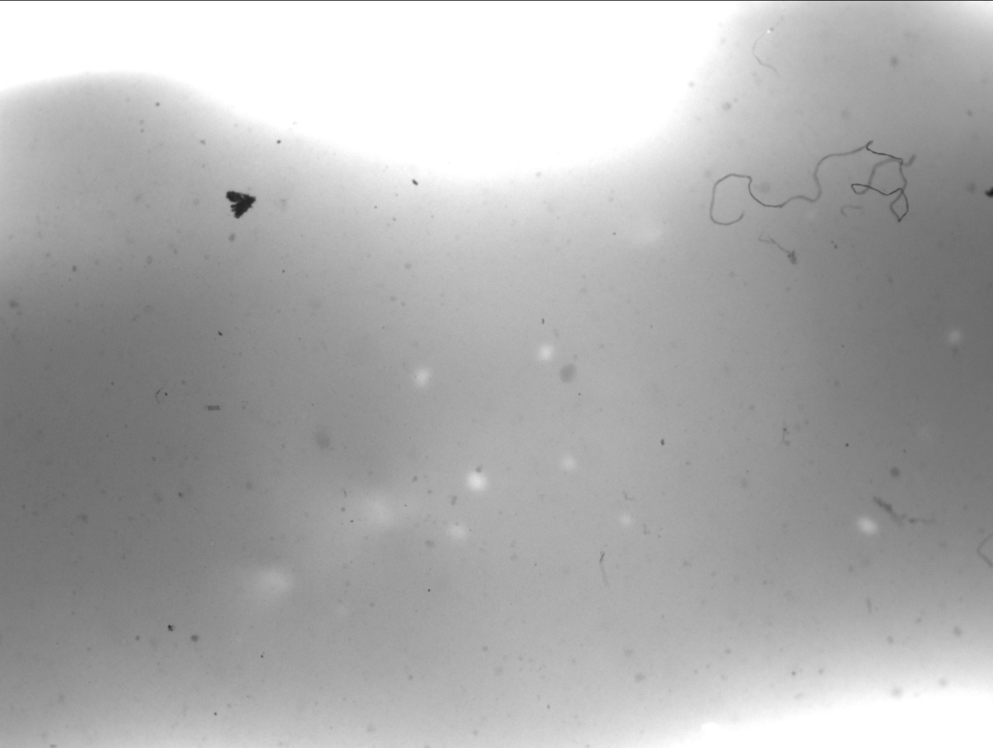
Image of Grease Sample

Slide 23
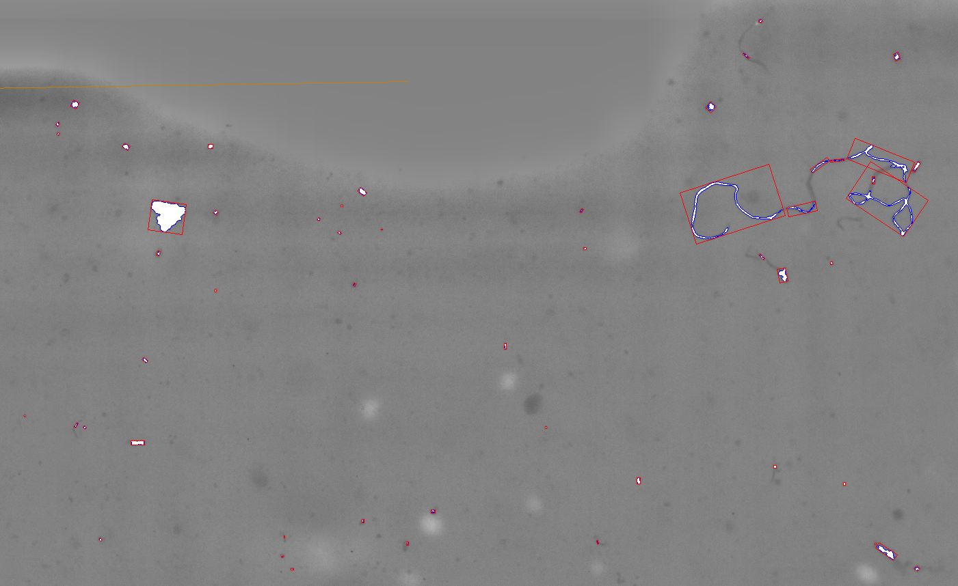
Digital Image of Grease

Slide 24
Lube Oil Analysis
Shape of Solids can be informative:
Cutting Wear : elongated particles with curved or curly shape.
Sliding Wear: longer than wide with straight edges.
Fatigue Wear: approximately as long as they are wide with jagged edges.
Non-metallic – translucent particles

Slide 25
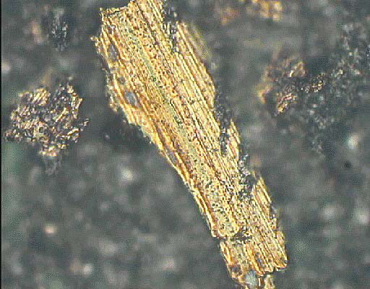
Sliding Wear
Created when moving surfaces abrade against each other.
Consider upgrading lubricant.

Slide 26
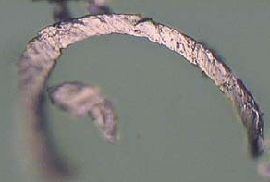
Cutting Particle
Created when hard, sharp edges cut into opposing surfaces.
Indicates poor fit of moving components. Continued detection may indicate pending failure.

Slide 27
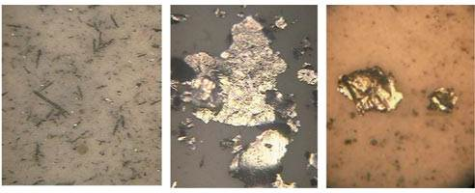
Fatigue Wear
Often created from the wear of bearing or rolling surfaces.
Check bearings for wear when detected.

Slide 28
Comparison of Machine Oils
The following slides depict the particulate level of used machine oil from a CNC lathe running 2 shifts per day, 5 days per week, and the same type fresh, unused machine oil (with additives).
Governing Procedure is ASTM D7596.

Slide 29
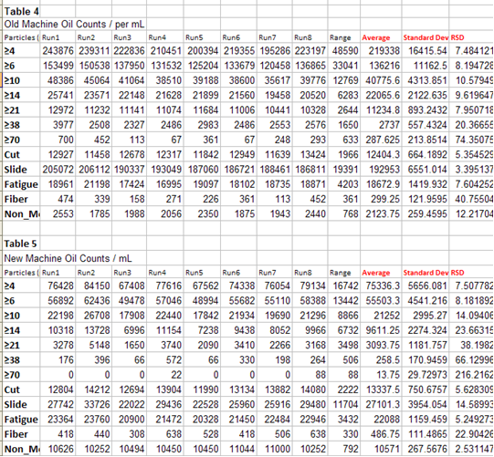
Solid Particle Comparison

Slide 30
CS4406 pending
The need to report solids and water separate has required a new report method.
ASTM D02.96.05 has a task group balloting this new reporting method

