Slide 1
Monitoring of Apoptotic Progress in Bioreaction
Suyang Wu

Slide 2
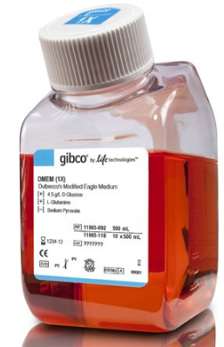
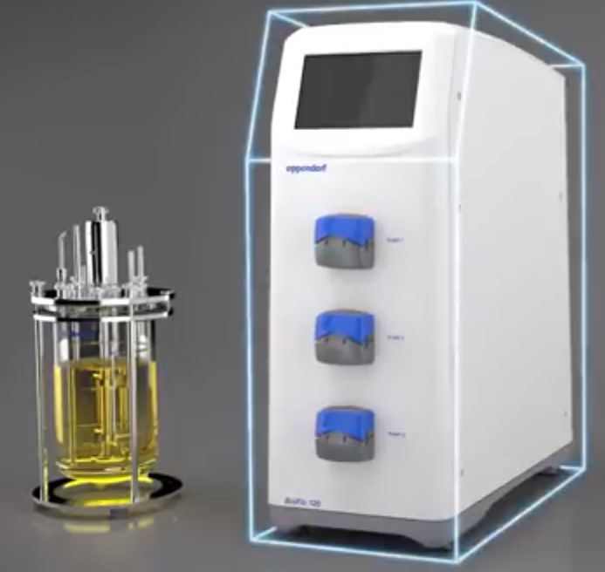

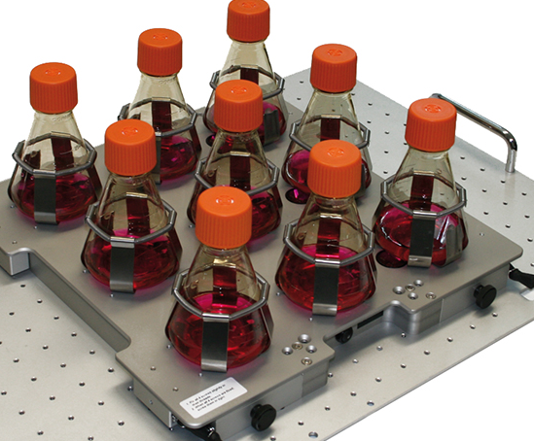
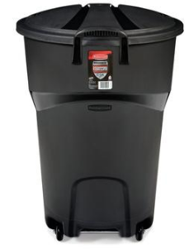
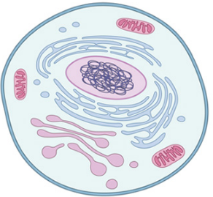
Bioreaction
Nutrient
Product
Toxic Metabolite
Cells
  Viable cell density, viability
Pic: https://www.nature.com/scitable/topicpage/what-is-a-cell-14023083
http://bioflo120.eppendorf.com/
https://www.thermofisher.com/us/en/home/life-science/cell-culture/mammalian-cell-culture/classical-media.html
https://www.thermofisher.com/us/en/home/life-science/protein-biology/protein-biology-learning-center/protein-biology-resource-library/pierce-protein-methods/overview-elisa.html
https://www.olympus-lifescience.com/en/software/cellsens/

Slide 3
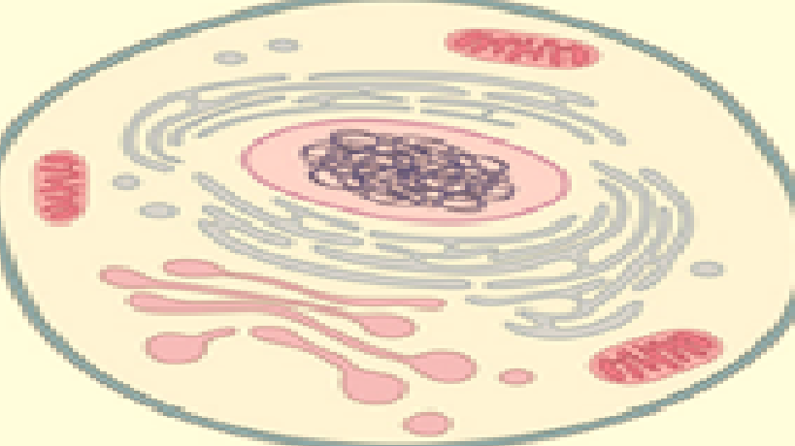
Trypan Blue Exclusion
Negative Result (TB⁻)
Healthy Cell
Trypan Blue
Positive Result (TB⁺)
Dead Cell (leaking)
Pic: https://www.nature.com/scitable/topicpage/what-is-a-cell-14023083

Slide 4
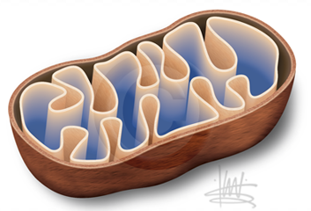

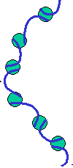
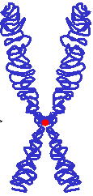


Apoptosis
Caspase Activation
> 10 hours
Healthy
MOMP
Apoptosis: Regulated Cell Death
Cytoskeleton Disruption
Plasma Membrane Break
DNA Fragmentation
DNA Condensation
Metabolic Activity
Early apoptosis event was marked by appearance of activated caspases.
Trypan blue indicates dead cells with permeable plasma membrane (last step)
Irreversible
process
Picture reproduced from:
Wei, Y.Y., et al., Proteomics analysis of chinese hamster ovary cells undergoing apoptosis during prolonged cultivation. Cytotechnology, 2011. 63(6): p. 663-77
Flow by Thermo Fisher: https://www.thermofisher.com/us/en/home/references/newsletters-and-journals/bioprobes-journal-of-cell-biology-applications/bioprobes-issues-2011/bioprobes-65-july-2011/cellevent-caspse-substrate.html
.
Notes:
Phosphatidylserine (PS)

Slide 5
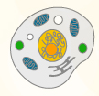
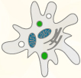


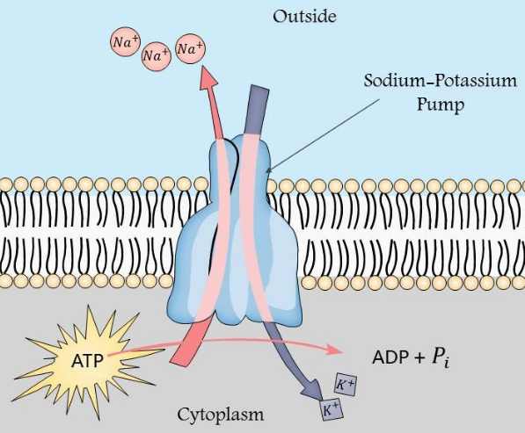
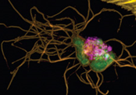
Apoptosis: Physical Change
Apoptosis Initiation
Mitochondria Outer Membrane Permeabilization
Healthy Cell
Low ATP and caspase cleavage
Cell Death
Intracellular Conductivity change
Membrane capacitance change
Apoptotic volume decrease
Cell cytoskeleton break and blebbing
Mainly by K⁺ and Cl⁻ channel
Vorobjev, I.A. and N.S. Barteneva, Multi-parametric imaging of cell heterogeneity in apoptosis analysis. Methods, 2017. 112: p. 105-123.
Patel, P. and G.H. Markx, Dielectric measurement of cell death. Enzyme and Microbial Technology, 2008. 43(7): p. 463-470.
Ansorge, S., G. Esteban, and G. Schmid, Multifrequency permittivity measurements enable on-line monitoring of changes in intracellular conductivity due to nutrient limitations during batch cultivations of CHO cells. Biotechnol Prog, 2010. 26(1): p. 272-83.
https://www.slideteam.net/catalog/product/gallery/id/42957/image/306543/
https://www.thermofisher.com/us/en/home/references/newsletters-and-journals/bioprobes-journal-of-cell-biology-applications/bioprobes-issues-2011/bioprobes-65-july-2011/cellevent-caspse-substrate.html
Notes:
Phosphatidylserine (PS) flipping

Slide 6
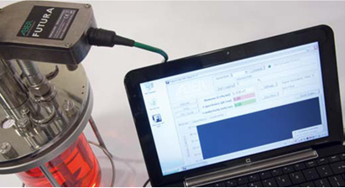
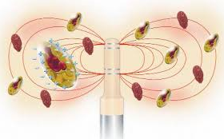
Project Hypothesis
Apoptotic progress of a cell culture (CHO cells) can be predicted in real-time by in-line dielectric spectroscopy analyzed using multivariate techniques
Notes:
The main qualities of a hypotheses are that it is testable and falsifiable with appropriate experiments. That is, your hypothesis can clearly be demonstrated or refuted through experimentation (although the experimentation is not typically and explicit in the hypothesis). In addition, there are other qualities of good hypotheses. These qualities include that it be observable (back to the appropriate experiments idea), precise (not general), relevant (explains a phenomenon and enables predictions) and parsimonious (succinct in the language that is used to express the hypothesis).

Slide 7
Shape Change
Set | Cell Density (10⁵ cells/mL)
Healthy | 77.4
Apoptosis | 83.7
Decline | 73.9

Slide 8
Separation in Score Space

Slide 9

Volume of Scrutiny
Dielectric spectroscopy
With a size of tennis ball
Scanning millions of cells simultaneously
Sensitivity cannot be guaranteed
CANTY CORE
Flow-through imaging system
Single-cell analysis level
Higher sensitivity
Orthogonal test to dielectric
Cells
6cm
6cm
4cm

Slide 10
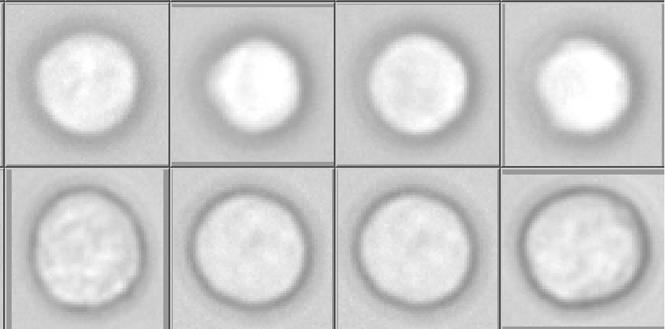
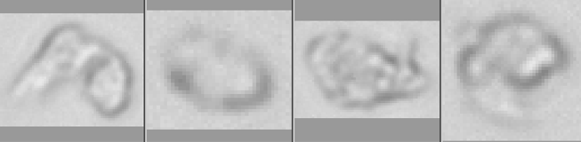
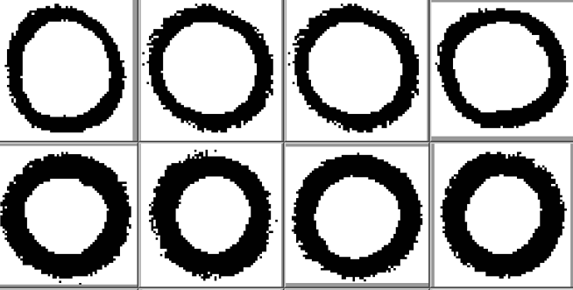

Preliminary Classification
Necrotic criteria: sphere and “white” inside
Viable criteria: sphere and “white” inside

Slide 11
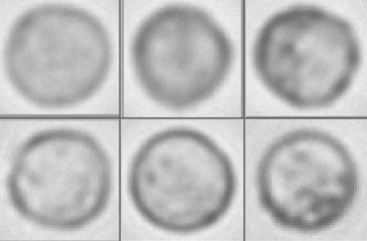
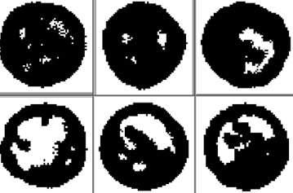
Preliminary Classification
Apoptosis criteria: intact membrane and dark spots inside (Possibly due to DNA condensation)

Slide 12
Preliminary Data Summary
Can predict apoptosis ratio accurately at late stage of bioreaction
Overestimate apoptosis ratio and necrotic ratio at early stage of bioreaction
  Need to refine classification
  Work on the set-up (sample size, dilution ratio, etc.)
  Switch to PBS from DI water
Hardware improvement may be needed:
  Auto-sampling system
  Cell sorter
Software improvement may be needed:
  Considering cell size into the classification criteria
  Use grayscale image instead of binary

Slide 13
Back-up

Slide 14
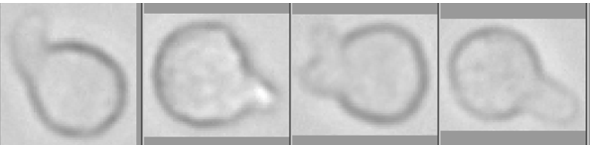

Osmolarity change results in cell swelling and burst

Slide 15
CANTY CORE
Morphological information is provided by CANTY imaging system
Single cell level is more sensitive toward apoptosis, possibly earlier warning
An orthogonal detection method to integrate
Support vector machine (SVM) to train the classification sets

