Slide 1
Advanced Imaging Technology for BioTech

Slide 2
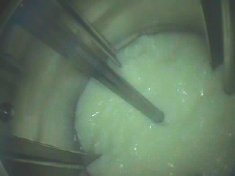
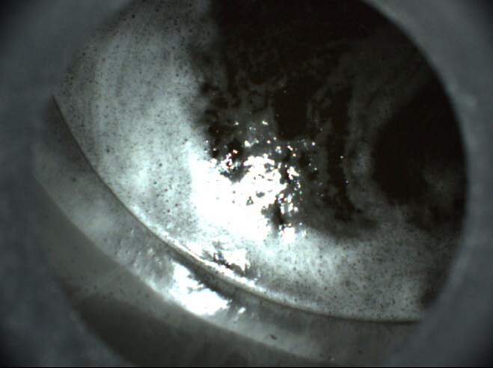
Foam Control Level Imaging Based Control
Application Overview
BIOCAMTM
S.U.BIOCAMTM

Slide 3
Why control foam levels?
Prevents lost batches
Limit over dispense of foam which reduces fermentation yield
Anti-foam inhibits cell growth & increases sparging
Less foam equals less downstream purification
Notes:
Prevents lost batches
Anti-foam is needed to prevent foam from overflowing and blocking filters. If it blocks the filters or overflows the whole batch has to be disposed and causes unplanned cleaning as well.
Limit over dispense of foam
When an operator is in control of manual addition, typically there is over dispense due to the fact they do not want to lose the batch. As foam increases the fermentation yield reduces.
Anti-foam inhibits cell growth
Anti-foam decreases aeration due to surface tension increases causing slower cell growth. This leads to an increase in sparging. Increased sparging causes more foaming which in requires more anti-foam
Less foam equals less downstream purification
Anti-foam is carried into purification where it needs to be removed. Cost of anti-foam is then magnified by cost of removal.
This is a great transition into our advance imaging technology for BioTech that will help control foam levels

Slide 4
BIOCAMTM Sanitary Process Camera
Compact, sanitary, no additional external power supply for operation
LED lighting
Built-in strobe
Does not obstruct photosensitive processes
Ethernet camera technology
Clear image at all times
Internal heater prevents condensation
Notes:
The camera utilizes built-in strobe LED light that has been optimized to run efficiently as to not obstruct photosensitive processes.
Bioreactors and fermenters are known to be difficult to see inside if not impossible.
The issue is the heat of the process generates steam in the head space.
BIOCAM has overcome this problem by heating and controlling the temperature of the fused glass to closely match the process temperature thereby avoiding condensation which would make the camera useless.

Slide 5
LED Originally developed for Subsea -5 year life
Strobed light allows for optimized illumination without interfering with photosensitive processes.
Canty software controls strobing based on user/process conditions
Easy to alter
Variety of pulse ranges: 30 times a second, Once per second , once per minute. Once per hour etc.
and all connections to the processor are the single Gigabyte ethernet connection.
The more active the foam i.e., the faster the rate of change the more often the system would want to analyze the fluid surface for foam.
Notes:
Strobed light allows for optimized illumination without interfering with photosensitive processes.
The light can be pulsed 30 times a second, Once per second , once per minute. Once per hour etc.
Pulsed timing can be user dictated or based on process conditions and activity. The more active the foam i.e., the faster the rate of change the more often the system would want to analyze the fluid surface for foam.
The strobe is controlled via the software and all connections to the processor are the single Gigabyte ethernet connection.

Slide 6
Canty Fused Glass
Fused Glass is the ASME BPE standard process interface

Slide 7
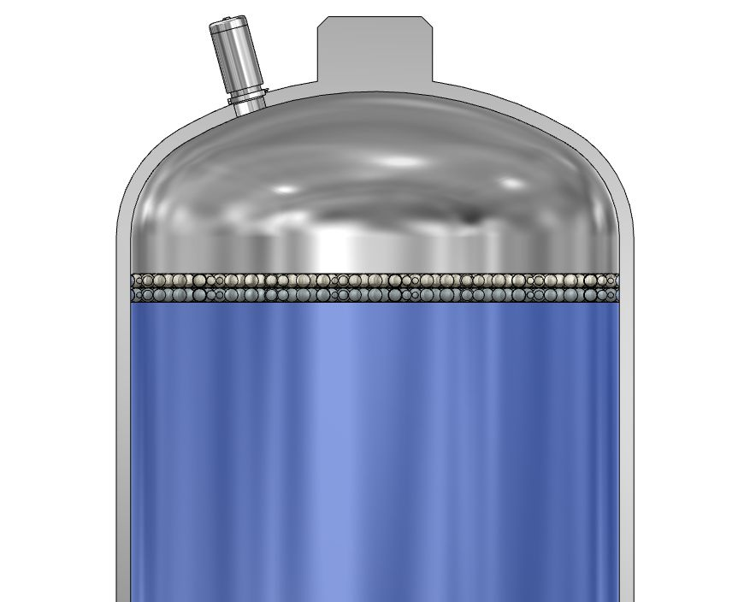
BIOCAMTM Installation
BIOCAMTM only needs 1 nozzle!
Light & camera are combined into one housing for accurate foam detection, reduction in space, and easy calibration
Cost savings as we only need 1 nozzle for two pieces of equipment
Notes:
This is on stainless steel vessels, ideally production areas

Slide 8
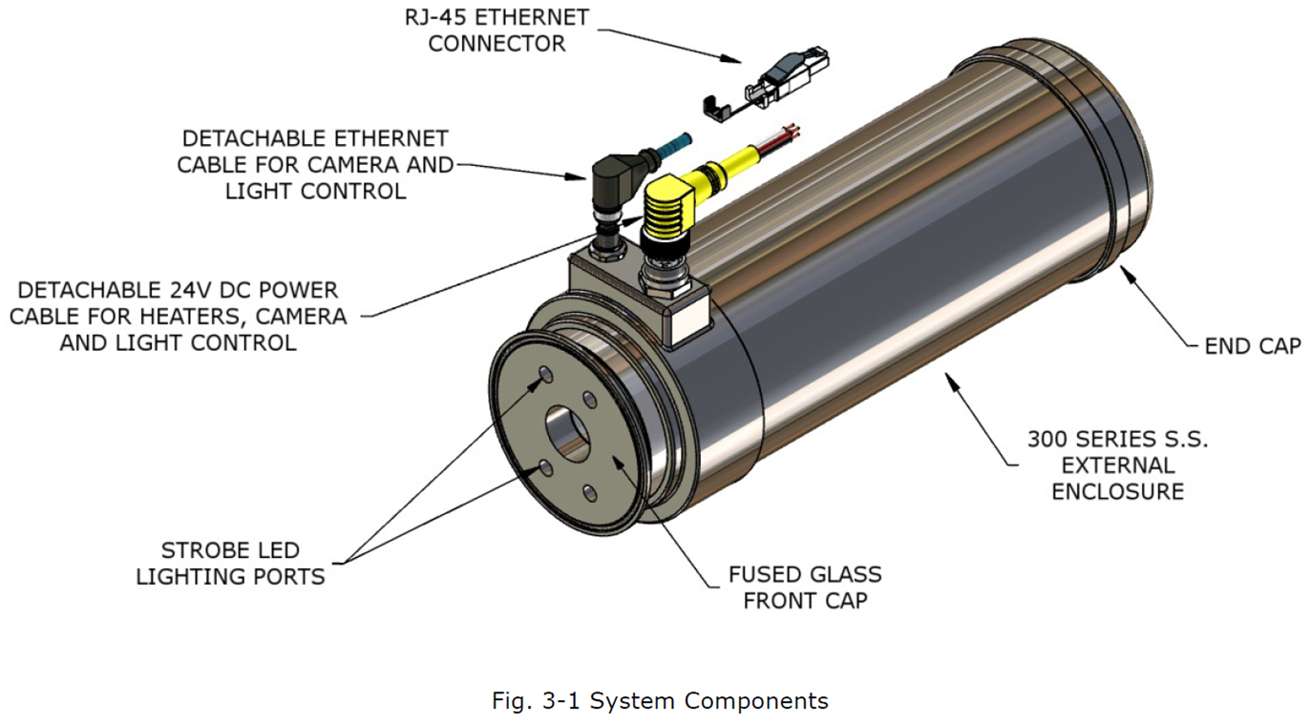
Notes:
Ethernet cable goes directly into VCM to control the BioCam and stobing.
User supplied 24V DC will be applied directly to the cable, there is no power supply

Slide 9
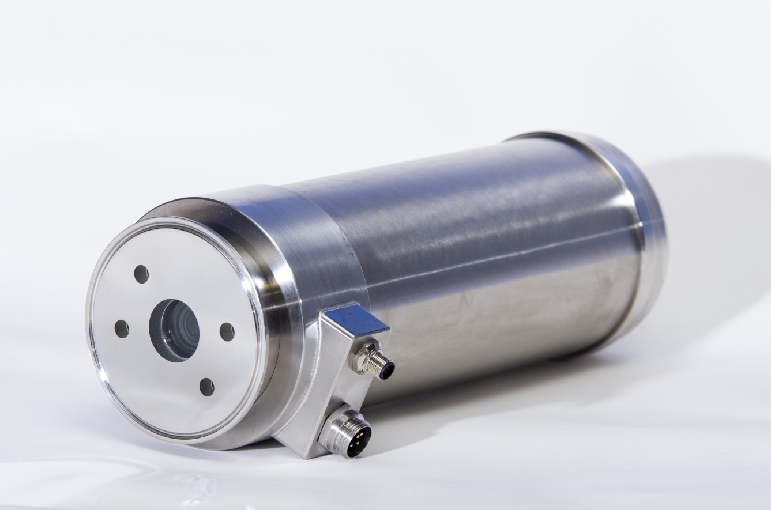
BIOCAMTM
Built in LED light source - maintenance free
Compact all-in-one design
Sanitary 316L S.S. Housing
No external power supplies required
Available in 24V DC, 120V AC, 240V AC
Strobed light allows for optimized illumination without interfering with photosensitive processes
Built in heater to prevent fog and condensation
One-piece streamlined design
Includes CantyVision™ software standard for analytics and feedback
System outputs via OPC or 4-20mA to a DCS or
PLC for complete, closed-loop control
Ideal system for foam detection - CantyVision™can output and control the addition of anti-foam

Slide 10
FUSEVIEWCFTM Condensation-Free Sight Glass
Bioreactors and fermenters are known to be difficult to see inside if not impossible
The issue is the heat of the process generates steam in the head space.
Canty’s unique heated fused sight glass has overcome this problem by heating and controlling the temperature of the fused glass to closely match the process temperature thereby avoiding condensation which would make the sight glass useless.

Slide 11
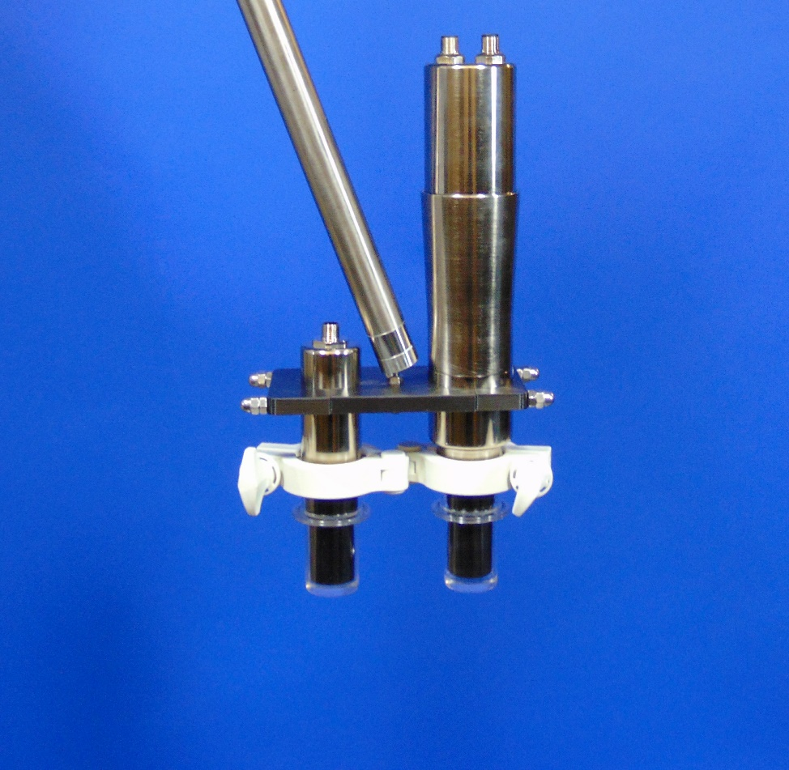
S.U.BIOCAM™ Sanitary Process Camera
Ideal for Single Use Applications
Disposable Single Use Fittings
Clear image at all times
Internal heater prevents condensation
Light-weight camera and light
LED lighting
Built-in strobe
Does not obstruct photosensitive processes
Ethernet camera technology
Notes:
Combines the latest in LED lighting with Ethernet camera technology in a streamlined package.
The camera utilizes built-in strobe LED light that has been optimized to run efficiently as to not obstruct photosensitive processes.

Slide 12
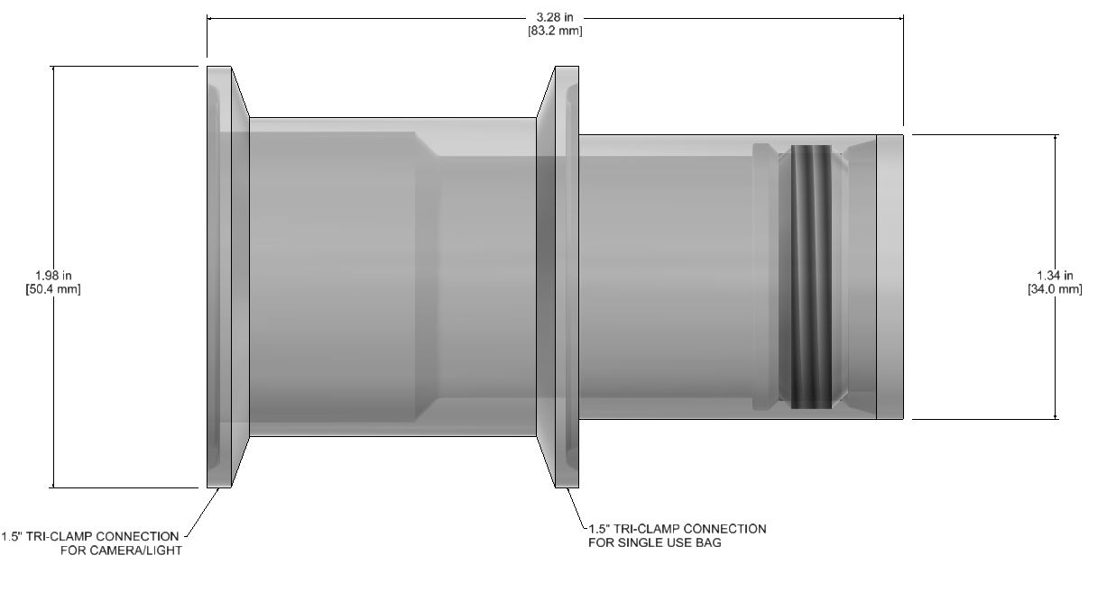
S.U.BIOCAM™ Single Use Fitting
Protects Camera & Light from Process
Disposable
1.5” Tri-Clamps
Bag attachment
Camera/Light attachment
Single Use Fitting Material Options:
Generic Polycarbonate
Makrolon 2458
Notes:
Makrolon 2458 is medical grade and traceable

Slide 13
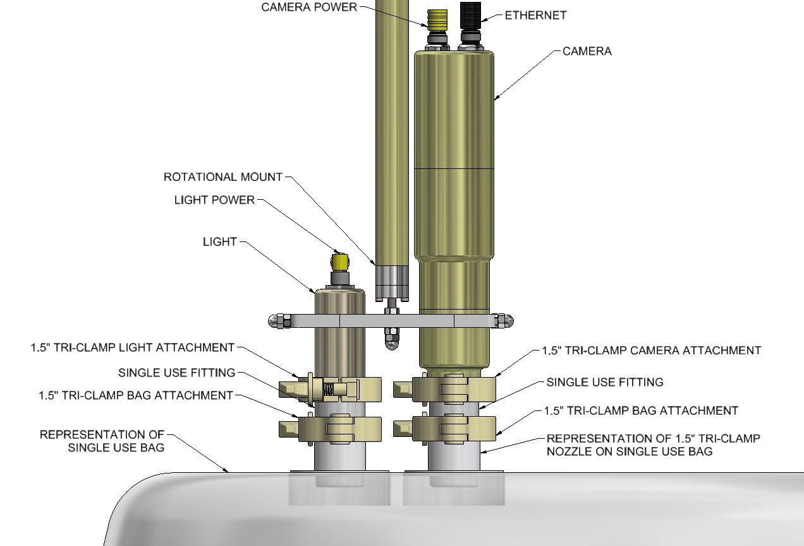
S.U.BIOCAMTM Installation
Light-weight, Nickel Plated Aluminum Camera & Light on two 1.5” Tri-Clamp Nozzles
2 Single Use Fittings
Heaters inside light and camera to keep Single Use Fitting condensation free
Rotational mount to allow for accommodation with bag

Slide 14
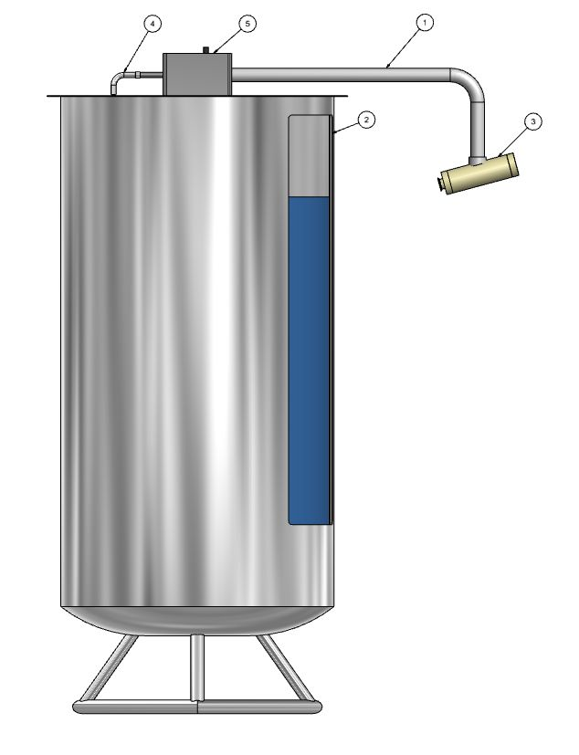
S.U.EXTERNAL BIOCAM™ Sanitary Process Camera
Connect instrumentation to a single use bag which is reusable and avoid contamination.
Able to electronically inspect and illuminate the contents of the single use process without being distorted through the bag.
Easily able to attach and detach a camera and light without being contaminated as removing the instrument.
Having a power supply for both camera and light together which supports the camera and light.

Slide 15
Automated Bubble Trap/ Filter
Bubble trap or outgassing unit with a filter to reduce the overall volume of two individual devices.
Increase in product yield through a combination of reduced volume and less additional fluid in a single vessel using imaging control systems.
Able to be CIP and SIP.
Imaging base level control and tapered section which allows enough reaction time for control of the off gassing and maintaining of liquid level over the filter element section.
Level device incorporated into this unique combination which detects the difference between liquid and foam allowing for artificial intelligence to determine the proper course of action to optimize production.
A rapidly responding gas release device at the top of the bubble trap – filter system that allows for opening and inspection in sensitive applications or other sensitive applications. Where build up or contamination could cause problems.

Slide 16
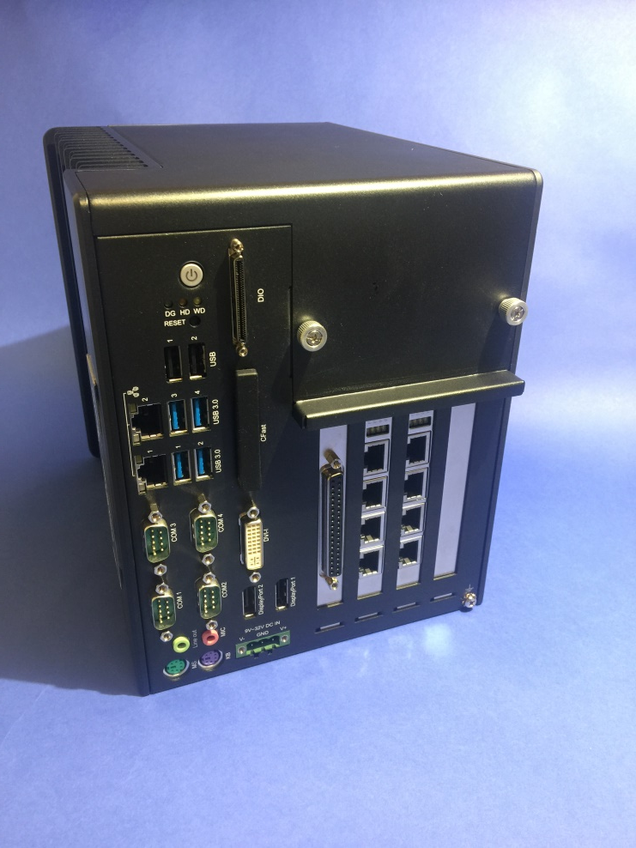
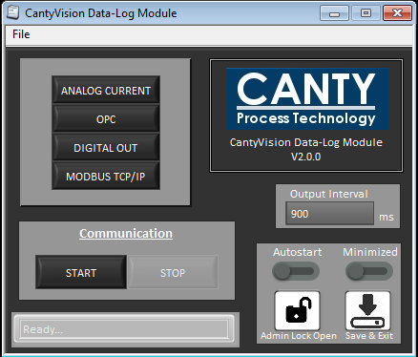
Canty Vision Software
VCM - VISION CONTROL MODULE
6 x Gigabyte Ethernet BioCam inputs
8 x 4-20 ma outputs
OPC interface
Modbus interface
Remote support via user provided internet connection, wifi or hotspot
Solid state industrial processor.

Slide 17
Solution for control of foam levels = CANTY
Automatic control of anti-foam for optimal and repeatable runs
Increased number of batches
Decreasing the amount of anti-foam
Increases cell growth
Decreases purification costs downstream
Great Business Decision!!
Notes:
Prevents lost batches
Limit over dispense of foam which reduces fermentation yield
Anti-foam inhibits cell growth & increases sparging
Less foam equals less downstream purification

