Slide 1

NUTSCHE FILTER OPTIMIZATION
JM Canty, Inc. · Buffalo, New York · Phone: (716) 625-4227 | JM Canty, Ltd. · Dublin, Ireland · Phone: +353 (1) 882-9621

Slide 2

OUTLINE
What is a Nutsche Filter and Where are They Used?
Process Vessel Cameras;
Brief Hardware Overview
Cake Detection Using the Camera
Level Measurement Using the Camera
InFlow Analyzer;
Brief Hardware Overview
Filter Breakthrough Measurement
JM Canty, Inc. · Buffalo, New York · Phone: (716) 625-4227 | JM Canty, Ltd. · Dublin, Ireland · Phone: +353 (1) 882-9621

Slide 3
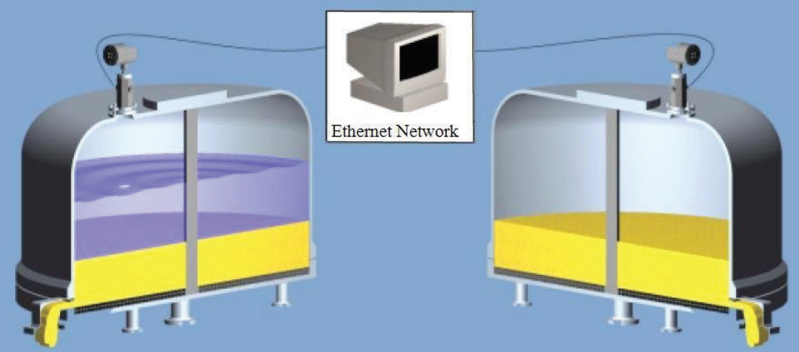
What is a Nutsche Filter
A Nutsche Filter is a machine used to separate solids from a slurry by using positive pressure or vacuum
Typically the feed is from a Crystallization Process
Liquid of the slurry is forced through a screen or cloth so that the solids can be collected
Retained solids are then washed and discharged from the vessel
JM Canty, Inc. · Buffalo, New York · Phone: (716) 625-4227 | JM Canty, Ltd. · Dublin, Ireland · Phone: +353 (1) 882-9621

Slide 4
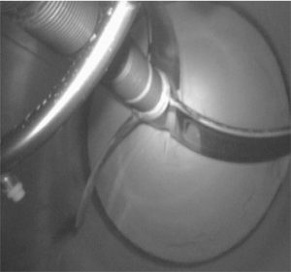
Why Use a Nutsche Filter vs Centrifuge
High Yield
High Value Product which are costly to make.
The more commodity type products tend to use centrifuges which are less expensive to run, with quicker batch times, but with lower yields
If exposure to the process is harmful to workers
Risk of contamination to the product is high
JM Canty, Inc. · Buffalo, New York · Phone: (716) 625-4227 | JM Canty, Ltd. · Dublin, Ireland · Phone: +353 (1) 882-9621

Slide 5
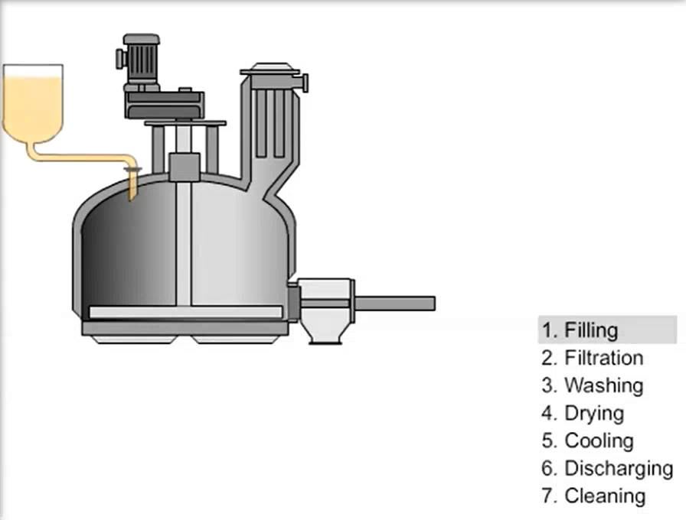
JM Canty, Inc. · Buffalo, New York · Phone: (716) 625-4227 | JM Canty, Ltd. · Dublin, Ireland · Phone: +353 (1) 882-9621

Slide 6

Even small differences in the particle size, shape & concentration in the slurry from the crystallization process, will cause differences in how the filtration process in the Nutsche filter performs
The process should run the same way for each batch fed with the same volume of slurry from the crystallization process
JM Canty, Inc. · Buffalo, New York · Phone: (716) 625-4227 | JM Canty, Ltd. · Dublin, Ireland · Phone: +353 (1) 882-9621

Slide 7

Keys To Process Optimization
Detecting the Filtration End Point!
This is the point where the liquid has just filtered through the top surface of the cake and is the optimum time to start washing
Start washing too late – the cake surface has dried out and cracked, so wash solution flows preferentially through the cracks
Start washing too early and the wash fluid mixes with residual mother liquor from the original slurry, so it’s effectiveness is reduced
JM Canty, Inc. · Buffalo, New York · Phone: (716) 625-4227 | JM Canty, Ltd. · Dublin, Ireland · Phone: +353 (1) 882-9621

Slide 8

Keys To Process Optimization
Both of these situations;
Increase utility (wash fluid) use – more cost
Reduce yield – more wash cycles means more lost product
Increase processing time
So….. What can Canty do?
JM Canty, Inc. · Buffalo, New York · Phone: (716) 625-4227 | JM Canty, Ltd. · Dublin, Ireland · Phone: +353 (1) 882-9621

Slide 9
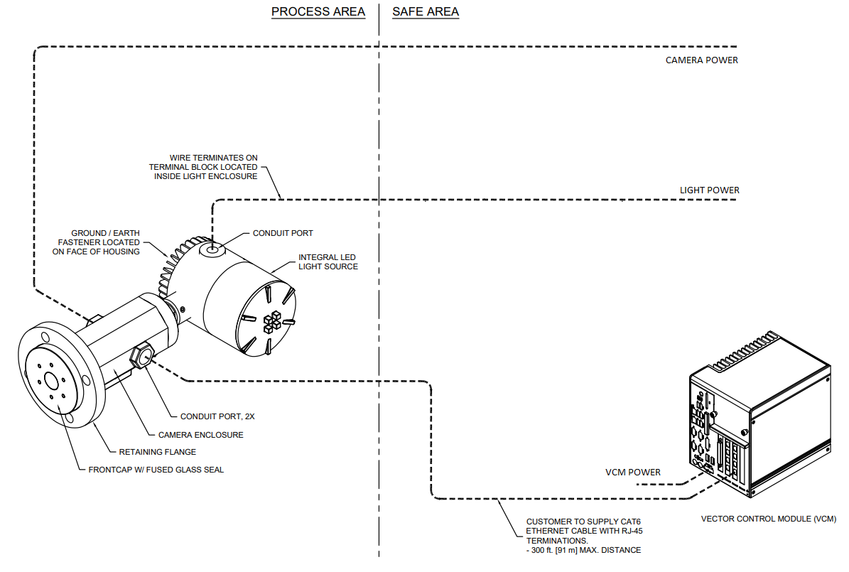
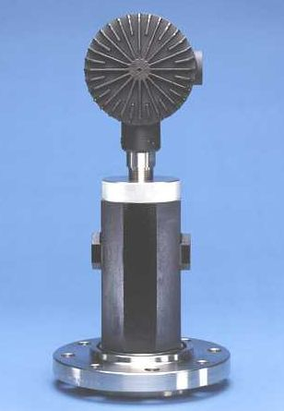
Cake Detection via Image Analysis
Camera / Light mounted to the head of the vessel feeding live images back to a Canty VCM running our image analysis software
JM Canty, Inc. · Buffalo, New York · Phone: (716) 625-4227 | JM Canty, Ltd. · Dublin, Ireland · Phone: +353 (1) 882-9621

Slide 10
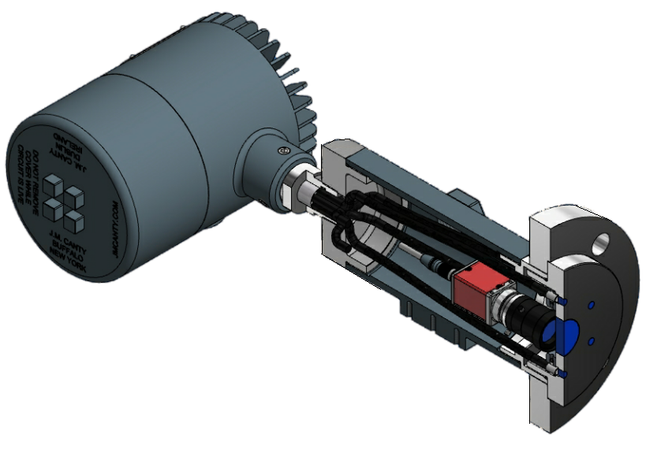
Camera / Light Refresher
LED LIGHT SOURCE
6 LEG FIBRE OPTIC BUNDLE
INDUSTRIAL HOUSING
PROCESS CONNECTION
(FUSED GLASS FRONT CAP)
CAMERA
LENS
JM Canty, Inc. · Buffalo, New York · Phone: (716) 625-4227 | JM Canty, Ltd. · Dublin, Ireland · Phone: +353 (1) 882-9621

Slide 11
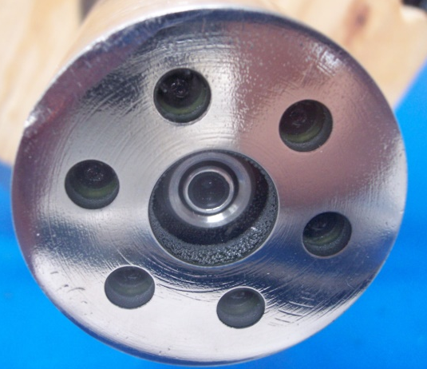
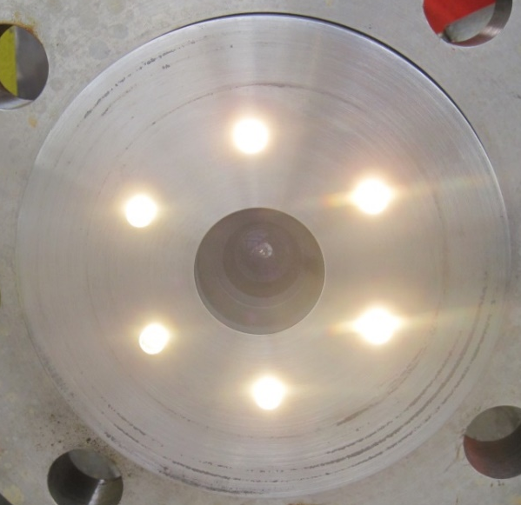
Camera / Light Refresher
JM Canty, Inc. · Buffalo, New York · Phone: (716) 625-4227 | JM Canty, Ltd. · Dublin, Ireland · Phone: +353 (1) 882-9621

Slide 12
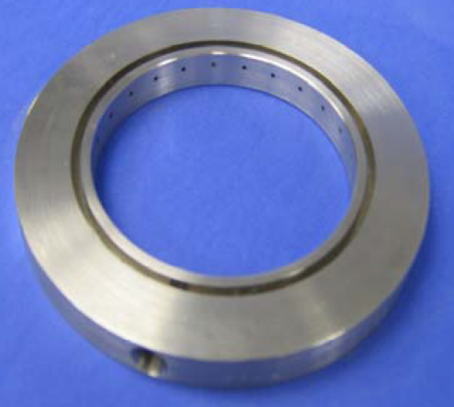
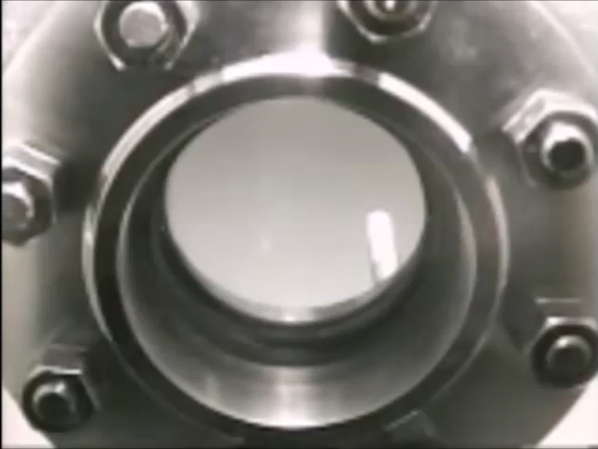
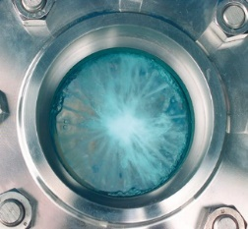
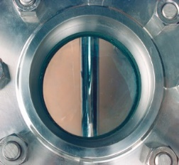
Camera / Light Refresher
JM Canty, Inc. · Buffalo, New York · Phone: (716) 625-4227 | JM Canty, Ltd. · Dublin, Ireland · Phone: +353 (1) 882-9621

Slide 13
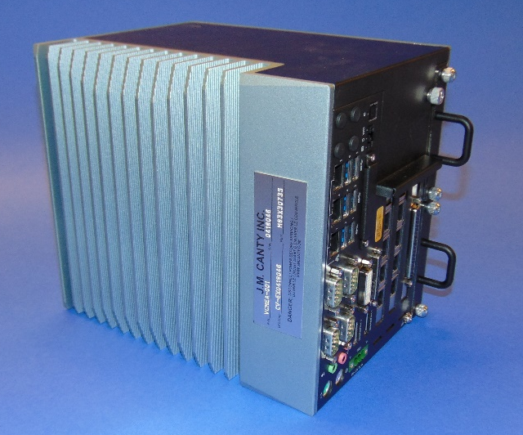
VCM Refresher
Options to simultaneously run between 3 and 6 cameras
Multiple outputs
Video Display
          4-20mA
        OPC
        MODBUS TCP/IP
Ease of Remote Support
JM Canty, Inc. · Buffalo, New York · Phone: (716) 625-4227 | JM Canty, Ltd. · Dublin, Ireland · Phone: +353 (1) 882-9621

Slide 14
Cake Detection Using CANTYVISION
The integral light source on the camera system causes a reflection on the liquid surface
When the cake emerges, the reflection of light disappears which can be detected by the software
JM Canty, Inc. · Buffalo, New York · Phone: (716) 625-4227 | JM Canty, Ltd. · Dublin, Ireland · Phone: +353 (1) 882-9621

Slide 15
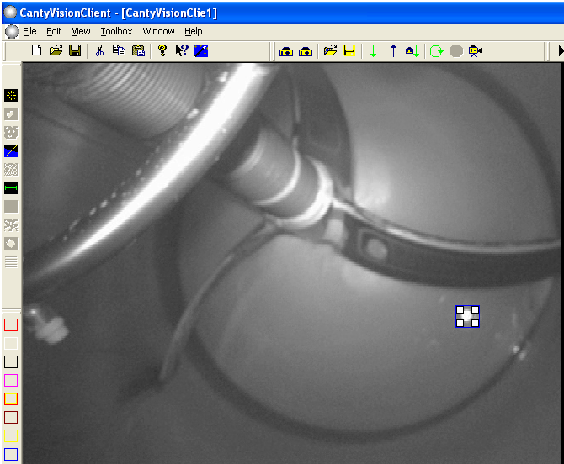
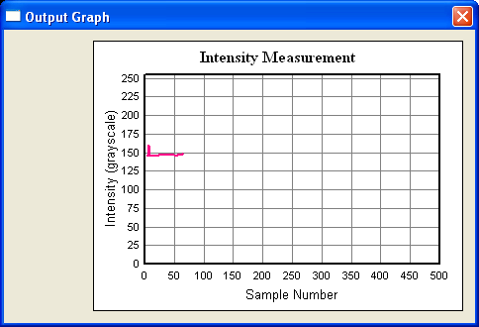
Cake Detection Using CANTYVISION
Every pixel within the intensity measurement zone is assigned a grayscale value from 0-255
When the cake emerges the monitored grayscale changes on which alarms can be based
JM Canty, Inc. · Buffalo, New York · Phone: (716) 625-4227 | JM Canty, Ltd. · Dublin, Ireland · Phone: +353 (1) 882-9621

Slide 16
Level Measurement Using CANTYVISION
Level in the Nutsche Filter can be used to determine the yield of the crystallizer
The liquid level at the start of the batch is the batch size
Level of cake can be measured on the filter wall after liquid passes through the cake layer
Yield is the level of the cake as a percentage of the starting level
JM Canty, Inc. · Buffalo, New York · Phone: (716) 625-4227 | JM Canty, Ltd. · Dublin, Ireland · Phone: +353 (1) 882-9621

Slide 17
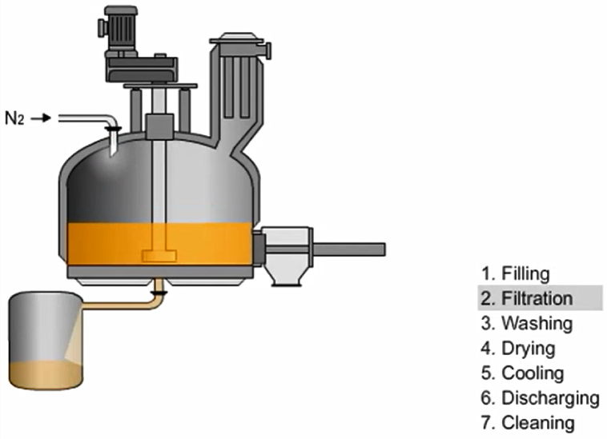
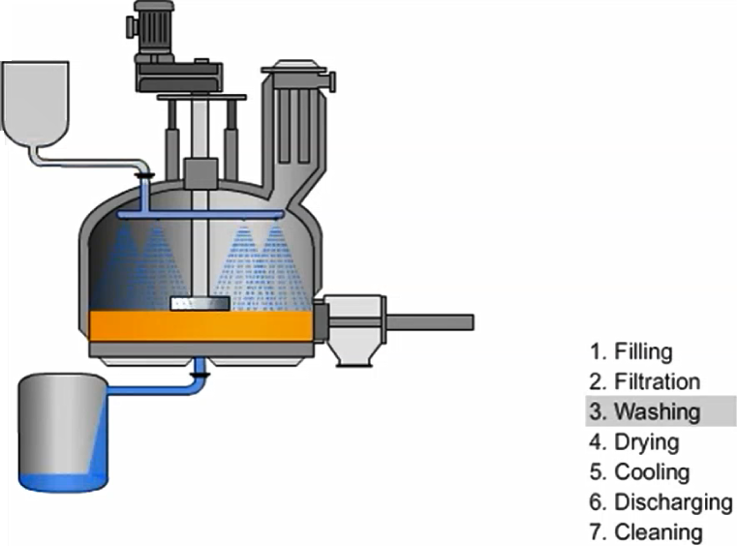
Are They Washing Their Product Away?
During filtration and washing stages, some particulate (money) may be removed with the liquid!
JM Canty, Inc. · Buffalo, New York · Phone: (716) 625-4227 | JM Canty, Ltd. · Dublin, Ireland · Phone: +353 (1) 882-9621

Slide 18
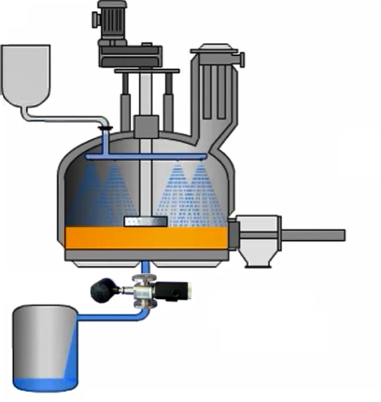
Are They Washing Their Product Away?
The InFlow analyzer can be used on the fluid discharge line to monitor the concentration being removed
Normal operation, limited amount will be removed and can be recovered
Larger amounts indicate a problem with the filter screen / cloth
JM Canty, Inc. · Buffalo, New York · Phone: (716) 625-4227 | JM Canty, Ltd. · Dublin, Ireland · Phone: +353 (1) 882-9621

Slide 19
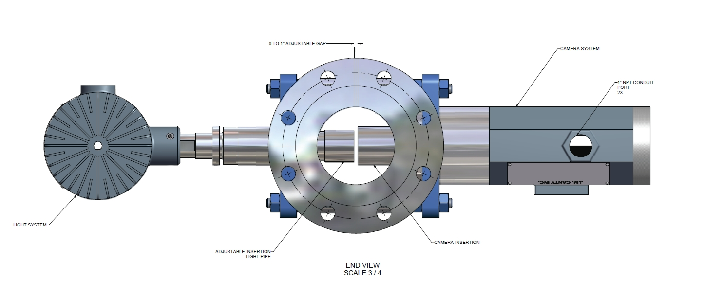
JM Canty, Inc. · Buffalo, New York · Phone: (716) 625-4227 | JM Canty, Ltd. · Dublin, Ireland · Phone: +353 (1) 882-9621

Slide 20

Turbidity InFlow
Lower Magnification System
Less Refined Measurement
Less Expensive
CANTYVISION software measures the intensity of light entering the camera chip, which is correlated with the turbidity of the fluid
Unaffected by air bubbles so will only base turbidity reading on fluid / solids
JM Canty, Inc. · Buffalo, New York · Phone: (716) 625-4227 | JM Canty, Ltd. · Dublin, Ireland · Phone: +353 (1) 882-9621

Slide 21
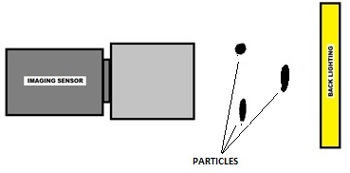
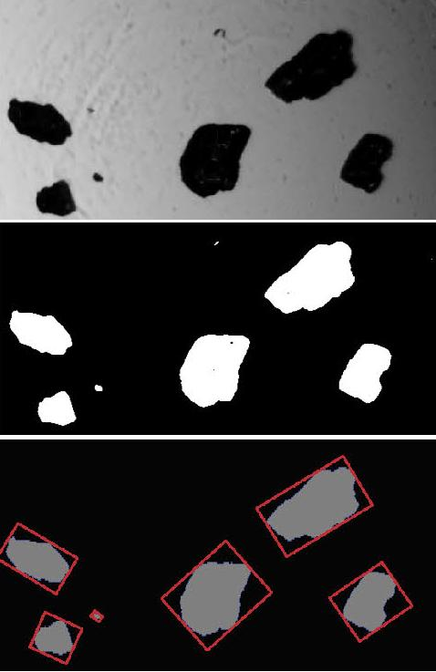
Particle Analysis InFlow
High Magnification System
CANTYVISION software measures the size and shape of individual particles as small as 0.7µm
Differentiates between particle types
Provides concentration measurement in the ppm range
JM Canty, Inc. · Buffalo, New York · Phone: (716) 625-4227 | JM Canty, Ltd. · Dublin, Ireland · Phone: +353 (1) 882-9621

Slide 22

$$$ Payback $$$
Cake detection prevents cracking, which results in fewer wash cycles being required. With each wash cycle some product is lost, so fewer washes result in a higher yield. 1 batch could be worth $100,000 or more, so even a 2% increase in yield is a $2,000 saving per batch!
Less washing also means less utility cost
Automatic cake detection means less personnel resources
The camera pays for itself!
JM Canty, Inc. · Buffalo, New York · Phone: (716) 625-4227 | JM Canty, Ltd. · Dublin, Ireland · Phone: +353 (1) 882-9621

Slide 23
Questions
&
Answers
JM Canty, Inc. · Buffalo, New York · Phone: (716) 625-4227 | JM Canty, Ltd. · Dublin, Ireland · Phone: +353 (1) 882-9621

