Slide 1
Centrifuge Camera
CANTY
PROCESS TECHNOLOGY
WWW.JMCANTY.COM

Slide 2
Topics
Introduction
What is a Centrifuge
Centrifuge types
CANTY Centrifuge Camera
Applications
VCM
Competitive Features & Advantages
Summary & Benefits
Typical Industries & Customer
J.M. CANTY INC. | BUFFALO NY | (716) 625-4227  J.M. CANTY INTL. | DUBLIN, IRELAND | +353 (1) 882-9621  J.M. CANTY INTL. ASIA | PHUKET THAILAND | +66 83 9689548

Slide 3
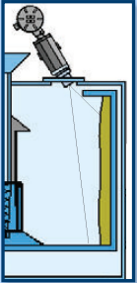
Introduction
A centrifuge is a device that applies rotational force to separate solids from liquid with the view to removing moisture.
The principle is similar to what you would see in your clothing dryer in your house.
The centrifuge operates in the same manner but instead of drying your clothes, it separates the solids from the liquid.
The product is typically transferred from the crystallizer to the centrifuge for drying.
J.M. CANTY INC. | BUFFALO NY | (716) 625-4227  J.M. CANTY INTL. | DUBLIN, IRELAND | +353 (1) 882-9621  J.M. CANTY INTL. ASIA | PHUKET THAILAND | +66 83 9689548

Slide 4
Introduction (cont’d)
The centrifuge, like your dryer has a drum (basket) that allows the solids to settle on its inner surface through use of a high rotation speed.
Once the solids settle out on the inner surface (cake) the washing of the ‘cake’ will be carried out via spray nozzles.
The centrifuge will accelerate to maximum allowable speed to remove the remaining moisture.
J.M. CANTY INC. | BUFFALO NY | (716) 625-4227  J.M. CANTY INTL. | DUBLIN, IRELAND | +353 (1) 882-9621  J.M. CANTY INTL. ASIA | PHUKET THAILAND | +66 83 9689548

Slide 5
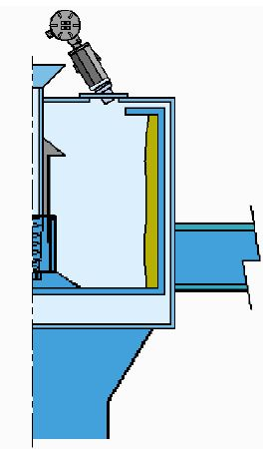
Centrifuge Types
Batch Centrifuge
Such as basket OR peeler are commonly used in the Pharmaceutical, Chemical and Food industries.
Tend to operate at variable speeds.
Discharge is typically done through inverting the basket or ‘knife’ discharge at the end of a cycle.
Batch centrifuges allow for higher purity of the final product. This is due to the higher separation efficiency of the solids and liquid from the slurry.
J.M. CANTY INC. | BUFFALO NY | (716) 625-4227  J.M. CANTY INTL. | DUBLIN, IRELAND | +353 (1) 882-9621  J.M. CANTY INTL. ASIA | PHUKET THAILAND | +66 83 9689548

Slide 6
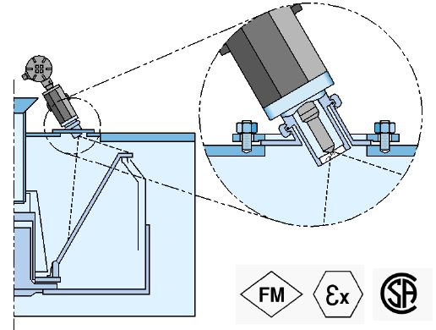
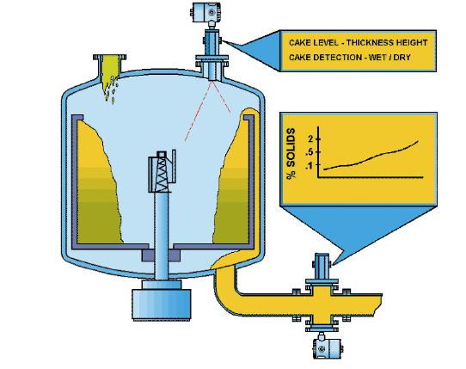
Centrifuge Types
Continuous centrifuge
Continuous centrifuges such as pusher OR decanter have a wide range of use in the Chemical, Wastewater treatment, Iron Ore, Oil and Food industries.
They tend to operate at a constant speed which can save time and energy costs.
Not as high of purity as the batch version but 3rd generations have improved immensely.
J.M. CANTY INC. | BUFFALO NY | (716) 625-4227  J.M. CANTY INTL. | DUBLIN, IRELAND | +353 (1) 882-9621  J.M. CANTY INTL. ASIA | PHUKET THAILAND | +66 83 9689548

Slide 7
Current Measurement Techniques:
Clients have a multitude of inaccurate ways to determining when filling is complete OR if the ‘cake’ is dry/washing complete.
Examples are:
Operator viewing through a window.
Pre-determined cycle times.
Devices that measure color after the product has been removed from the centrifuge.
Multiple devices for determining the filling level.
J.M. CANTY INC. | BUFFALO NY | (716) 625-4227  J.M. CANTY INTL. | DUBLIN, IRELAND | +353 (1) 882-9621  J.M. CANTY INTL. ASIA | PHUKET THAILAND | +66 83 9689548

Slide 8
Problems encountered:
Previously mentioned systems rely on product quality from the crystallizer being the same each and every time.
The operator determining the cake has been washed & separated to the same standard each time.
Color measurement after the centrifuge detects the issues too late.
This leads to poor quality product and lower yield, as it is impossible to have repeatability.
Repeatability on centrifuges can only truly be achieved through use of the CANTY Centrifuge Camera System!
J.M. CANTY INC. | BUFFALO NY | (716) 625-4227  J.M. CANTY INTL. | DUBLIN, IRELAND | +353 (1) 882-9621  J.M. CANTY INTL. ASIA | PHUKET THAILAND | +66 83 9689548

Slide 9
CANTY Centrifuge Camera:
The Canty Centrifuge Camera system carries out real time measurements that are transmitted to the control system (4-20mA, OPC, Modbus) to ensure a repeatable, homogeneous product. This is achieved by:
Level Measurement
Continuous level measurement allows for accurate tracking of filling.
Cake Drying/Color Measurement.
Color measurement is carried out to determine when the drying has been complete or to determine product quality.
J.M. CANTY INC. | BUFFALO NY | (716) 625-4227  J.M. CANTY INTL. | DUBLIN, IRELAND | +353 (1) 882-9621  J.M. CANTY INTL. ASIA | PHUKET THAILAND | +66 83 9689548

Slide 10
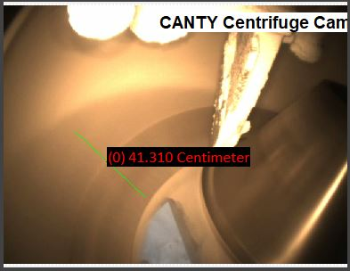
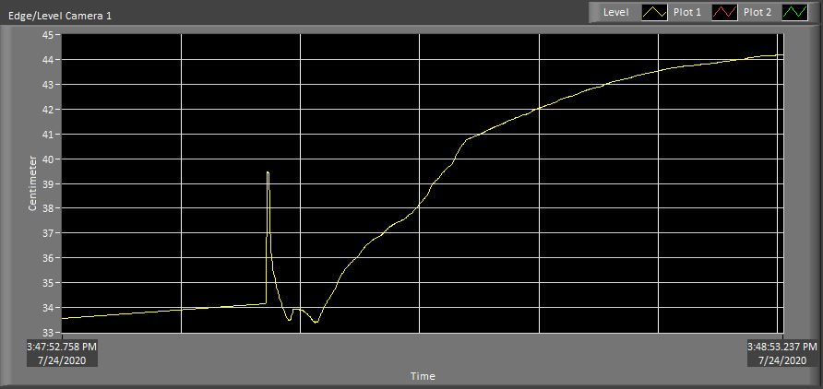
Cake Thickness/Fill Level:
J.M. CANTY INC. | BUFFALO NY | (716) 625-4227  J.M. CANTY INTL. | DUBLIN, IRELAND | +353 (1) 882-9621  J.M. CANTY INTL. ASIA | PHUKET THAILAND | +66 83 9689548

Slide 11
Cake Thickness/Fill Level:
Level measurement allows for accurate tracking of filling to prevent over filling and product loss.
Track the color line in continuous centrifuge systems. Prevent liquid carry over.
Continuous Cake thickness measurement.
Accuracy of up to 2mm/0.8” (basket size dependent)
Measurements output in mm/inches/percent Via 4-20mA, OPC DA, OPC UA, Modbus.
Use multiple level tools over full view area for increased accuracy or redundancy measurements.
J.M. CANTY INC. | BUFFALO NY | (716) 625-4227  J.M. CANTY INTL. | DUBLIN, IRELAND | +353 (1) 882-9621  J.M. CANTY INTL. ASIA | PHUKET THAILAND | +66 83 9689548

Slide 12
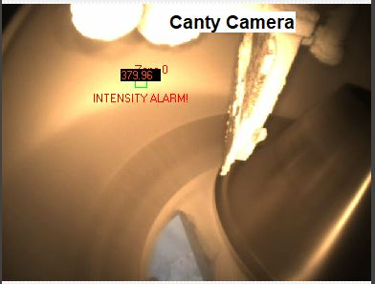
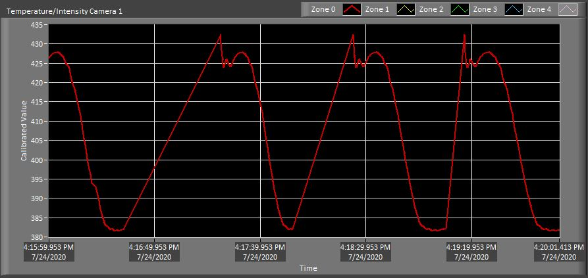
Color/Wash Optimization:
J.M. CANTY INC. | BUFFALO NY | (716) 625-4227  J.M. CANTY INTL. | DUBLIN, IRELAND | +353 (1) 882-9621  J.M. CANTY INTL. ASIA | PHUKET THAILAND | +66 83 9689548

Slide 13
Color / Wash Optimization:
Provides repeatability batch to batch.
Optimize product washing.
Detect early filtration issues such as filter plugging or excess washing fluid.
Calibrate to various color scales such as ICUMSA, NTU, FTU.
Increase yield by up to 12%.
Measurements output Via 4-20mA, OPC DA, OPC UA, Modbus.
Payback for system in a matter of weeks!
J.M. CANTY INC. | BUFFALO NY | (716) 625-4227  J.M. CANTY INTL. | DUBLIN, IRELAND | +353 (1) 882-9621  J.M. CANTY INTL. ASIA | PHUKET THAILAND | +66 83 9689548

Slide 14
J.M. CANTY INC. | BUFFALO NY | (716) 625-4227  J.M. CANTY INTL. | DUBLIN, IRELAND | +353 (1) 882-9621  J.M. CANTY INTL. ASIA | PHUKET THAILAND | +66 83 9689548

Slide 15
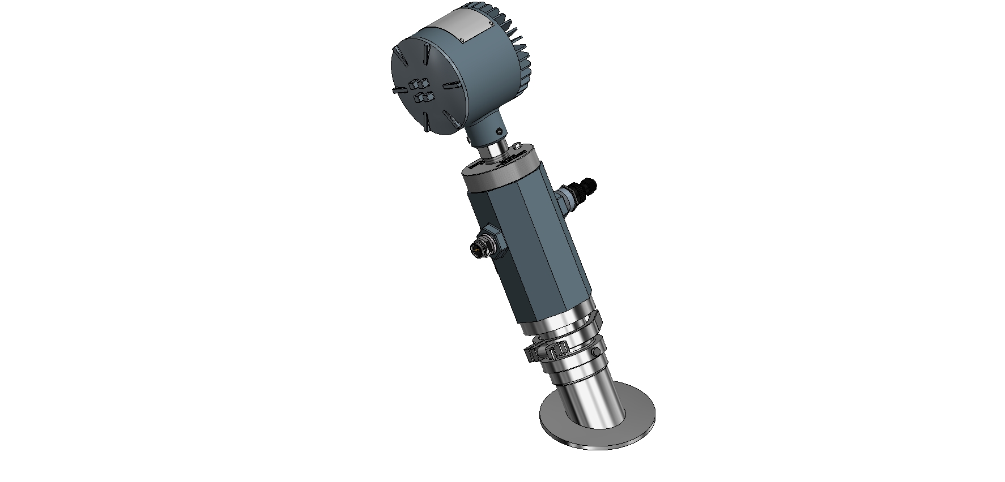
Camera Hardware
LED light Source
Ethernet from Camera to VCM
Power to camera
Anodized aluminum housing
J.M. CANTY INC. | BUFFALO NY | (716) 625-4227  J.M. CANTY INTL. | DUBLIN, IRELAND | +353 (1) 882-9621  J.M. CANTY INTL. ASIA | PHUKET THAILAND | +66 83 9689548

Slide 16
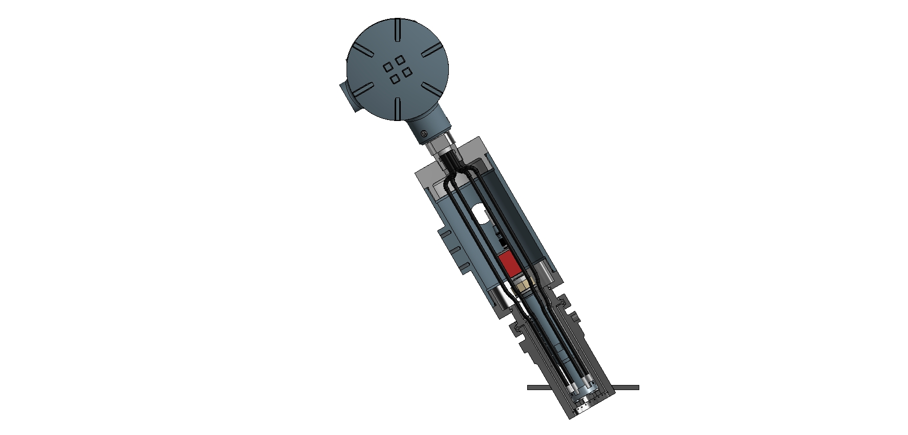
Camera Hardware
6 Leg Fiber Optic Bundle
Hi-Res Camera
Camera Lens
Integrated Spray Ring Cleaning System
J.M. CANTY INC. | BUFFALO NY | (716) 625-4227  J.M. CANTY INTL. | DUBLIN, IRELAND | +353 (1) 882-9621  J.M. CANTY INTL. ASIA | PHUKET THAILAND | +66 83 9689548

Slide 17
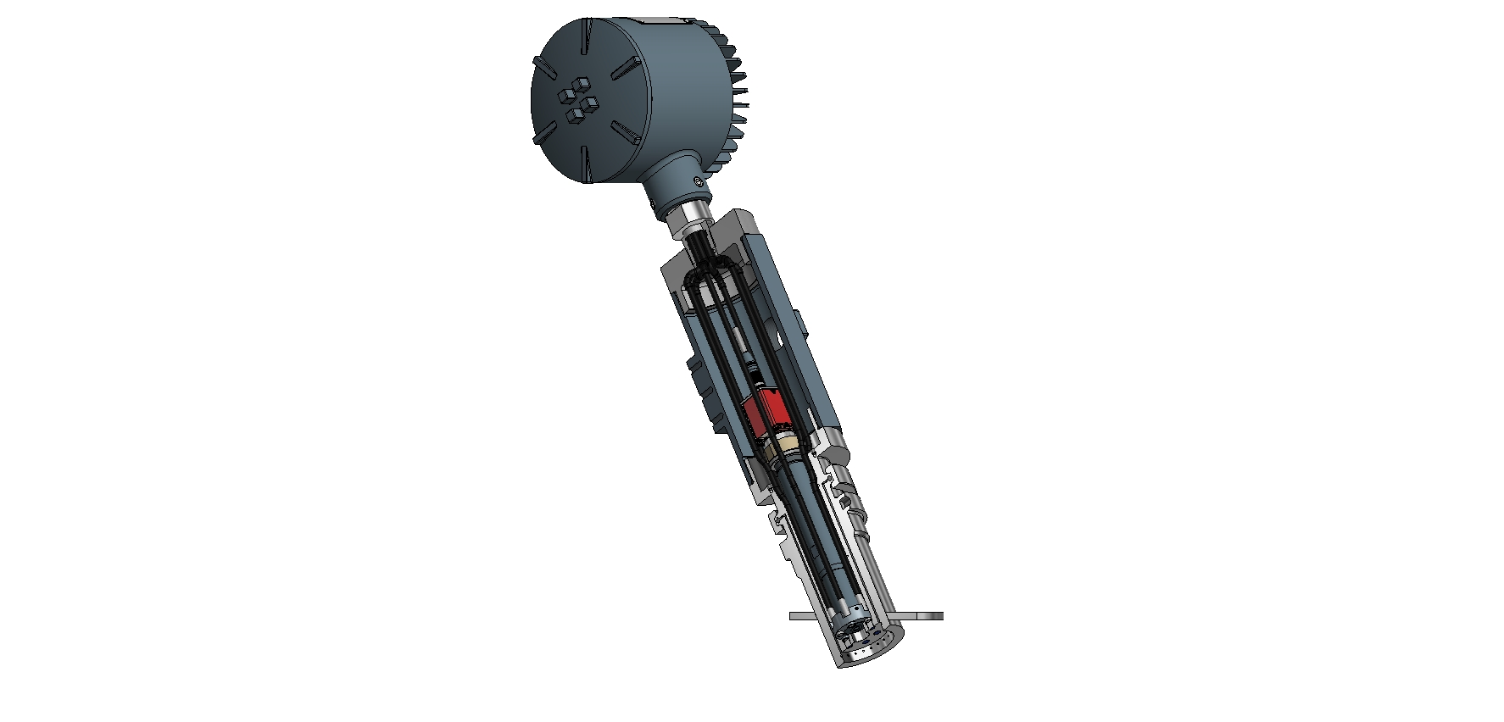
Camera Hardware
Angled 6” OD Mounting plate
Fused Glass front cap.
J.M. CANTY INC. | BUFFALO NY | (716) 625-4227  J.M. CANTY INTL. | DUBLIN, IRELAND | +353 (1) 882-9621  J.M. CANTY INTL. ASIA | PHUKET THAILAND | +66 83 9689548

Slide 18
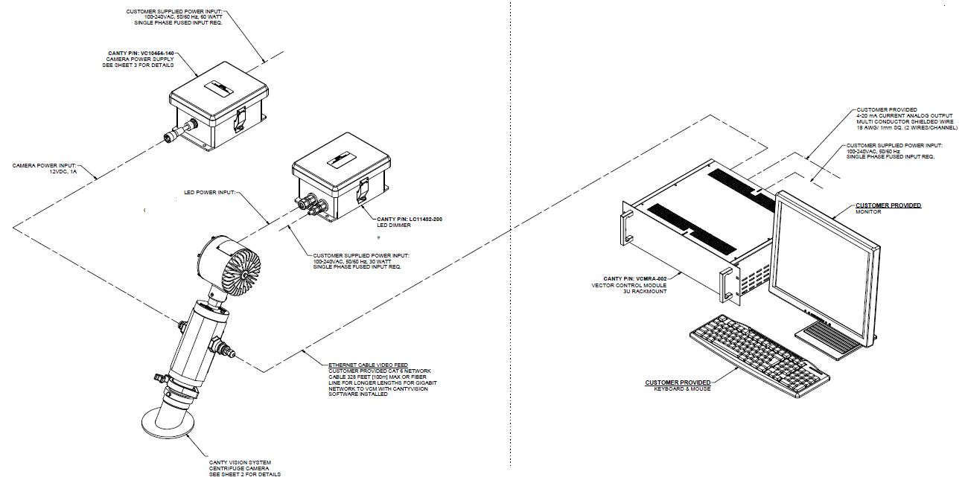
Camera installation Layout
J.M. CANTY INC. | BUFFALO NY | (716) 625-4227  J.M. CANTY INTL. | DUBLIN, IRELAND | +353 (1) 882-9621  J.M. CANTY INTL. ASIA | PHUKET THAILAND | +66 83 9689548

Slide 19
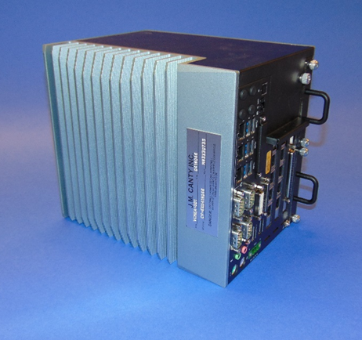
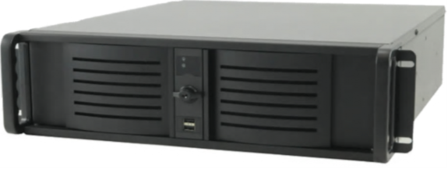
VCM - VISION CONTROL MODULE
Allows for input up to 6 cameras
Multiple outputs
-4-20mA
-OPC (OPC UA now available)
-Modbus
-Video Display
-ONVIF Conformant
Ease of Remote Support
J.M. CANTY INC. | BUFFALO NY | (716) 625-4227  J.M. CANTY INTL. | DUBLIN, IRELAND | +353 (1) 882-9621  J.M. CANTY INTL. ASIA | PHUKET THAILAND | +66 83 9689548

Slide 20
Competitive Features:
Fused Glass front cap provides barrier between optics and Process.
Easily replaces existing sight glass & light set-up.
Unrivalled remote view in to the process from the control room for increased operator safety.
Once installed, no further calibration is required.
Virtually maintenance free.
Provides Level tracking and wash optimization all in one system.
Record images for archive purposes.
Atex/IECex/FM/CSA certified.
J.M. CANTY INC. | BUFFALO NY | (716) 625-4227  J.M. CANTY INTL. | DUBLIN, IRELAND | +353 (1) 882-9621  J.M. CANTY INTL. ASIA | PHUKET THAILAND | +66 83 9689548

Slide 21
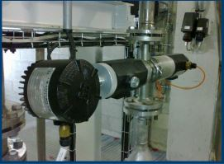
Particle Analysis/Fines Recovery:
J.M. CANTY INC. | BUFFALO NY | (716) 625-4227  J.M. CANTY INTL. | DUBLIN, IRELAND | +353 (1) 882-9621  J.M. CANTY INTL. ASIA | PHUKET THAILAND | +66 83 9689548

Slide 22
Particle Analysis/Fines Recovery:
Recover fines that maybe other wise lost to drain.
Receive real time particle analysis information straight to you DCS such as % Solids, Parts Per Million (PPM), Particle size.
Detect screen breaks or filtration issues early!
Size down to 0.7μm.
Record images for off-line analysis
Combine Particle analysis system and centrifuge camera system on the same VCM for measurement outputs & ultimate optimization.
J.M. CANTY INC. | BUFFALO NY | (716) 625-4227  J.M. CANTY INTL. | DUBLIN, IRELAND | +353 (1) 882-9621  J.M. CANTY INTL. ASIA | PHUKET THAILAND | +66 83 9689548

Slide 23
J.M. CANTY INC. | BUFFALO NY | (716) 625-4227  J.M. CANTY INTL. | DUBLIN, IRELAND | +353 (1) 882-9621  J.M. CANTY INTL. ASIA | PHUKET THAILAND | +66 83 9689548

Slide 24
Summary & Benefits
Increase yield & optimize cycle time by up to 12% through level tracking and wash optimization.
Combine Particle analysis system with Centrifuge camera system for ultimate yield increase & product recovery.
Early fault detection.
Real time measurements.
Non-contact measurements.
Accurate and repeatable measurements
Easily replaces current sight glass and light set-up.
Archive data/images/video.
J.M. CANTY INC. | BUFFALO NY | (716) 625-4227  J.M. CANTY INTL. | DUBLIN, IRELAND | +353 (1) 882-9621  J.M. CANTY INTL. ASIA | PHUKET THAILAND | +66 83 9689548

Slide 25
Questions
and
Answers
J.M. CANTY INC. | BUFFALO NY | (716) 625-4227  J.M. CANTY INTL. | DUBLIN, IRELAND | +353 (1) 882-9621  J.M. CANTY INTL. ASIA | PHUKET THAILAND | +66 83 9689548

