Slide 1

Dayton Fuel Conference 2020
Using Shape Recognition Capacity of Dynamic Imaging to Achieve a More Accurate Analysis of Fluids
CANTY
PROCESS TECHNOLOGY
WWW.JMCANTY.COM

Slide 2
Dynamic Imaging Fundamentals
WWW.JMCANTY.COM
CANTY
CANTY
PROCESS TECHNOLOGY
PROCESS TECHNOLOGY
High Speed, High Resolution and High Magnification images result in particle count and categorization capability in one measurement.
LED advancements have improved particle detections due to brighter, more consistent lighting fields, as well as the ability to analyze high speed flows.
Shape parameters allow software to discern between solid particles, water droplets and air bubbles revealing the true condition of the analyzed fluid.
Analysis conforming to ASTM D8049 Standard Method for analyzing distillate fuels for solid particle and water content.
Reporting to ISO codes 4406 and ASTM D8072 –Standard Classification for reporting imaging results for solid particle and water content in hydrocarbon based petroleum products.
ASTM D7596 -Standard Test Method for Automatic Particle Counting and Classification of Oils Using a Direct Imaging Tester
J.M. CANTY INC. | BUFFALO NY | (716) 625-4227  J.M. CANTY INTL. | DUBLIN, IRELAND | +353 (1) 882-9621  J.M. CANTY ASIA OFFICE | PHUKET THAILAND

Slide 3
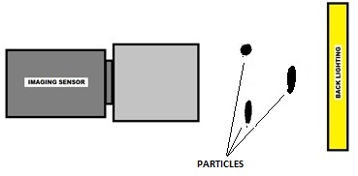
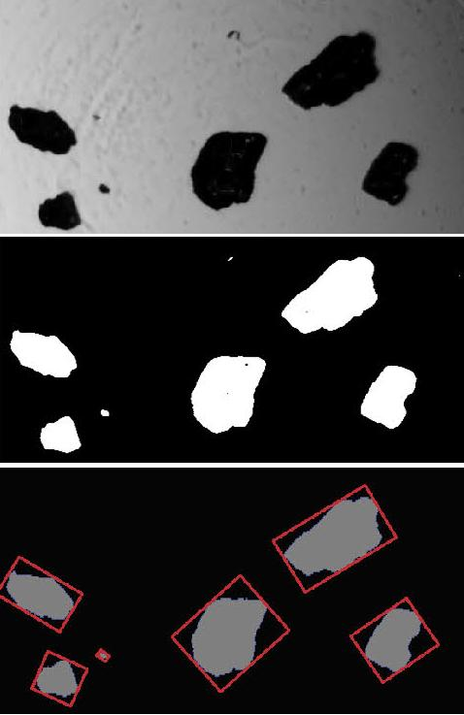
Vision Based Particle Analysis Basic Principle
WWW.JMCANTY.COM
CANTY
CANTY
PROCESS TECHNOLOGY
PROCESS TECHNOLOGY
JM Canty’s vision based technique works on the basic principle of presenting the fluid between a high intensity light source, and microscopic camera
The captured images are then sent to CantyVision Client Software for analysis, where the suspended particulate (oil or water, solids, gas bubbles etc.) is measured under a number of different parameters to provide size, shape and concentration data
J.M. CANTY INC. | BUFFALO NY | (716) 625-4227  J.M. CANTY INTL. | DUBLIN, IRELAND | +353 (1) 882-9621  J.M. CANTY ASIA OFFICE | PHUKET THAILAND

Slide 4
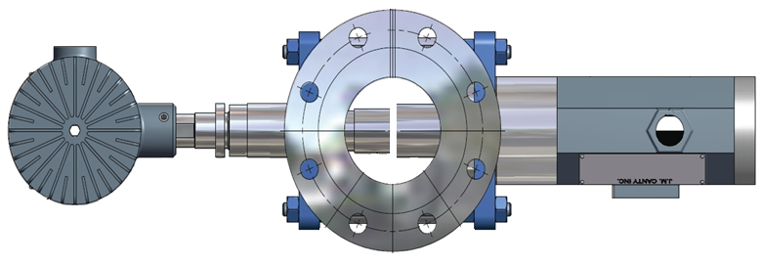
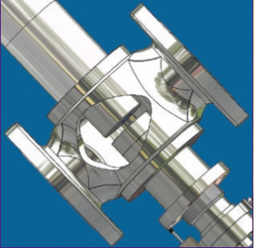
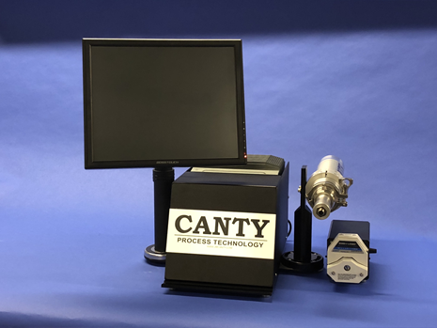
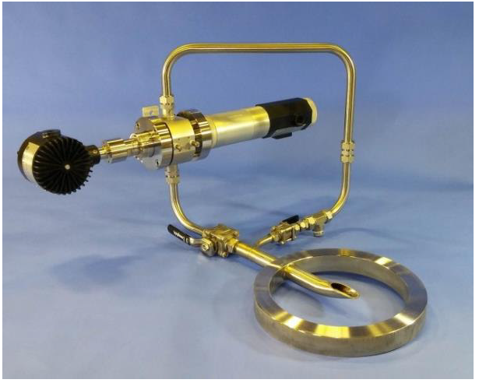
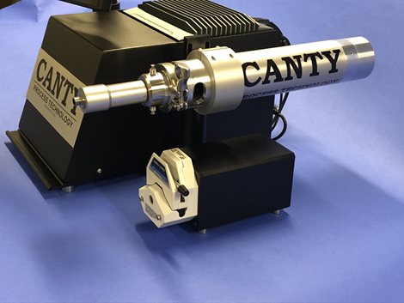
Canty Technology Advantages
WWW.JMCANTY.COM
CANTY
CANTY
PROCESS TECHNOLOGY
PROCESS TECHNOLOGY
LED Strobed Technology (2 µs Pulsewidth) allows for flowrates through analyzer up to 5 m/s.
8.9 Mega-Pixel CCD Imaging Sensor Measurement capability to 0.7µm
Calibration verification using NIST Traceable Polystyrene Microspheres.
High speed software with easy to use graphical user interface.
J.M. CANTY INC. | BUFFALO NY | (716) 625-4227  J.M. CANTY INTL. | DUBLIN, IRELAND | +353 (1) 882-9621  J.M. CANTY ASIA OFFICE | PHUKET THAILAND

Slide 5
Lab System
Canty Mini Cell Core Unit
WWW.JMCANTY.COM
CANTY
CANTY
PROCESS TECHNOLOGY
PROCESS TECHNOLOGY
CORE system is designed for laboratory use. Complete system can easily fit in fume hood or on a small bench.
System takes advantage of ultra high intensity strobed LED.
System power, computer (VCM), pump and touch-screen monitor all incorporated into one design.
System takes advantage of up to 8.9 Megapixel Camera coupled with ultra high resolution optics for measurements down to .7µm.
High speed software with easy to use graphical user interface.
Sample size – Typically 50ml container , 80% full.
Automated pump allow for easy analysis.
Calibration verification using NIST Traceable Polystyrene Microspheres.
J.M. CANTY INC. | BUFFALO NY | (716) 625-4227  J.M. CANTY INTL. | DUBLIN, IRELAND | +353 (1) 882-9621  J.M. CANTY ASIA OFFICE | PHUKET THAILAND

Slide 6
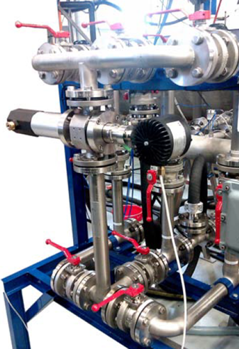
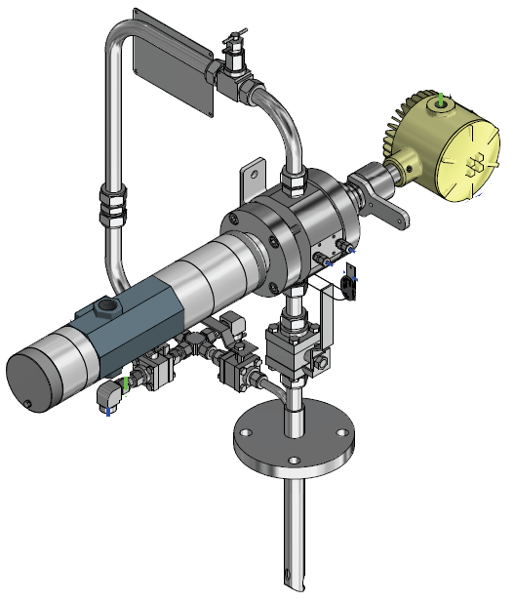
Inline/Online Systems
Canty Inflow System
WWW.JMCANTY.COM
CANTY
CANTY
PROCESS TECHNOLOGY
PROCESS TECHNOLOGY
ATEX/IECEx Zone 0/1 II 1 / 2 GD, EX db IIB+H2 T5. IP66
Optically identical to lab system allowing for consistency between lab and online results
Inline InFlow mounts as permanent spool piece in main process pipeline
For large diameter process pipelines, Inflow mounts in compact flow loop – wafer or flange mount to pipeline
J.M. CANTY INC. | BUFFALO NY | (716) 625-4227  J.M. CANTY INTL. | DUBLIN, IRELAND | +353 (1) 882-9621  J.M. CANTY ASIA OFFICE | PHUKET THAILAND

Slide 7
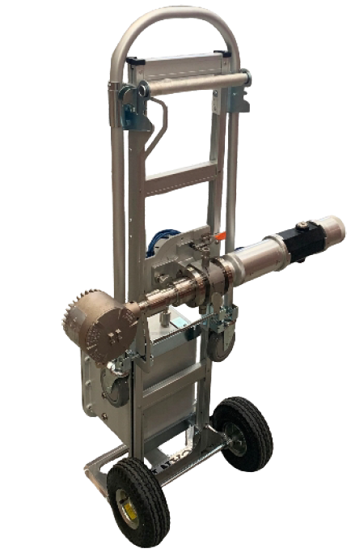
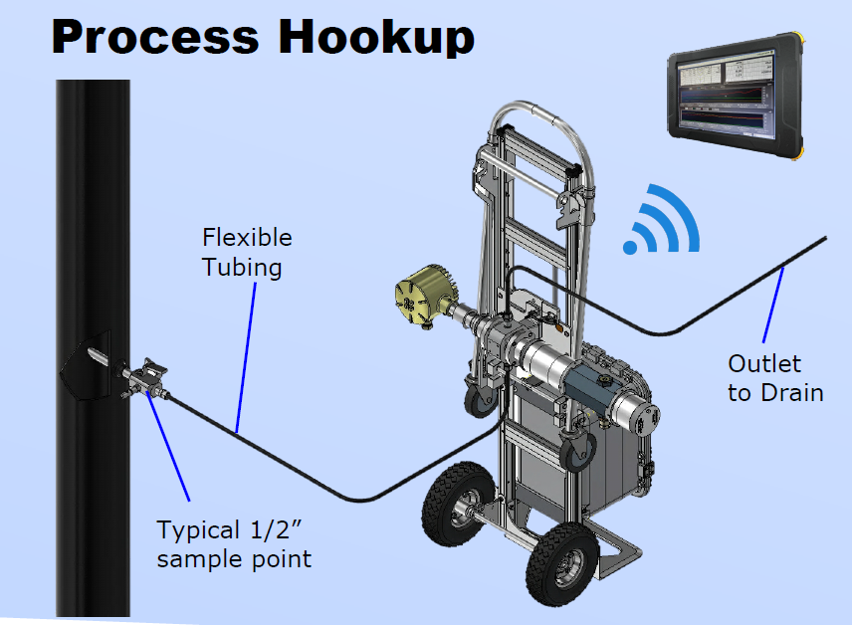
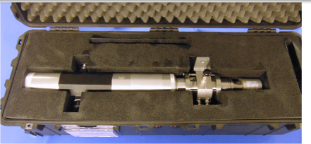
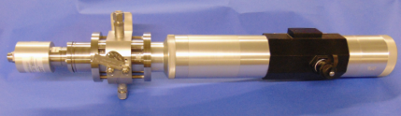
Mobile System
Canty Transportable/Portable Systems
WWW.JMCANTY.COM
CANTY
CANTY
PROCESS TECHNOLOGY
PROCESS TECHNOLOGY
Canty Transportable System
ATEX/IECEx Zone 0/1, 1 / 2 GD, Ex db IIB+H2 T5.
Optically identical to lab &online systems allowing for consistency between lab and online results
System is designed for multi point surveys in the process facility. System can be easily moved to different sample points.
System is fully configured and operated by ATEX/IECEx Zone 1 rated wireless tablet
Canty Portable System
WP/IP66 Portable system with pelican case
J.M. CANTY INC. | BUFFALO NY | (716) 625-4227  J.M. CANTY INTL. | DUBLIN, IRELAND | +353 (1) 882-9621  J.M. CANTY ASIA OFFICE | PHUKET THAILAND

Slide 8

Image Retrieval – Hardware – CCD Camera
WWW.JMCANTY.COM
CANTY
CANTY
PROCESS TECHNOLOGY
PROCESS TECHNOLOGY
Gigabit Ethernet technology for optimum image retrieval
Camera resolution up to 8.9MP.
Particle / Droplet Size to 0.7µm
Simple RJ45 Network Connection to VCM
J.M. CANTY INC. | BUFFALO NY | (716) 625-4227  J.M. CANTY INTL. | DUBLIN, IRELAND | +353 (1) 882-9621  J.M. CANTY ASIA OFFICE | PHUKET THAILAND

Slide 9
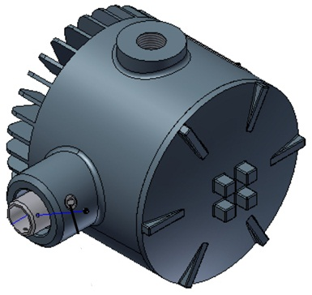
Image Retrieval – Hardware– Lighting System
WWW.JMCANTY.COM
CANTY
CANTY
PROCESS TECHNOLOGY
PROCESS TECHNOLOGY
LED Strobed Technology (2 µs Pulsewidth) allows for flowrates through analyzer up to 5 m/s.
High Intensity LED Light Source
5+ Years Continuous Operation
Flow velocity up to 5m/s
J.M. CANTY INC. | BUFFALO NY | (716) 625-4227  J.M. CANTY INTL. | DUBLIN, IRELAND | +353 (1) 882-9621  J.M. CANTY ASIA OFFICE | PHUKET THAILAND

Slide 10
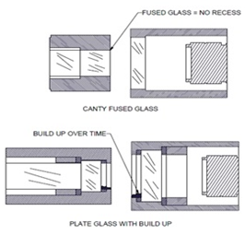
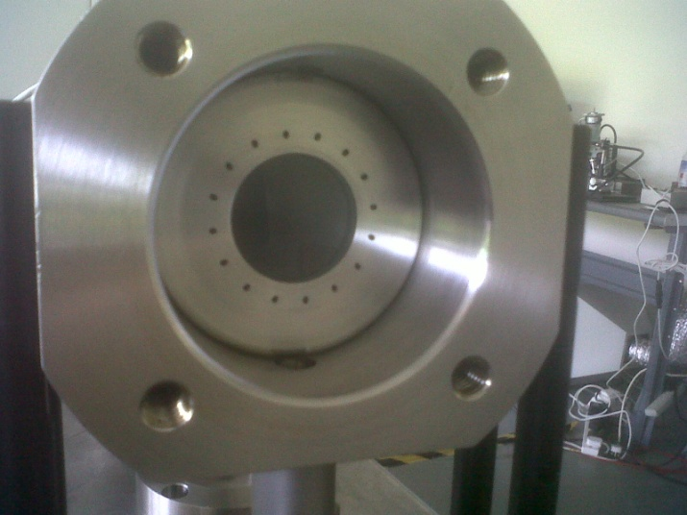
Image Retrieval – Hardware – Fused Glass Flow Path
WWW.JMCANTY.COM
CANTY
CANTY
PROCESS TECHNOLOGY
PROCESS TECHNOLOGY
Fused one piece construction with no recesses or steps where product can adhere to and build up
Pressures to 600 BAR
Integral Jet Spray Ring
Adjustable Gap Size dependent on sample present
J.M. CANTY INC. | BUFFALO NY | (716) 625-4227  J.M. CANTY INTL. | DUBLIN, IRELAND | +353 (1) 882-9621  J.M. CANTY ASIA OFFICE | PHUKET THAILAND

Slide 11

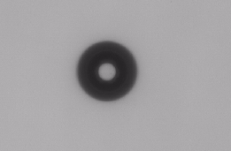

Solid Particle and Water Droplet in Fuel
WWW.JMCANTY.COM
CANTY
CANTY
PROCESS TECHNOLOGY
PROCESS TECHNOLOGY
Based on index of refraction; solid particles, water droplets and gas bubbles can all be distinguished by CantyVision Software.
Solid Particle
Gas
Water Droplet
Shape Parameter | Value
Circularity | .70
Aspect Ratio | 2.23
% Holes Area | 0%
Shape Parameter | Value
Circularity | .33
Aspect Ratio | 1.0
% Holes Area | 25.5%
Shape Parameter | Value
Circularity | .13
Aspect Ratio | 1.0
% Holes Area | 92.5%
J.M. CANTY INC. | BUFFALO NY | (716) 625-4227  J.M. CANTY INTL. | DUBLIN, IRELAND | +353 (1) 882-9621  J.M. CANTY ASIA OFFICE | PHUKET THAILAND

Slide 12
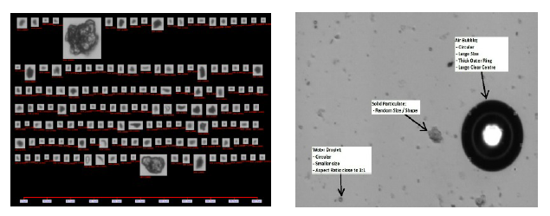
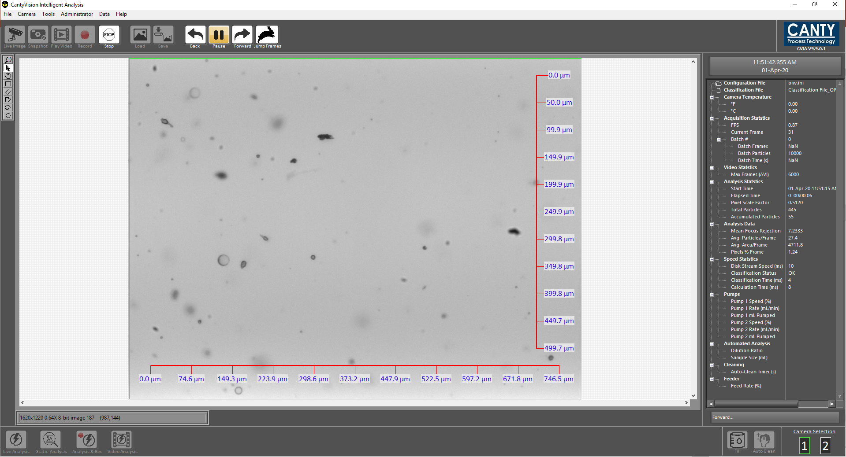
CantyVision Software
WWW.JMCANTY.COM
CANTY
CANTY
PROCESS TECHNOLOGY
PROCESS TECHNOLOGY
Canty AI software - Classification of particles
CantyVision Software is able to process images at high speed real time.
Software provides graphical trends in charts with statistical data for particles and water.
Individual ISO4406 data charts and outputs.
Customized reporting feature for excel data output.
J.M. CANTY INC. | BUFFALO NY | (716) 625-4227  J.M. CANTY INTL. | DUBLIN, IRELAND | +353 (1) 882-9621  J.M. CANTY ASIA OFFICE | PHUKET THAILAND

Slide 13
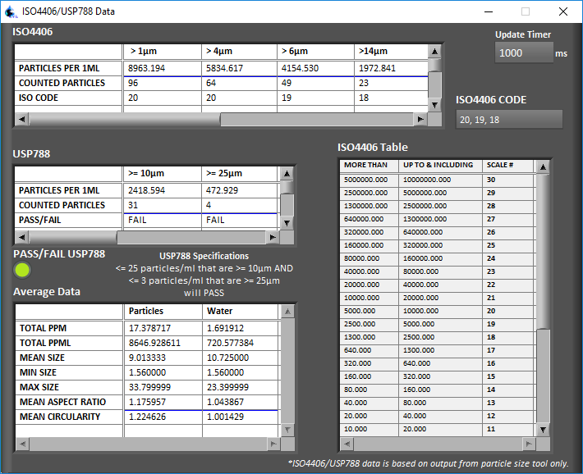
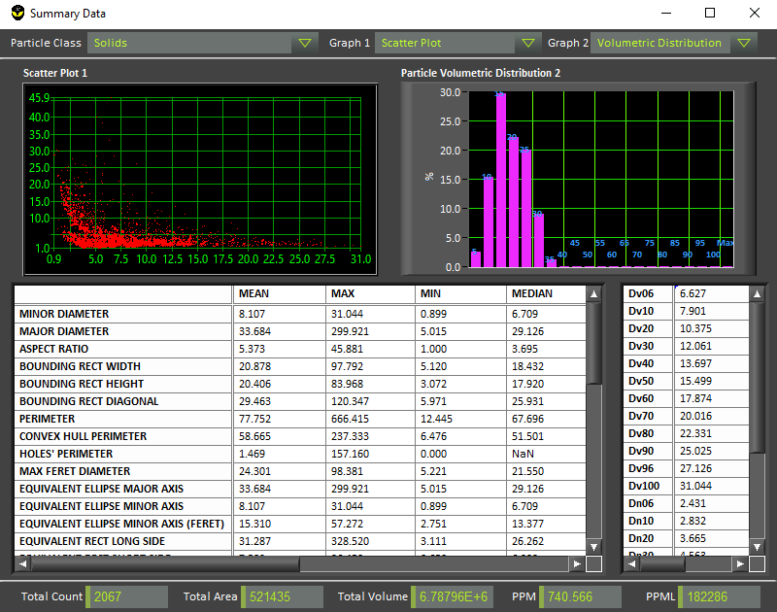
Canty Vision Software – Graphs & Charts
WWW.JMCANTY.COM
CANTY
CANTY
PROCESS TECHNOLOGY
PROCESS TECHNOLOGY
J.M. CANTY INC. | BUFFALO NY | (716) 625-4227  J.M. CANTY INTL. | DUBLIN, IRELAND | +353 (1) 882-9621  J.M. CANTY ASIA OFFICE | PHUKET THAILAND

Slide 14
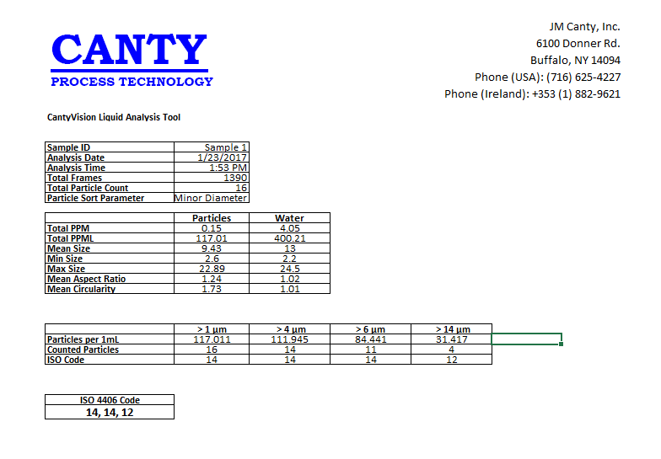
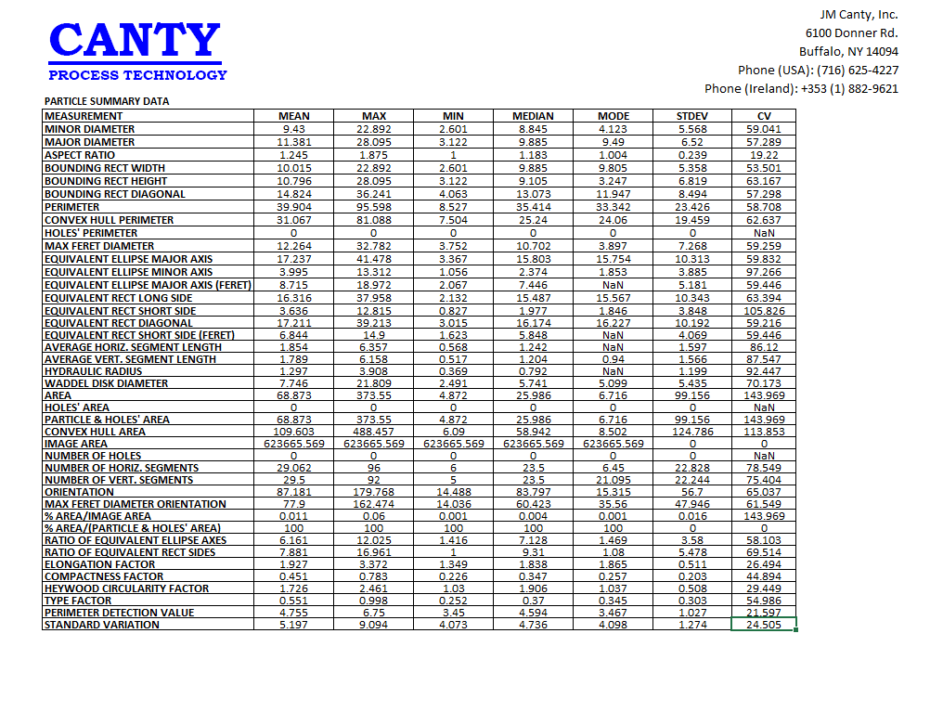
CantyVision Software – Excel Output Reports
WWW.JMCANTY.COM
CANTY
CANTY
PROCESS TECHNOLOGY
PROCESS TECHNOLOGY
J.M. CANTY INC. | BUFFALO NY | (716) 625-4227  J.M. CANTY INTL. | DUBLIN, IRELAND | +353 (1) 882-9621  J.M. CANTY ASIA OFFICE | PHUKET THAILAND

Slide 15
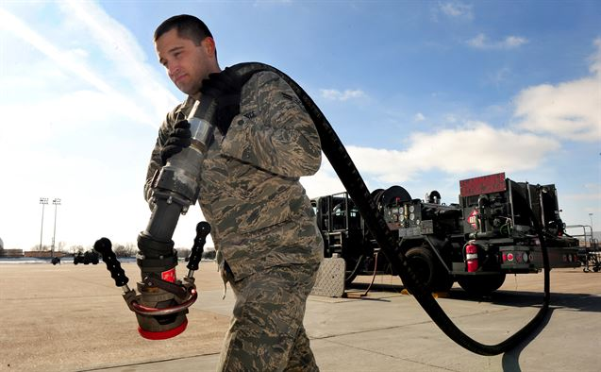
Fuels
WWW.JMCANTY.COM
CANTY
CANTY
PROCESS TECHNOLOGY
PROCESS TECHNOLOGY
Primary Concerns:
  Solid Particles – clog filters and injection ports, pump failure.
  Water Droplets – can freeze at altitude clogging lines and filters, reduce combustion efficiency of fuel.
  Air Bubbles – cause error for in-line measurements mostly resulting in inaccurate fuel analysis.
  Microbial Growth – Increased fuel consumption, reduced engine RPM, increased emissions.
  Aside from the worst case scenarios, which are equipment downtime and human safety, fuel contamination can prove to be very costly.
U.S. Air Force photo/Josh Plueger
J.M. CANTY INC. | BUFFALO NY | (716) 625-4227  J.M. CANTY INTL. | DUBLIN, IRELAND | +353 (1) 882-9621  J.M. CANTY ASIA OFFICE | PHUKET THAILAND

Slide 16
Technology Trend
WWW.JMCANTY.COM
CANTY
CANTY
PROCESS TECHNOLOGY
PROCESS TECHNOLOGY
Inspection throughout the supply chain is required, right up to the point of vehicle load which is the critical point where fuel must be clean and dry. This is currently not the case on a widespread basis.
Rapid, near real time analysis is required to make field applications feasible. Toward that end, the following improvements have come on line:
  Rapid frame analysis – traditional CMOS camera technology can process frames up to 45 per second at a reasonable cost. Current software can analyze up to 20 frames per second.
  Camera resolution continues to improve
  LED technology is now advanced enough to provide bright illumination and consistent field lighting. Timed, pulse lighting controls thermal generation enabling very long life cycle.
J.M. CANTY INC. | BUFFALO NY | (716) 625-4227  J.M. CANTY INTL. | DUBLIN, IRELAND | +353 (1) 882-9621  J.M. CANTY ASIA OFFICE | PHUKET THAILAND

Slide 17
Technology Readiness Level- TRL9
WWW.JMCANTY.COM
CANTY
CANTY
PROCESS TECHNOLOGY
PROCESS TECHNOLOGY
Operator and JIP Subsea Projects
ATEX/IECEx, FM, CSA Certifications
Diesel Water Testing- Louisiana
Pax River Test- Jet Fuel
Field Testing - Norfolk
Commercial airport installations on Jet.
GA installation, Netherlands
J.M. CANTY INC. | BUFFALO NY | (716) 625-4227  J.M. CANTY INTL. | DUBLIN, IRELAND | +353 (1) 882-9621  J.M. CANTY ASIA OFFICE | PHUKET THAILAND

Slide 18
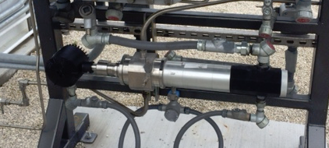
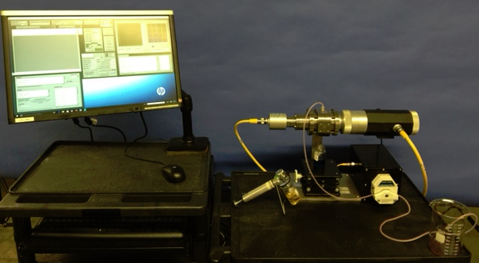
Field Testing - Norfolk
WWW.JMCANTY.COM
CANTY
CANTY
PROCESS TECHNOLOGY
PROCESS TECHNOLOGY
Testing was conducted shipboard to search for contamination source in the vehicle fuel supply chain.
Fuel was tested on-line and off line.
At the fueling hose (after filtration) and prior to filtration (around ship.
Canty instrument tested both ways. Off line test was compared to a laser light obscuration unit.
J.M. CANTY INC. | BUFFALO NY | (716) 625-4227  J.M. CANTY INTL. | DUBLIN, IRELAND | +353 (1) 882-9621  J.M. CANTY ASIA OFFICE | PHUKET THAILAND

Slide 19

Field Testing Off Line – Norfolk
WWW.JMCANTY.COM
CANTY
CANTY
PROCESS TECHNOLOGY
PROCESS TECHNOLOGY
Off-line testing was preformed prior to secondary fuel filtration.
Bottle Sample Preparation
  Samples were gathered from various points around the ships refueling system and presented to the analyzer in glass sample containers containing ~500 – 750mL each. Using the hand shaking method, each bottle was agitated vigorously for 60 seconds to redistribute any particles present.
Water concentration was found in
multiple samples tested.
J.M. CANTY INC. | BUFFALO NY | (716) 625-4227  J.M. CANTY INTL. | DUBLIN, IRELAND | +353 (1) 882-9621  J.M. CANTY ASIA OFFICE | PHUKET THAILAND

Slide 20

Field Testing On-Line - Norfolk
WWW.JMCANTY.COM
CANTY
CANTY
PROCESS TECHNOLOGY
PROCESS TECHNOLOGY
On-Line testing was performed using JM Canty 2” Inflow directly in-line on outlet from secondary filtration.
A large number of gas bubbles were seen in the analysis which could cause false readings in other instruments. CantyVision Software was able to accurately detect these gas bubbles and remove them from detection.
J.M. CANTY INC. | BUFFALO NY | (716) 625-4227  J.M. CANTY INTL. | DUBLIN, IRELAND | +353 (1) 882-9621  J.M. CANTY ASIA OFFICE | PHUKET THAILAND

Slide 21
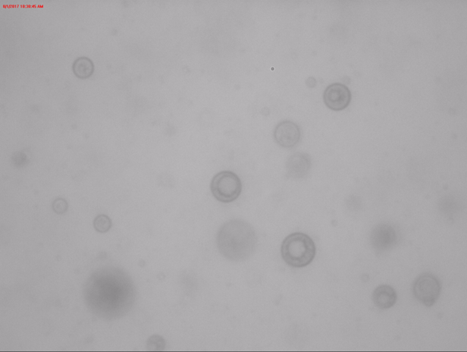
Anti-Foam – Image Filtering
WWW.JMCANTY.COM
CANTY
CANTY
PROCESS TECHNOLOGY
PROCESS TECHNOLOGY
Hydraulic fluid with Anti-foam
Dynamic imaging anlsysis system have the ability to identify flocculent or spherical synthetic additives from other components in the sample.
This allows any additives to be independently measured
J.M. CANTY INC. | BUFFALO NY | (716) 625-4227  J.M. CANTY INTL. | DUBLIN, IRELAND | +353 (1) 882-9621  J.M. CANTY ASIA OFFICE | PHUKET THAILAND

Slide 22
QUESTIONS?
WWW.JMCANTY.COM
CANTY
CANTY
PROCESS TECHNOLOGY
PROCESS TECHNOLOGY
THANK YOU
J.M. CANTY INC. | BUFFALO NY | (716) 625-4227  J.M. CANTY INTL. | DUBLIN, IRELAND | +353 (1) 882-9621  J.M. CANTY ASIA OFFICE | PHUKET THAILAND
J.M. CANTY INC. | BUFFALO NY | (716) 625-4227  J.M. CANTY INTL. | DUBLIN, IRELAND | +353 (1) 882-9621  J.M. CANTY ASIA OFFICE | PHUKET THAILAND

