Slide 1
Ethylene Furnace
(Fired Heater)
Monitoring

Slide 2
AGENDA
Operating Issues
Temperature Measurement
- Non CANTY Techniques
- The CANTY Solution
Advantages
Conclusions

Slide 3

THEORY vs REALITY
In theory an ethylene furnace will operate at a consistent operating temperature, which is based the quality of the feed stock, the performance of burners, and the condition of the furnace tubes
The reality is that the process is not always fed with the same quality feed stock, the burners which are used to heat up the tubes don’t always burn at the same temperature, and coking of the tubes can affect their heat transfer properties, and ultimately cause the tubes to plug
Notes:
Also the single largest energy consumer with an Ethylene plant (between 30-50% of the plant energy costs)
Optimizing it and avoiding component failure is of critical importance

Slide 4
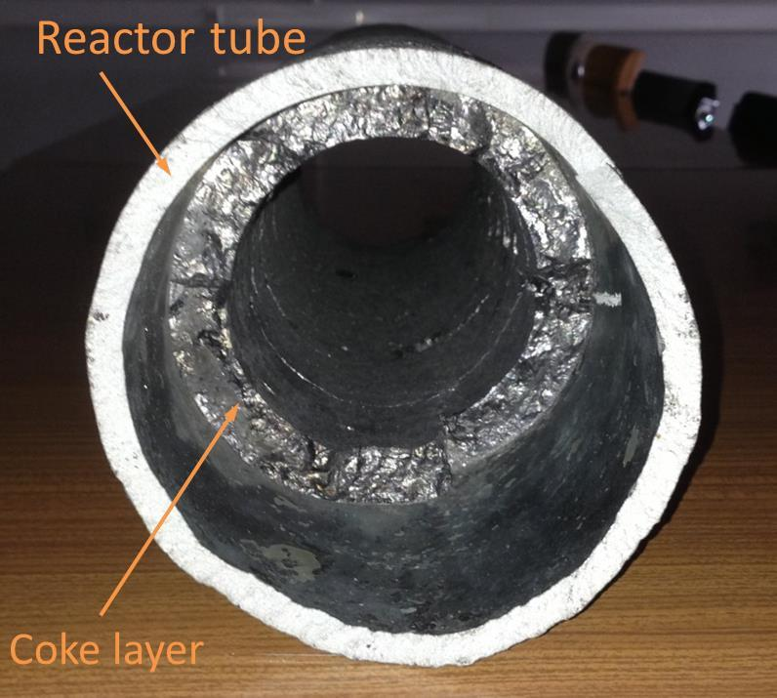
THEORY vs REALITY

Slide 5

TUBE METAL TEMPERATURE
The single greatest cause of component failure and furnace downtown, is overheating tubes. If tubes overheat, it can lead to tube rupture, and possible escape of the feed stock into the firebox area of the furnace, which not only is a process issue, but also a safety issue
If you know a tube is drastically heating up you can adjust the process - stop feedstock and input steam to prevent tube plugging
Tube Metal Temperature measurement is therefore of the utmost criticality

Slide 6
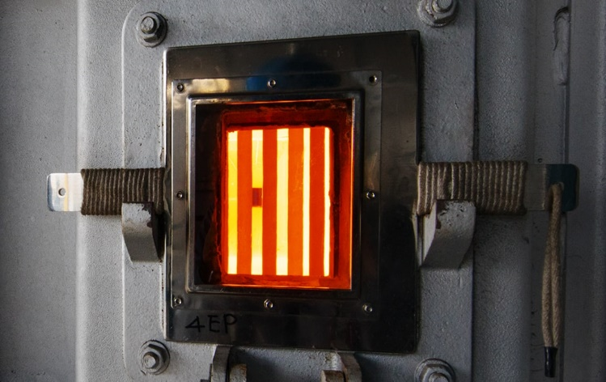
TUBE METAL TEMPERATURE
Common Current Techniques
Manual measurement by a handheld pyrometer through hatch / door
    do they leave the door open to long and let the furnace cool down?
    do they measure the same spot on the tube?
    if only measured every 8 hours when did the tube fail?
Thermocouples installed on the tubes
- contact device – harsh process conditions
- sensor failure – regular replacement
- drift in measurement

Slide 7
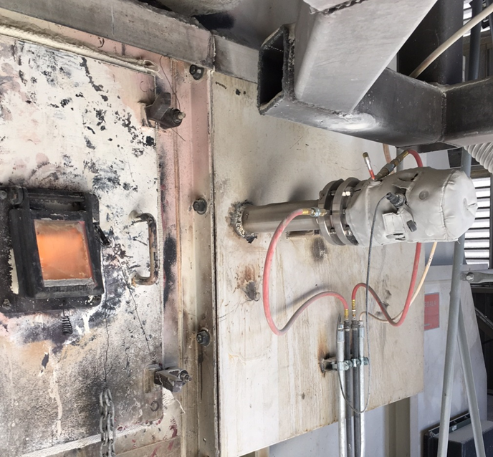
TUBE METAL TEMPERATURE
The CANTY Solution: UltraTemp Cameras with VCM

Slide 8
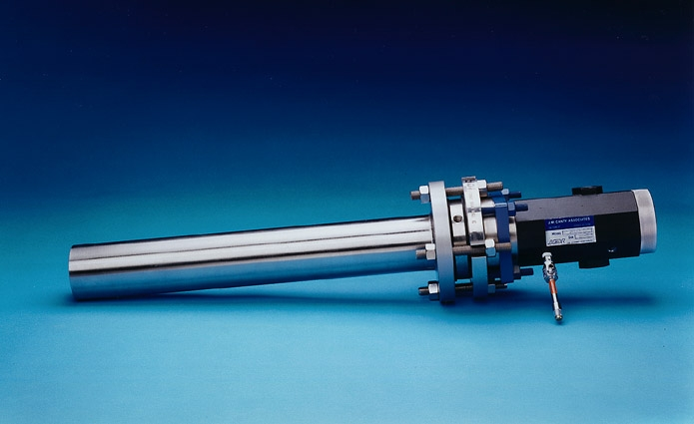
ULTRATEMP CAMERA
Process Temp: 1370ºC (2500⁰F)
24” Insertion
Hazardous Area Rated (EXP / ATEX)
65 Degree View Angle

Slide 9
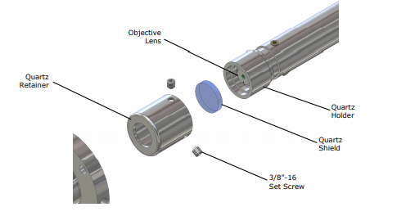
Quartz Shield
Our Camera is protected with a Quartz shield in the event of a loss of heat this shield protects the rest of the optics from becoming damaged and is easily and inexpensively replaced
Notes:
Quartz shield is consumable and only costs around $80

Slide 10
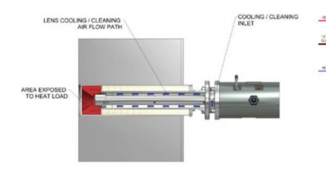
Cooling & Heat Load

Slide 11
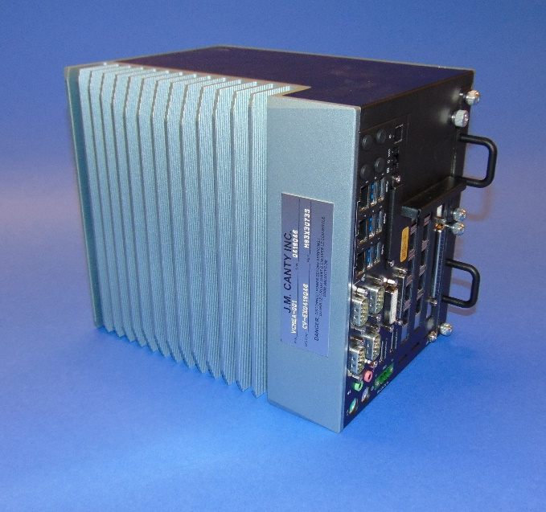
VECTOR CONTROL MODULE
Allows for input up to 6 cameras
Temperature measurement by vision
Multiple outputs
- OPC
- Modbus
- 4-20mA
- Video Display
Ease of Remote Support

Slide 12
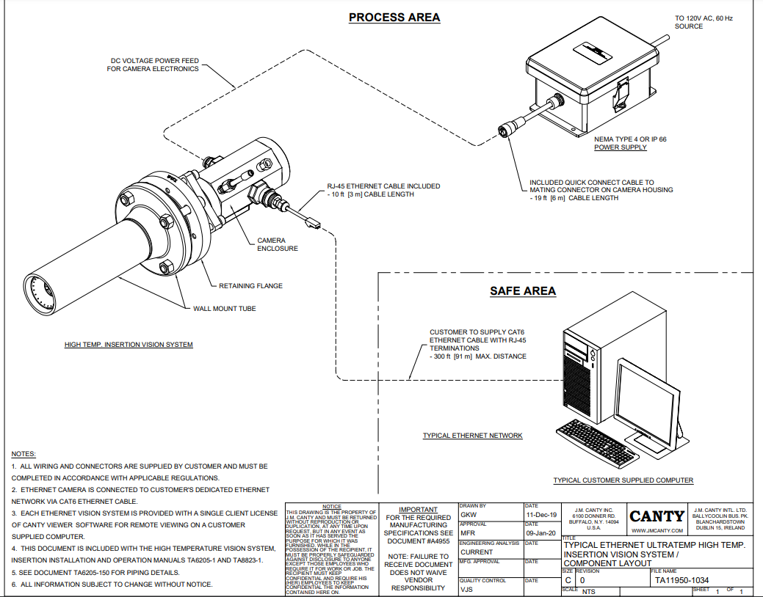
Wiring Layout

Slide 13
EXAMPLE VIEW

Slide 14
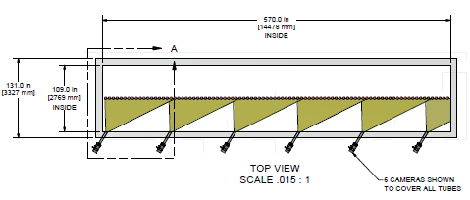
INSTALLATION LAYOUTS

Slide 15
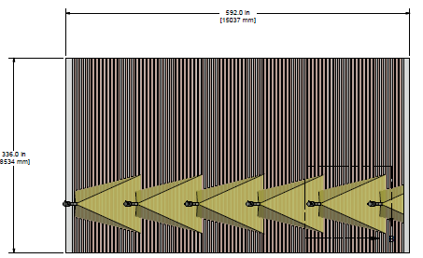
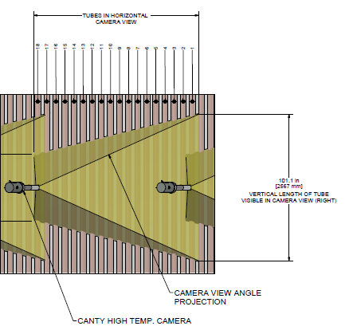
INSTALLATION LAYOUTS

Slide 16
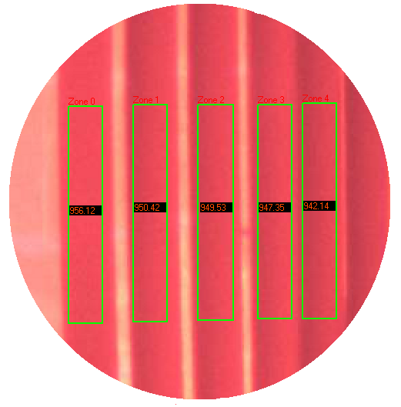
TEMPERATURE BY VISION
Notes:
Analysis of any portion of the screen.
Multiple analysis zones available
Can measure temperature, flame size or flame detection in any zone. Zone area is analyzed, not just one point.
Visual aspect of the technology allows operator to optimize detection settings. Measurement area is the same each time.
Visual verification of upset conditions.

Slide 17
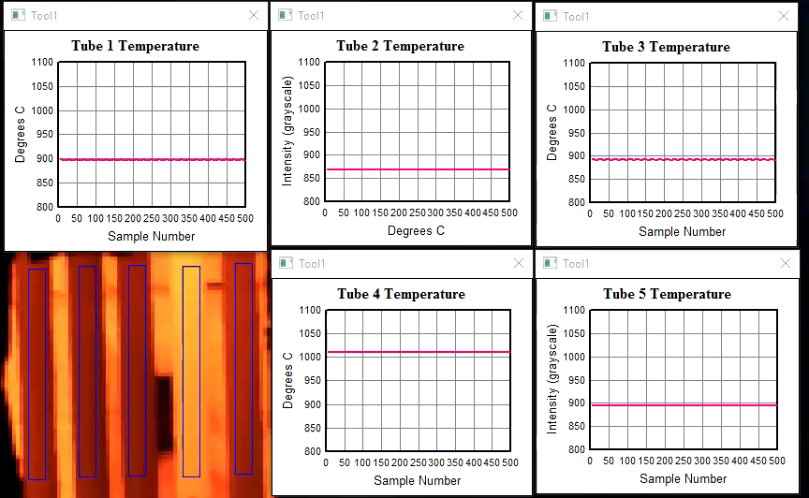
Tube 4 is running too hot “Cooked”
Now has to be cut it out and reweld a new tube on

Slide 18
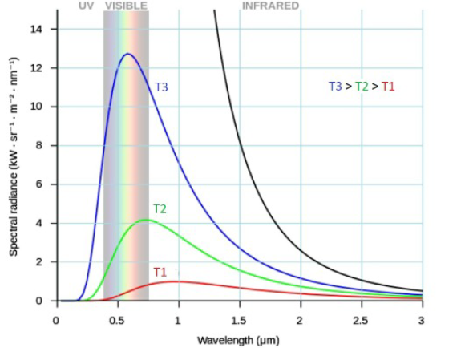
TEMPERATURE BY VISION
Operates in the Visual Spectrum
Biggest difference in the spectral radiance (intensity) for any temperature change occurs in that spectrum, meaning higher sensitivity of instruments
Shorter wavelength instruments less affected by changes over time in the emissivity of an object (tube)
Notes:
Typical Mount where the sight glass is located

Slide 19
Example of Emissivity Error
e at .6 micron = .8 (vision system)
e at 3.9 micron = .4 (pyrometer)
Selection of the exact value is difficult. If one
Selects .75 for the vision system and .35 for the pyrometer, the error associated with each is:
Vision - (.8 - .75) / .8 = 6.25%
Pyrometer – (.4 - .35) / .4 = 12.5%

Slide 20

CANTY ADVANTAGES
Non Contact Measurement
Measurement done in the visual spectrum
- more sensitive to temperature changes
- less affected by emissivity
Visual Verification of process conditions
Rugged Hardware – fused glass / quartz optics / no retraction system
Ease of Maintenance – electronics isolated from the process
Ease of remote support with the VCM
CANTY
Notes:
Typical Mount where the sight glass is located

Slide 21
CONCLUSION
Real time continuous measurement of tube temperature is critical
Reduces down time, increases efficiency, and therefore yield / profit
Current commonly used techniques have multiple issues
CANTY solution overcomes these issues and provides an accurate, reliable, and multi-point measurement

Slide 22

QUESTIONS & ANSWERS

