Slide 1

Water for Injection
CANTY
PROCESS TECHNOLOGY
WWW.JMCANTY.COM

Slide 2

What is Water for Injection
Water for Injection is a solute-free, extremely high quality preparation of distilled water.
Sterilized and used for parenteral drug administration or used in pharmaceutical manufacturing with sterilization carried out downstream.
Subject to USP 788 to prevent undesired immune responses to subvisible particulate in patients.
J.M. CANTY INC. | BUFFALO NY | (716) 625-4227  J.M. CANTY INTL. | DUBLIN, IRELAND | +353 (1) 882-9621  J.M. CANTY INTL. ASIA | PHUKET THAILAND | +66 83 9689548

Slide 3
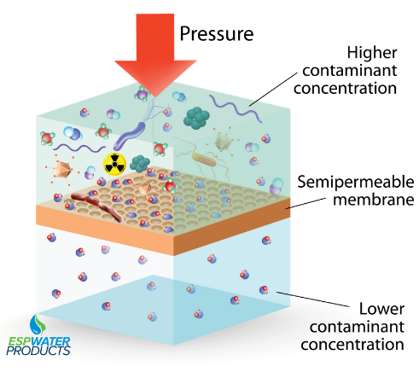
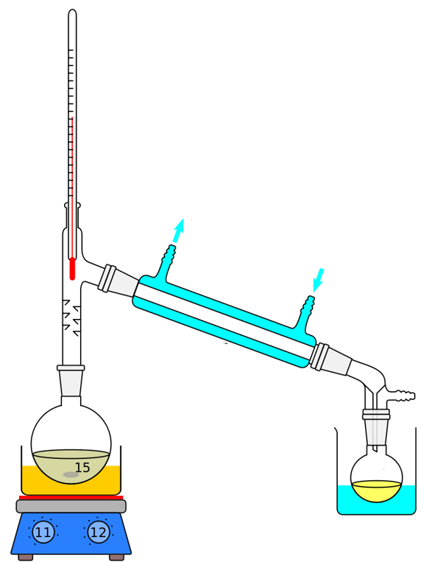
Water for Injection Preparation
WFI is typically prepared by Distillation or Reverse Osmosis.
Distillation
Reverse Osmosis
J.M. CANTY INC. | BUFFALO NY | (716) 625-4227  J.M. CANTY INTL. | DUBLIN, IRELAND | +353 (1) 882-9621  J.M. CANTY INTL. ASIA | PHUKET THAILAND | +66 83 9689548

Slide 4
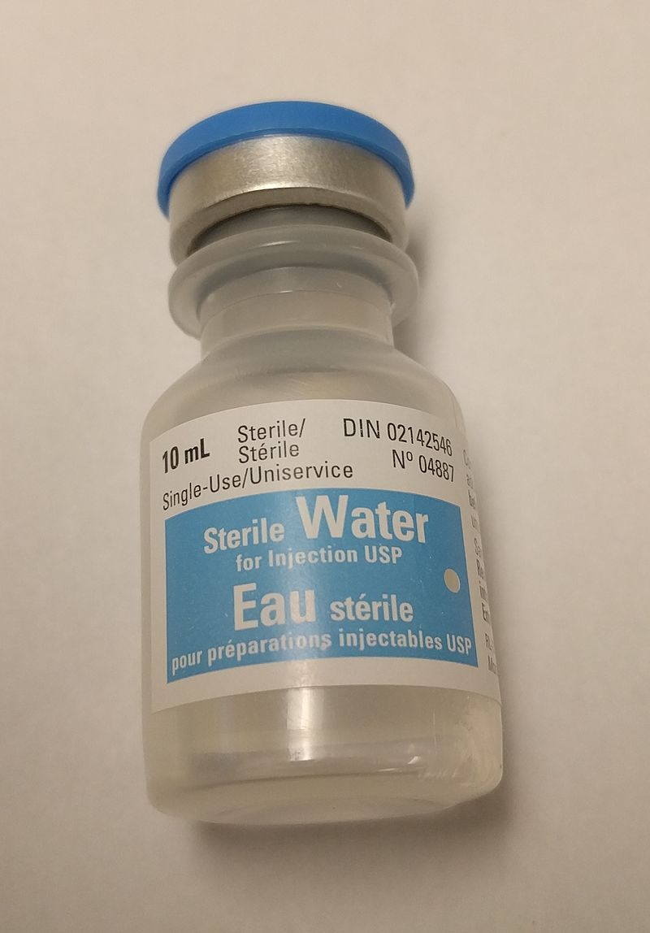
Water for Injection Applications
Sterilized WFI is used in the formulation of intravenously delivered drugs that require dilution or dissolution in an aqueous medium.
Unsterilized WFI is used as an aqueous vehicle in bulk manufacturing where the final product is sterilized.
J.M. CANTY INC. | BUFFALO NY | (716) 625-4227  J.M. CANTY INTL. | DUBLIN, IRELAND | +353 (1) 882-9621  J.M. CANTY INTL. ASIA | PHUKET THAILAND | +66 83 9689548

Slide 5
USP 788
A WFI preparation complies if the average number of particles equal to or greater than 10 and 25 µm falls within the below counts per ml.
Two procedures are currently used, light obscuration and microscopic particle count tests.
Size | Maximum Count per ml
≥10 µm | 25
≥25 µm | 3
J.M. CANTY INC. | BUFFALO NY | (716) 625-4227  J.M. CANTY INTL. | DUBLIN, IRELAND | +353 (1) 882-9621  J.M. CANTY INTL. ASIA | PHUKET THAILAND | +66 83 9689548

Slide 6
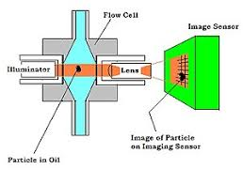
Laser Light Obscuration
One dimensional, indirect measurement.
Requires refractive index of particles.
Detects gas and bubbles as particles
J.M. CANTY INC. | BUFFALO NY | (716) 625-4227  J.M. CANTY INTL. | DUBLIN, IRELAND | +353 (1) 882-9621  J.M. CANTY INTL. ASIA | PHUKET THAILAND | +66 83 9689548

Slide 7
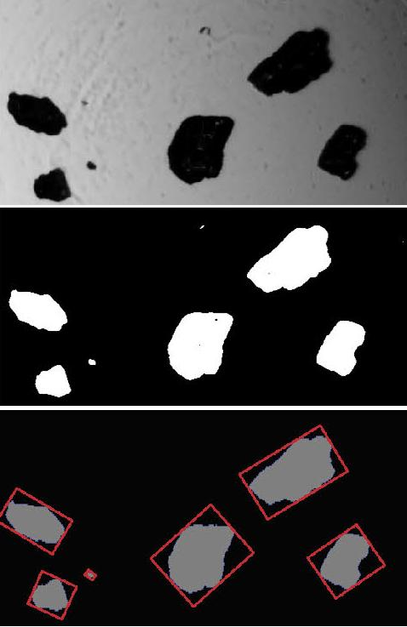
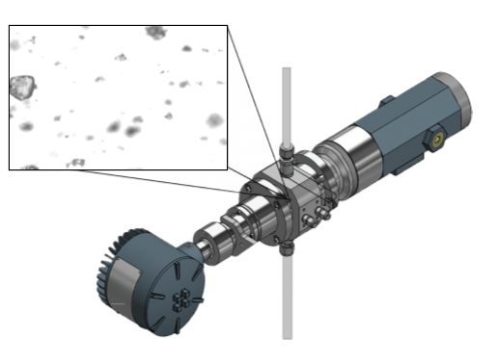
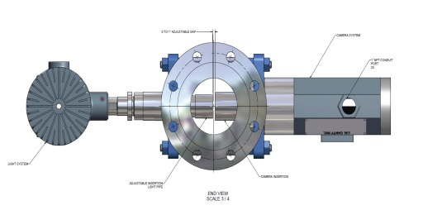
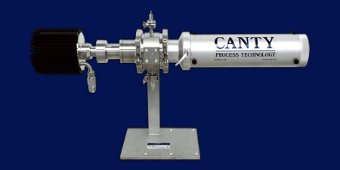
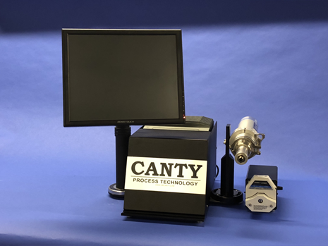
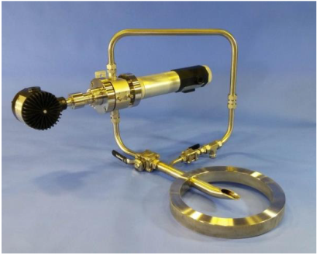
Dynamic Imaging Microscopy
Canty’s dynamic imaging technique works on the basic principle of presenting the product between a high intensity Light source and a high speed, high resolution microscopic camera
The captured 2D images are then sent to the imaging software for analysis, where the suspended particles are measured directly under a number of different parameters providing the true Size, Shape and Concentration
J.M. CANTY INC. | BUFFALO NY | (716) 625-4227  J.M. CANTY INTL. | DUBLIN, IRELAND | +353 (1) 882-9621  J.M. CANTY INTL. ASIA | PHUKET THAILAND | +66 83 9689548

Slide 8
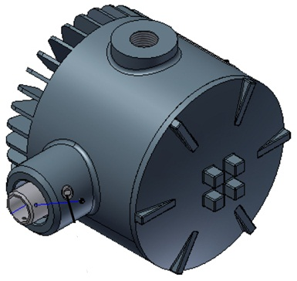
Image Retrieval – Lighting System
High Intensity LED Strobed Light Source
Providing bright even illumination backlighting in order to deliver optimum contrast for particle detection
5+ Years Continuous Operation
Ability to measure flow velocities up to 5m/s
J.M. CANTY INC. | BUFFALO NY | (716) 625-4227  J.M. CANTY INTL. | DUBLIN, IRELAND | +353 (1) 882-9621  J.M. CANTY INTL. ASIA | PHUKET THAILAND | +66 83 9689548

Slide 9
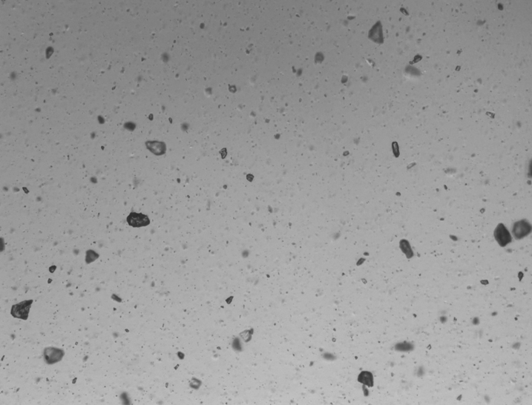
Image Retrieval – CCD
Gigabit Ethernet technology for optimum image retrieval
Camera resolution up to 8.9MP Particle / Droplet Size to 0.7µm
Simple RJ45 Network Connection to VCM
Optics have Zoom/Focus ability to vary magnification dependent of particle size range of interest.
J.M. CANTY INC. | BUFFALO NY | (716) 625-4227  J.M. CANTY INTL. | DUBLIN, IRELAND | +353 (1) 882-9621  J.M. CANTY INTL. ASIA | PHUKET THAILAND | +66 83 9689548

Slide 10
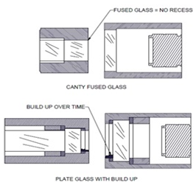
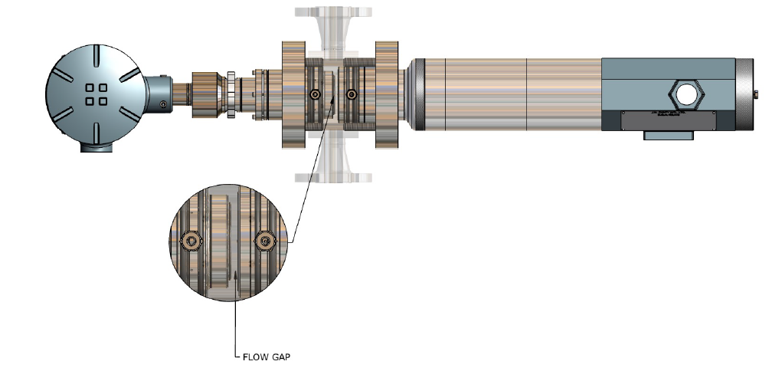
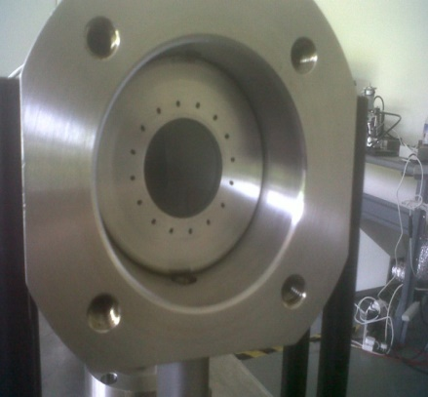
Image Retrieval – Hardware – Fused Glass FlowPath
Fused one piece construction with no recesses or steps where product can adhere to and build up
The unique flow path design allow for laminar flow resulting in the particle orientating so that the face of the particle is presented to the imaging sensor
Pressures to 600 BAR
Adjustable Gap Size dependent on sample present
Integral Jet Spray Ring options available
J.M. CANTY INC. | BUFFALO NY | (716) 625-4227  J.M. CANTY INTL. | DUBLIN, IRELAND | +353 (1) 882-9621  J.M. CANTY INTL. ASIA | PHUKET THAILAND | +66 83 9689548

Slide 11
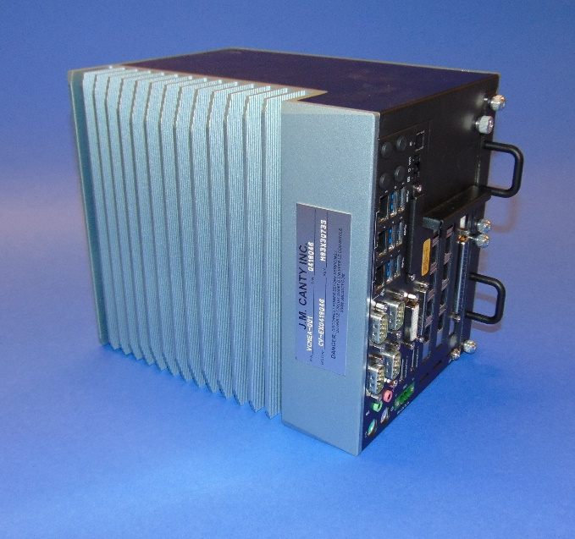
Image Analysis – Hardware – Vector Control Module
CantyVision Intelligent Analysis Software Pre-Installed and configured
Rackmount VCM can support two particle analysis systems
Multiple outputs
-4-20mA
-OPC (OPC UA now available)
-TCP/IP Modbus
-Video Display
Remote Support Functionality
J.M. CANTY INC. | BUFFALO NY | (716) 625-4227  J.M. CANTY INTL. | DUBLIN, IRELAND | +353 (1) 882-9621  J.M. CANTY INTL. ASIA | PHUKET THAILAND | +66 83 9689548

Slide 12
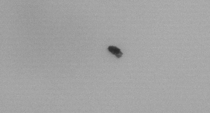
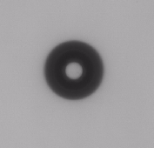
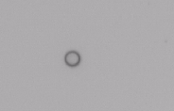

Differentiating between Solids, Liquids and Bubbles
Based on index of refraction; solid particles, water/oil droplets and gas bubbles can all be distinguished by Canty software based on the direct 2D images.
Delivering the TRUE particle size of the particles.
Solid Particle
Gas
Water/Light Oil Droplet
Heavy Oil Droplet
Shape Parameter | Value
Circularity | .70
Aspect Ratio | 2.23
% Holes Area | 0%
Shape Parameter | Value
Circularity | .33
Aspect Ratio | 1.0
% Holes Area | 25.5%
Shape Parameter | Value
Circularity | .13
Aspect Ratio | 1.0
% Holes Area | 92.5%
Shape Parameter | Value
Circularity | 1
Aspect Ratio | 1.0
% Holes Area | 0%
J.M. CANTY INC. | BUFFALO NY | (716) 625-4227  J.M. CANTY INTL. | DUBLIN, IRELAND | +353 (1) 882-9621  J.M. CANTY INTL. ASIA | PHUKET THAILAND | +66 83 9689548

Slide 13
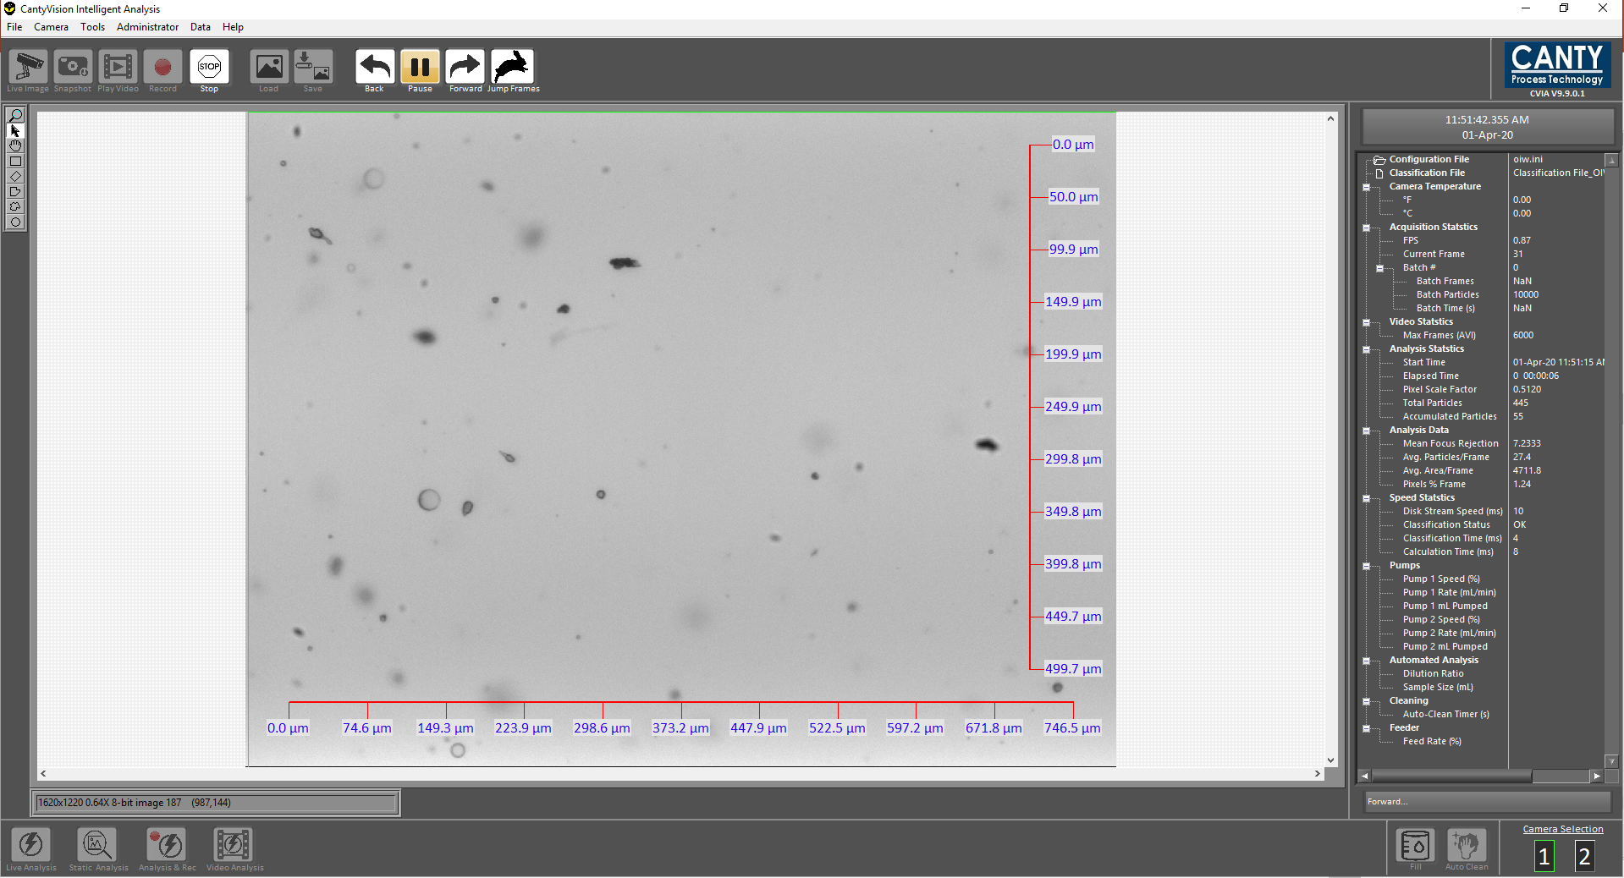
Canty Intelligent Analysis Software
CantyVision Software is able to process images at high speed real time.
Software provides graphical trends in charts with statistical data for particles, droplets and gas.
Individual data charts and outputs.
- Particle size distribution,
- Particle shape
- Concentrations - counts per ml, ppm
Customized reporting feature for excel data output.
J.M. CANTY INC. | BUFFALO NY | (716) 625-4227  J.M. CANTY INTL. | DUBLIN, IRELAND | +353 (1) 882-9621  J.M. CANTY INTL. ASIA | PHUKET THAILAND | +66 83 9689548

Slide 14
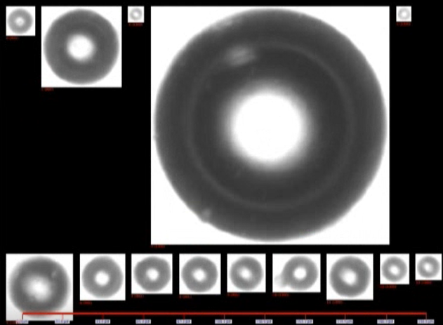
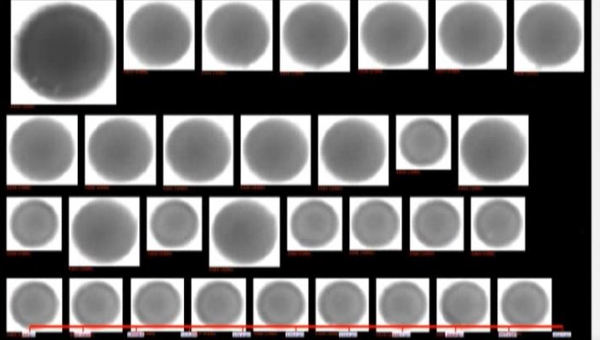
Image Analysis – CantyVision Intelligent Analysis Software
Gas Bubbles
Solids
Droplets
Particles are automatically classified using latest AI machine learning classification feature to identify and distinguish between solids, droplets and bubbles based 37 different measurements parameters (shape, particle intensity, surface roughness …..).
System self classifies removing operator error
J.M. CANTY INC. | BUFFALO NY | (716) 625-4227  J.M. CANTY INTL. | DUBLIN, IRELAND | +353 (1) 882-9621  J.M. CANTY INTL. ASIA | PHUKET THAILAND | +66 83 9689548

Slide 15
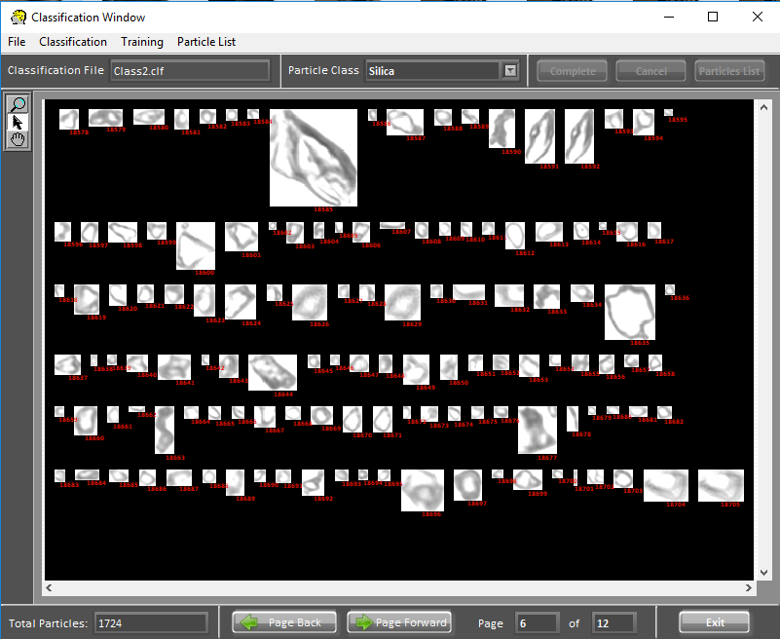
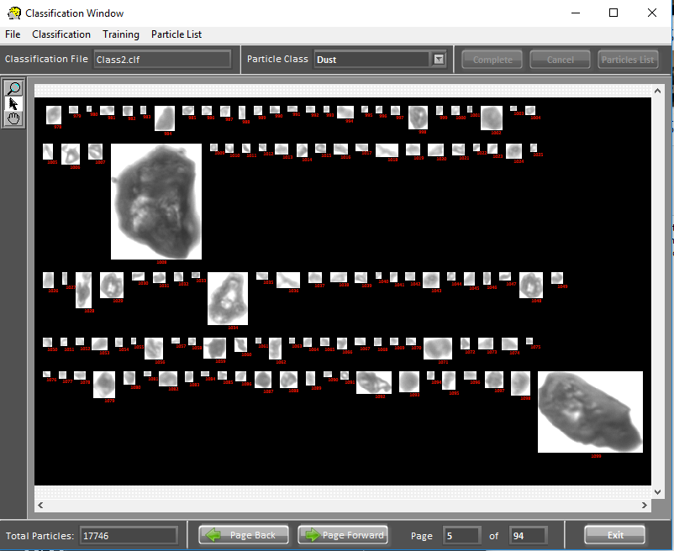
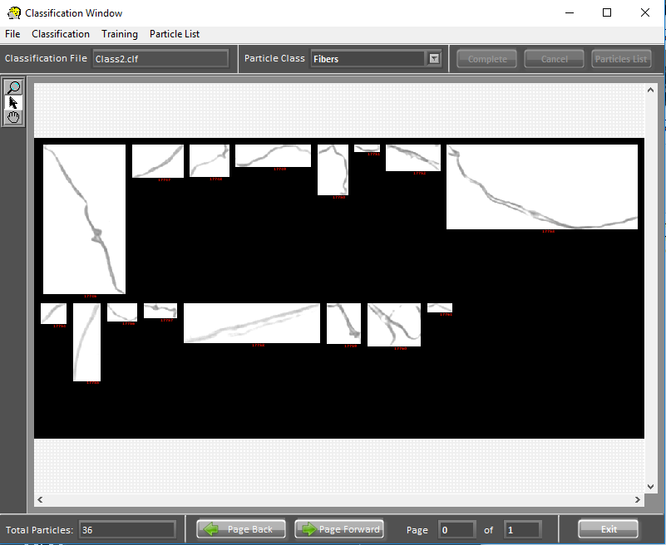
Image Analysis – CantyVision Intelligent Analysis Software
Software can be set up with multiple classification parameters to detect the difference between different types of particles.
Easy to use graphical interface allows user to click on particles within the class they want to measure and sort particles by their individual classes.
Machine learning algorithms build a database of particle shape characteristics.
J.M. CANTY INC. | BUFFALO NY | (716) 625-4227  J.M. CANTY INTL. | DUBLIN, IRELAND | +353 (1) 882-9621  J.M. CANTY INTL. ASIA | PHUKET THAILAND | +66 83 9689548

Slide 16
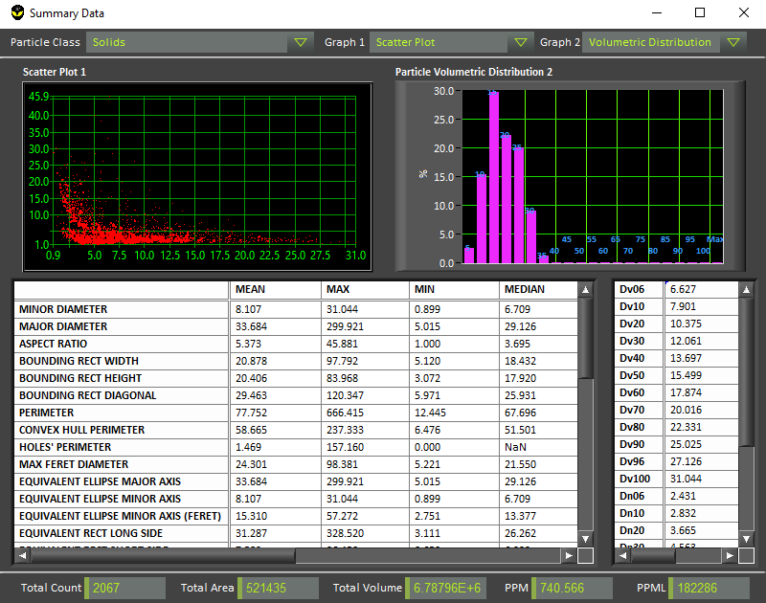
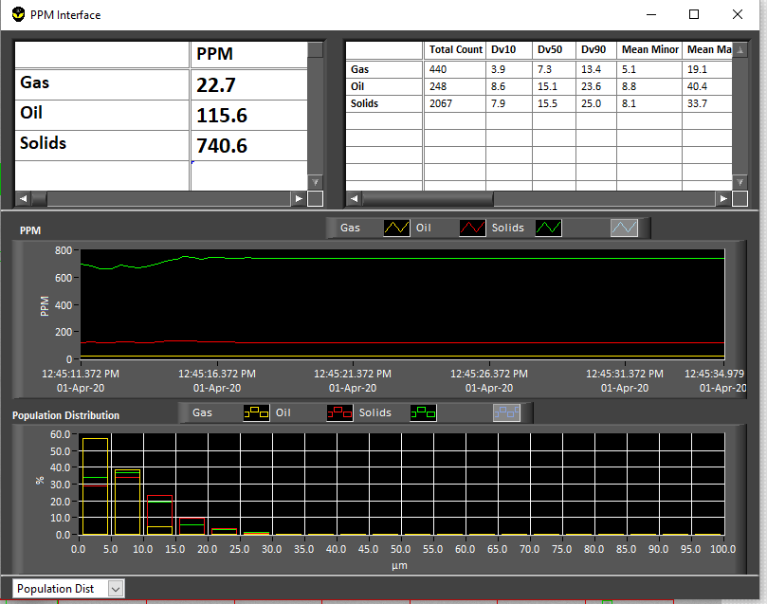
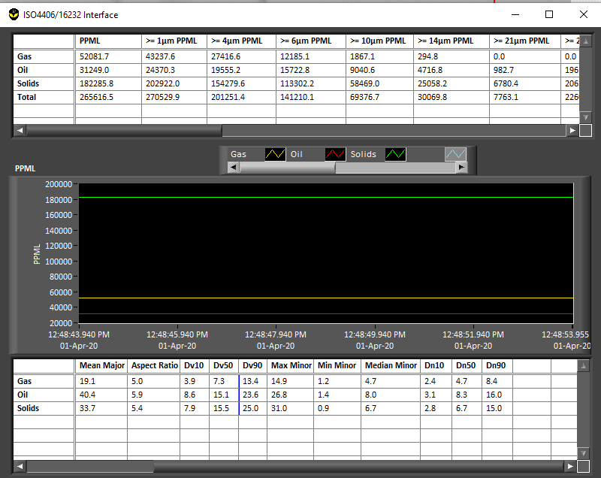
Image Analysis – CantyVision Intelligent Analysis Software
Multiple Charts depending on information required
Real time volumetric concentration measurements charts
Real time particle size distribution and shape information charts
Particle count per ml charts
J.M. CANTY INC. | BUFFALO NY | (716) 625-4227  J.M. CANTY INTL. | DUBLIN, IRELAND | +353 (1) 882-9621  J.M. CANTY INTL. ASIA | PHUKET THAILAND | +66 83 9689548

Slide 17
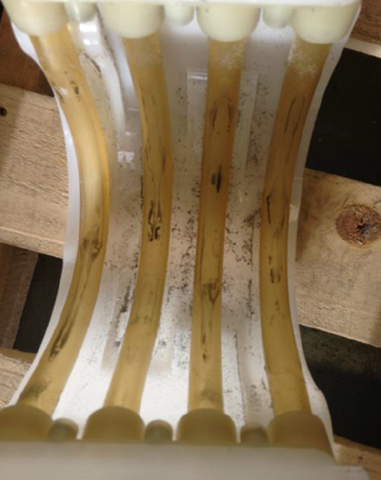
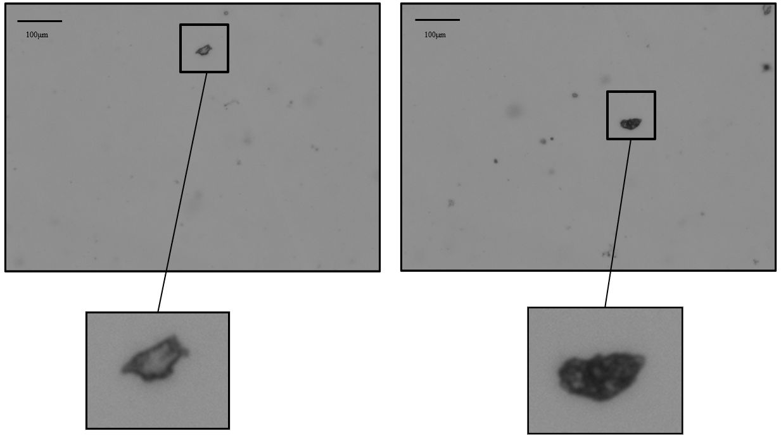
Tube Spallation
WFI delivered through plastic tubing via peristaltic pumps run the risk of contamination through internal tube spallation
Need for continuous monitoring
J.M. CANTY INC. | BUFFALO NY | (716) 625-4227  J.M. CANTY INTL. | DUBLIN, IRELAND | +353 (1) 882-9621  J.M. CANTY INTL. ASIA | PHUKET THAILAND | +66 83 9689548

Slide 18
Tube Spallation – Case Study
Trial to monitor tube spallation as contaminant PPML
Two tubing materials investigated
Graph showing the PPML of Test 1 and Test 2 over 24 hour testing period
J.M. CANTY INC. | BUFFALO NY | (716) 625-4227  J.M. CANTY INTL. | DUBLIN, IRELAND | +353 (1) 882-9621  J.M. CANTY INTL. ASIA | PHUKET THAILAND | +66 83 9689548

Slide 19
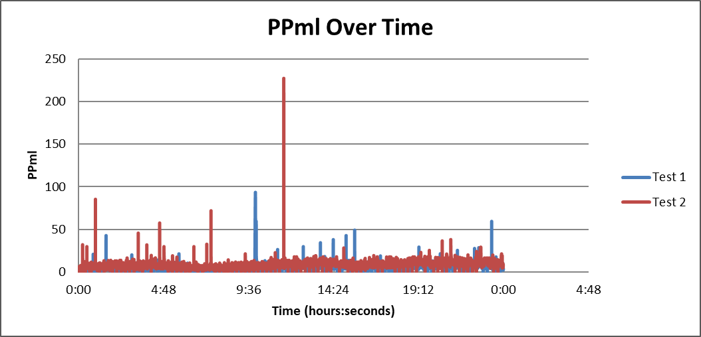
Tube Spallation – Case Study
PPML data showed that spallation in Test 1 and Test 2 occurred at a constant rate
- No increase in spallation over the 24-hour testing period
Number of spikes in PPML seen sporadically in both tests
Cumulative PPML data showed almost double the quantity of spalled particles in Test 2 than in Test 1
Dv50 data showed that particles spalled in Test 2 were generally larger than in Test 1
Results were consistent with tubing specification in that tubing in Test 1 was of higher grade than tubing in Test 2
J.M. CANTY INC. | BUFFALO NY | (716) 625-4227  J.M. CANTY INTL. | DUBLIN, IRELAND | +353 (1) 882-9621  J.M. CANTY INTL. ASIA | PHUKET THAILAND | +66 83 9689548

