Slide 1

PVC – PolyVinyl Chloride
CANTY
PROCESS TECHNOLOGY
WWW.JMCANTY.COM

Slide 2

Topics
Introduction.
How is it made.
Critical Areas to Monitor.
The CANTY Advantage.
References
J.M. CANTY INC. | BUFFALO NY | (716) 625-4227  J.M. CANTY INTL. | DUBLIN, IRELAND | +353 (1) 882-9621  J.M. CANTY INTL. ASIA | PHUKET THAILAND | +66 83 9689548

Slide 3
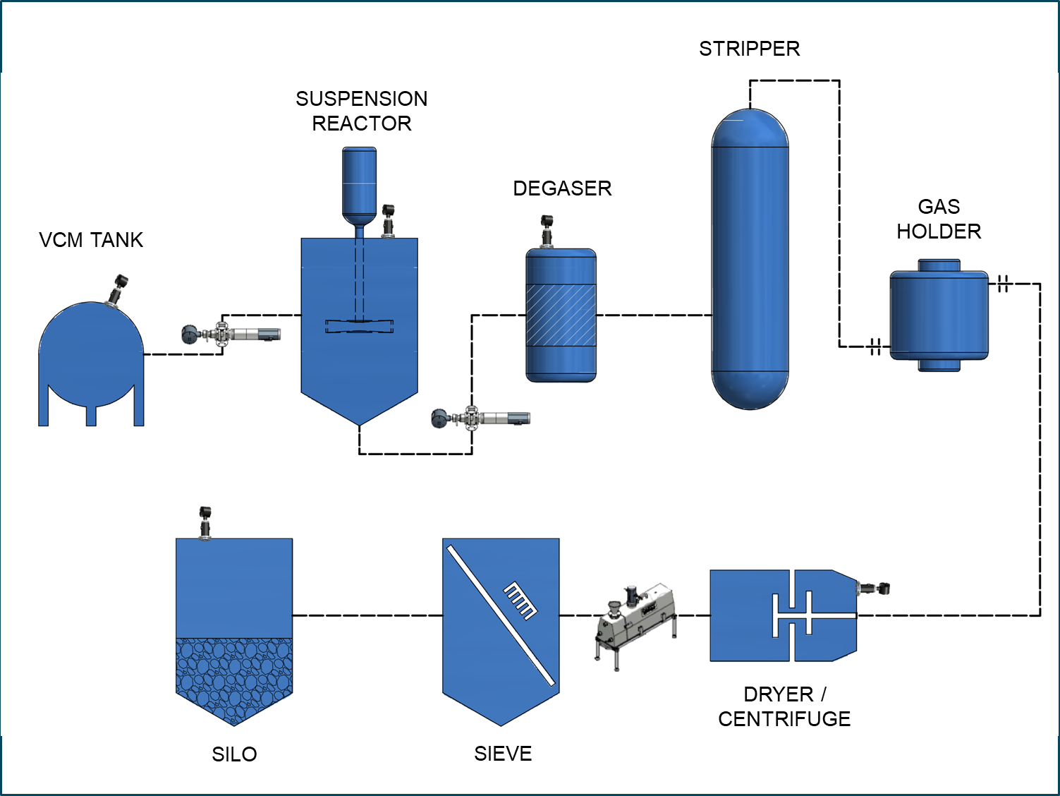
PVC – Uses and Industry
J.M. CANTY INC. | BUFFALO NY | (716) 625-4227  J.M. CANTY INTL. | DUBLIN, IRELAND | +353 (1) 882-9621  J.M. CANTY INTL. ASIA | PHUKET THAILAND | +66 83 9689548

Slide 4
Polymerisation:
PVC is manufactured through polymerization of Vinly Chloride Monomer (VC Monomer).
VC Monomer is pressurized and liquefied prior to being added to reaction vessel.
Reactor charged with vc monomer, deionized water/suspension agents and catalysts with temperatures ranging from 100 - 200°F(40 - 93°C) and pressure up to 150psi (10bar)
The process is placed under heavy agitation for several hours.
Resultant slurry typically has a 50-200μm particle size range.
Process conditions are changed to determine end product characteristics. Agitator speed, Duration, amount of catalyst…etc
J.M. CANTY INC. | BUFFALO NY | (716) 625-4227  J.M. CANTY INTL. | DUBLIN, IRELAND | +353 (1) 882-9621  J.M. CANTY INTL. ASIA | PHUKET THAILAND | +66 83 9689548

Slide 5


Stripping column:
The PVC slurry and left over VC Monomer is moved to a stripping column.
Left over VC Monomer gas is moved to a storage tank.
Remaining VC Monomer is stripped by heating the slurry with steam.
Vacuum is created in the column to remove the remaining VC Monomer.
This creates a dry foam in the column which results in lower production throughput, higher running costs and plugging of the vacuum pump heads with ‘Dry foam’.
J.M. CANTY INC. | BUFFALO NY | (716) 625-4227  J.M. CANTY INTL. | DUBLIN, IRELAND | +353 (1) 882-9621  J.M. CANTY INTL. ASIA | PHUKET THAILAND | +66 83 9689548

Slide 6

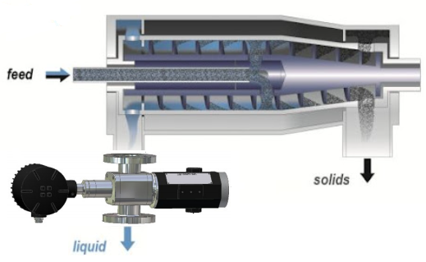
Blending & Decanting:
The stripped PVC and water slurry is transferred to a blending tank.
Multiple batches are transferred to the tank for blending to create product uniformity.
Once blending is complete the slurry will be transferred to a centrifuge for decanting of the water.
J.M. CANTY INC. | BUFFALO NY | (716) 625-4227  J.M. CANTY INTL. | DUBLIN, IRELAND | +353 (1) 882-9621  J.M. CANTY INTL. ASIA | PHUKET THAILAND | +66 83 9689548

Slide 7
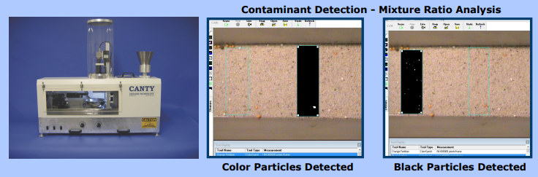
Drying & Storage:
Wet cake is transferred from the decanter centrifuge to the fluidized bed for drying.
Remaining water will be removed from the PVC at this point.
Once drying is complete the PVC resin is transferred to either silos for storage/ blending or Bulk transfer
J.M. CANTY INC. | BUFFALO NY | (716) 625-4227  J.M. CANTY INTL. | DUBLIN, IRELAND | +353 (1) 882-9621  J.M. CANTY INTL. ASIA | PHUKET THAILAND | +66 83 9689548

Slide 8
CANTY Advantages
Fused Glass front cap provides barrier between optics and Process.
Easily replaces existing sight glass & light set-up.
Unrivalled remote view in to the process from the control room for increased operator safety.
Once installed, no further calibration is required.
Virtually maintenance free.
Provides Level tracking and wash optimization all in one system.
Record images for archive purposes.
Atex/IECex/FM/CSA certified.
J.M. CANTY INC. | BUFFALO NY | (716) 625-4227  J.M. CANTY INTL. | DUBLIN, IRELAND | +353 (1) 882-9621  J.M. CANTY INTL. ASIA | PHUKET THAILAND | +66 83 9689548

Slide 9
Level Measurement
Level control is used in all industries for multiple reasons.
Pixel based measurement
1% Accuracy
Visual Verification
Increased level height = Increased yield
Prevent overfill in foamy applications
Measures to the top level
Continuous level output to the PLC
J.M. CANTY INC. | BUFFALO NY | (716) 625-4227  J.M. CANTY INTL. | DUBLIN, IRELAND | +353 (1) 882-9621  J.M. CANTY INTL. ASIA | PHUKET THAILAND | +66 83 9689548

Slide 10

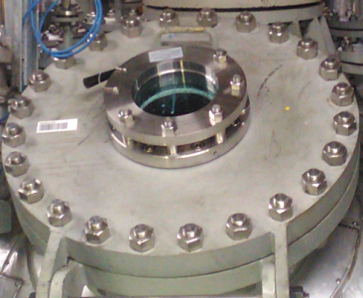
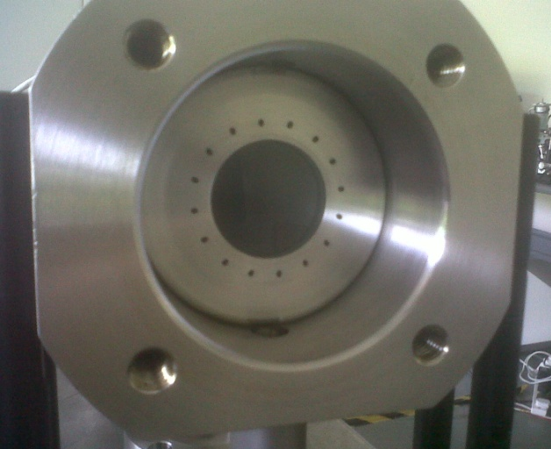
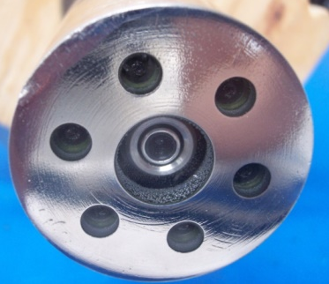

CANTY FuseView
Fused glass, or glass to metal fusion, is a proprietary technology developed by CANTY
Fused glass forms critical components in almost every piece of equipment CANTY manufacture;
- sight glasses
- vessel access closures
- lighting systems
- camera systems
- particle analysers

Slide 11
CANTY FuseView
Glass is strong in compression but not under tension or shear. When the fused glass part is pressurized, the glass bends and relieves the compression, and avoids tension. This is the same as is done with concrete - it is pre-stressed in compression in order to take bending.

Slide 12
FUSED vs CON-FUSED
Practical Advantages of CANTY;
- Larger view size for any connection sight glass
- Higher Pressure (standard from 10 Bar / 150PSI, Options to 600 Bar)
- Higher Impact Resistance
- Higher Thermal Shock Resistance
- Lifetime No Crack Guarantee

Slide 13
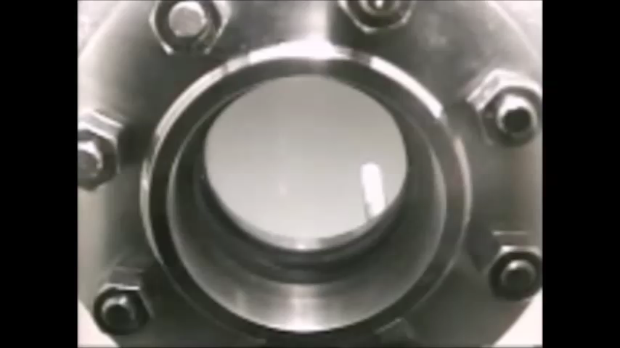
Jet Spray Ring Cleaning

Slide 14
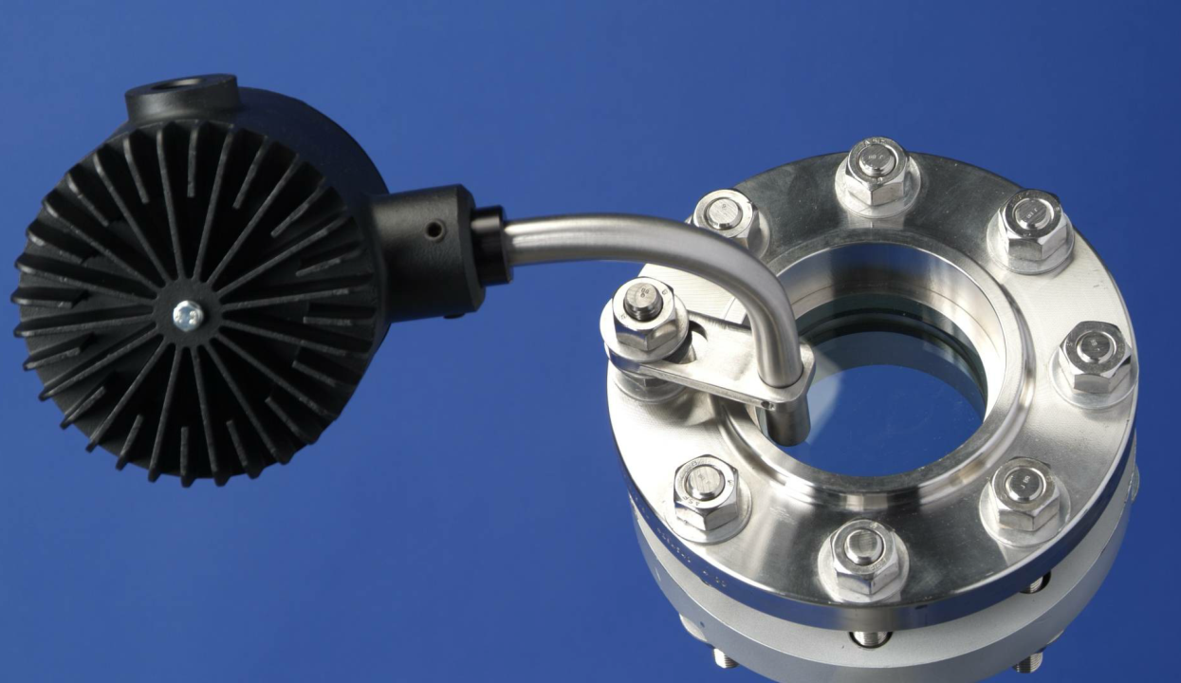
WWW.JMCANTY.COM
FIBER OPTIC MOUNT
Allows the purchasing of the complete light, bracket and sight glass assembly as a single part number.
Remote mount the light source to free up space in the vessel head area
Illumination of where the operator is viewing
Avoids potential electrical pinching hazard by keeping cables away from the manway lid
Fused Glass
Light Guide
J.M. CANTY INC. | BUFFALO NY | (716) 625-4227  J.M. CANTY INTL. | DUBLIN, IRELAND | +353 (1) 882-9621  J.M. CANTY ASIA OFFICE | PHUKET THAILAND

Slide 15
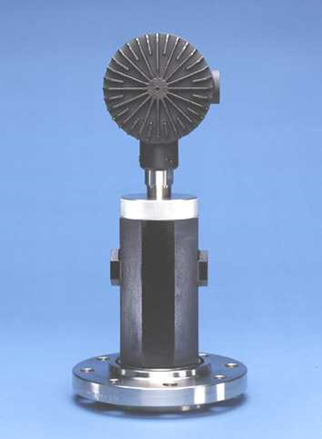
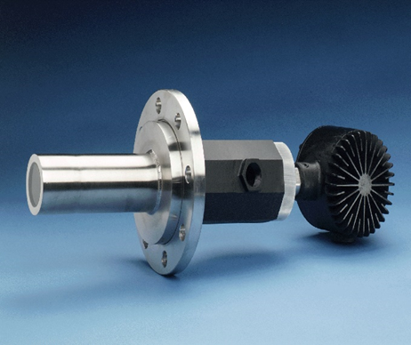
Process Camera
VISUAL VERIFICATION!!!
EXP/FP or Weather Proof
Fused Glass (Standard)
One Connection
Spray Ring Option
Various View Angles
Fiber Optic Lighting
J.M. CANTY INC. | BUFFALO NY | (716) 625-4227  J.M. CANTY INTL. | DUBLIN, IRELAND | +353 (1) 882-9621  J.M. CANTY INTL. ASIA | PHUKET THAILAND | +66 83 9689548

Slide 16
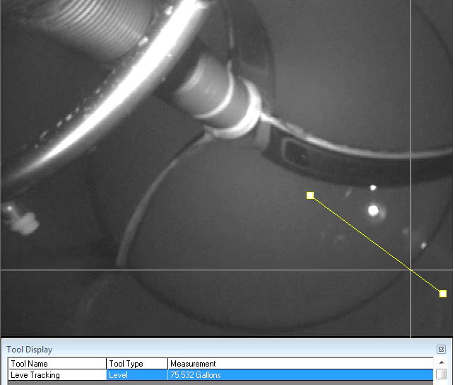
Level Control
J.M. CANTY INC. | BUFFALO NY | (716) 625-4227  J.M. CANTY INTL. | DUBLIN, IRELAND | +353 (1) 882-9621  J.M. CANTY INTL. ASIA | PHUKET THAILAND | +66 83 9689548

Slide 17
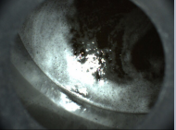
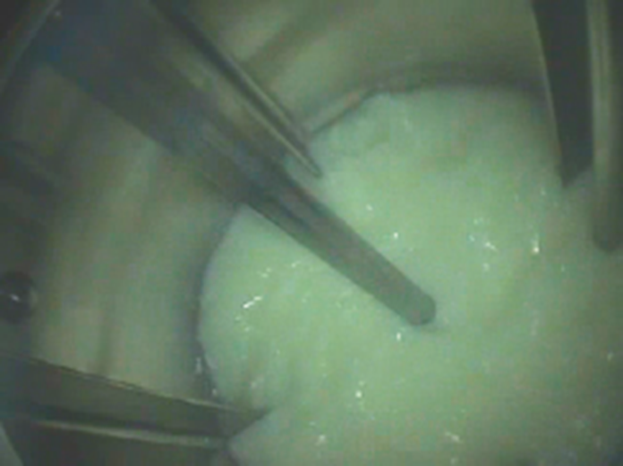
Foam Control
Antifoam is required to suppress the foam.
Increase fill level inside tank due to continuous detection of the process.
Prevent plugging of the Vacuum heads.
Visual Verification
Decreased of Anti-Foam stripping and time.
Remove Subjectivity.
Adjust
  Agitation
  Temperature
  Pressure
  Antifoam feed rate and amount.
J.M. CANTY INC. | BUFFALO NY | (716) 625-4227  J.M. CANTY INTL. | DUBLIN, IRELAND | +353 (1) 882-9621  J.M. CANTY INTL. ASIA | PHUKET THAILAND | +66 83 9689548

Slide 18

Foam Control
J.M. CANTY INC. | BUFFALO NY | (716) 625-4227  J.M. CANTY INTL. | DUBLIN, IRELAND | +353 (1) 882-9621  J.M. CANTY INTL. ASIA | PHUKET THAILAND | +66 83 9689548

Slide 19
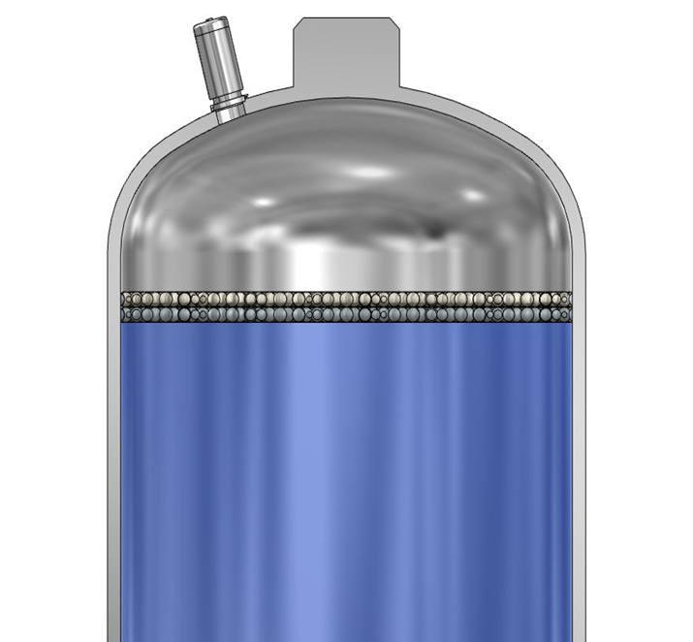
Process Camera Requirements
The camera and light need to be mounted in the same nozzle in order to sense the foam properly and accurately.
Separating the light and camera into 2 nozzles makes setup and calibration very difficult . The geometry and reflective intensity will vary based an the distance apart. In fixed stainless systems this is critical to have one nozzle. In single use systems the nozzle spacing is fixed in the mounting.
The cost also increases when you require 2 nozzles.
J.M. CANTY INC. | BUFFALO NY | (716) 625-4227  J.M. CANTY INTL. | DUBLIN, IRELAND | +353 (1) 882-9621  J.M. CANTY INTL. ASIA | PHUKET THAILAND | +66 83 9689548

Slide 20
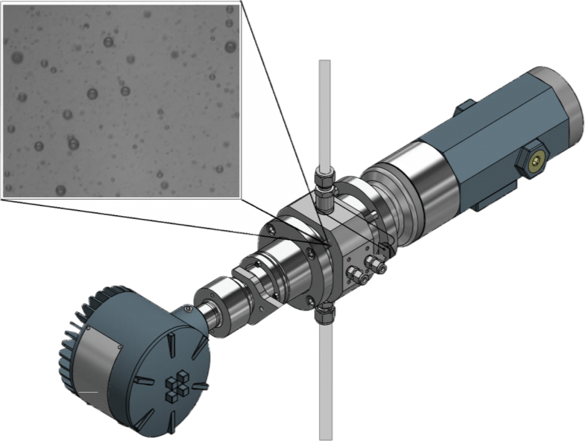




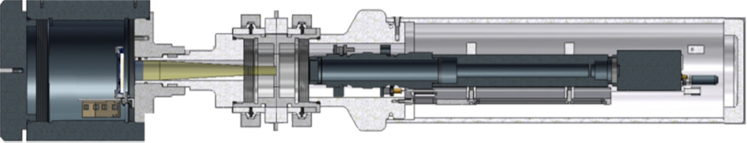
Particle analysis
Gigabit Camera & Microscopic Lens
LED Light Source
Flow Cell
Sample In
J.M. CANTY INC. | BUFFALO NY | (716) 625-4227  J.M. CANTY INTL. | DUBLIN, IRELAND | +353 (1) 882-9621  J.M. CANTY INTL. ASIA | PHUKET THAILAND | +66 83 9689548

Slide 21
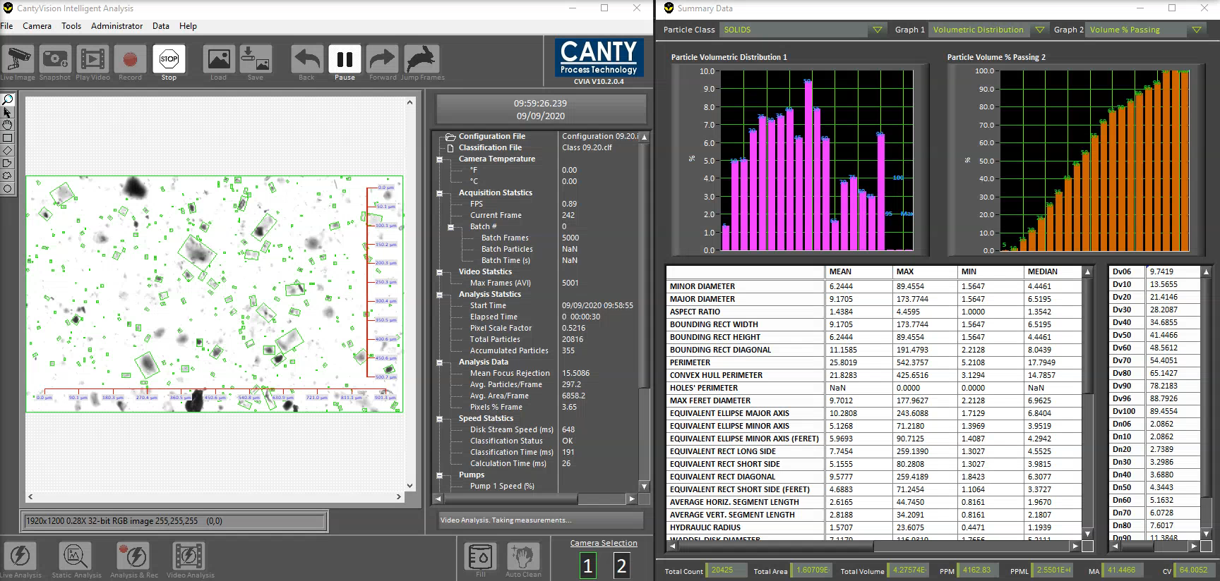
Particle Analysis
J.M. CANTY INC. | BUFFALO NY | (716) 625-4227  J.M. CANTY INTL. | DUBLIN, IRELAND | +353 (1) 882-9621  J.M. CANTY INTL. ASIA | PHUKET THAILAND | +66 83 9689548

Slide 22
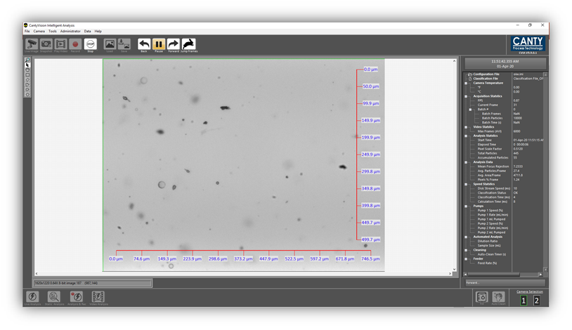
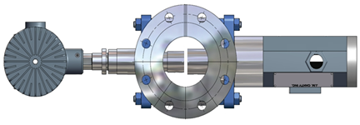
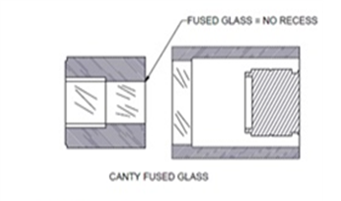
Particle analysis
Recover fines that maybe other wise lost to drain.
Receive real time particle analysis information straight to you DCS such as %Solids, Parts Per Million (PPM), Particle size.
Size down to 0.7μm.
Record images for off-line analysis
Quality control of the waste water
J.M. CANTY INC. | BUFFALO NY | (716) 625-4227  J.M. CANTY INTL. | DUBLIN, IRELAND | +353 (1) 882-9621  J.M. CANTY INTL. ASIA | PHUKET THAILAND | +66 83 9689548

Slide 23
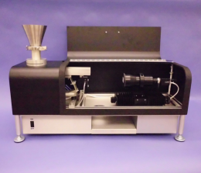
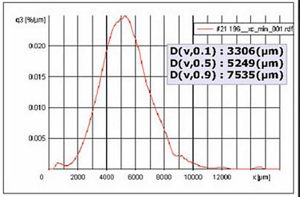
Black Spec Detection
Front Lighting for accurate color measurement.
Multiple Zone detection to differentiate different colors.
Built in material handling system to ensure a even layer of product is presented to the sensor.
Visual Verification
Record videos & images for analysis later/QC records
Remove Subjectivity.
Meets all relevant ASTM standards.
J.M. CANTY INC. | BUFFALO NY | (716) 625-4227  J.M. CANTY INTL. | DUBLIN, IRELAND | +353 (1) 882-9621  J.M. CANTY INTL. ASIA | PHUKET THAILAND | +66 83 9689548

Slide 24
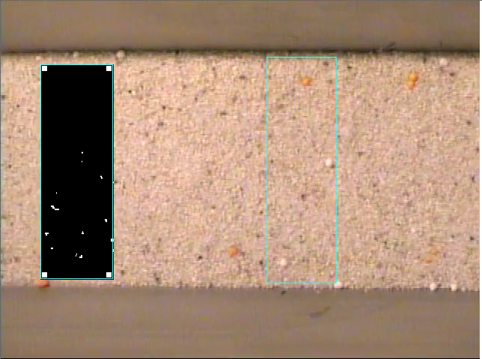
Black Spec detection.
J.M. CANTY INC. | BUFFALO NY | (716) 625-4227  J.M. CANTY INTL. | DUBLIN, IRELAND | +353 (1) 882-9621  J.M. CANTY INTL. ASIA | PHUKET THAILAND | +66 83 9689548

Slide 25
VECTOR CONTROL MODULE
Allows for input up to 6 cameras
Multiple outputs.
  4-20mA
  OPC UA/DA
  Modbus
  Video Display
CANTYVisn Software Embedded
Windows 10 embedded
Easy interface with plant HMI’s or PLC’s
Ease of Remote Support
J.M. CANTY INC. | BUFFALO NY | (716) 625-4227  J.M. CANTY INTL. | DUBLIN, IRELAND | +353 (1) 882-9621  J.M. CANTY INTL. ASIA | PHUKET THAILAND | +66 83 9689548

Slide 26

Payback
Decreased down time due to foam related issues.
Increased yield. Running larger batches
Reduced costs of Antifoam
Reduced Production Time/ Energy Savings
Recovery of fine materials
Early detection of quality issues.
J.M. CANTY INC. | BUFFALO NY | (716) 625-4227  J.M. CANTY INTL. | DUBLIN, IRELAND | +353 (1) 882-9621  J.M. CANTY INTL. ASIA | PHUKET THAILAND | +66 83 9689548

Slide 27

Questions
and
Answers
J.M. CANTY INC. | BUFFALO NY | (716) 625-4227  J.M. CANTY INTL. | DUBLIN, IRELAND | +353 (1) 882-9621  J.M. CANTY INTL. ASIA | PHUKET THAILAND | +66 83 9689548

