Slide 1

High Temperature Camera
CANTY
PROCESS TECHNOLOGY
WWW.JMCANTY.COM

Slide 2

Topics
Introduction
Camera Models
Technical Specifications
Camera Installation
Competitive Features & Advantages
CANTY Vs Retractable Camera Systems
Industry Applications
Summary & Benefits
Typical industries & Customers
J.M. CANTY INC. | BUFFALO NY | (716) 625-4227  J.M. CANTY INTL. | DUBLIN, IRELAND | +353 (1) 882-9621  J.M. CANTY INTL. ASIA | PHUKET THAILAND | +66 83 9689548

Slide 3
Introduction
CANTY high temperature cameras are ideal for demanding applications involving visual inspection & verification in extreme temperature environments from 750°F (400°C) to 3000°F (1650°C).
When used with the CANTY Vision analysis software and Vector Control Module, the system offers accurate measurement capabilities of temperature and early process upsets.
The high temperature system integrates the CANTY FuseView technology to provide a barrier between the lens system and the camera electronics.
J.M. CANTY INC. | BUFFALO NY | (716) 625-4227  J.M. CANTY INTL. | DUBLIN, IRELAND | +353 (1) 882-9621  J.M. CANTY INTL. ASIA | PHUKET THAILAND | +66 83 9689548

Slide 4
Introduction (cont’d)
The electronics remain outside the process with the Quartz lens system inserting through the refractory, staying flush or slightly recessed to the wall.
The camera comes with built in temperature read out that is relayed to the VCM over the same ethernet cable used for transmitting the image.
J.M. CANTY INC. | BUFFALO NY | (716) 625-4227  J.M. CANTY INTL. | DUBLIN, IRELAND | +353 (1) 882-9621  J.M. CANTY INTL. ASIA | PHUKET THAILAND | +66 83 9689548

Slide 5
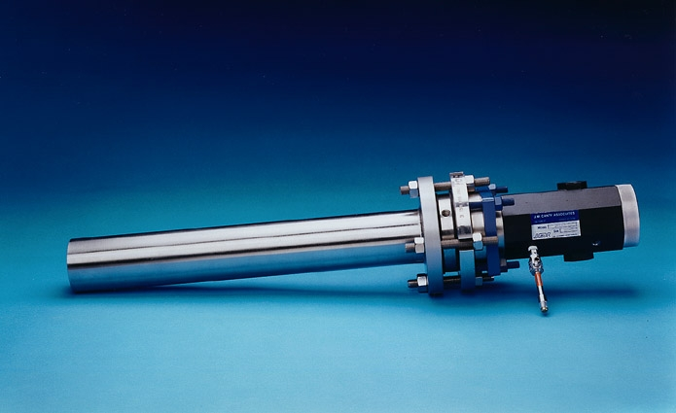
HT Camera Models
Ultra Temperature Camera Process
Temp: 2500°F (1370ºC )
12”, 24” or 36” Insertion
Extreme Temperature Camera
Process Temp: 3000°F (1650ºC )
12”, 24” or 36” Insertion
J.M. CANTY INC. | BUFFALO NY | (716) 625-4227  J.M. CANTY INTL. | DUBLIN, IRELAND | +353 (1) 882-9621  J.M. CANTY INTL. ASIA | PHUKET THAILAND | +66 83 9689548

Slide 6
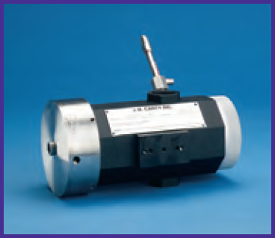
HT Cameras Camera models
Flush Ultra Temp Camera
Process Temp: 2000°F (1090ºC )
Refractory < 4”
High Temp. Surveillance Camera
Ambient Temperature: 200°F (90ºC )
Open Process
J.M. CANTY INC. | BUFFALO NY | (716) 625-4227  J.M. CANTY INTL. | DUBLIN, IRELAND | +353 (1) 882-9621  J.M. CANTY INTL. ASIA | PHUKET THAILAND | +66 83 9689548

Slide 7
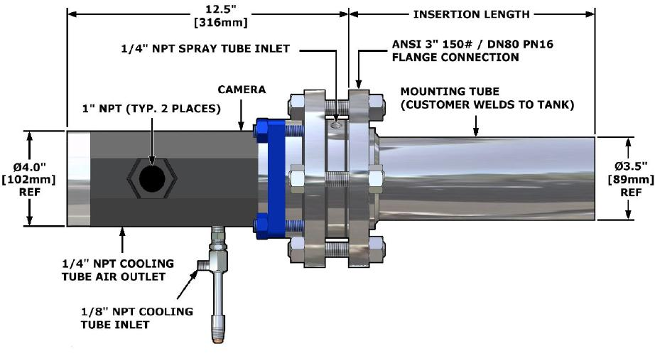
UltraTemp Insertion
J.M. CANTY INC. | BUFFALO NY | (716) 625-4227  J.M. CANTY INTL. | DUBLIN, IRELAND | +353 (1) 882-9621  J.M. CANTY INTL. ASIA | PHUKET THAILAND | +66 83 9689548

Slide 8
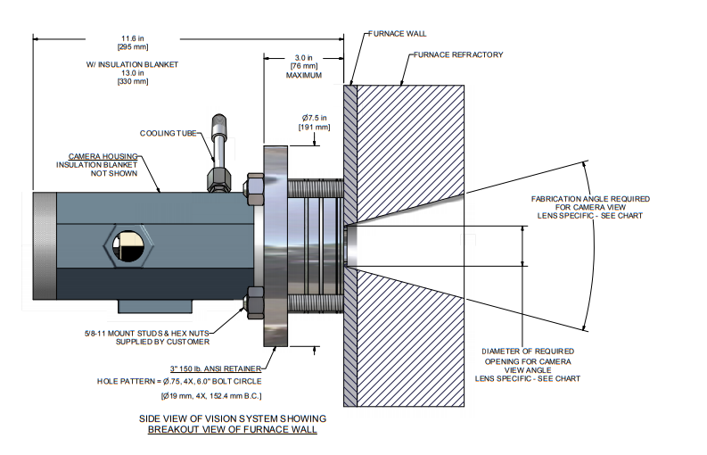
UltraTemp Flush mount
J.M. CANTY INC. | BUFFALO NY | (716) 625-4227  J.M. CANTY INTL. | DUBLIN, IRELAND | +353 (1) 882-9621  J.M. CANTY INTL. ASIA | PHUKET THAILAND | +66 83 9689548

Slide 9
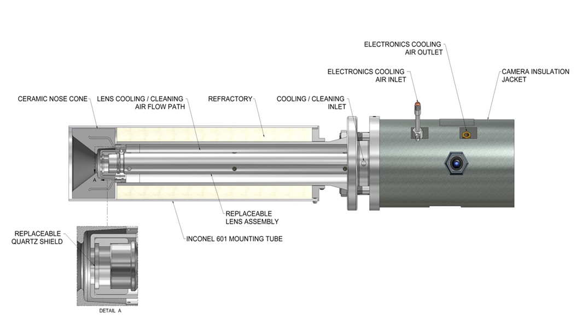
ExtremeTemp
●
J.M. CANTY INC. | BUFFALO NY | (716) 625-4227  J.M. CANTY INTL. | DUBLIN, IRELAND | +353 (1) 882-9621  J.M. CANTY INTL. ASIA | PHUKET THAILAND | +66 83 9689548

Slide 10
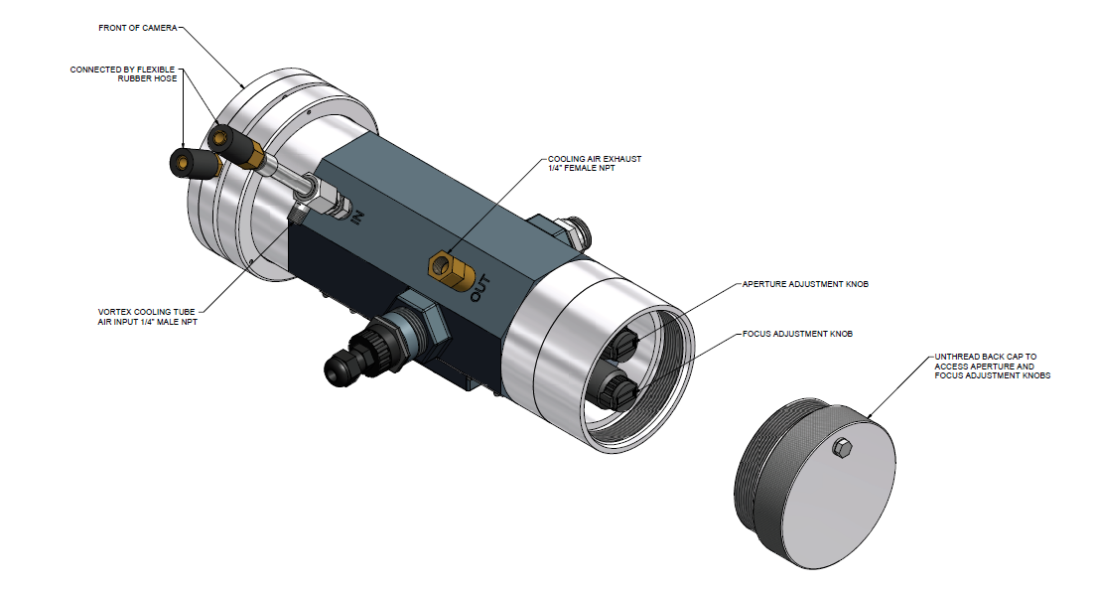
Surveillance Camera
J.M. CANTY INC. | BUFFALO NY | (716) 625-4227  J.M. CANTY INTL. | DUBLIN, IRELAND | +353 (1) 882-9621  J.M. CANTY INTL. ASIA | PHUKET THAILAND | +66 83 9689548

Slide 11
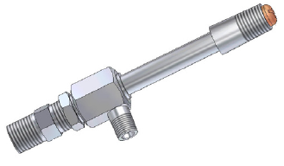
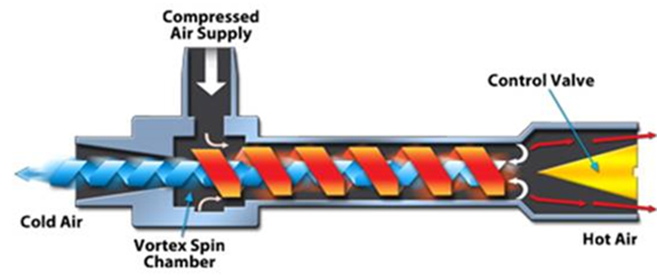
Technical Specification:
Camera External
Camera Housing – Rugged Aluminium Housing suitable for harsh industrial applications.
- NEMA 4 or IP66
Vortex Cooling Tube – Used to cool electronic components of camera
- 0.14 cubic metres per minute required for typical installation
(Water cooled options also available)
J.M. CANTY INC. | BUFFALO NY | (716) 625-4227  J.M. CANTY INTL. | DUBLIN, IRELAND | +353 (1) 882-9621  J.M. CANTY INTL. ASIA | PHUKET THAILAND | +66 83 9689548

Slide 12
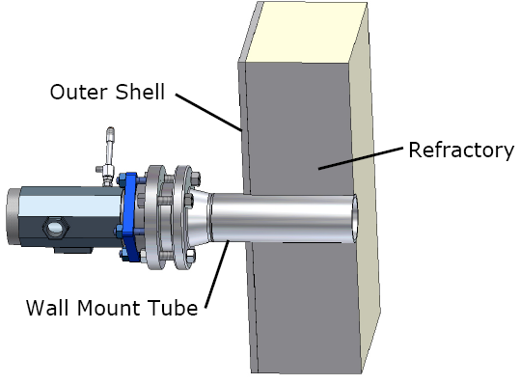
Technical Specification:
Camera External (cont’d)
Spray Tube – Positive air flow used to keep dust / debris accumulating on lens (0.4 cubic metres per minute). Some non-EXP installations will not require any air purge for cooling which will save money every year
Wall Mount Connection – Customer welds into place for camera to mount to via 3” ANSI flange
J.M. CANTY INC. | BUFFALO NY | (716) 625-4227  J.M. CANTY INTL. | DUBLIN, IRELAND | +353 (1) 882-9621  J.M. CANTY INTL. ASIA | PHUKET THAILAND | +66 83 9689548

Slide 13
Technical specifications:
Camera Internals
CCD Camera – Ethernet
    Built in temperature read out.
    Power over Ethernet (PoE) models available on request.
Fused Glass provides the barrier between the electronics and Lens system. Ensuring the electronics are always protected.
Lens System – Patented Quartz series of lenses to relay the high quality image back to the camera.
J.M. CANTY INC. | BUFFALO NY | (716) 625-4227  J.M. CANTY INTL. | DUBLIN, IRELAND | +353 (1) 882-9621  J.M. CANTY INTL. ASIA | PHUKET THAILAND | +66 83 9689548

Slide 14
Technical specifications:
Camera Internals (cont’d)
Quartz Shield – Easily and cheaply replaceable – protects the lens system from abrasion damage, prevents product adhering to the lenses so they don’t have to be replaced.
Built in Lens cleaning system to prevent product build up on Quartz Shield.
J.M. CANTY INC. | BUFFALO NY | (716) 625-4227  J.M. CANTY INTL. | DUBLIN, IRELAND | +353 (1) 882-9621  J.M. CANTY INTL. ASIA | PHUKET THAILAND | +66 83 9689548

Slide 15
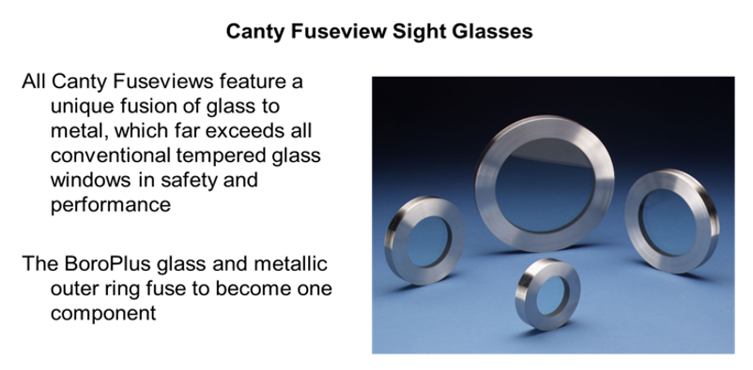
Technical specifications:
Fused Glass
J.M. CANTY INC. | BUFFALO NY | (716) 625-4227  J.M. CANTY INTL. | DUBLIN, IRELAND | +353 (1) 882-9621  J.M. CANTY INTL. ASIA | PHUKET THAILAND | +66 83 9689548

Slide 16
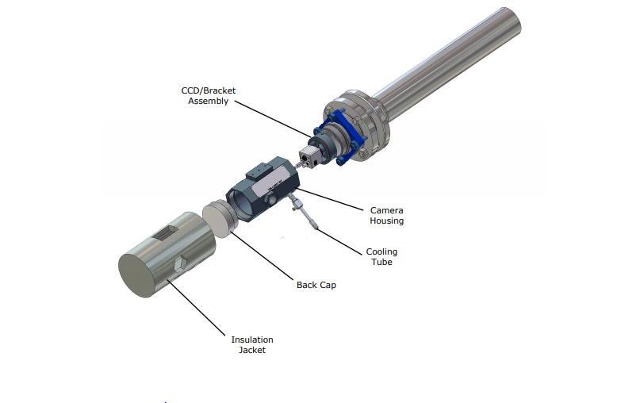
Technical specifications:
Camera Assembly
J.M. CANTY INC. | BUFFALO NY | (716) 625-4227  J.M. CANTY INTL. | DUBLIN, IRELAND | +353 (1) 882-9621  J.M. CANTY INTL. ASIA | PHUKET THAILAND | +66 83 9689548

Slide 17
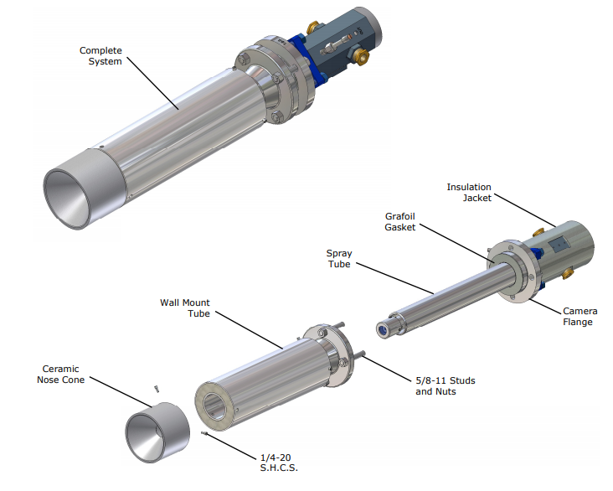
Technical specifications:
Camera Assembly(cont’d)
J.M. CANTY INC. | BUFFALO NY | (716) 625-4227  J.M. CANTY INTL. | DUBLIN, IRELAND | +353 (1) 882-9621  J.M. CANTY INTL. ASIA | PHUKET THAILAND | +66 83 9689548

Slide 18
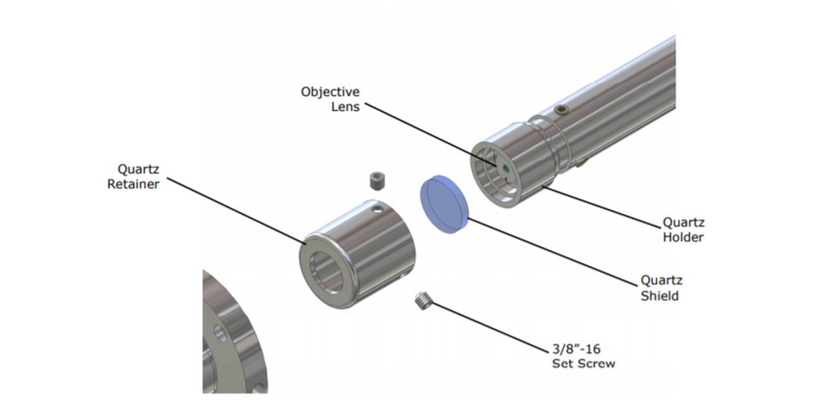
Technical specifications:
Quartz shield
J.M. CANTY INC. | BUFFALO NY | (716) 625-4227  J.M. CANTY INTL. | DUBLIN, IRELAND | +353 (1) 882-9621  J.M. CANTY INTL. ASIA | PHUKET THAILAND | +66 83 9689548

Slide 19
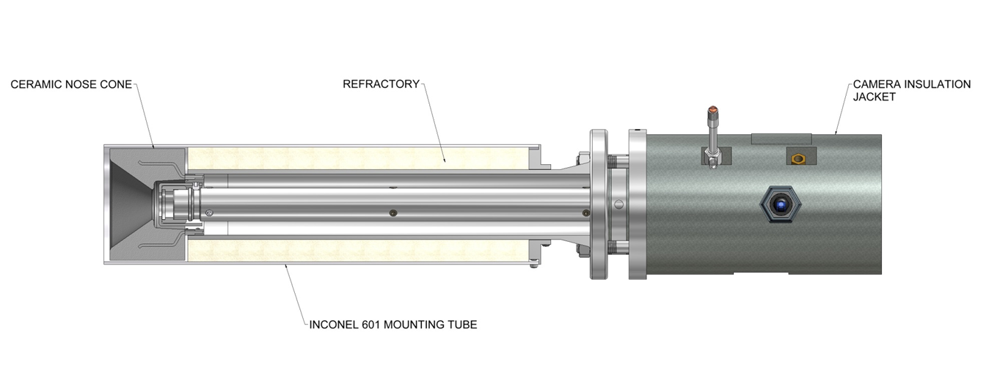
Technical specifications:
Camera Insertion
J.M. CANTY INC. | BUFFALO NY | (716) 625-4227  J.M. CANTY INTL. | DUBLIN, IRELAND | +353 (1) 882-9621  J.M. CANTY INTL. ASIA | PHUKET THAILAND | +66 83 9689548

Slide 20
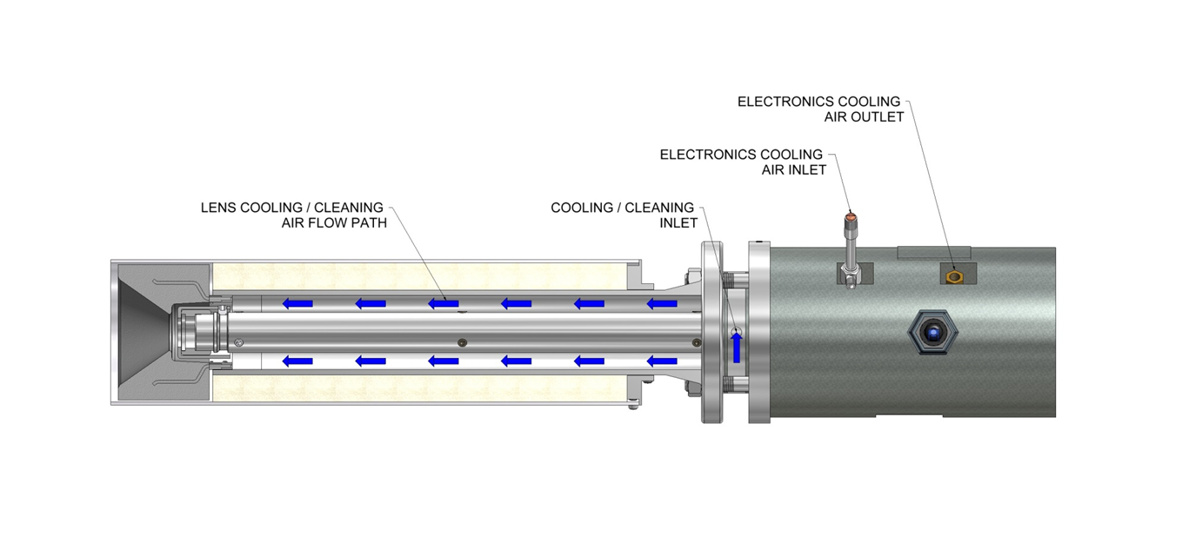
Technical specifications:
Cleaning & Cooling
J.M. CANTY INC. | BUFFALO NY | (716) 625-4227  J.M. CANTY INTL. | DUBLIN, IRELAND | +353 (1) 882-9621  J.M. CANTY INTL. ASIA | PHUKET THAILAND | +66 83 9689548

Slide 21
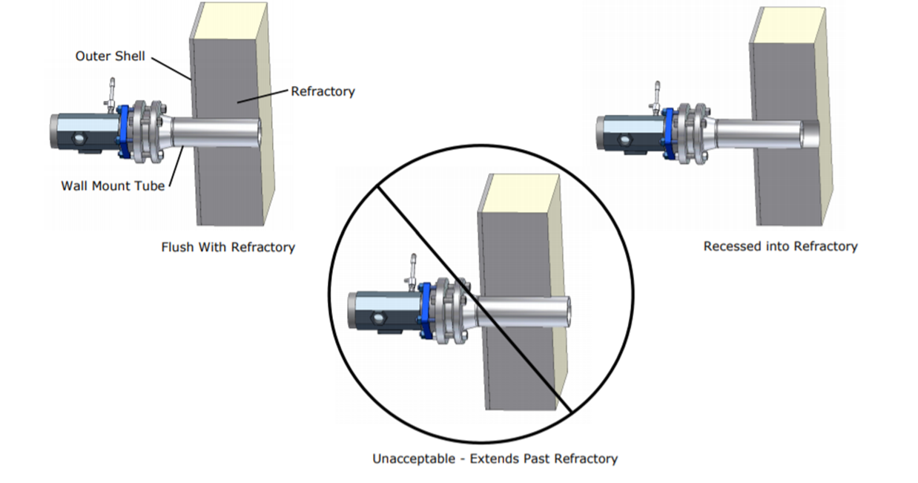
Camera Installation:
Installation Good Practice
J.M. CANTY INC. | BUFFALO NY | (716) 625-4227  J.M. CANTY INTL. | DUBLIN, IRELAND | +353 (1) 882-9621  J.M. CANTY INTL. ASIA | PHUKET THAILAND | +66 83 9689548

Slide 22
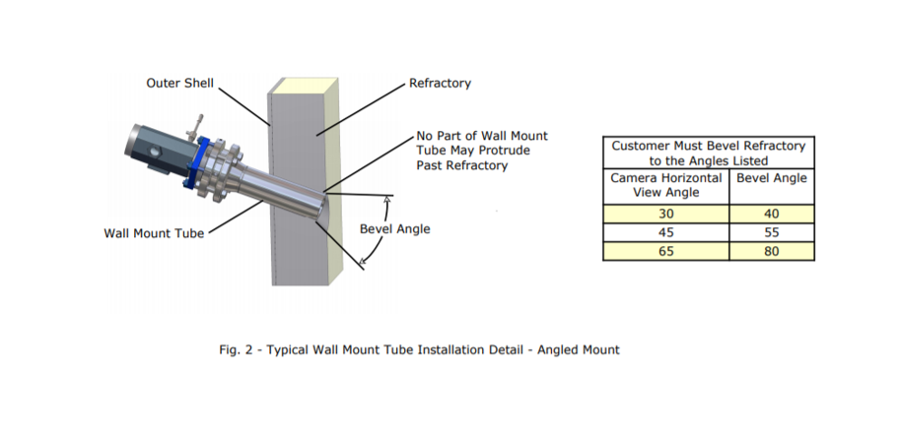
Camera Installation:
Installation Good Practice (cont’d)
J.M. CANTY INC. | BUFFALO NY | (716) 625-4227  J.M. CANTY INTL. | DUBLIN, IRELAND | +353 (1) 882-9621  J.M. CANTY INTL. ASIA | PHUKET THAILAND | +66 83 9689548

Slide 23
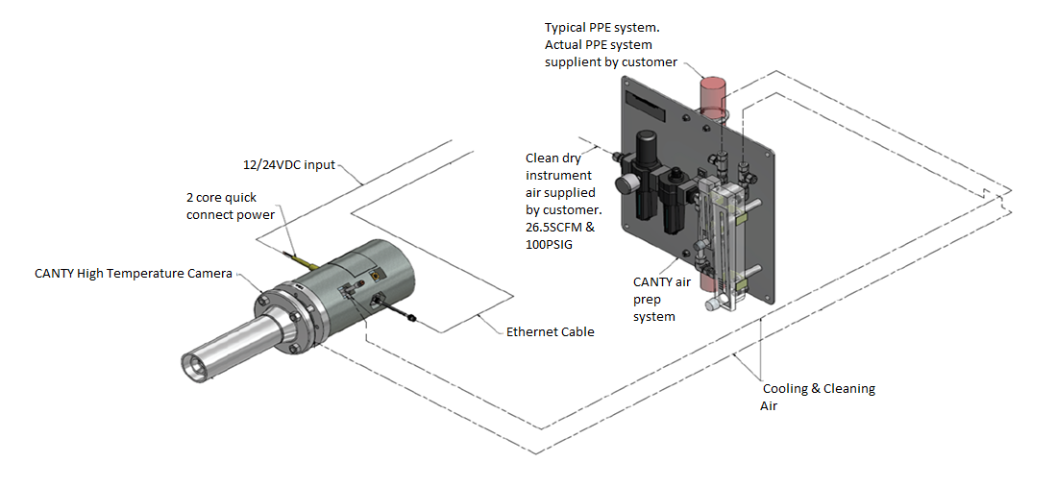
Camera Installation:
Layout
J.M. CANTY INC. | BUFFALO NY | (716) 625-4227  J.M. CANTY INTL. | DUBLIN, IRELAND | +353 (1) 882-9621  J.M. CANTY INTL. ASIA | PHUKET THAILAND | +66 83 9689548

Slide 24
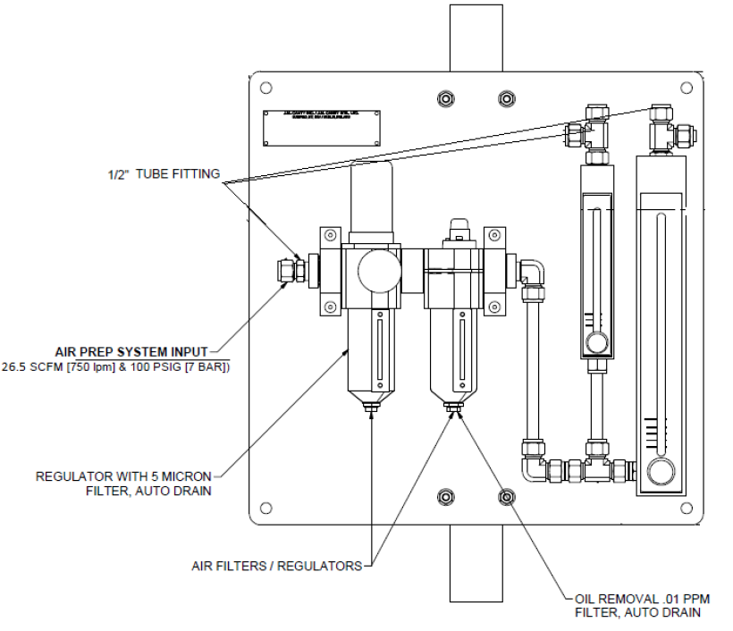
Camera Installation:
Air Prep Panel
J.M. CANTY INC. | BUFFALO NY | (716) 625-4227  J.M. CANTY INTL. | DUBLIN, IRELAND | +353 (1) 882-9621  J.M. CANTY INTL. ASIA | PHUKET THAILAND | +66 83 9689548

Slide 25
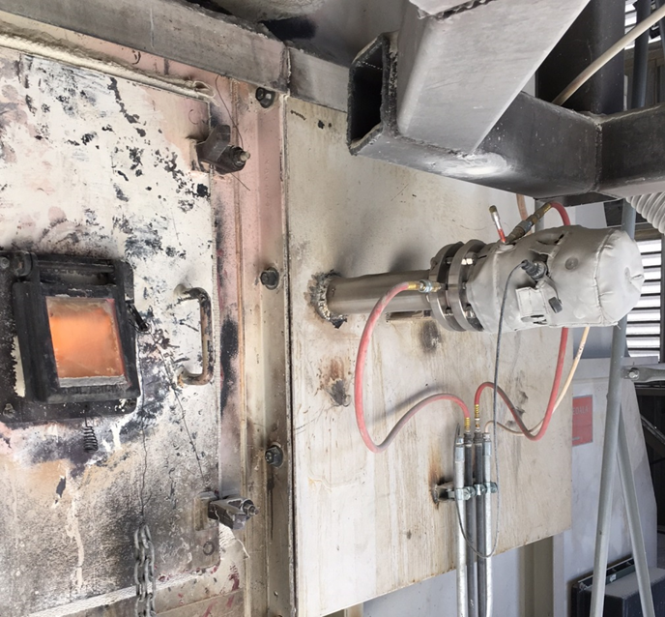
Camera Installation:
Example installation
J.M. CANTY INC. | BUFFALO NY | (716) 625-4227  J.M. CANTY INTL. | DUBLIN, IRELAND | +353 (1) 882-9621  J.M. CANTY INTL. ASIA | PHUKET THAILAND | +66 83 9689548

Slide 26
Competitive Features / Advantages:
Requires a fraction of the air needed to cool other camera systems – more cost effective!
Camera located outside the furnace, if electronics cooling air is lost, image may be lost but
the CDD camera will not need to be replaced.
Ethernet Camera with CANTY Vector Control Module (VCM) gives the option of remote access for technical support.
Utilise CANTY’s unique fused glass technology to form a protective barrier between the
electronics and the harsh process environment
High Quality Quartz optics used
Very Low Maintenance of camera plus no retraction system to maintain
J.M. CANTY INC. | BUFFALO NY | (716) 625-4227  J.M. CANTY INTL. | DUBLIN, IRELAND | +353 (1) 882-9621  J.M. CANTY INTL. ASIA | PHUKET THAILAND | +66 83 9689548

Slide 27
CANTY VS Retractable Cameras
CANTY | Retractable Camera
No lens Cooling required up to 1370°C | Continuous Cooling required.
Small footprint. No retraction system. | Large footprint due to the area required to retract camera
No heat losses as camera is snugly mounted in place. | Heat losses due to tolerances required for retraction of camera.
Virtually no maintenance costs. Replacement of quartz shield. (Process dependent) | Expensive maintenance costs for automated retraction system.
No risk of instantaneous component failure. | Increased risk of instantaneous component failure.
Reduced cost due to camera only. | Increased cost due to purchase of Camera, Retraction & Retraction system infrastructure
No Risk | Potential to fail in dusty environments. Leads to camera failure
J.M. CANTY INC. | BUFFALO NY | (716) 625-4227  J.M. CANTY INTL. | DUBLIN, IRELAND | +353 (1) 882-9621  J.M. CANTY INTL. ASIA | PHUKET THAILAND | +66 83 9689548

Slide 28
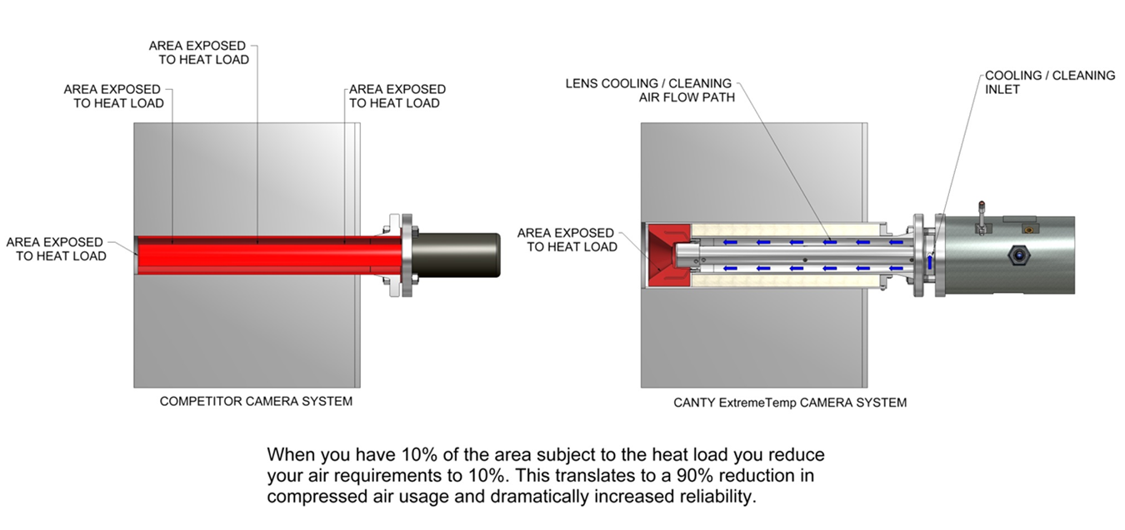
CANTY Vs Retractable Cameras (Cont’d)
J.M. CANTY INC. | BUFFALO NY | (716) 625-4227  J.M. CANTY INTL. | DUBLIN, IRELAND | +353 (1) 882-9621  J.M. CANTY INTL. ASIA | PHUKET THAILAND | +66 83 9689548

Slide 29
Industry Applications
Surveillance:
- Visual Inspection
- Flame Monitoring
Using CANTY analysis Software:
- Temperature Measurement (by vision)
- Multiple Zone analysis
- Flame presence detection
- Level Tracking
- Record Images & Videos
- Outputs for each measurement via 4-20mA/OPC/modbus
J.M. CANTY INC. | BUFFALO NY | (716) 625-4227  J.M. CANTY INTL. | DUBLIN, IRELAND | +353 (1) 882-9621  J.M. CANTY INTL. ASIA | PHUKET THAILAND | +66 83 9689548

Slide 30
CV – Temp. Measurement by Vision
CANTY’S thermal imaging system works by measuring the energy produced by a process.
As the intensity of emitted energy grows due to it’s rise in temperature, there is an associated colour change which can be registered by the camera.
Using the CANTY software, this change in colour can be calibrated to represent the change in temperature.
Extremely accurate and repeatable (+/-1%) for temperatures above 400ºC (750°F) (operating in the visual spectrum)
J.M. CANTY INC. | BUFFALO NY | (716) 625-4227  J.M. CANTY INTL. | DUBLIN, IRELAND | +353 (1) 882-9621  J.M. CANTY INTL. ASIA | PHUKET THAILAND | +66 83 9689548

Slide 31
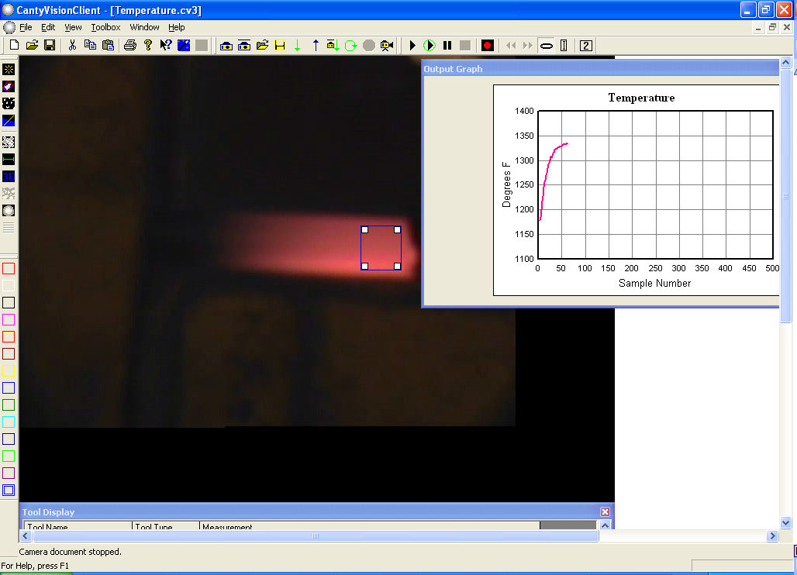
Temperature Measurement
Software monitors change in average colour intensity within the “intensity zone” (blue box) – change in intensity can be calibrated to temperature
J.M. CANTY INC. | BUFFALO NY | (716) 625-4227  J.M. CANTY INTL. | DUBLIN, IRELAND | +353 (1) 882-9621  J.M. CANTY INTL. ASIA | PHUKET THAILAND | +66 83 9689548

Slide 32
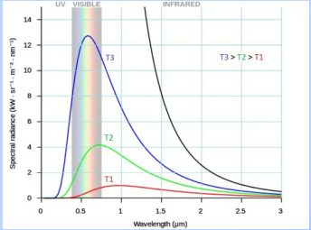
Emissivity Considerations:
- Visible spectrum(0.4-0.7μm)
allows for a wide range
of materials to be measured
without recalibration.
- Targeted temperature
measurement over wider range of wave lengths.
- Thermal radiation greatest in the visible range.
- Increased accuracy with the use of short wave length instrumentation.
J.M. CANTY INC. | BUFFALO NY | (716) 625-4227  J.M. CANTY INTL. | DUBLIN, IRELAND | +353 (1) 882-9621  J.M. CANTY INTL. ASIA | PHUKET THAILAND | +66 83 9689548

Slide 33
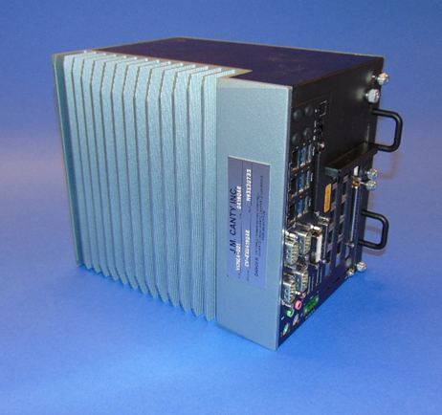
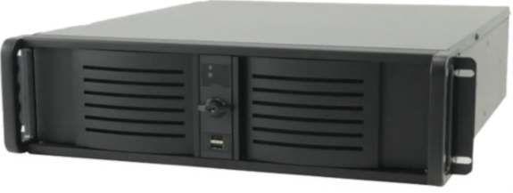
VCM - VISION CONTROL MODULE
Allows for input up to 6 cameras
Multiple outputs
-4-20mA
-OPC (OPC UA now available)
-Modbus
-Video Display
Ease of Remote Support
J.M. CANTY INC. | BUFFALO NY | (716) 625-4227  J.M. CANTY INTL. | DUBLIN, IRELAND | +353 (1) 882-9621  J.M. CANTY INTL. ASIA | PHUKET THAILAND | +66 83 9689548

Slide 34

Summary & Benefits
FuseView isolates the electronics from the process.
Quartz Lens system relaying images to camera located outside the process.
Built in camera temperature output.
Real Time measurement.
CANTY Vision software analysis gives continuous vision based temperature measurement output.
Early fault detection
Increase efficiency
API Committee Member
J.M. CANTY INC. | BUFFALO NY | (716) 625-4227  J.M. CANTY INTL. | DUBLIN, IRELAND | +353 (1) 882-9621  J.M. CANTY INTL. ASIA | PHUKET THAILAND | +66 83 9689548

Slide 35
Industries & Customers
Waste / Waste to Energy | Metal & Foundry | Chemical | Cement | Glass
Indaver | US Steel | BP Chemical | FLSmidth | Ardagh
Vyncke | Rolex | Borealis | OMAN cement | Pilkington
Kepple Seghers | First Quantum Minerals | Basf | Dalmia Cement | Cardinal
 | Arcelor mittal | Linde | Star Cement | Unifrax
 | Alcoa | Nippon Gas | Greymont | Corning
 |  | GSK | Chettinad Cement | Saint Gobain
J.M. CANTY INC. | BUFFALO NY | (716) 625-4227  J.M. CANTY INTL. | DUBLIN, IRELAND | +353 (1) 882-9621  J.M. CANTY INTL. ASIA | PHUKET THAILAND | +66 83 9689548

