Slide 1
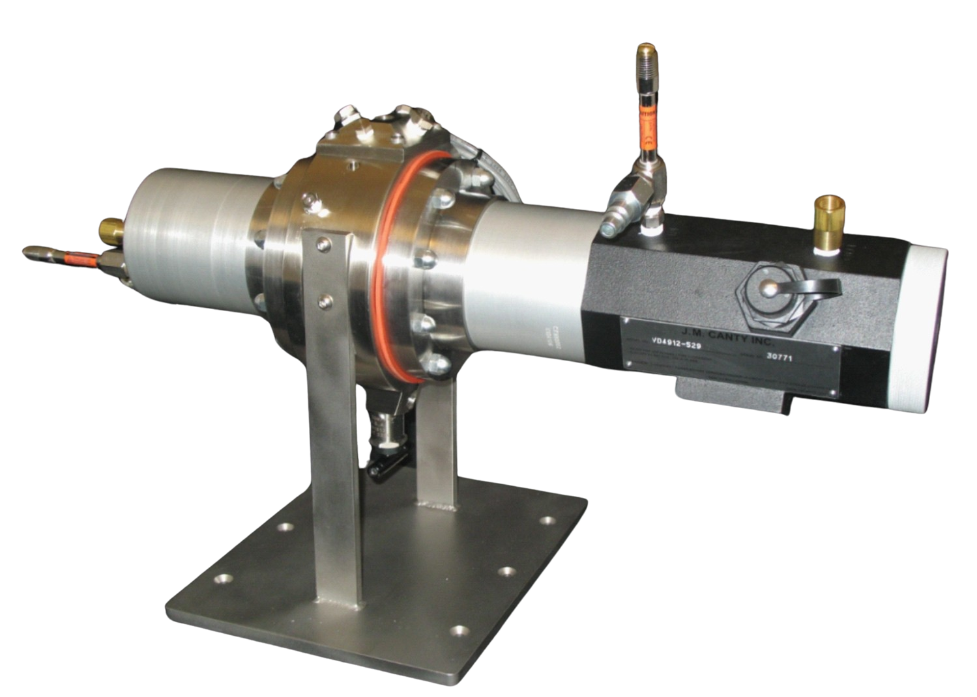
CANTY DCR INTERFACE SYSTEM
JM Canty, Inc. · Buffalo, New York · Phone: (716) 625-4227 | JM Canty, Ltd. · Dublin, Ireland · Phone: +353 (1) 882-9621

Slide 2
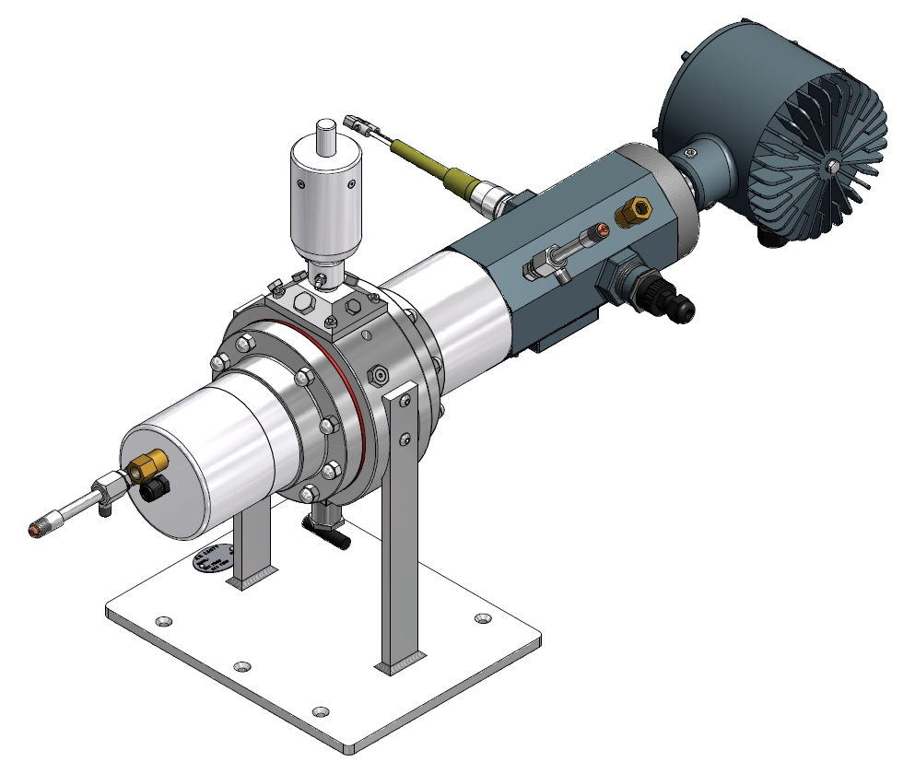
Presentation Outline
The use for tracking the phase splits in an oil/water emulsion
Introduction to CANTY’s DCR
Required Hardware
Layout Drawing
Software Overview
JM Canty, Inc. · Buffalo, New York · Phone: (716) 625-4227 | JM Canty, Ltd. · Dublin, Ireland · Phone: +353 (1) 882-9621

Slide 3
The Use for Tracking the Phase Splits in an Oil/Water Emulsion
Measure settling / separation rates
Measure volumes present in different phases to determine concentrations
Detect and quantify the presence of a rag layer
Study the effectiveness of chemical additives (e.g. emulsion breakers) prior to large scale field deployment
JM Canty, Inc. · Buffalo, New York · Phone: (716) 625-4227 | JM Canty, Ltd. · Dublin, Ireland · Phone: +353 (1) 882-9621

Slide 4
Dispersion Characterization Rig (DCR) - Introduction
Applies the principles of image analysis to monitor the interface between multiple phases in a sample
Once a sample is charged, the unit can automatically mix the sample to ensure tests begin well-mixed
LED panel illuminates the process chamber while the camera sends images to software for analysis
Analysis can be performed under pressure and at temperature
JM Canty, Inc. · Buffalo, New York · Phone: (716) 625-4227 | JM Canty, Ltd. · Dublin, Ireland · Phone: +353 (1) 882-9621

Slide 5
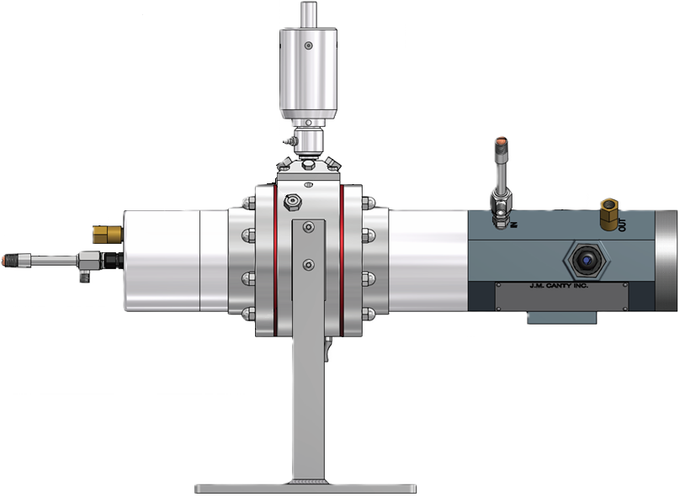
DCR - Hardware
Camera
Light
Analysis Chamber
Computer Hardware
JM Canty, Inc. · Buffalo, New York · Phone: (716) 625-4227 | JM Canty, Ltd. · Dublin, Ireland · Phone: +353 (1) 882-9621

Slide 6
Hardware – Camera
Gigabit Ethernet technology for optimum image retrieval
High resolution pixel array for increased accuracy
Simple CAT6 Network Connection to Vector Control Module (VCM)
Cooling tube for high temperature analysis
Camera
Cooling Tube
Exhaust Check Valve
CAT6 Ethernet Connection
JM Canty, Inc. · Buffalo, New York · Phone: (716) 625-4227 | JM Canty, Ltd. · Dublin, Ireland · Phone: +353 (1) 882-9621

Slide 7
Hardware – Lighting
High Intensity LED Light Source – Brightest in the industry!
5+ Years Continuous Operation
Even illumination through the entire cell
Exhaust Check Valve
Cooling Tube
LED
JM Canty, Inc. · Buffalo, New York · Phone: (716) 625-4227 | JM Canty, Ltd. · Dublin, Ireland · Phone: +353 (1) 882-9621

Slide 8
Hardware – Analysis Chamber
Fused glass process barrier to run at high pressure
Cartridge heaters to run at temperature
Removable cap with multiple instrument ports.
Side sampling ports for easy access.
Magnetic Drive Stirrer to uniformly mix the two test fluids together before separation.
Insulation jacket for safety, heater efficiency (not pictured)
Magnetic Drive Stirrer
Analysis Chamber
Cartridge Heaters
Sampling Port
Gaskets
JM Canty, Inc. · Buffalo, New York · Phone: (716) 625-4227 | JM Canty, Ltd. · Dublin, Ireland · Phone: +353 (1) 882-9621

Slide 9
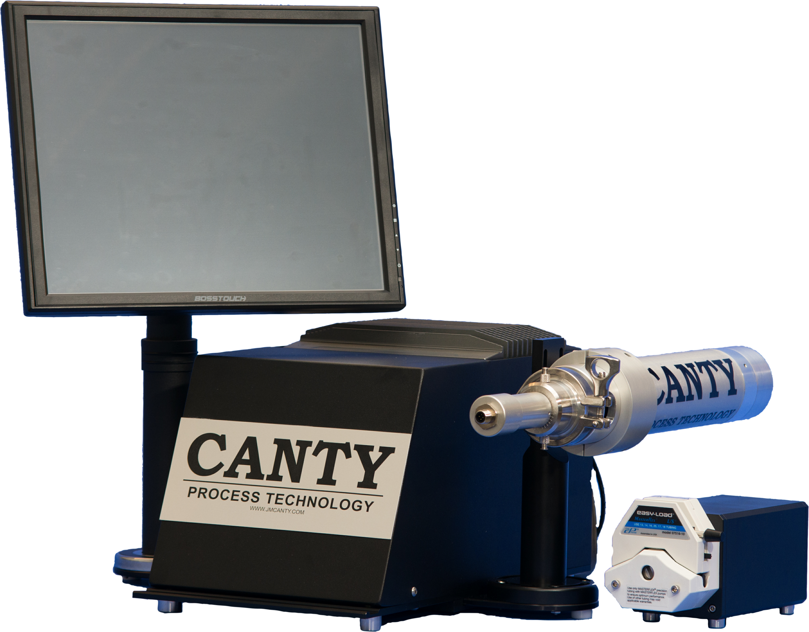
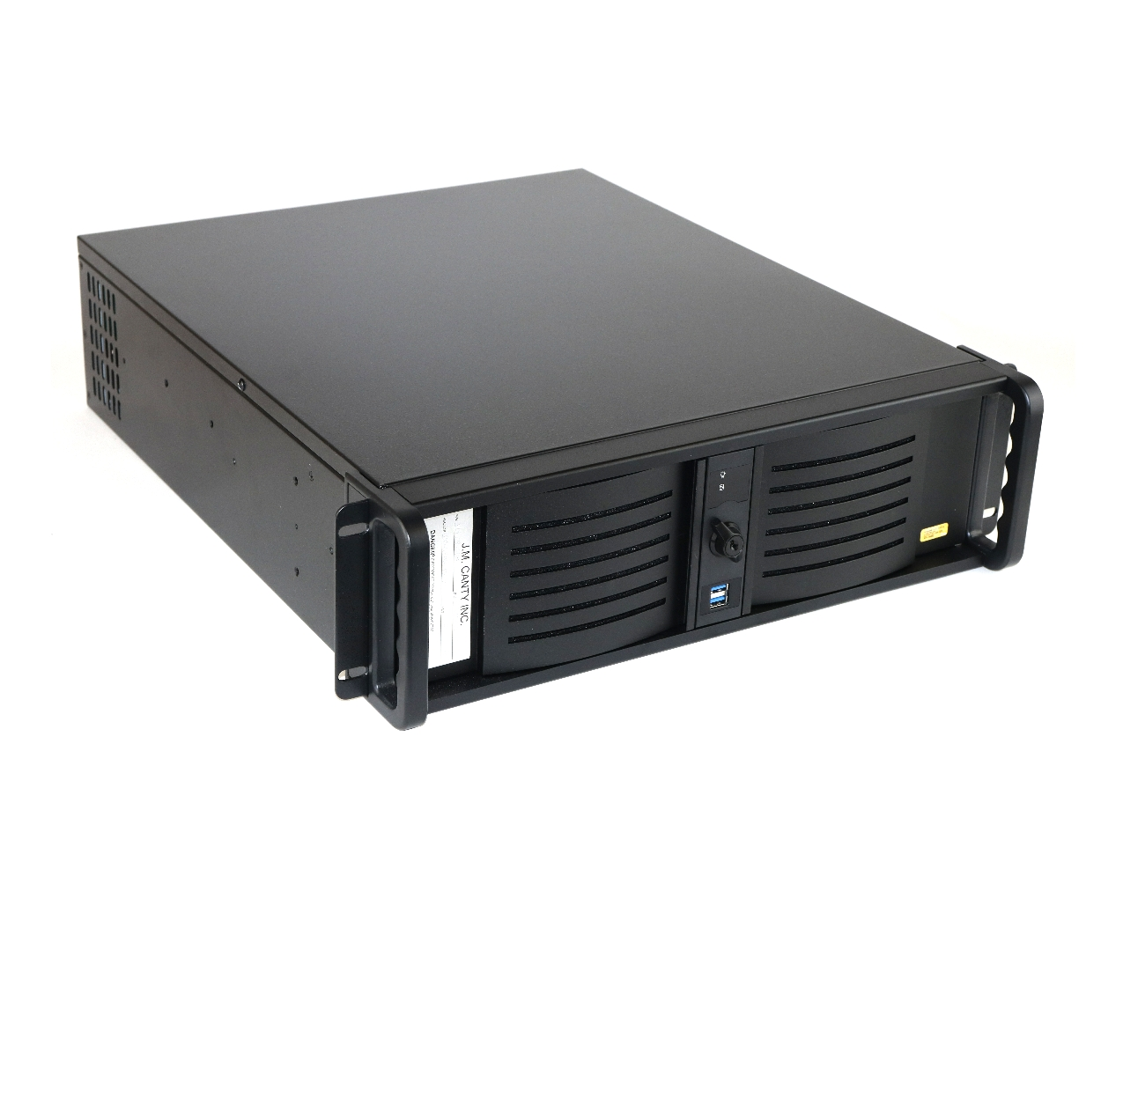
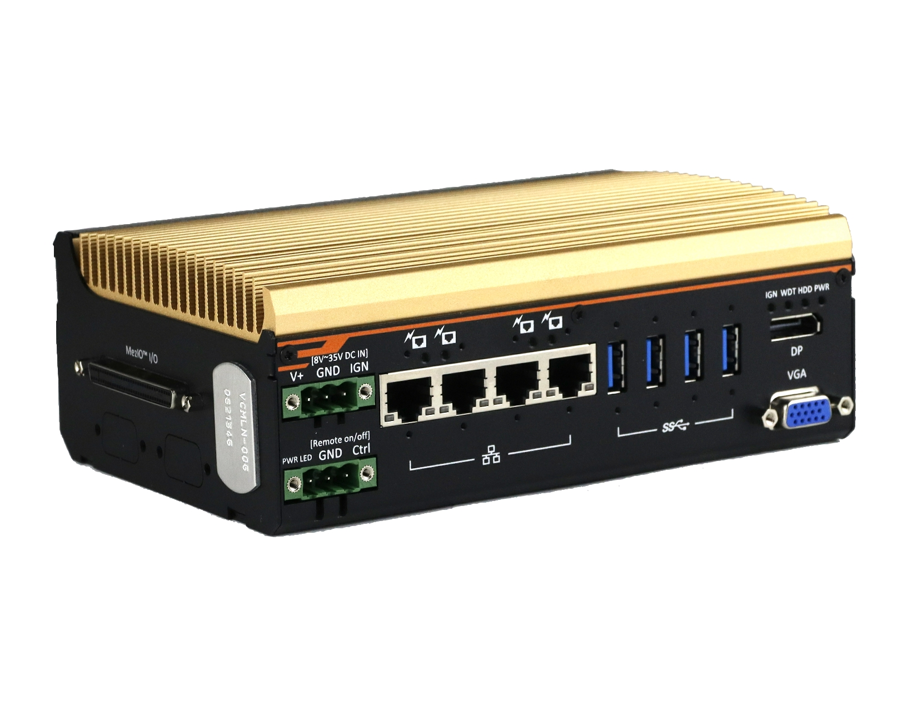
Hardware – Vector Control Module (VCM)
Ease of use and installation
Multiple analyzers from one VCM
Multiple outputs to interface with
Remote Support Functionality
JM Canty, Inc. · Buffalo, New York · Phone: (716) 625-4227 | JM Canty, Ltd. · Dublin, Ireland · Phone: +353 (1) 882-9621

Slide 10
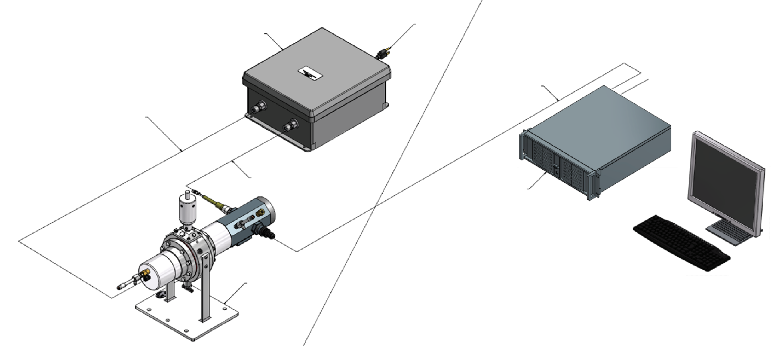
DCR – Layout Drawing
Power Supply
120VAC Power
CAT6 Ethernet Cable
120VAC Power
Low Voltage DC to LED
Weatherproof Area
General Purpose Location
Low Voltage DC to Camera
CANTY Vector Control Module (VCM)
CANTY DCR
JM Canty, Inc. · Buffalo, New York · Phone: (716) 625-4227 | JM Canty, Ltd. · Dublin, Ireland · Phone: +353 (1) 882-9621

Slide 11
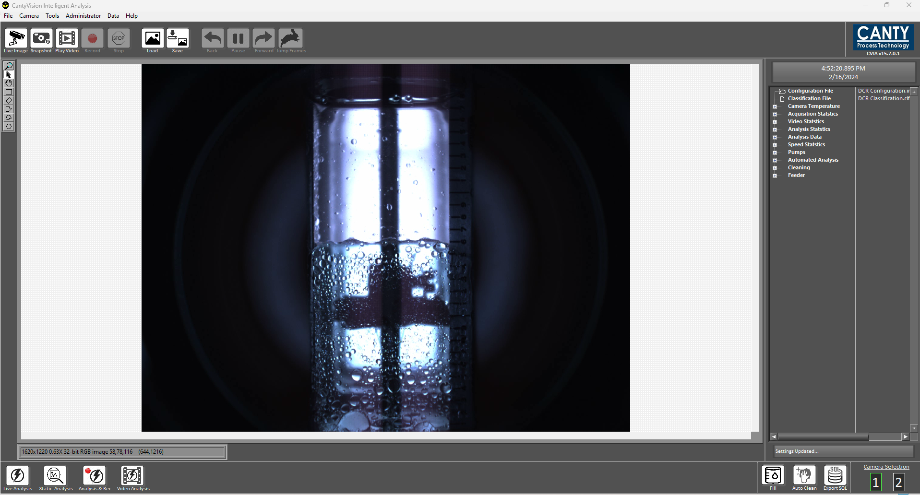
CantyVision Software – Overview
Easy to use interface
Real time analysis
Video analysis options
Pattern matching for highly accurate analysis
Reports time, interface levels, rag layers, etc…
JM Canty, Inc. · Buffalo, New York · Phone: (716) 625-4227 | JM Canty, Ltd. · Dublin, Ireland · Phone: +353 (1) 882-9621

Slide 12
Questions?
JM Canty, Inc. · Buffalo, New York · Phone: (716) 625-4227 | JM Canty, Ltd. · Dublin, Ireland · Phone: +353 (1) 882-9621

