Slide 1
Cracking Furnace
(Fired Heater)
Monitoring

Slide 2
AGENDA
Where are Cracking Furnaces Used?
Operating Issues
Tube Metal Temperature
- Non CANTY Techniques
- The CANTY Solution
CANTY Advantages
Related Applications
Conclusions

Slide 3
Where are Cracking Furnaces Used
Production of many different substances including:
Ethylene
Vinyl chloride monomer (VCM)
Hydrogen
Ammonia
Olefins

Slide 4

Operating Challenges:
THEORY vs REALITY
Theory: a cracking furnace will operate at consistent temperatures if one maintains the same feed rate
Reality: temperatures in a cracking furnace fluctuate due to a number of parameters including
  Quality and composition of feed stock
  Burner performance over time
  Coking of tubes

Slide 5
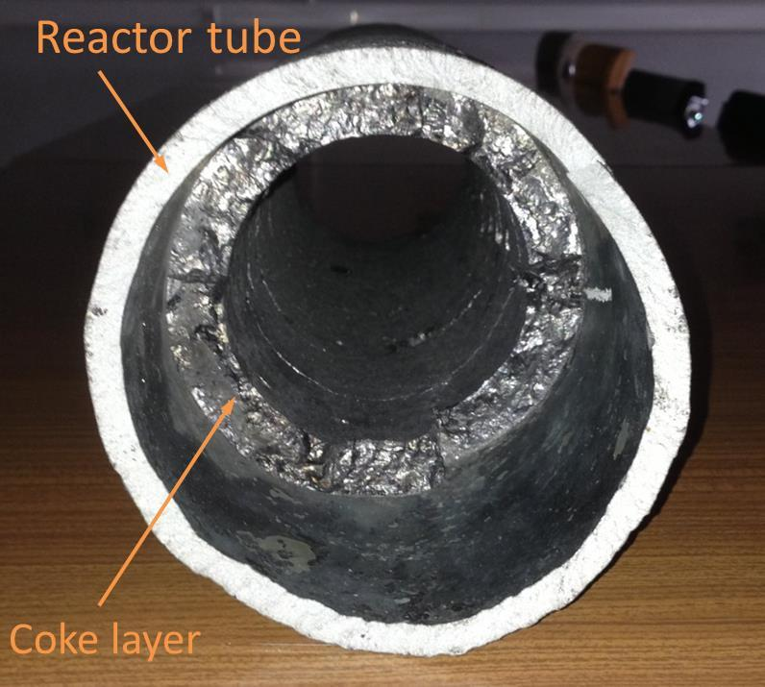
Operating Challenges:
Coking of Tubes
As raw materials react to form the desired product in tubes, undesirable by-products also form.
These form a layer of coke inside the tubes which impacts heat transfer and flow rates.

Slide 6

TUBE METAL TEMPERATURE
The greatest cause of component failure and furnace downtown, is overheating tubes.
If tubes overheat, it can lead to tube rupture and the possible escape of the feed stock into the firebox area of the furnace.
Causes issues for the process, can present safety problems, and wastes money
If you know a tube is drastically heating up, the process can be adjusted. Sometimes this means adjusting burners, decoking tubes, or even ending a run.
As a results, monitoring Tube Metal Temperature is CRITICAL

Slide 7
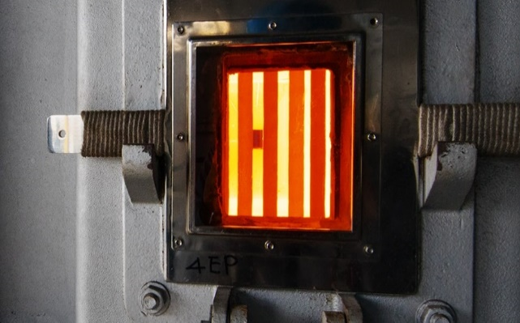
TUBE METAL TEMPERATURE
Common Current Techniques
Manual measurement by a handheld pyrometer through hatch / door
    do they leave the door open to long and let the furnace cool down?
    do they measure the same spot on the tube?
    if only measured every 8 hours when did the tube fail?
Thermocouples installed on the tubes
- contact device – harsh process conditions
- sensor failure – regular replacement
- drift in measurement

Slide 8
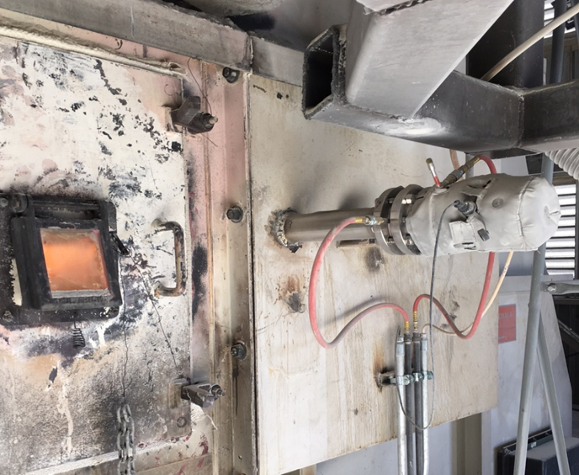
THE CANTY SOLUTION:
High Temperature Camera Systems

Slide 9
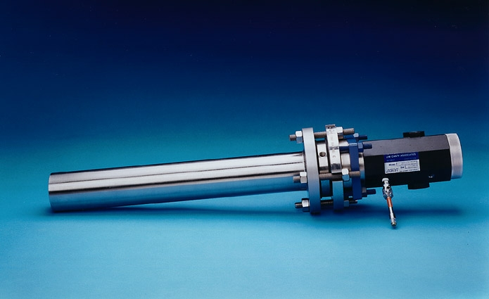
High Temperature Camera Models
Ultra Temperature Camera Process
Process Temp: 2500°F (1370ºC )
12”, 24” or 36” Insertion
Extreme Temperature Camera
Process Temp: 3000°F (1650ºC )
12”, 24” or 36” Insertion

Slide 10
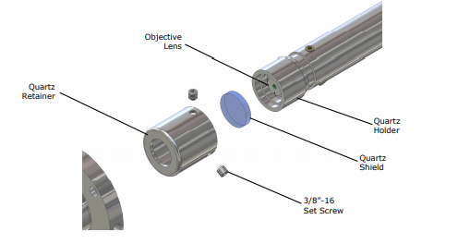
Quartz Shield
Our Camera is protected with a Quartz shield in the event of a loss of heat this shield protects the rest of the optics from becoming damaged and is easily and inexpensively replaced

Slide 11
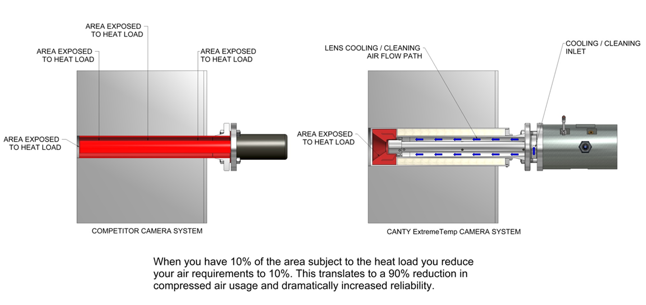
Cooling & Heat Load

Slide 12
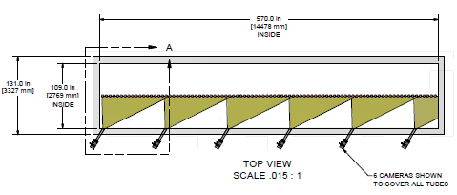
INSTALLATION LAYOUTS

Slide 13
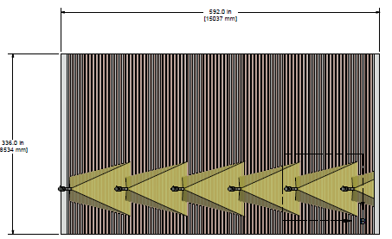
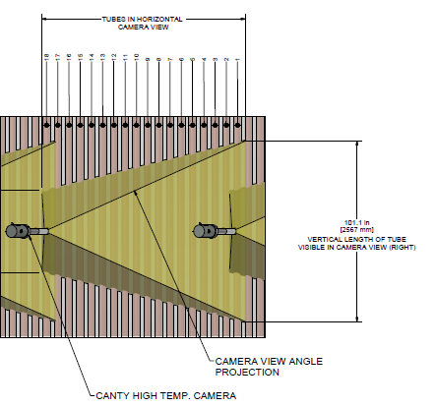
INSTALLATION LAYOUTS

Slide 14
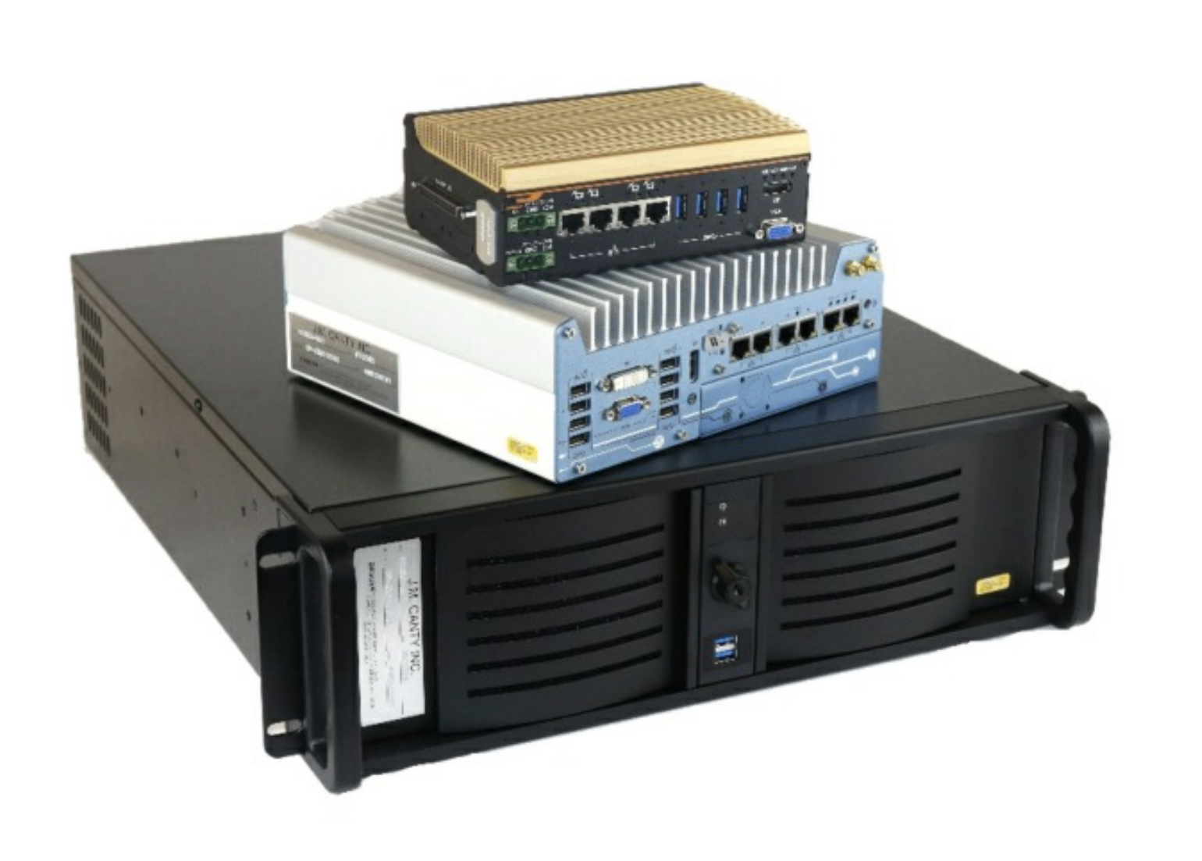
Vector Control Module (VCM)
Hosts the CantyVision Smart Tube software
Allows for input up to 6 cameras
Multiple outputs
- OPC
- Modbus
- 4-20mA
- Video Display
Ease of Remote Support

Slide 15
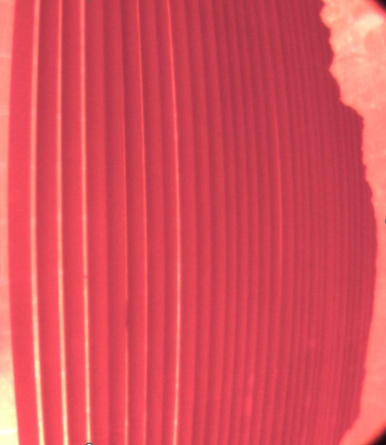
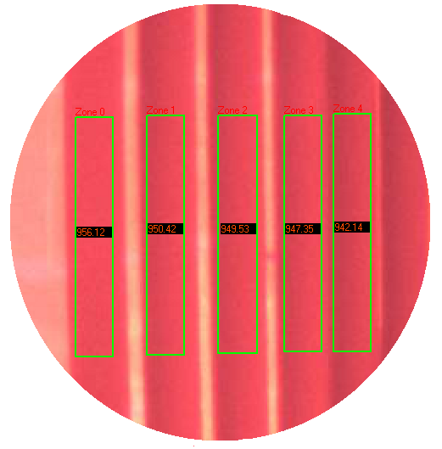
CantyVision Smart Tube Software
Real time, live analysis
Monitor TMT’s
Alert to hot spots on tubes
Track tube positions as they shift over time
Playback and re-analyze recorded videos

Slide 16
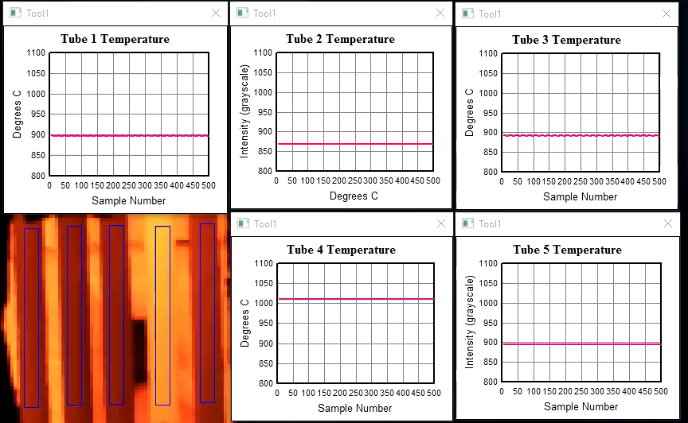
Tube 4 is running too hot “Cooked”
Now has to be cut it out and reweld a new tube on

Slide 17

CANTY ADVANTAGES
Non Contact Measurement
Measurement done in the visual spectrum
- more sensitive to temperature changes
- less affected by emissivity
Visual Verification of process conditions
Rugged Hardware – fused glass / quartz optics / no retraction system
Ease of Maintenance – electronics isolated from the process
Ease of remote support with the VCM
CANTY

Slide 18
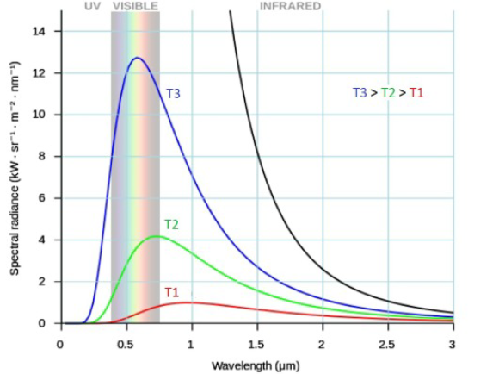
TEMPERATURE BY VISION
Operates in the Visual Spectrum
Biggest difference in the spectral radiance (intensity) for any temperature change occurs in that spectrum, meaning higher sensitivity of instruments
Shorter wavelength instruments less affected by changes over time in the emissivity of an object (tube)

Slide 19
Example of Emissivity Error
e at .6 micron = .8 (vision system)
e at 3.9 micron = .4 (pyrometer)
Selection of the exact value is difficult. If one
Selects .75 for the vision system and .35 for the pyrometer, the error associated with each is:
Vision - (.8 - .75) / .8 = 6.25%
Pyrometer – (.4 - .35) / .4 = 12.5%

Slide 20
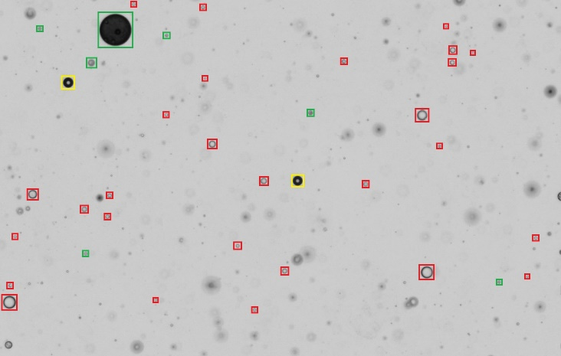
RELATED APPLICATIONS
CANTY makes many other measurements related to cracking furnaces. A few of them include:
Flame Monitoring
  Monitor for smoking, flame detachment, flame color
Quench Oil Analysis
  Measure TSS and concentration of water in quench oil
Quench Water Analysis
  Measure TSS and concentration of oil in quench water

Slide 21
CONCLUSION
Real time continuous measurement of tube temperature is critical
Reduces down time, increases efficiency, and therefore yield / profit
Current commonly used techniques have multiple issues
CANTY solution overcomes these issues and provides an accurate, reliable, and multi-point measurement

Slide 22

QUESTIONS & ANSWERS

