Slide 1

Monitoring
Basic Sediment & Water (BS&W) in Oil
Canty Process Technology
JM Canty, Inc. · Buffalo, New York · Phone: (716) 625-4227 | JM Canty, Ltd. · Dublin, Ireland · Phone: +353 (1) 882-9621

Slide 2
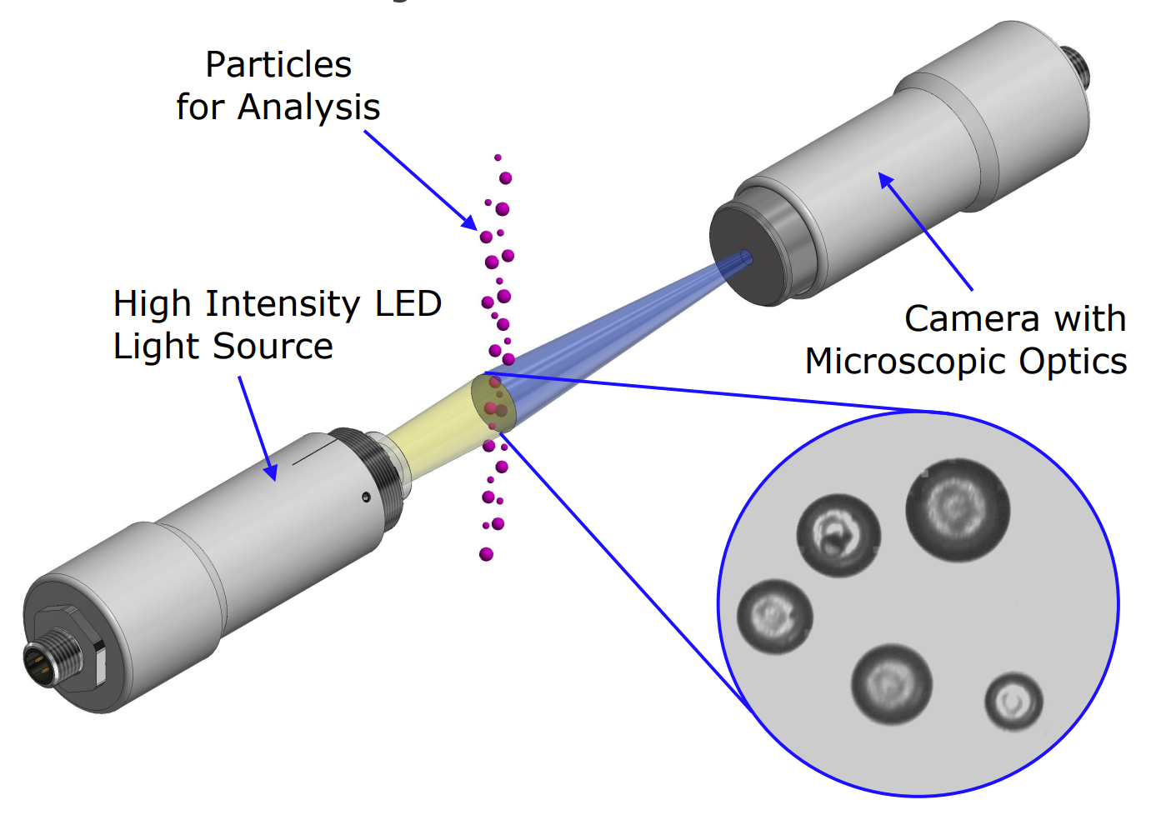
Vision Based Particle Analysis Basic Principle
JM Canty’s vision based technique works on the basic principle of presenting the fluid between a high intensity light source, and microscopic camera
The captured images are then sent to CantyVision Software for analysis, where the suspended “particles” (water droplets in oil, solids, gas bubbles etc.) are measured for a number of different parameters to provide size, shape and concentration data
JM Canty, Inc. · Buffalo, New York · Phone: (716) 625-4227 | JM Canty, Ltd. · Dublin, Ireland · Phone: +353 (1) 882-9621

Slide 3
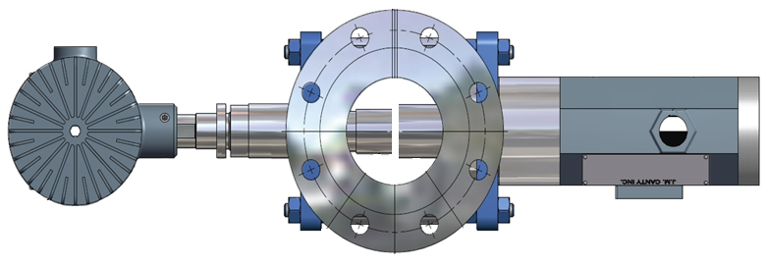
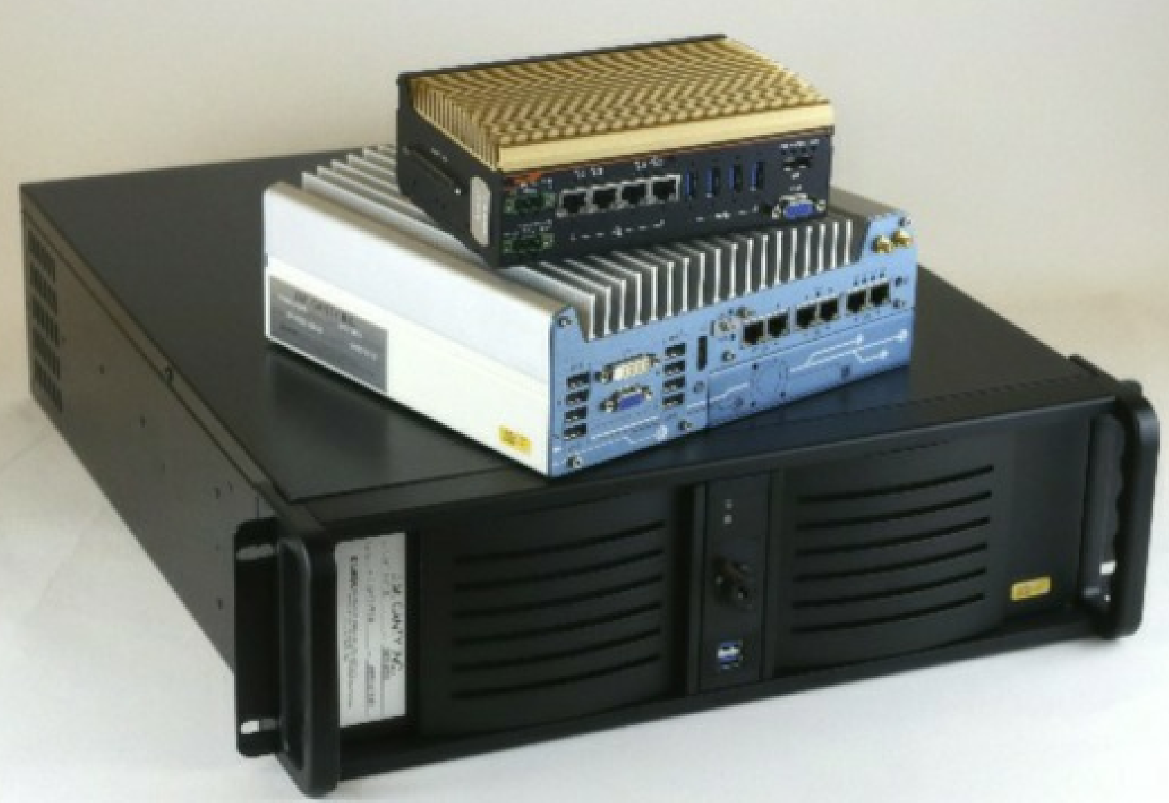
Hardware – Image Retrieval and Analysis
4 Primary Hardware Components Required For High Quality Image Analysis:
Camera
Light
Flow Cell
Vector Control Module
(VCM)
JM Canty, Inc. · Buffalo, New York · Phone: (716) 625-4227 | JM Canty, Ltd. · Dublin, Ireland · Phone: +353 (1) 882-9621

Slide 4

Hardware – Image Retrieval
Camera
Gigabit Ethernet technology for optimum image retrieval
4112 x 2176 Pixel Array configurable to 0.23µm per Pixel Resolution
Particle / Droplet Size to 0.7µm
Simple RJ45 Network Connection to Control PC
Sand in Water
JM Canty, Inc. · Buffalo, New York · Phone: (716) 625-4227 | JM Canty, Ltd. · Dublin, Ireland · Phone: +353 (1) 882-9621

Slide 5
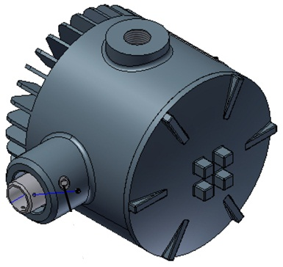
Hardware – Image Retrieval
Lighting System
High flow rates inline require an increased shutter speed and so an increased amount of light to capture particulate in “freeze frame” in order to perform software analysis
High Intensity LED Light Source
5+ Years Continuous Operation
Flow velocity up to 5m/s
JM Canty, Inc. · Buffalo, New York · Phone: (716) 625-4227 | JM Canty, Ltd. · Dublin, Ireland · Phone: +353 (1) 882-9621

Slide 6
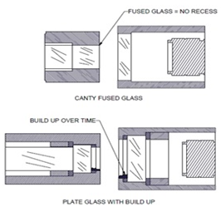
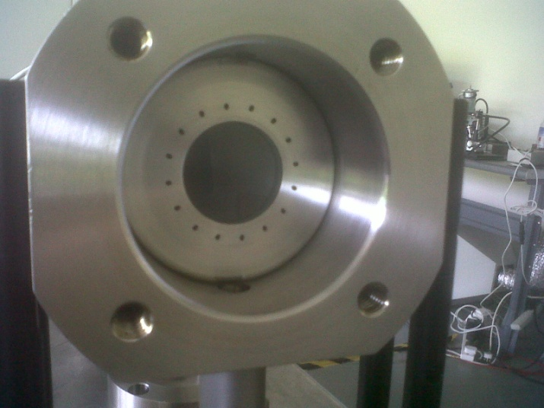
Hardware – Image Retrieval
Fused Glass Flow Path
Fused one piece construction with no recesses or steps where product can adhere to and build up
Pressures to 600 BAR
Integral Jet Spray Ring
Adjustable Gap Size dependent on sample present
JM Canty, Inc. · Buffalo, New York · Phone: (716) 625-4227 | JM Canty, Ltd. · Dublin, Ireland · Phone: +353 (1) 882-9621

Slide 7
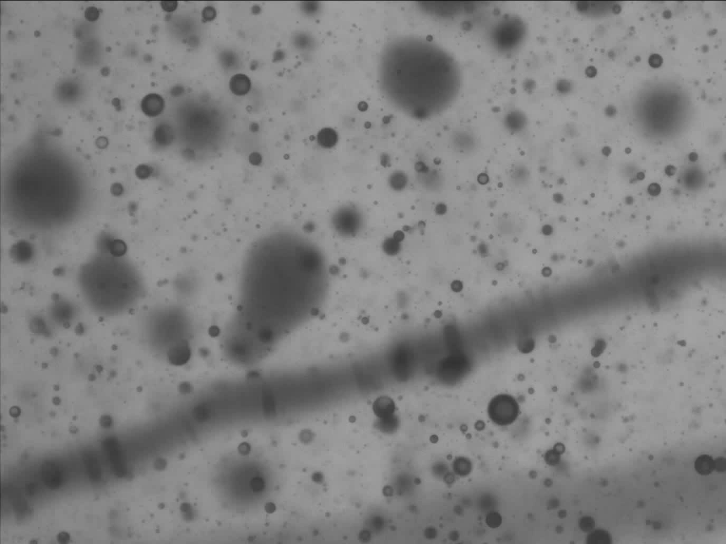
JM Canty, Inc. · Buffalo, New York · Phone: (716) 625-4227 | JM Canty, Ltd. · Dublin, Ireland · Phone: +353 (1) 882-9621

Slide 8
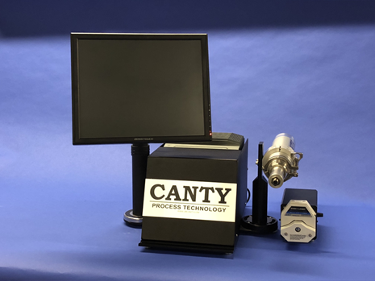
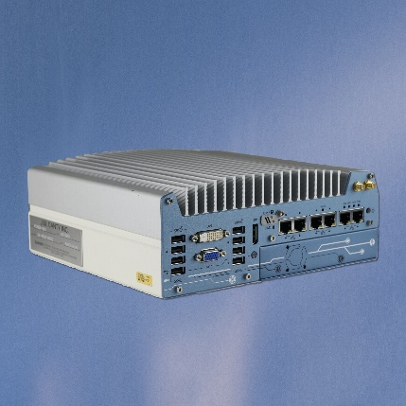
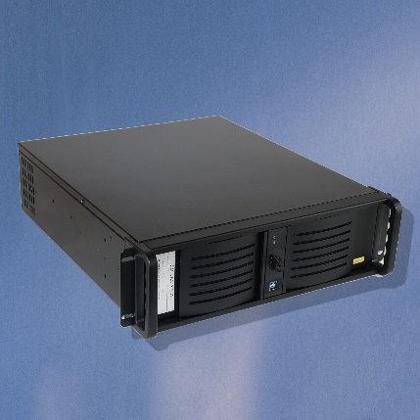
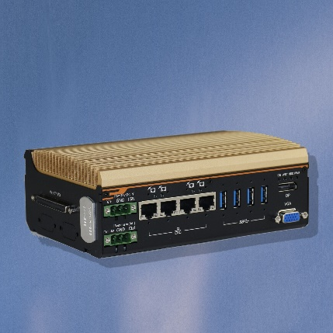
Hardware – Image Analysis
Vector Control Module (VCM)
Ease of use and installation
Multiple analyzers from one VCM
Multiple outputs to interface with
Remote Support Functionality
JM Canty, Inc. · Buffalo, New York · Phone: (716) 625-4227 | JM Canty, Ltd. · Dublin, Ireland · Phone: +353 (1) 882-9621

Slide 9
Installations
Many different types of installations to adapt to where analysis is needed:
      Inline
      At-Line
      Skid
      Cart
      Portable
      Transportable
      Lab
JM Canty, Inc. · Buffalo, New York · Phone: (716) 625-4227 | JM Canty, Ltd. · Dublin, Ireland · Phone: +353 (1) 882-9621

Slide 10
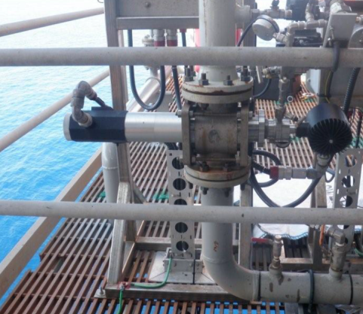
Installations – In-line
Directly in process
Acts as a spool piece in the pipe
Typically up to 2” lines
Can also be mounted on fast loop bypass line for larger process lines
JM Canty, Inc. · Buffalo, New York · Phone: (716) 625-4227 | JM Canty, Ltd. · Dublin, Ireland · Phone: +353 (1) 882-9621

Slide 11
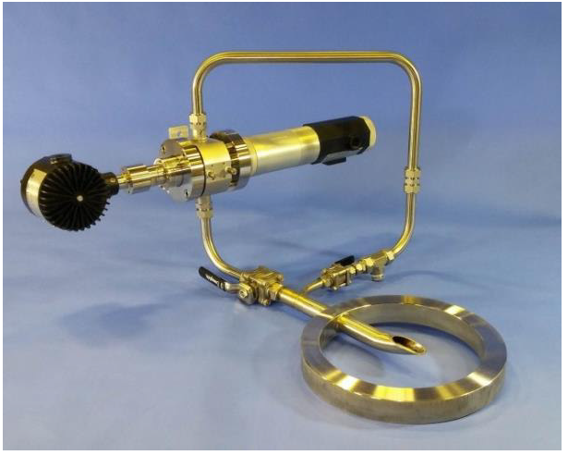
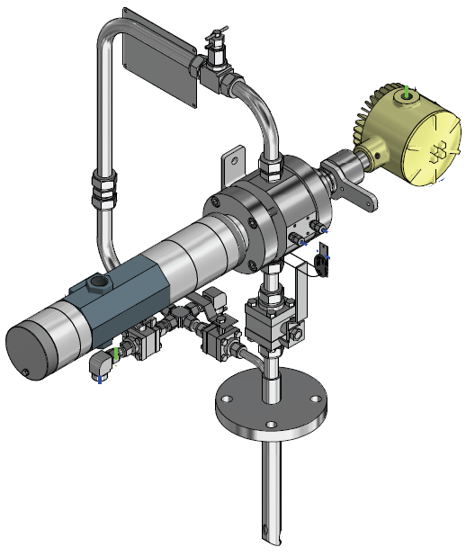
Installations – At-Line
Short Loop Sampler
  Wafer or flange models
Ability to isolate from process
One take out and return line
Line size 3”+
JM Canty, Inc. · Buffalo, New York · Phone: (716) 625-4227 | JM Canty, Ltd. · Dublin, Ireland · Phone: +353 (1) 882-9621

Slide 12
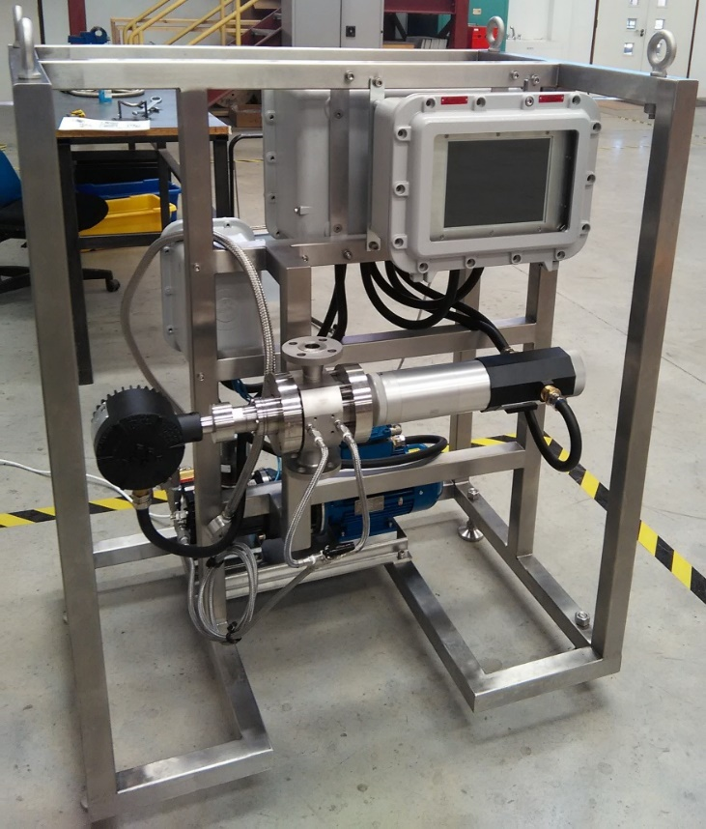
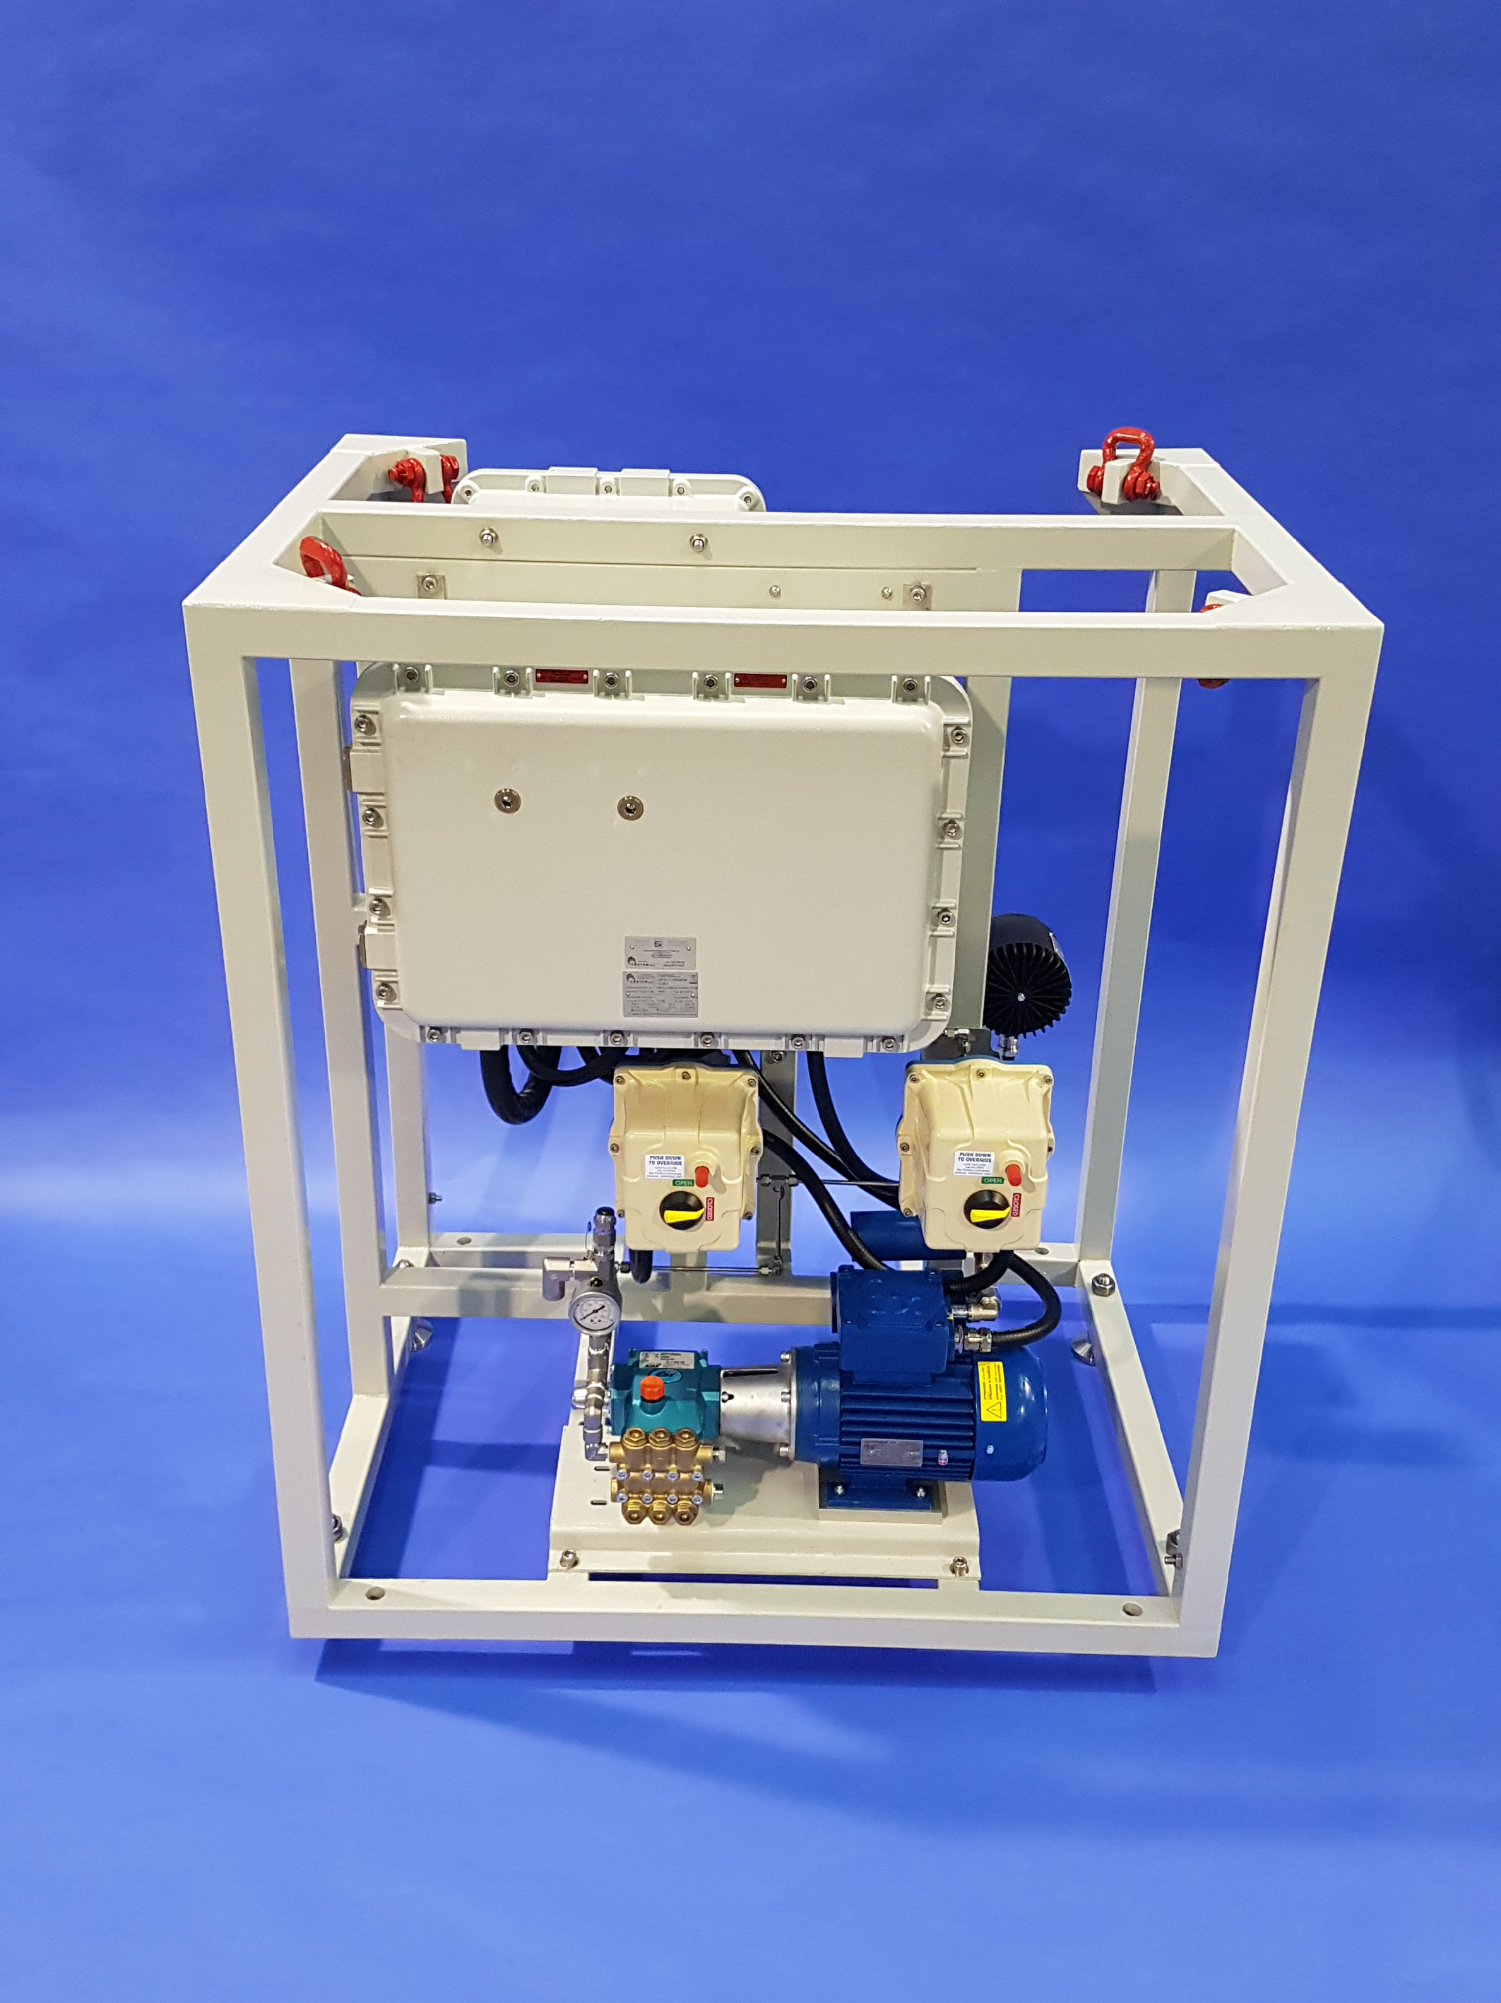
Installations – Skid
Allows for full control of cleaning system
Can be an all-in-one installation for VCM, cleaning, power supply, and analyzer
Can be integrated with in-line and at-line systems
JM Canty, Inc. · Buffalo, New York · Phone: (716) 625-4227 | JM Canty, Ltd. · Dublin, Ireland · Phone: +353 (1) 882-9621

Slide 13
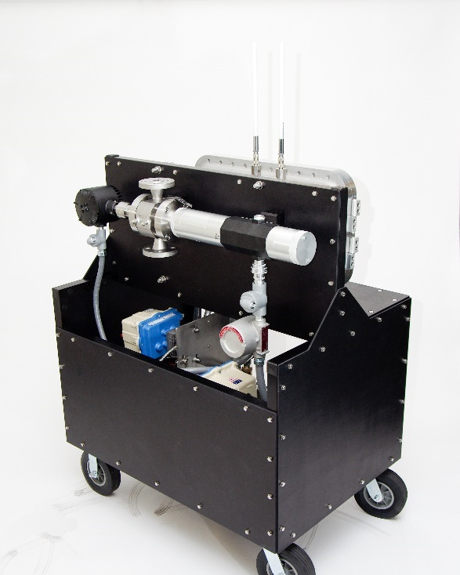
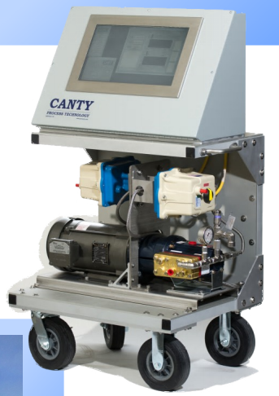
Installations - Cart
Long-term temporary testing
Mobile system
Includes cleaning pump
Functionally a skid system on wheels
JM Canty, Inc. · Buffalo, New York · Phone: (716) 625-4227 | JM Canty, Ltd. · Dublin, Ireland · Phone: +353 (1) 882-9621

Slide 14
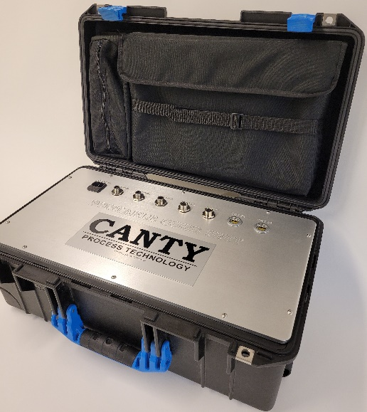
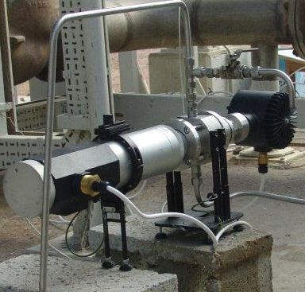
Installations – Portable
Short-term temporary testing
Easy to transport
General purpose
Analysis hardware built in PSU
JM Canty, Inc. · Buffalo, New York · Phone: (716) 625-4227 | JM Canty, Ltd. · Dublin, Ireland · Phone: +353 (1) 882-9621

Slide 15
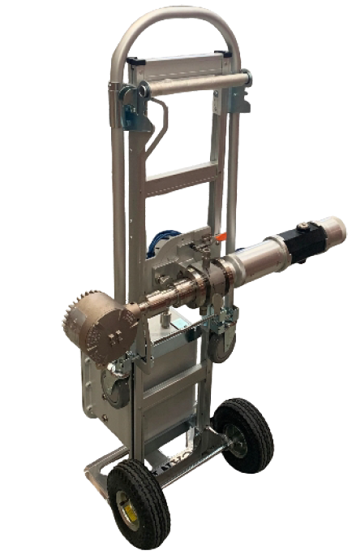
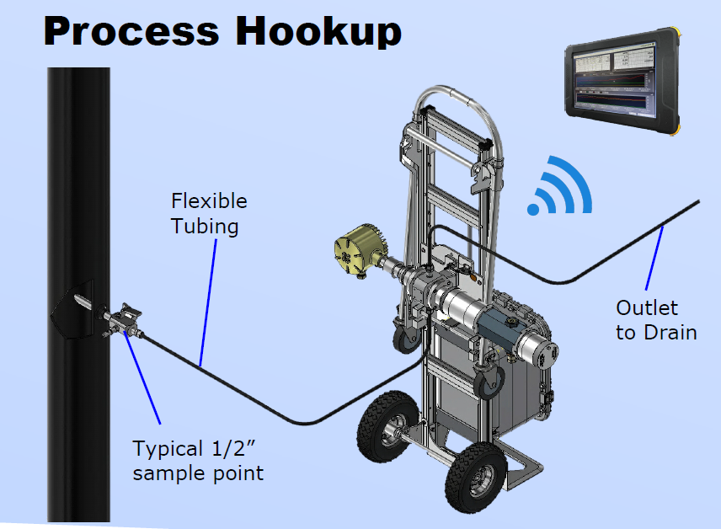
Installations - Transportable
Short-term temporary testing
ATEX rated
Easy to move from sample point to sample point
VCM built into unit, accessed via ATEX tablet
JM Canty, Inc. · Buffalo, New York · Phone: (716) 625-4227 | JM Canty, Ltd. · Dublin, Ireland · Phone: +353 (1) 882-9621

Slide 16
Installations - Lab
Same technology applied for offline samples
Smaller flow cell for smaller sample volumes
Screen, VCM, and power supply all built into one unit
CSV file reports
JM Canty, Inc. · Buffalo, New York · Phone: (716) 625-4227 | JM Canty, Ltd. · Dublin, Ireland · Phone: +353 (1) 882-9621

Slide 17
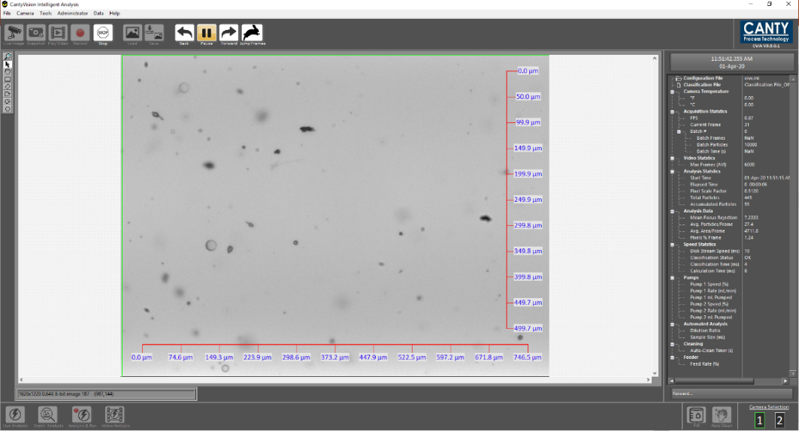
Software – Image Analysis
CantyVision Intelligent Analysis (CVIA)
Easy to use interface
Real time analysis
Video analysis options
Reports PSSD’s (particle size and shape distributions), concentrations
JM Canty, Inc. · Buffalo, New York · Phone: (716) 625-4227 | JM Canty, Ltd. · Dublin, Ireland · Phone: +353 (1) 882-9621

Slide 18
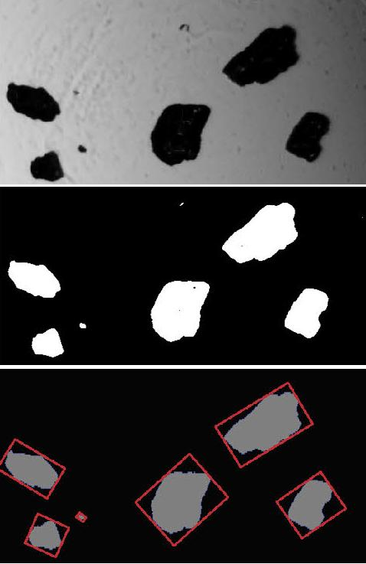
Software – Image Analysis
How does it work?
For each image in the analysis:
Distinguish background from “particles”
Throw out anything that is out of focus
Measure shape and size parameters of each particle
Determine the particle “class”
  Solid, water droplet, gas bubble, etc…
Compile measurements (size, volume, etc…)
Update results
JM Canty, Inc. · Buffalo, New York · Phone: (716) 625-4227 | JM Canty, Ltd. · Dublin, Ireland · Phone: +353 (1) 882-9621

Slide 19
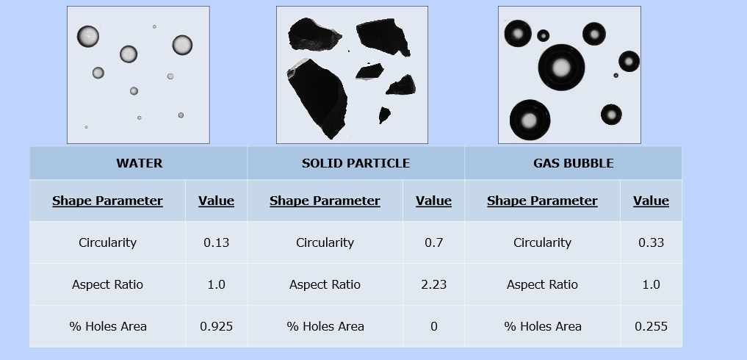
Software – Image Analysis
Differentiating between Solids, Droplets, and Bubbles
Based on particle morphology solid particles, oil droplets, and gas bubbles can all be distinguished by Canty software based on the direct 2D images.
Originally accomplished using a small number of shape parameters
Now accomplished via machine learning
JM Canty, Inc. · Buffalo, New York · Phone: (716) 625-4227 | JM Canty, Ltd. · Dublin, Ireland · Phone: +353 (1) 882-9621

Slide 20
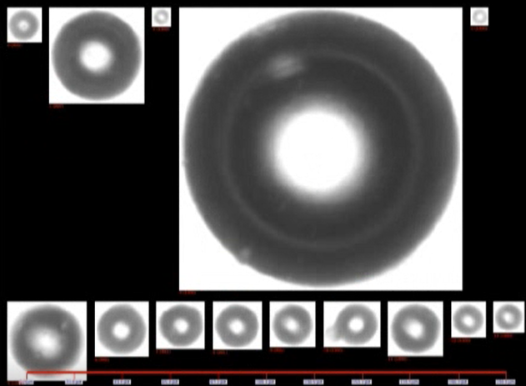
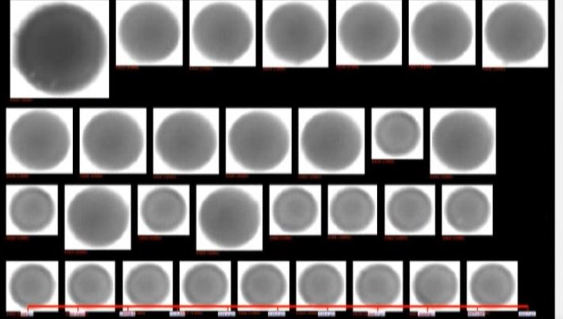
Software – Image Analysis
Differentiating between Solids, Droplets, and Bubbles
Gas Bubbles
Solids
Droplets
Example particle images trained into software
40+ shape and size parameter trends analyzed
System self classifies removing operator error
JM Canty, Inc. · Buffalo, New York · Phone: (716) 625-4227 | JM Canty, Ltd. · Dublin, Ireland · Phone: +353 (1) 882-9621

Slide 21
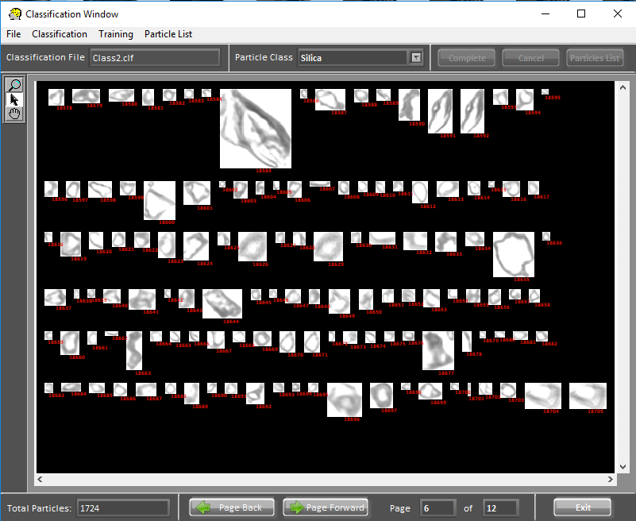
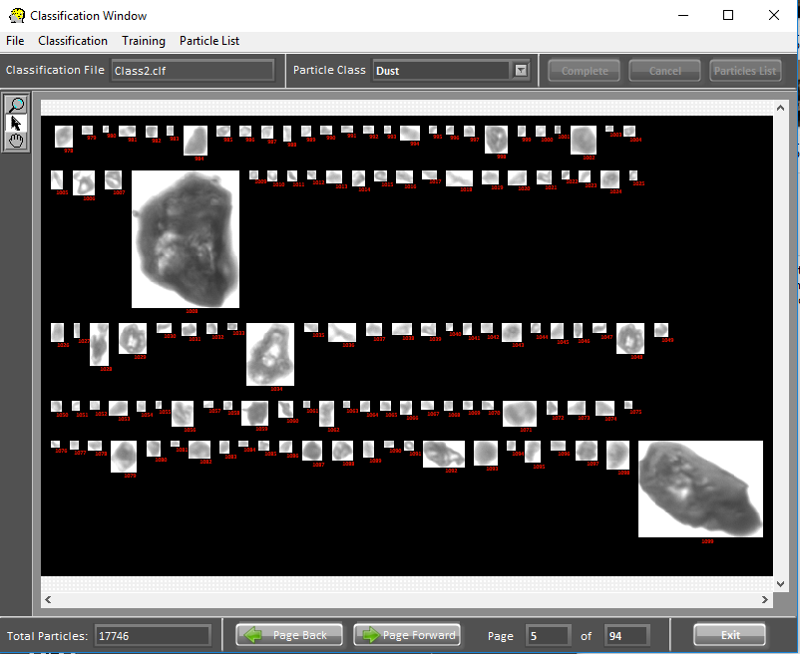
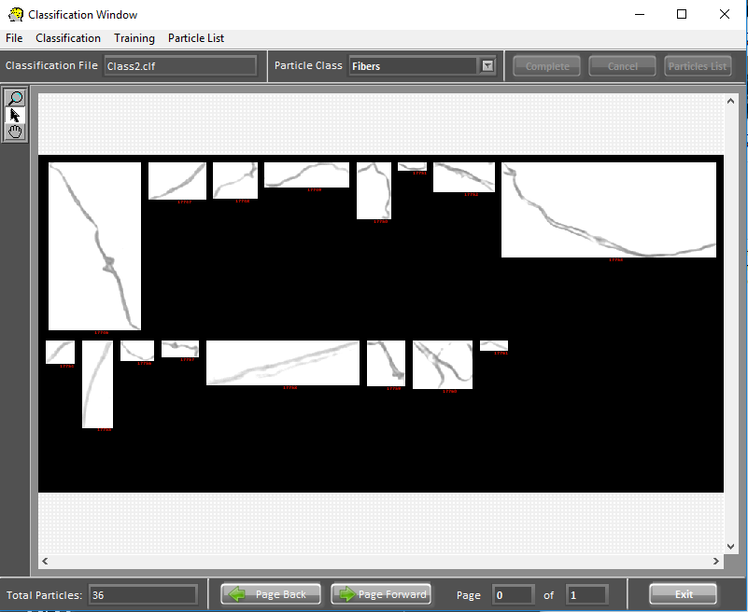
Software – Image Analysis
Differentiating between Solids, Droplets, and Bubbles
Easy to build in multiple custom classes for specific R&D
Intuitive GUI allows user to click on particles within the class they want to measure and sort particles by their individual classes.
JM Canty, Inc. · Buffalo, New York · Phone: (716) 625-4227 | JM Canty, Ltd. · Dublin, Ireland · Phone: +353 (1) 882-9621

Slide 22
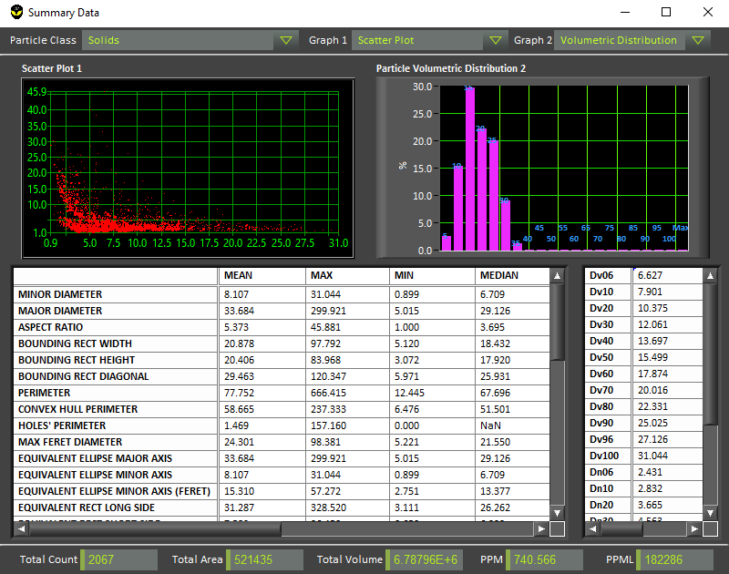
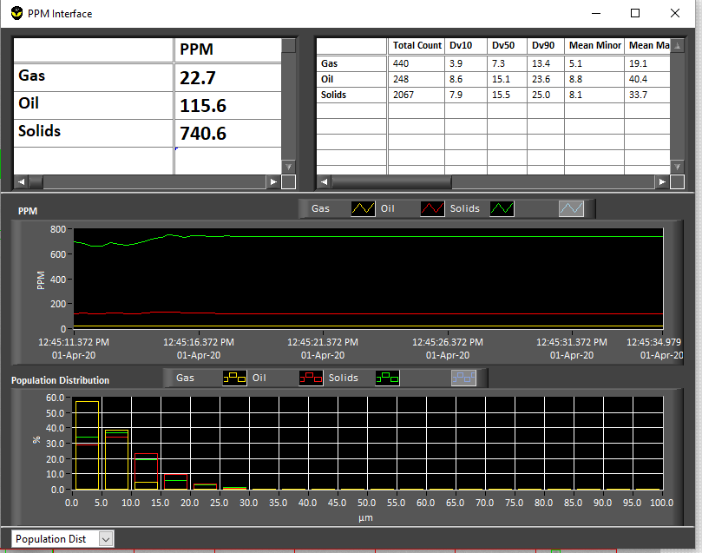
Image Analysis – Outputs
Real time PSSA, concentration display
  Percentiles
  Binned Distributions
  PPM
  PPML
Local CSV Report Outputs
Outputs can be sent via 4-20mA, Modbus TCP/IP, OPC UA, and others
JM Canty, Inc. · Buffalo, New York · Phone: (716) 625-4227 | JM Canty, Ltd. · Dublin, Ireland · Phone: +353 (1) 882-9621

Slide 23
Comparison of methods to measure water in oil
  Crackle test
    Offline, qualitative, variability operator to operator
  Karl Fischer
    Offline (performed in hood), Requires reagents, Requires skilled lab tech, Time-consuming, No size distribution measured
  Calcium Hydride
    Offline, Requires reagents, No size distribution measured
  Relative Humidity
    Cannot measure free water, no particle size distribution
  Infrared
    Cannot measure free water and is heavily influenced by the presence of free water
  Dynamic Imaging
    Offline and Online, no reagents, measures free water concentration AND size distribution, measures TSS at the same time
JM Canty, Inc. · Buffalo, New York · Phone: (716) 625-4227 | JM Canty, Ltd. · Dublin, Ireland · Phone: +353 (1) 882-9621

Slide 24
Comparison of methods to measure water in oil
Technology | Offline/ Online | Requires Reagents | Measures Free Water | Measures TSS | Provides Size Distribution
Dynamic Imaging | Both | No | Yes | Yes | Yes
Karl Fischer | Offline Only (Lab) | Yes | Total water only | No | No
Infrared | Both | Sometimes | No* | No | No
Calcium Hydride | Offline Only | Yes | Total water only | No | No
Relative Humidity | Both | No | No | No | No
Crackle Test | Offline Only | No** | Qualitative only | No | No
*Infrared systems can be heavily impacted by the presence free water as the free droplets can scatter the spectrum.
**The crackle test does not require additional reagents, but it does require heating the sample.
JM Canty, Inc. · Buffalo, New York · Phone: (716) 625-4227 | JM Canty, Ltd. · Dublin, Ireland · Phone: +353 (1) 882-9621

Slide 25
Case Study 1: Measurement of Water Droplets in Crude
Recently , there have been intensive studies to determine water droplet size distribution along the 800 mile Alyeska Pipeline stretching from Purdue Bay to Valdez Alaska.
Over the years, crude flow has decreased significantly from the original design of 2 million barrels per day to the present 700,000 barrels per day.
This decrease in flow is a major cause of concern for water dropout. The volume of water, water droplet size and crude temperature are the major variables which determine the amount of water dropout in low-lying areas.
If water happens to accumulate in low-lying areas from reduction in flow or a pipeline shutdown, it could freeze and cause major restart issues and equipment damage.
JM Canty, Inc. · Buffalo, New York · Phone: (716) 625-4227 | JM Canty, Ltd. · Dublin, Ireland · Phone: +353 (1) 882-9621

Slide 26
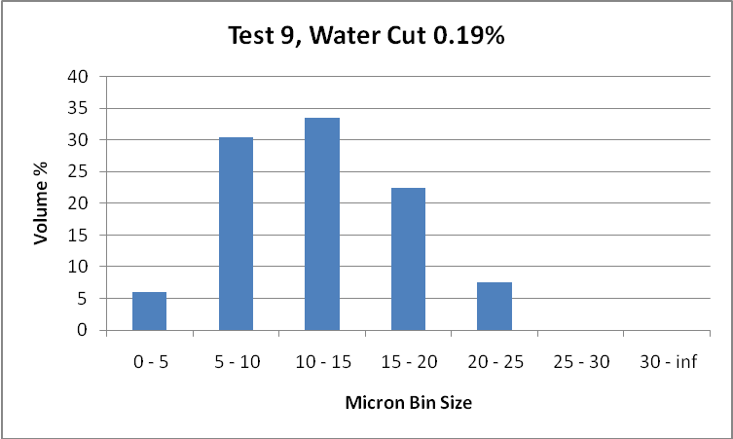
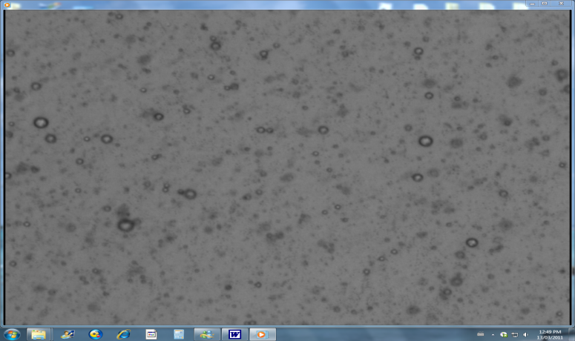
JM Canty, Inc. · Buffalo, New York · Phone: (716) 625-4227 | JM Canty, Ltd. · Dublin, Ireland · Phone: +353 (1) 882-9621

Slide 27
Case Study 2: Effect of Pressure Reduction Valves on Water Droplets in Crude
As the crude reaches East Meters in Valdez, the line pressure ranges between 750 to 850 psi
The crude enters East Meters and passes through pressure reduction valves, dropping the pressure to approximately 120 psi
The Canty was installed to determine the effect of this pressure drop on water droplet size. This application also demonstrates the importance of choosing the correct process location to study droplet size
The Canty was installed at both the high pressure and low pressure side of the pressure reduction valves
JM Canty, Inc. · Buffalo, New York · Phone: (716) 625-4227 | JM Canty, Ltd. · Dublin, Ireland · Phone: +353 (1) 882-9621

Slide 28
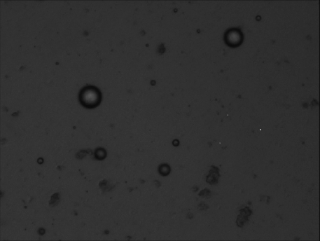

Before Pressure Reduction Valves
Water Droplets Clearly Visible
After Pressure Reduction Valves
Water Droplets Have Been Sheared
JM Canty, Inc. · Buffalo, New York · Phone: (716) 625-4227 | JM Canty, Ltd. · Dublin, Ireland · Phone: +353 (1) 882-9621

Slide 29
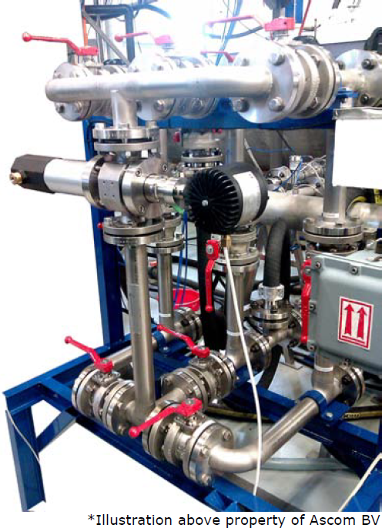
Questions
&
Answers
JM Canty, Inc. · Buffalo, New York · Phone: (716) 625-4227 | JM Canty, Ltd. · Dublin, Ireland · Phone: +353 (1) 882-9621

