Slide 1
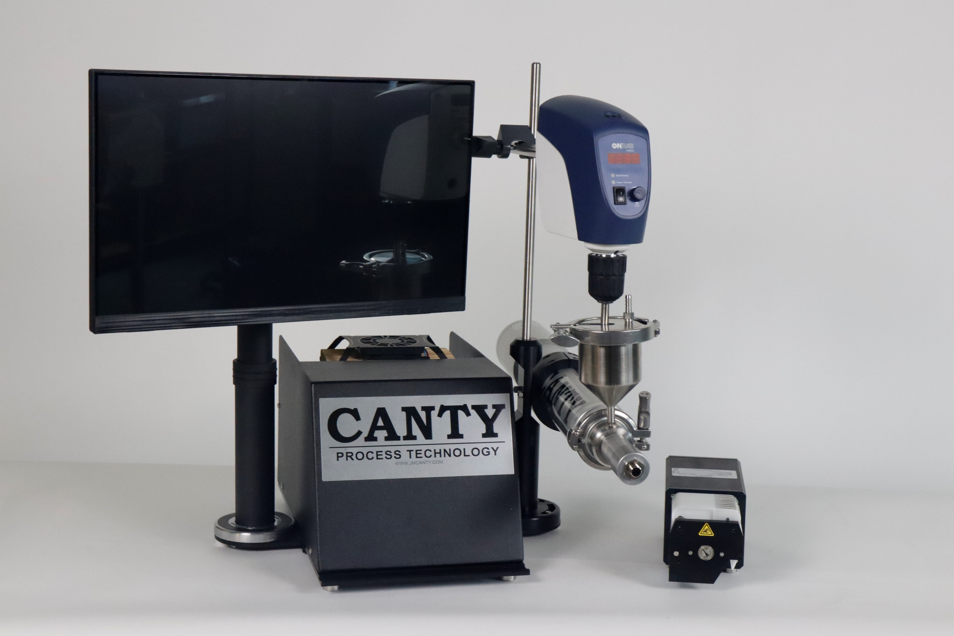
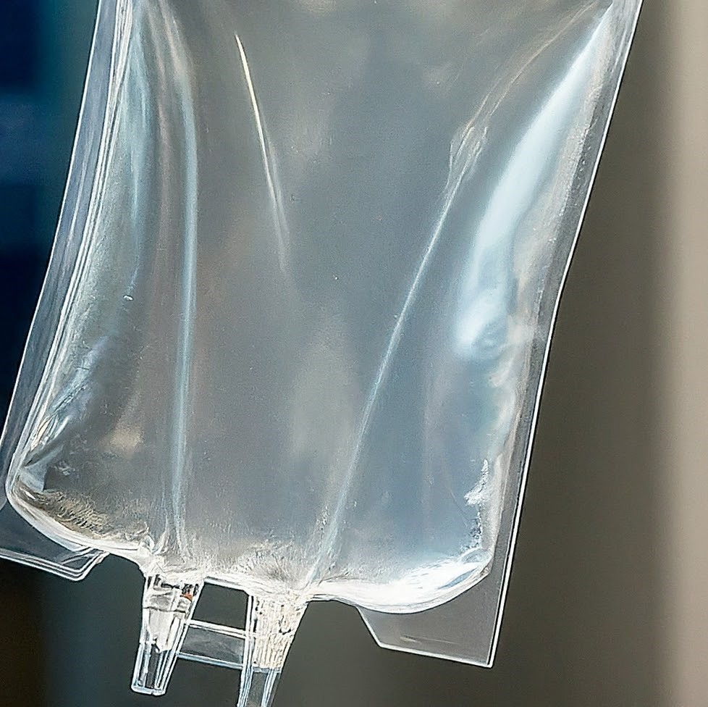
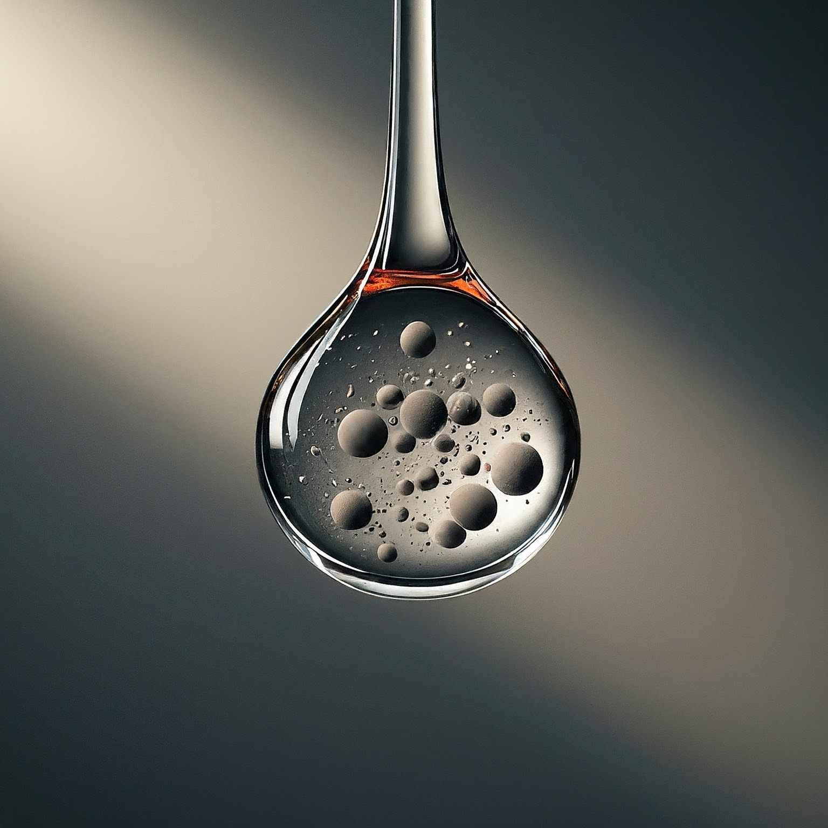
Particle Analysis in Biotech

Slide 2
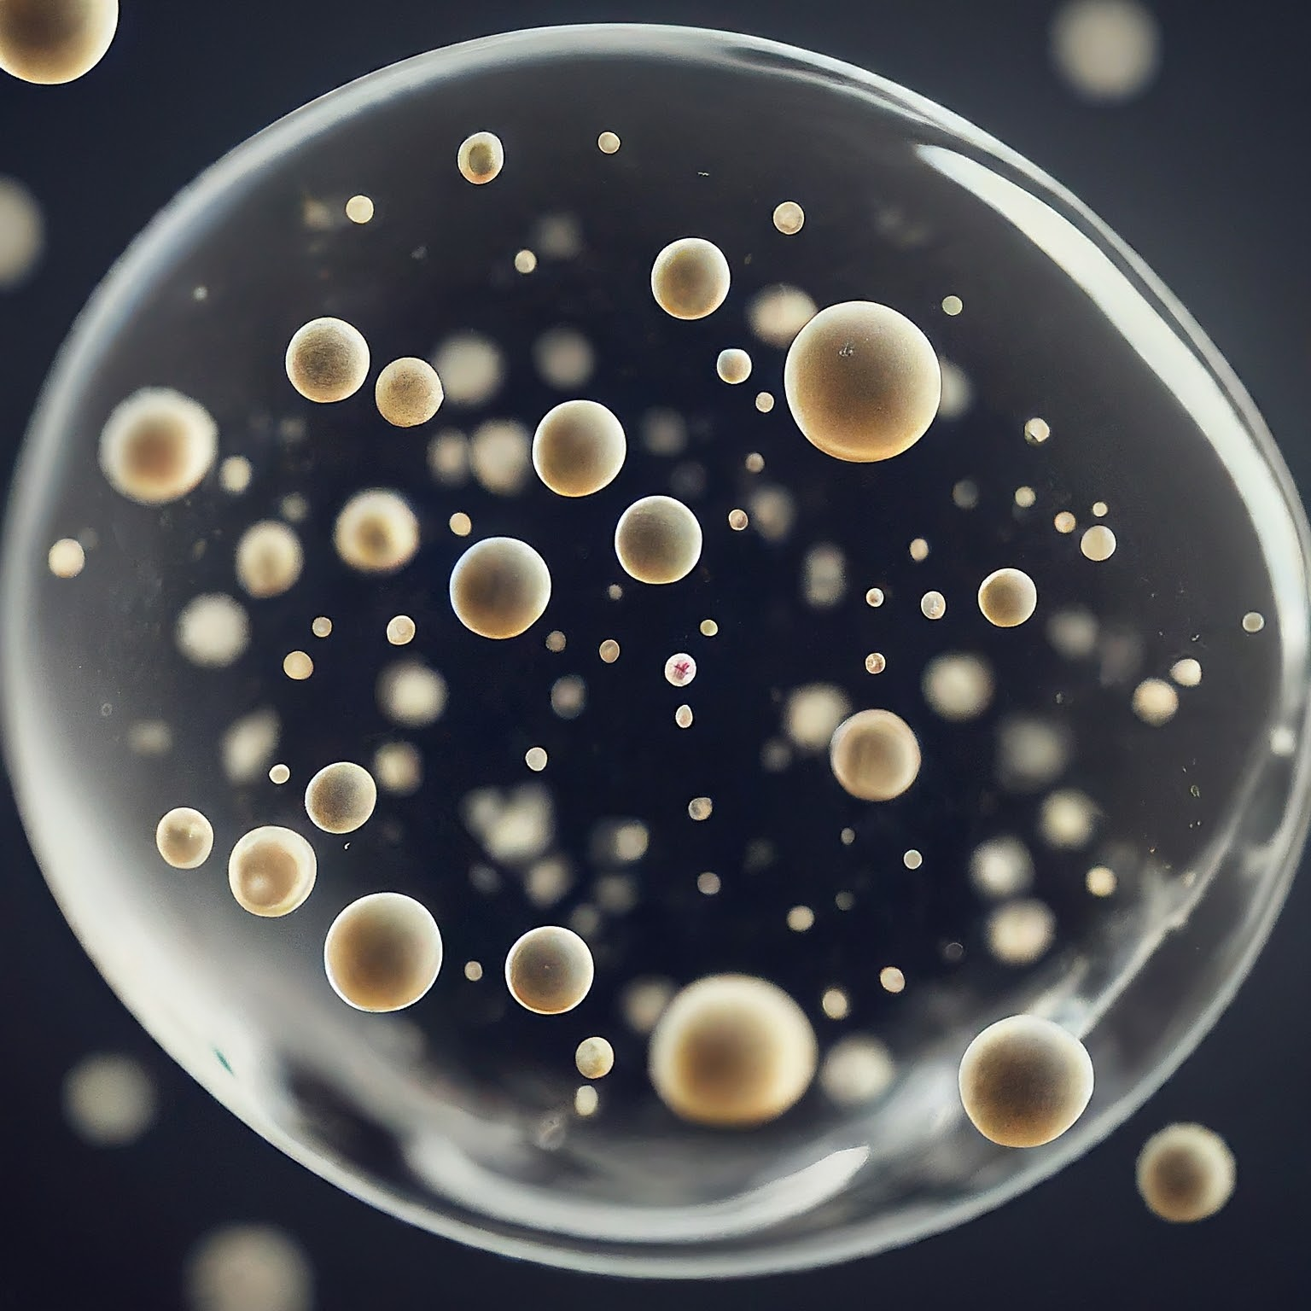
Agenda:
Particle Analysis Measurements
Where is Particle Analysis Used?
Technologies Used for Particle Analysis
Contamination Detection
Reporting Methods
Path Forward for SUB’s

Slide 3
Particle Analysis Measurements:
PARTICLE COUNT
PARTICLE SIZE DISTRIBUTION
Measures the approximate size of particles and counts them in broad ranged fixed bin sizes. The purpose is to measure the significance of Particle contamination . The count is based on a count per ml (milliliter) of fluid. The count is reported for each bin based on ASTM D8072
Used to accurately measure the size of particles in liquid or as dry solids with no regard to the concentration of particles. A continuous distribution is plotted by volume or by population (count). A volumetric plot is used when large particle detection and control is needed. A population distribution by count is used to highlight small particles.

Slide 4
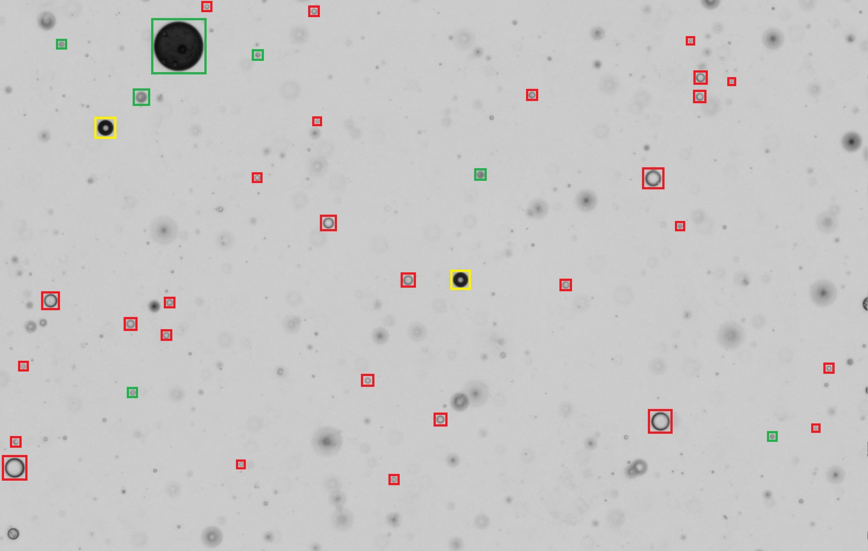
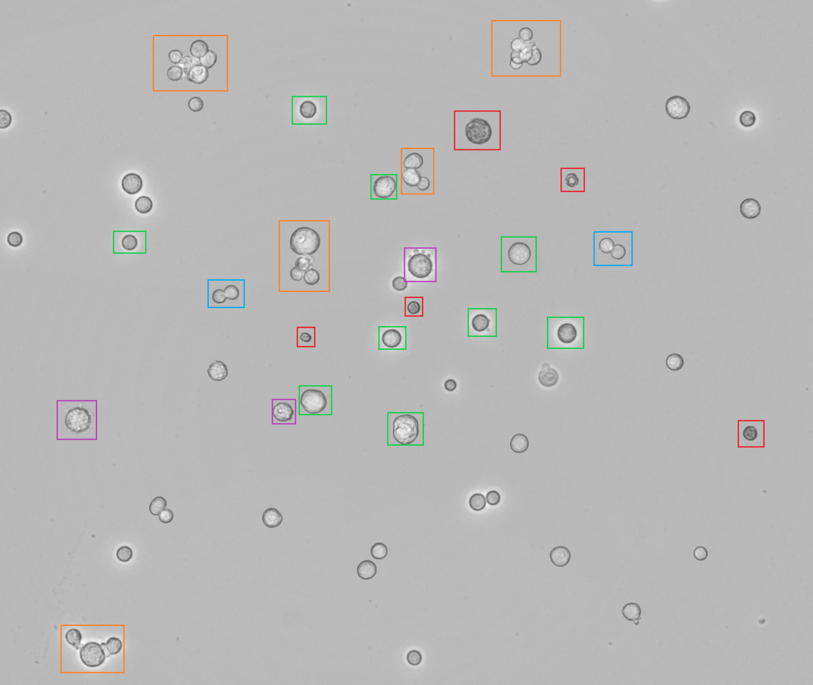
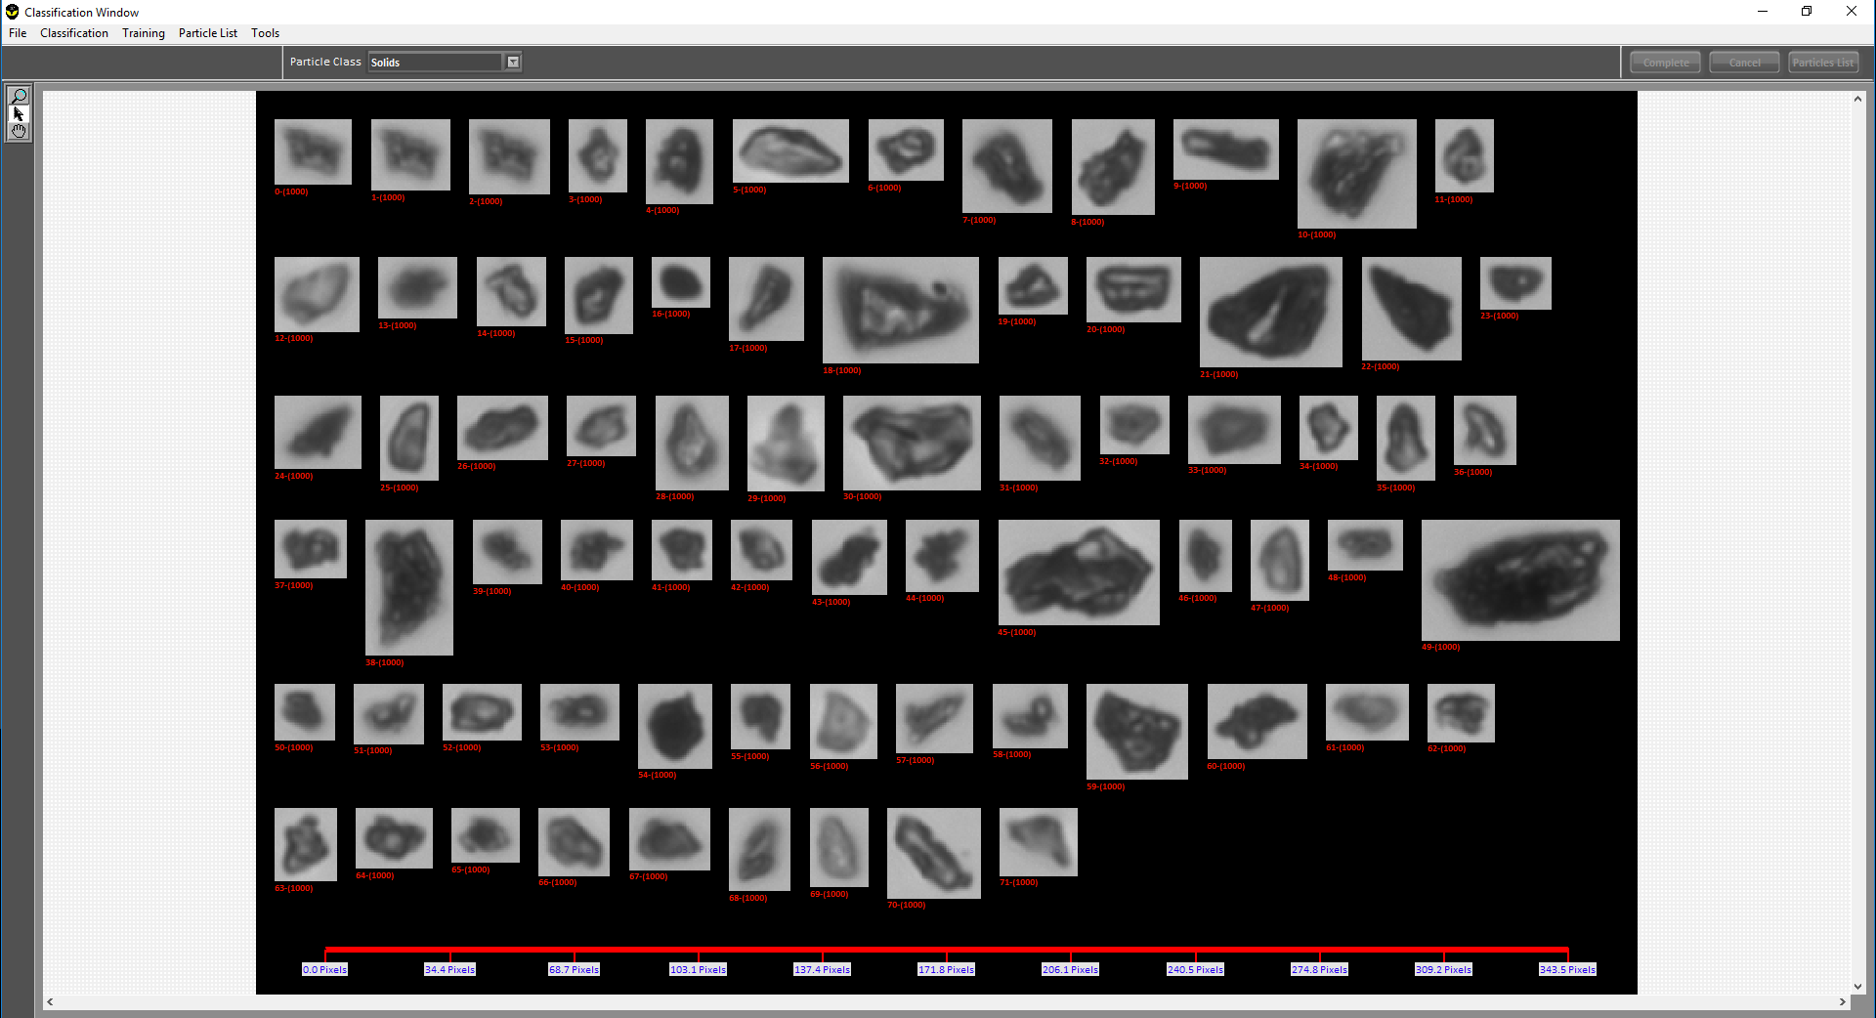
Where is Particle Analysis Used?
PARTICLE COUNT
PARTICLE SIZE DISTRIBUTION
Measure contamination
Pharma & Biotech
Fuels
Lube Oils
Hydraulic Oil
Water
Edible Oils
Pharma drug products
Biotech cell analysis
Milling
Crystallization
Chemical
Food
Oil & Gas

Slide 5
Technologies Used for Particle Analysis
Technology | Particle Concentration (Count/mL) | Particle Size Distribution | Shape Analysis | Lab/Online
Dynamic Imaging | Independent but concurrent measurements for solids, droplets, and bubbles | 2-Dimensional Measurements | Yes | Lab Or Online
Static Microscopy Filter Pad | Sensitive to pad color. (Ex: Hard to see white particles on a white pad.) Doesn’t pick up clear particles well. | N/A | Limited | Lab Only
Laser Light Obscuration | Bubble and droplet interference | 1-Dimensional Measurement | N/A | Lab Only
Laser Diffraction | Bubble and droplet interference | 1-Dimensional Measurement | N/A | Lab Only
Sieves | N/A | 1-Dimensional Measurement | N/A | Lab Only
Millipore Filter Pad | % Solids only | N/A | N/A | Lab Only

Slide 6
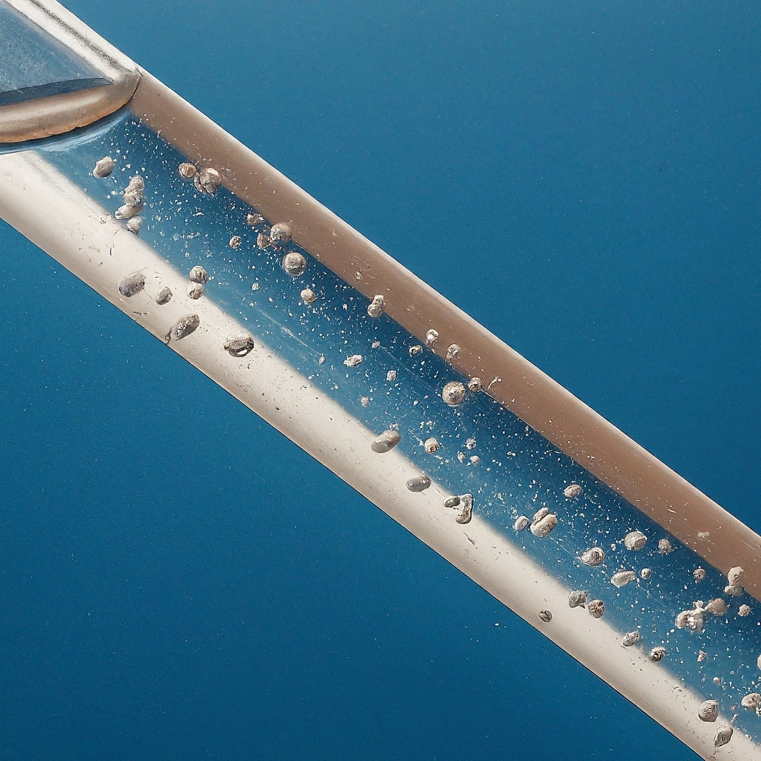
Contamination Detection
Particle count is the best way to measure and control particle contamination in a Biotech product.
Each product category will have its own preparation method, test procedure, and contamination level.

Slide 7
Particle Contamination Reporting Methods
Most commonly used scales used for particle counting are based on Renard Preferred number series
ISO 3 preferred numbers https://www.iso.org/standard/3564.html
https://www.youtube.com/watch?v=wCH3hOxyL5E
This was then defined further as ISO 4406 as a 3 digit code.
USP 1788
ASTM E3060-16 Dynamic flow imaging of sub-visible particles in biopharma
The recommended path for BIOTECH AND PHARMA is the expansion by CANTY of this in ASTM 8072 https://www.astm.org/d8072-17.html

Slide 8
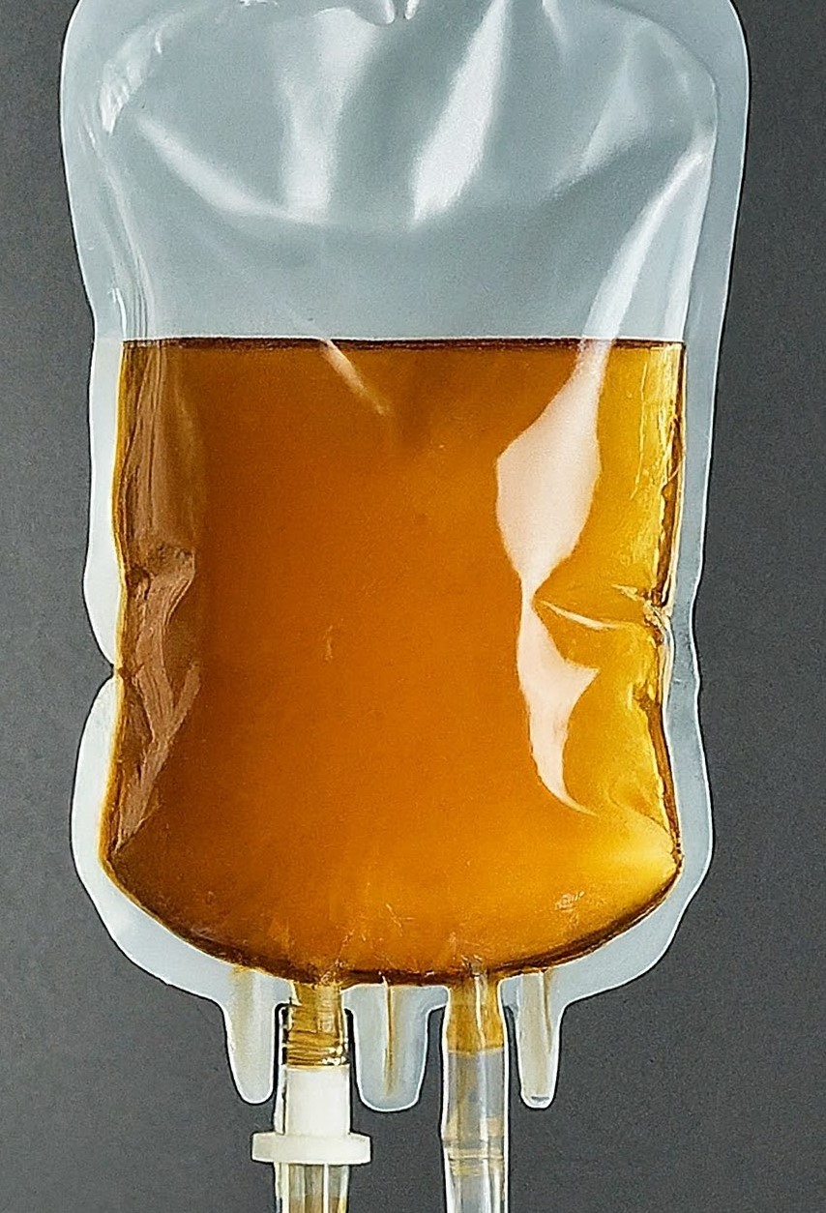
Path Forward for Single Use Bioreactors (SUB’s)
The industry needs to set limits on acceptable levels of particle contamination. To determine these levels, Canty would propose the following test:
Fill sample bags with 50% water filtered with .2 micron filter.
Push on 4 sides of the bag 90 degrees apart at the liquid level line and push in 20% of diameter 5 times on each side . Each side should be pushed once then move 90 degrees and repeat.
Connect the drain valve to the Dynamic Imaging Particle Analyzer and gravity flow the entire contents through the analyzer . Report the D8072 value every minute of the process until empty.
The base line limits will be developed after 20 bags are checked at random, and will be set at double the avg count of particles over those 20 bags.

