Slide 1
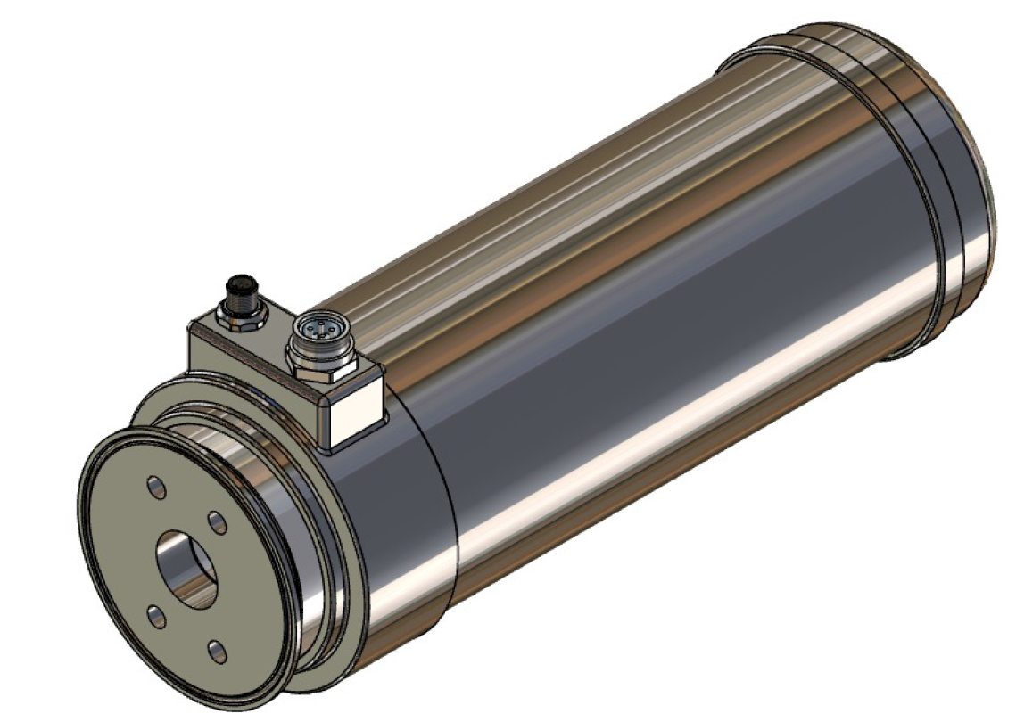
Canty Foam Camera
Biotech Company
Fermenter Foam Control

Slide 2
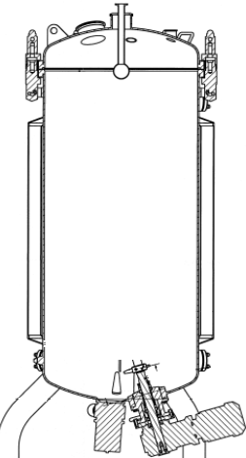
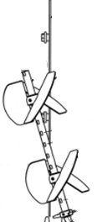
Importance of automated foam control
Eliminate subjectivity!
Maintain process consistency of when antifoam is added
Surface foam can have significant impact
It is our goal to automate whenever possible
Prevent bioreactor foam-outs

Slide 3
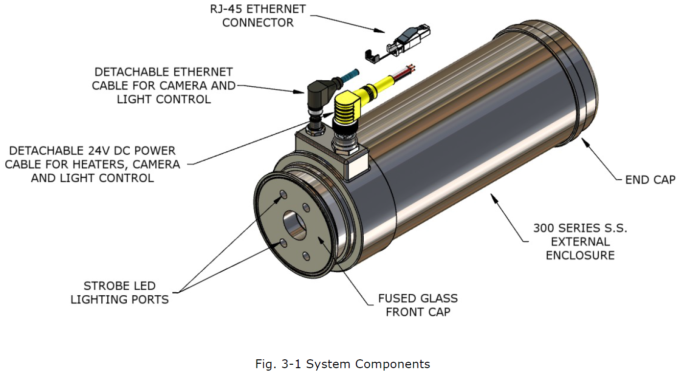
Canty Biocam

Slide 4
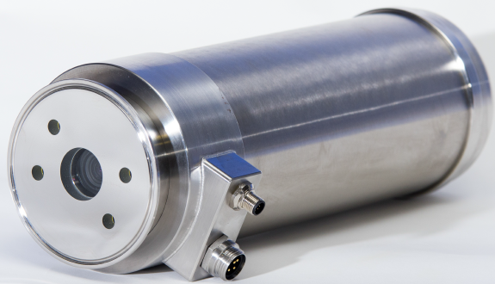
Canty Biocam
Fits onto 4” SS bioreactor port and built to withstand SIP and CIP
SINGLE USE AVAILABLE
Continuous video feed
LED light pulse inside reactor
  Adjustable through FPS rate setpoint
“Intensity” output of 0-255 value triggers antifoam pump response and is historized through PI
Continuously autofocuses and appropriate for all bioreactor scales from pilot to LSM
Heated lens prevents droplet accumulation

Slide 5
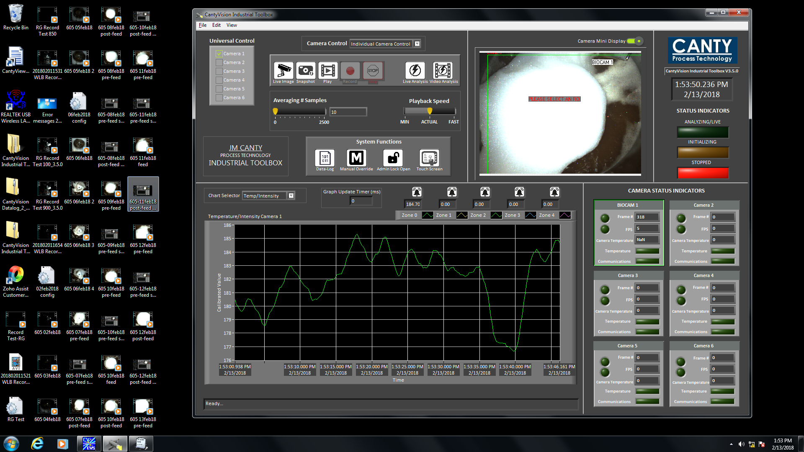
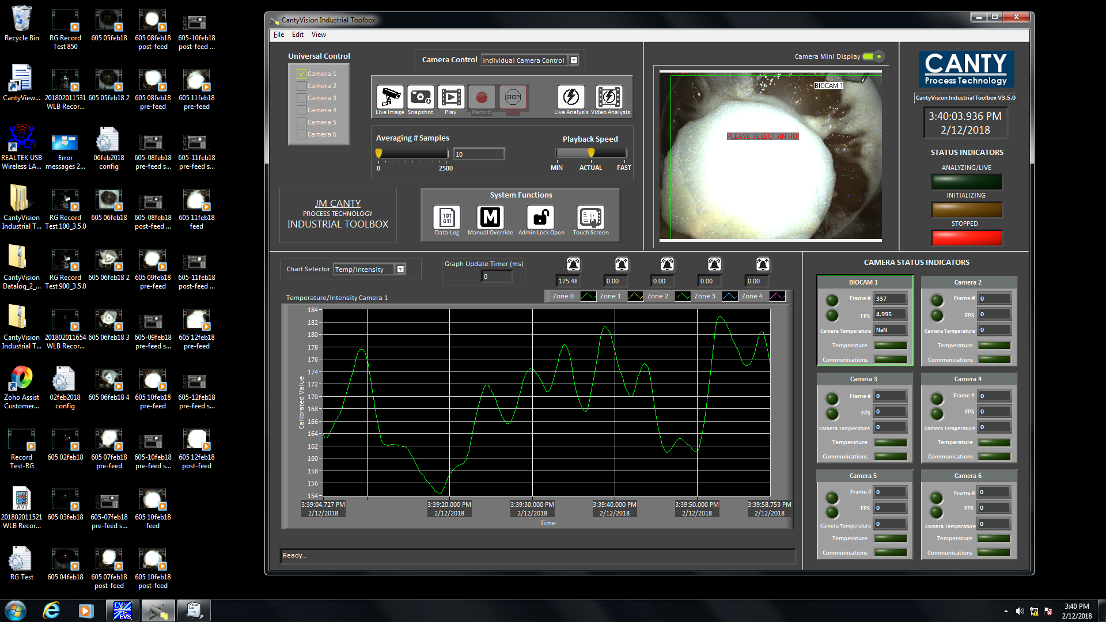
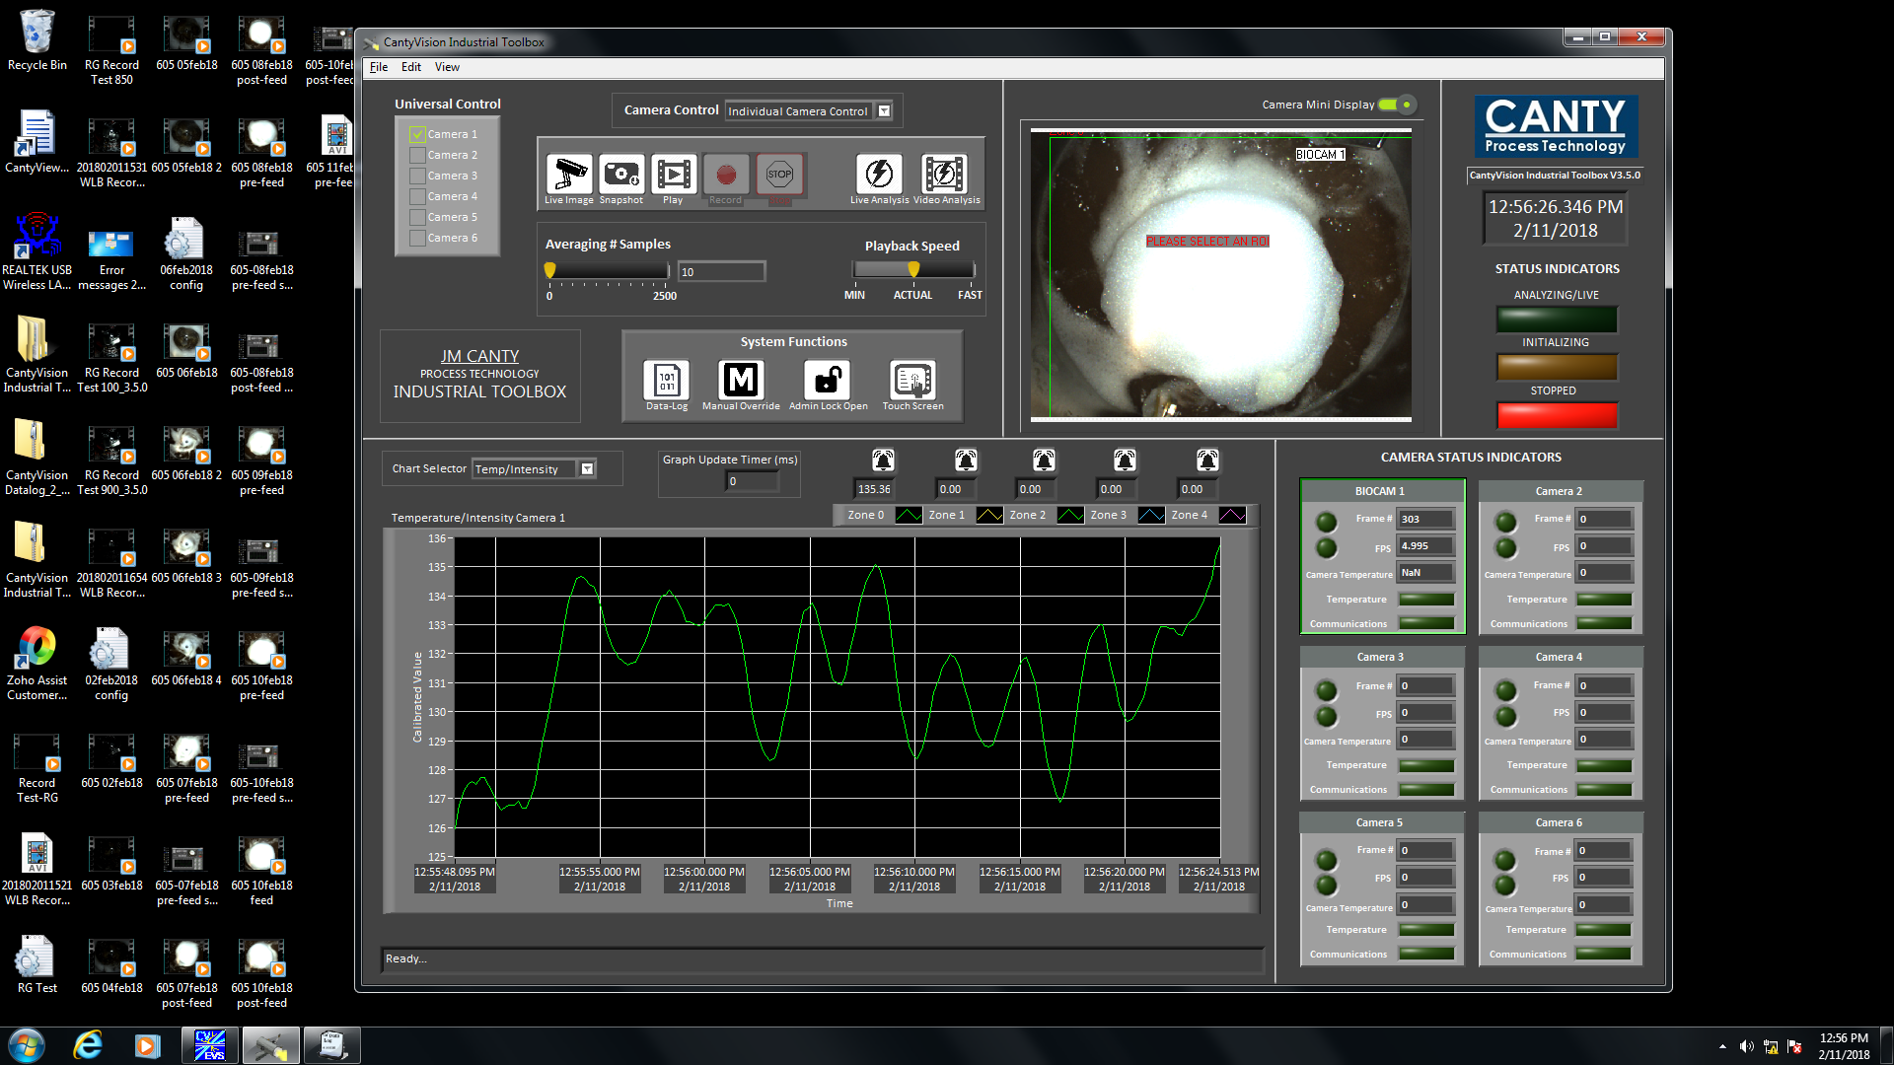
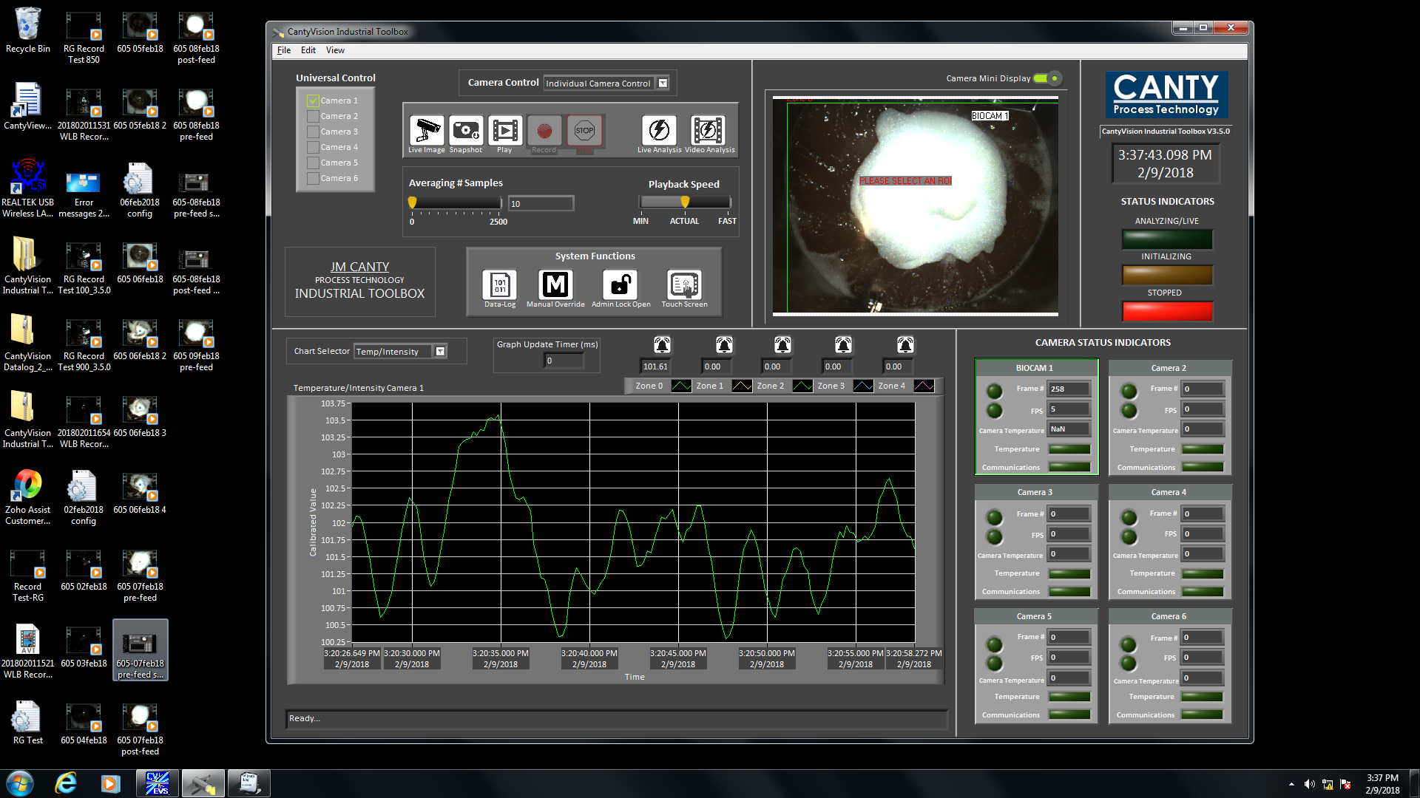
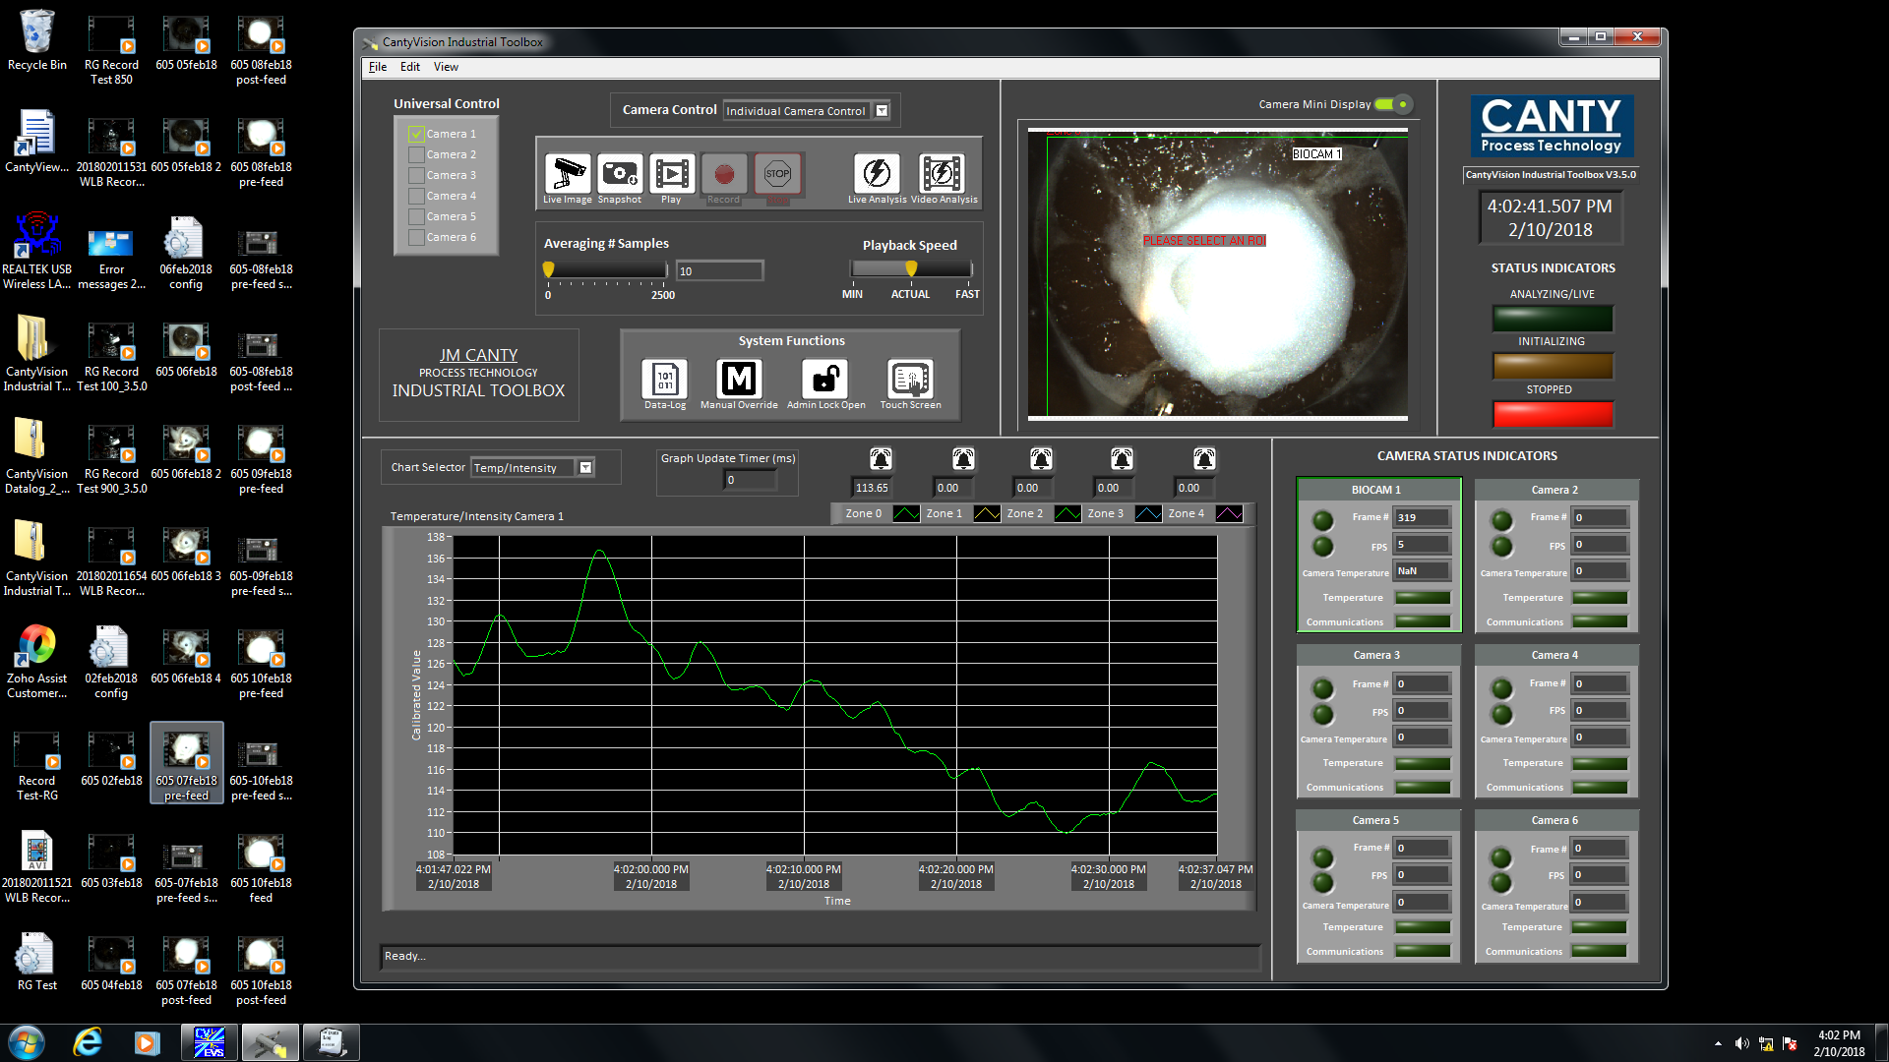
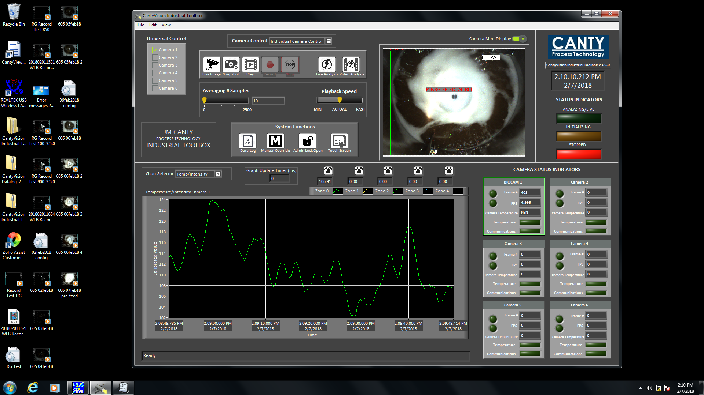
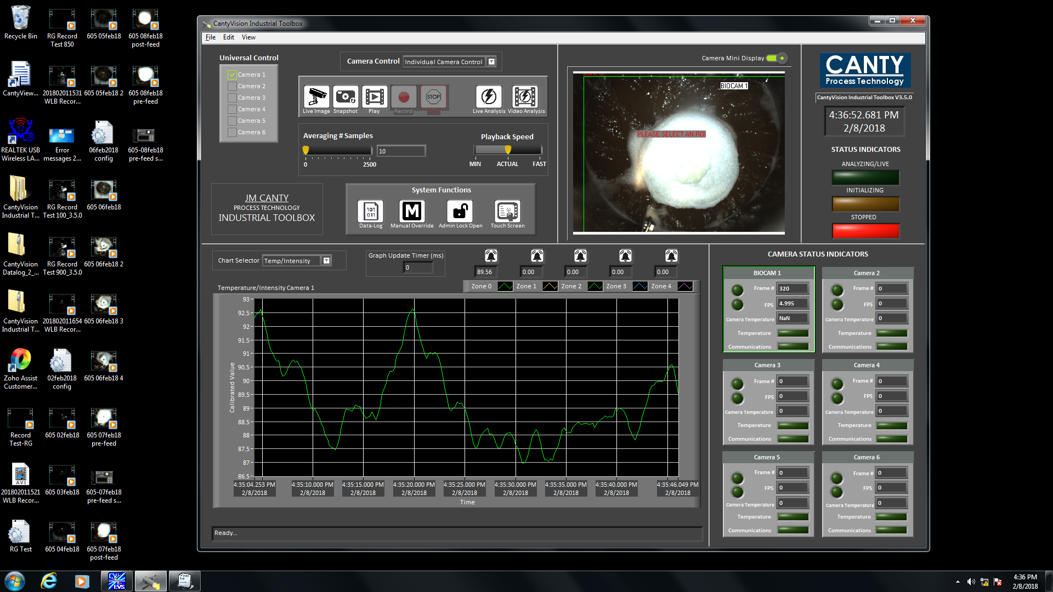
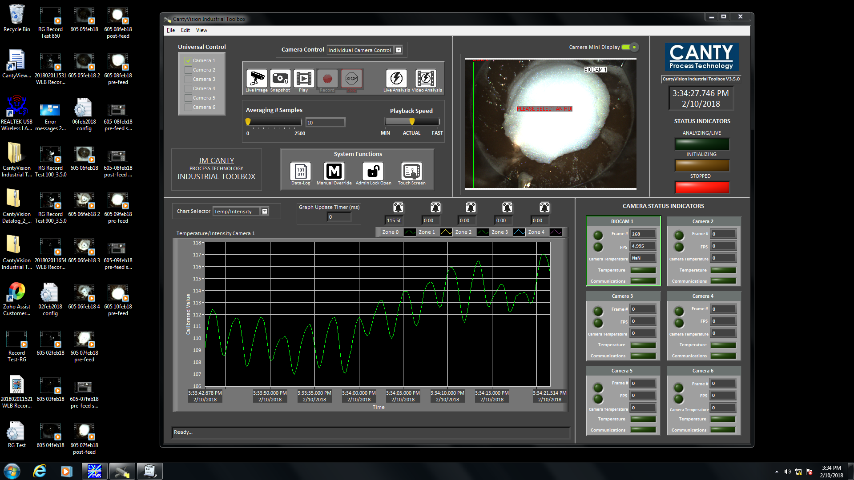
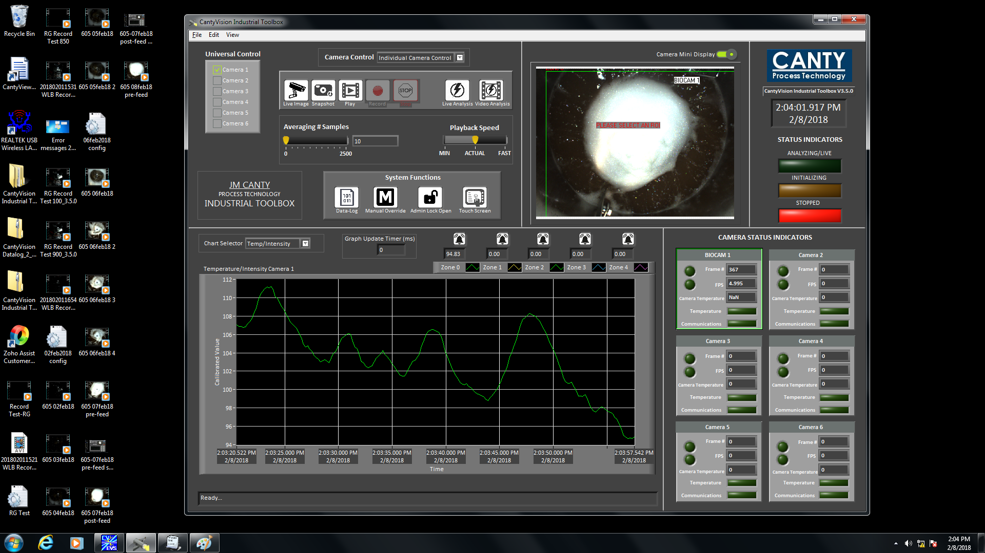
Trial Run
Click through animations to show screenshots of each consecutive day of cell culture run
Notice the increasing intensity value as bioreactor foam accumulates over time

Slide 6
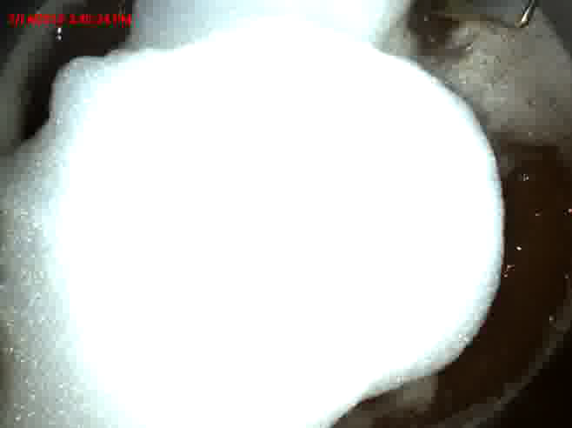
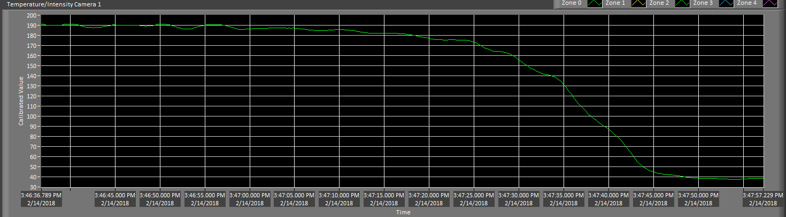
Footage and intensity trend as antifoam added during BIIB605 production run
Operator-determined critical foam level ~190, and value drops to ~40 when foam completely gone

Slide 7
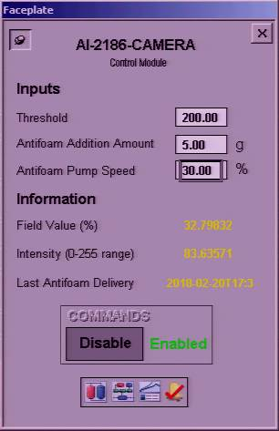
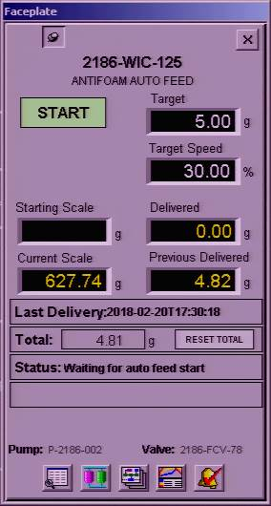
Simplified Automation Module
User-defined input for intensity threshold and antifoam delivery setpoints
Antifoam delivery works through future feed module in DeltaV

Slide 8
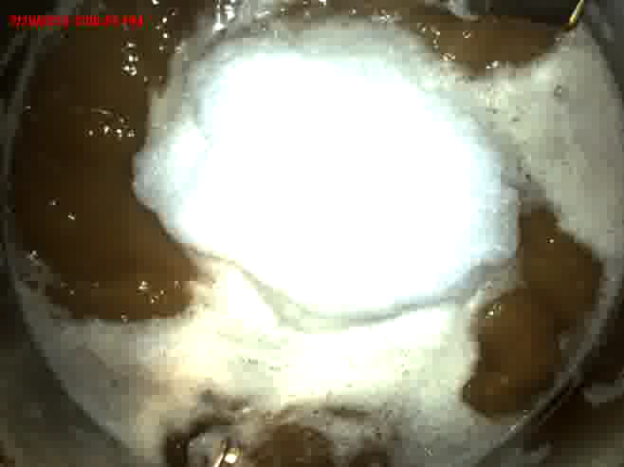
Full foam control automation test
This was done fully automatically using Canty Biocam and antifoam delivery module

Slide 9
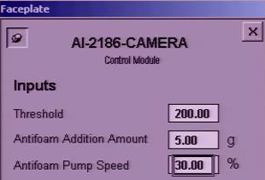
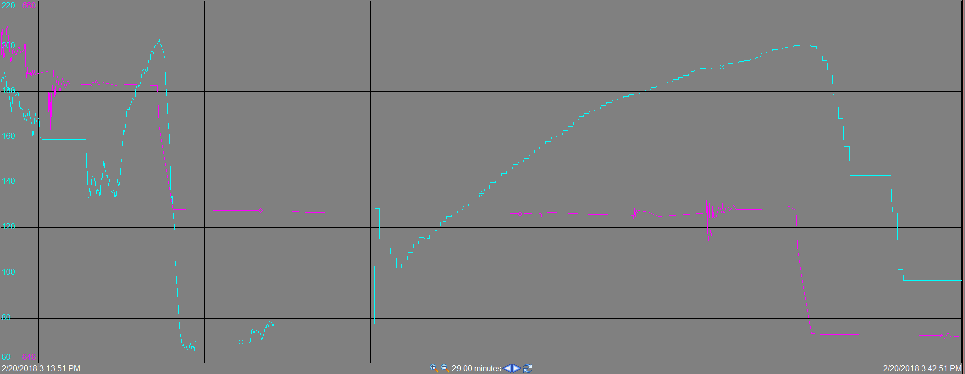
Automation test shown through PI
Foam intensity
Antifoam scale
!
Critical intensity=200
!
Antifoam pump response
Antifoam pump response
Sparge initiated
Capture rate (frames per second) shifted from 5 to 0.1

Slide 10
Other future capabilities
Liquid level detection technology
  Already built into software, just needs to be calibrated for each reactor
  Could be more accurate than reactor load cell for inoc or drain/fill
Consistent foam layer maintenance
  Eliminate risk of foam layer affecting surface kLa in runs or kLa studies
New antifoam feed strategy: cascade vs bolus additions
  We could add antifoam as needed (like base) rather than fixed volume shots
Quantitation of foam can increase our understanding
  We can collect data of intensity value across runs to further understand relationship between VCD, total sparge, and foam accumulation
  Could use to predict foam accumulation in future runs

